Slide 1
Firebase
Andrew Hill

Slide 2

Twitch
Online streaming service primarily for gamers

Slide 3




Slide 4
Firebase
Real time non-relational database.
  Like a big JSON file but in real-time
  Every concurrent connection to that database is updated in real time without something like a hand-written API in the middle.

Slide 5
Timeline
Relatively new
  Discussions began in 2011
  Over $1.4 million in seed money in 2012
  Available to the public without invite in 2013
  Partnered with Angular in January 2014
  Joins Google Cloud platform team in Oct 2014

Slide 6
Key Features
Real Time Updating
  All platforms – desktop, iOS, Android – are synchronized in real time so it takes .25 seconds for a new entry to appear

Slide 7
Key Features
No need to worry about extra server capacity or expanding the backend
  Firebase covers that when you pay for a very cheap plan

Slide 8
Key Features
Security
  Data security logic is handled in their dashboard that you can customize with your own code
  All traffic to and from Firebase databases is encrypted with SSL

Slide 9
Key Features
Offline capability
  Changes that happen on the user’s end to the database trigger local events
  Once connectivity is reestablished

Slide 10
AngularFire
Partnered with Angular
  Dependency injected into Angular
  Connects directly to Firebase
  Compatible with Yeoman

Slide 11
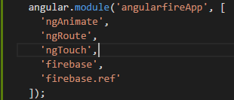
Code Sample

Slide 12
Code Sample

Slide 13
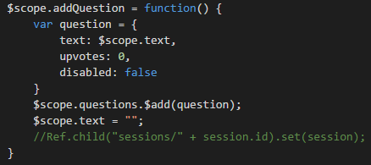
Code Sample

Slide 14
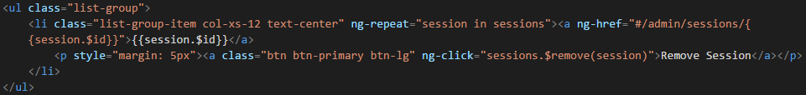

Slide 15
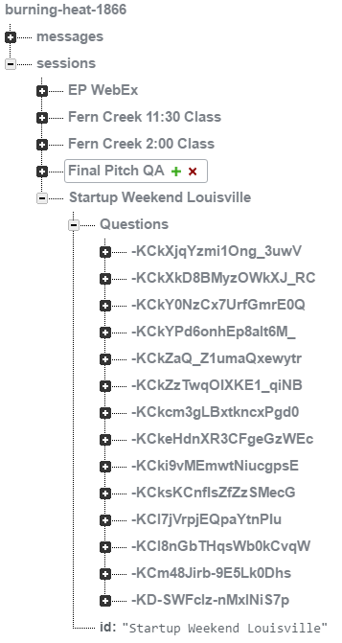

Slide 16

Sources (list them)
http://www.google.com
https://www.firebase.com/
http://www.twitch.tv
https://jawbone.com/
http://www.atlassian.com
http://tweetwall.com
http://www.nitrous.io
Myself!

