Slide 1
Tyler Blake
PrivatOS

Slide 2
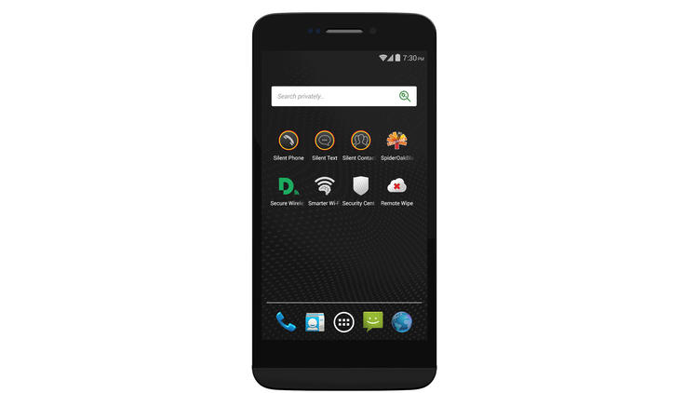
What is it?
Android-based OS by Silent Circle

Slide 3
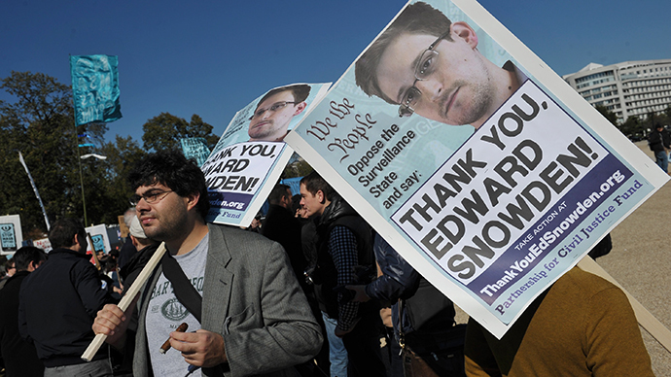
What’s the craze?
Super “secure” mobile OS platform

Slide 4
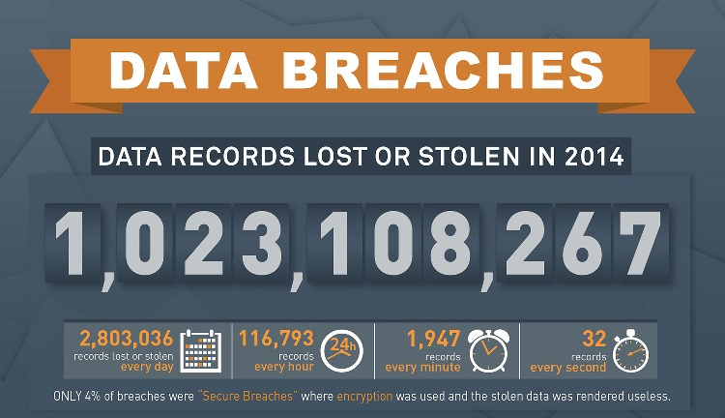
Importance?

Slide 5
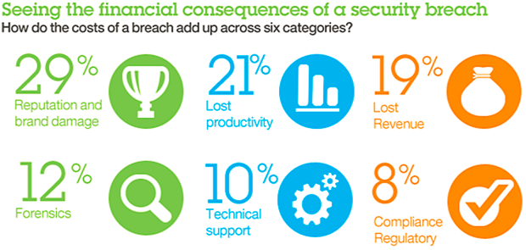
Importance? (cont.)

Slide 6
Components
Spaces
Silent Space
Silent Store

Slide 7

Silent Circle
Encrypted communications firm
Uses 2 protocols
  SCIMP
  ZRTP

Slide 8
SCIMP
Silent Circle Instant Messaging Protocol

Slide 9


Starting a conversation

Slide 10
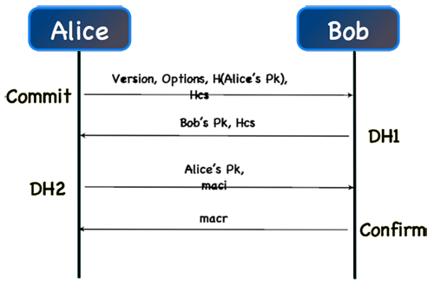
Set up secure connection

Slide 11
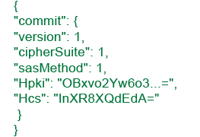
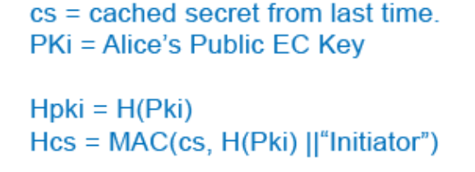
1st Commit
Alice commits to Bob

Slide 12
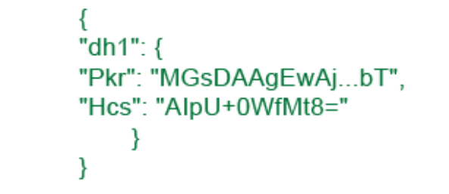
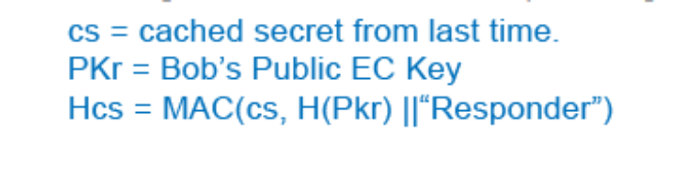
Bob replies with DH1

Slide 13
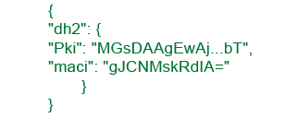
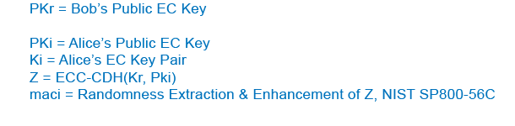
Alice responds with DH2

Slide 14
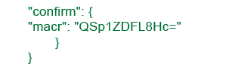
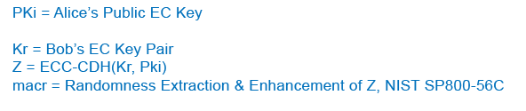
Bob completes set up

Slide 15
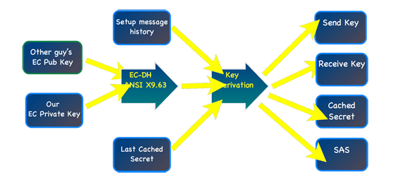
Now what?

Slide 16
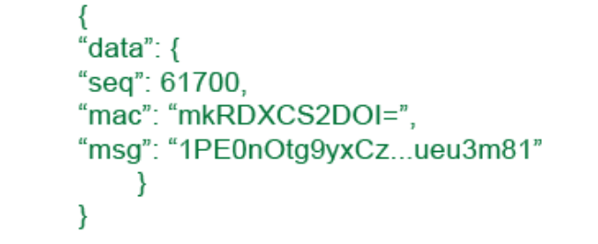
Secure messaging
Sequence numbers with a random start index
Different key for each message and direction

Slide 17
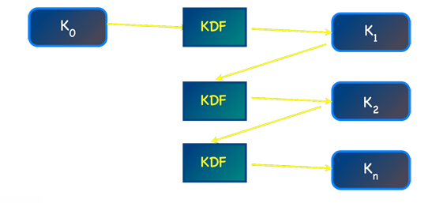
And if you lose your phone?
Messages are deleted asap
Each receive their own key

Slide 18
Bug Bounties
Launched September 2014
Varying amounts of money rewarded
Who doesn’t love a bug bounty?!?

Slide 19

Sources (list them)
http://www.google.com
https://silentcircle.com/sites/default/themes/silentcircle/assets/downloads/SCIMP_paper.pdf
https://silentcircle.com/scimp-protocol
http://www-935.ibm.com/services/us/en/it-services/security-services/data-breach/

