Slide 1
Responsive Web Design
Kaitlyn Davis

Slide 2
What is it?
Set of techniques and ideas to form an approach to web design
Adapts to the user’s environment
Provides optimal viewing experience

Slide 3
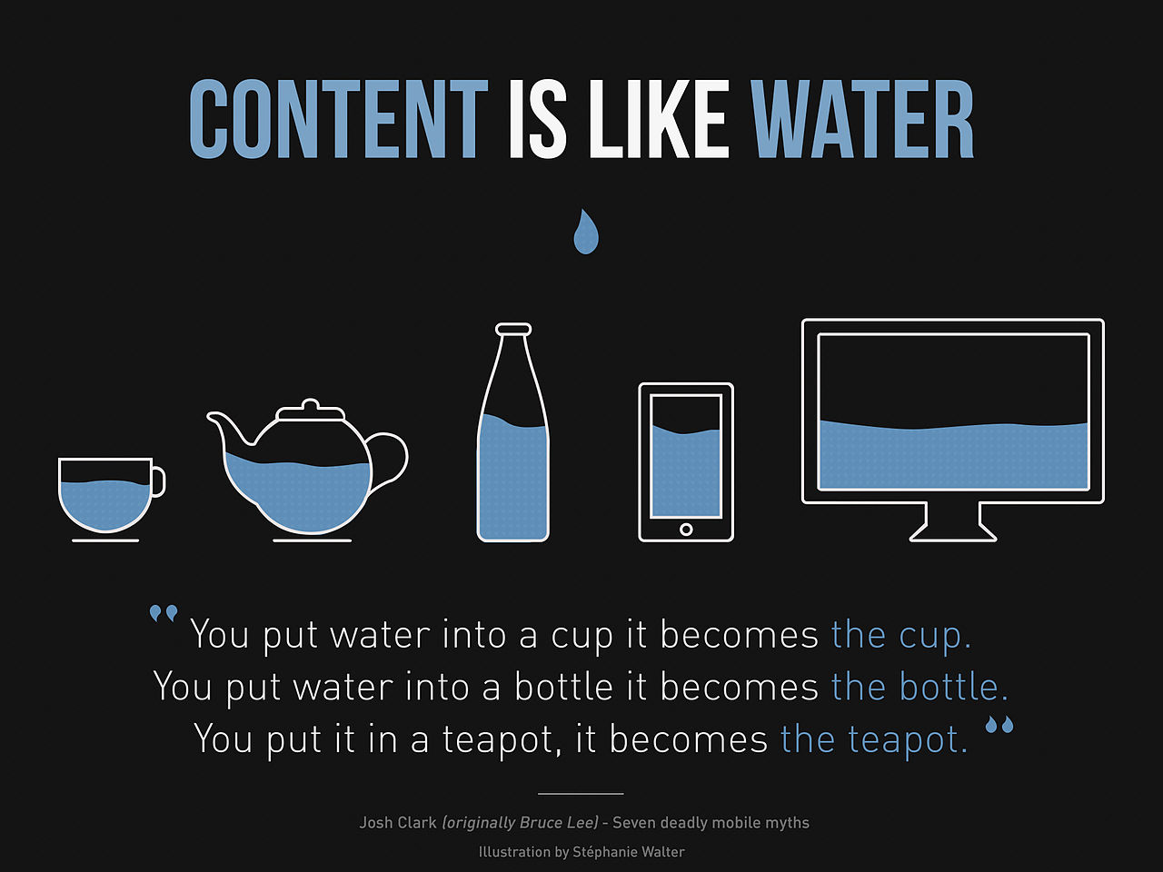
What is it?
Website for any screen, any resolution

Slide 4
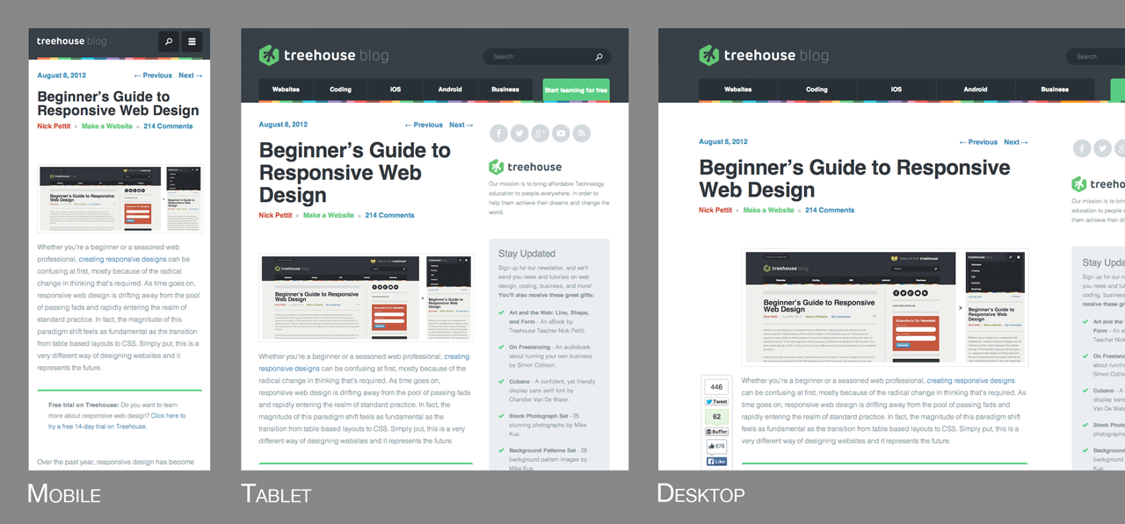
Why use it?
Web pages look good on all devices
One website for every screen

Slide 5
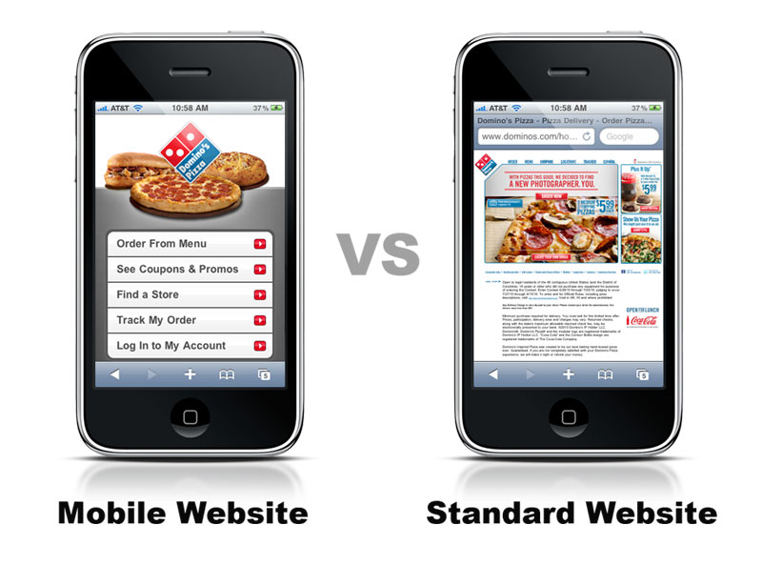
Why use it?
Easy reading & navigation
Helps in organizing layouts

Slide 6


Responsive Frameworks
Bootstrap
Foundation

Slide 7
Techniques
Fluid Grids
Media Queries
Flexible Images

Slide 8
Fluid Grids
Designed in terms of proportions
Built with relative units
Target / Context = Result
  960 px / 1200 px = 80%

Slide 9
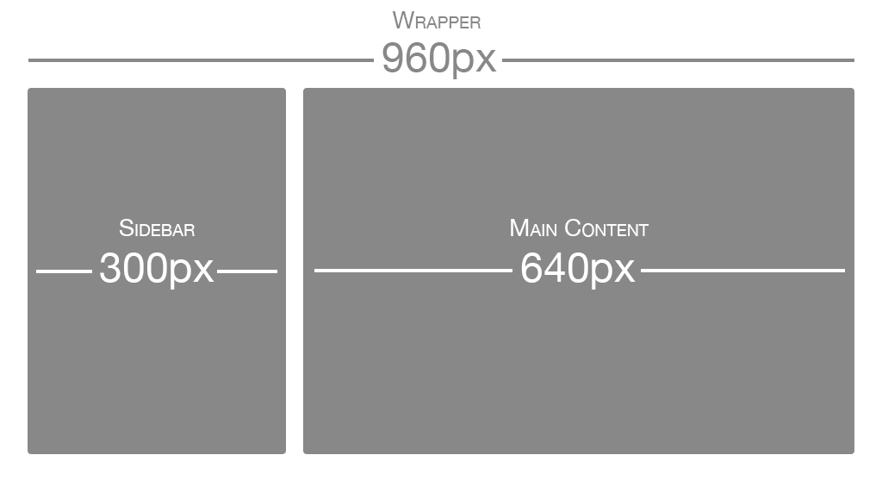
Fluid Grids

Slide 10
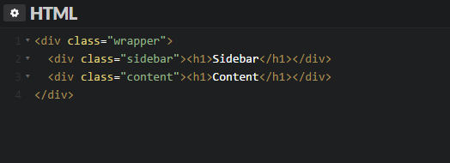
Fluid Grids

Slide 11
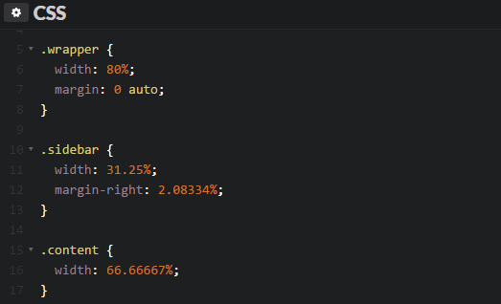
Fluid Grids

Slide 12
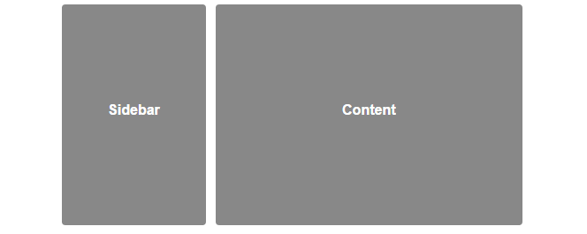
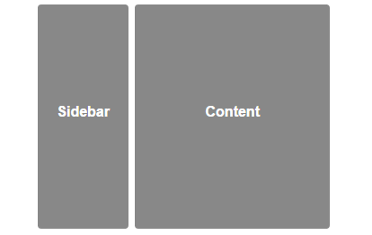
Fluid Grids

Slide 13
Media Queries
Apply specific CSS styles if browser size changes to specified widths
Min-width feature

Slide 14
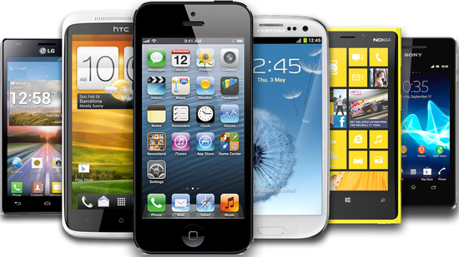
Media Queries
Mobile first approach

Slide 15

Media Queries

Slide 16
Flexible Images
Sized in relative units
Prevents images from displaying outside their containers

Slide 17

Flexible Images

Slide 18
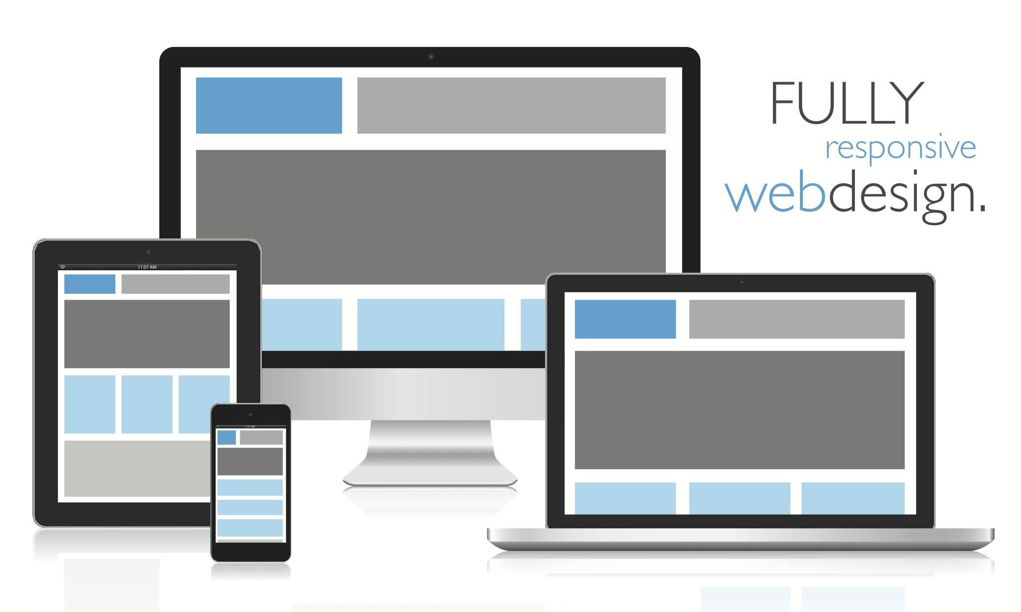
Conclusion

Slide 19

Sources (list them)
http://blog.teamtreehouse.com/beginners-guide-to-responsive-web-design
http://blog.teamtreehouse.com/modern-field-guide-responsive-web-design

