Slide 1
Open Broadcast Software
Kha Le

Slide 2
What is OBS Classic?
Open source software
  Video recording
  Live streaming
  OBS GitHub

Slide 3
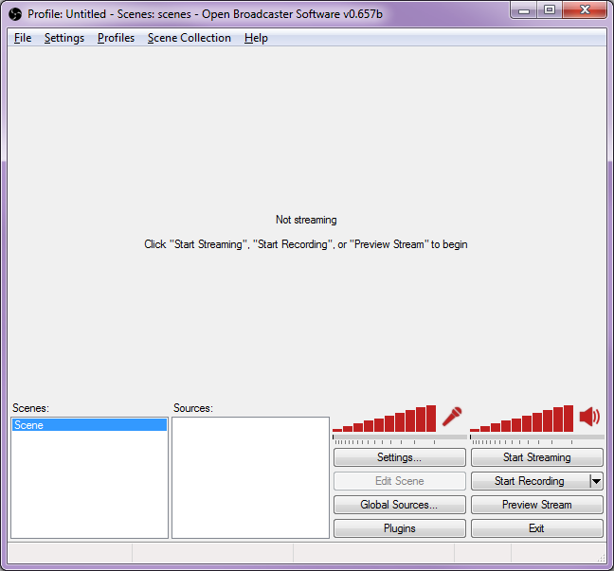
OBS Classic
User friendly
41 languages
9 websites

Slide 4
OBS Classic
Hugh “Jim” Bailey
Released September 1, 2012
Last release, November 24, 2015

Slide 5
Technical Details
Language: C, C++
OS: Windows
Platform: IA-32 and x86-64
License: GNU GPLv2

Slide 6
Why Use OBS?
Alternatives: Xsplit, Bandicam, Evolve, etc.
Free
Ease of Use
Chat Support

Slide 7
Features
Record/Stream Audio
Record/Stream Video
Talking to Websites: RTMP

Slide 8
Real Time Message Protocol
Developed by Macromedia
Owned by Adobe
Intended Uses:
  Streaming audio, video, data
  Between flash player and server

Slide 9
RTMP
5 variations
  TCP port number 1935 by default
RTMPE
  Adobe encryption

Slide 10
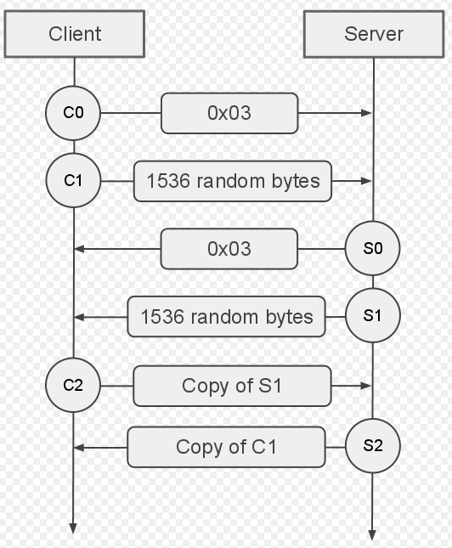
Handshake

Slide 11
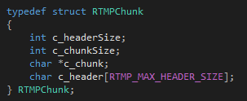
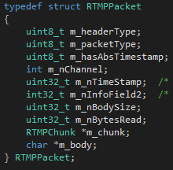
Coding
Size
Structure

Slide 12



Coding
Creating Macros
Sending

Slide 13
OBS Classic vs Studio
Classic no longer being developed
Studio (Multiplatform)

Slide 14
OBS Classic
Design Flaws:
  Hard-coded for Windows
  Poor device/audio code

Slide 15
OBS Classic
Coding Flaws:
  Inconsistent coding style
  Hard to maintain
  Giant classes
  Giant functions

Slide 16
OBS Studio
March 21, 2016
Multiplatform support
  Mac
  Linux
Stronger API

Slide 17
OBS Studio
Simplify complex system
Easier to use and maintain

Slide 18
OBS Studio
Before
Release
After
Release

Slide 19

Sources
http://www.google.com
https://github.com/jp9000/obs-studio
https://en.wikipedia.org/wiki/Real_Time_Messaging_Protocol
https://en.wikipedia.org/wiki/Open_Broadcaster_Software

