Slide 1

MongoDB
Joey McCoy

Slide 2
What is MongoDB?
A document-oriented database (NoSQL)
Stores JSON-like documents with dynamic schemas (Mongo calls them BSON documents)
Designed to be highly scalable
“A developer’s database”

Slide 3
A Brief History
The project started in 2007 and was released in 2009
Developed by the company formerly known as 10gen – now MongoDB Inc.
Has been open-source since 2009, but offers commercial support

Slide 4
MongoDB vs MySQL
Biggest Difference:
MongoDB = Non-relational, Document-Oriented
MySQL = Relational
MongoDB is schema-less, unlike SQL databases. You can add a new field without affecting the old ones and it will instantly update.

Slide 5
Advantages of MongoDB
Schema less – Number of fields, content and size differ from one document to the next
No complex joins
Dynamic querying just like SQL
Extremely scalable

Slide 6
More Advantages
    Replication – increases data availability with multiple copies of data
    Protects DB from the loss of a single server
Indexing – allows you to optimize database querying
    Navigating through a database is extremely fast

Slide 7
Even More Advantages
Works well with programming languages
  Java, JavaScript, Python, Node, etc.
  Several GUIs that make MongoDB even easier to work with
  RoboMongo, MongoVue, MongoHub

Slide 8


Connecting a DB in Java
1. Use these Import Statements:
2. Connect to a MongoDB instance on localhost:

Slide 9

Connecting a DB in Java
3. Once successfully connected, access the database:
In 3 simple steps, you are connected to a Mongo database in your Java project.

Slide 10

Connecting a DB in Node
1. You can download Mongo using npm:
2. Use the same Mongo Client to retrieve Mongo:

Slide 11
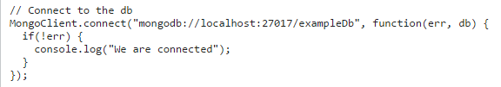
Connecting a DB in Node
3. Connect to the database “exampleDB”

Slide 12

Common Commands
Accessing the Mongo shell
Inserting a document into the database:

Slide 13

Common Commands
Show collections (tables) inside a database:
Import an external file into a database:

Slide 14
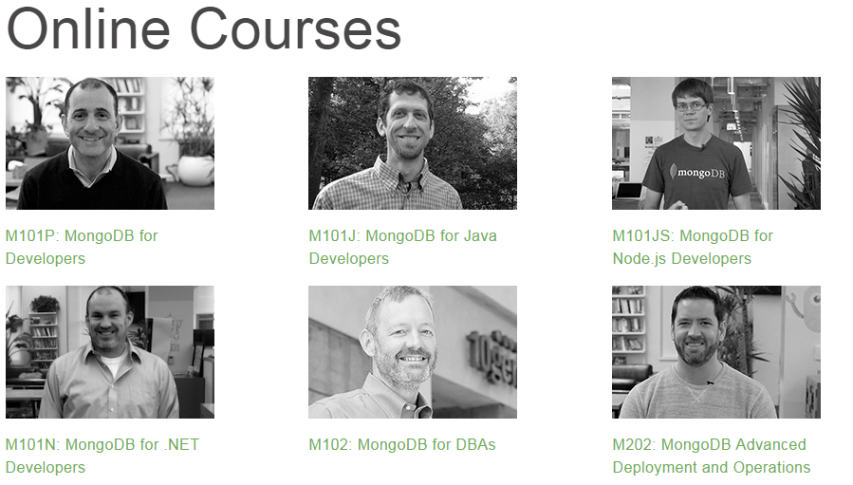
Free Training
Go to: university.mongodb.com/
Free 6 week training courses

Slide 15
My Experience with Mongo
I learned MongoDB this summer at my internship
Designed a database containing web service information
Adding fields? No problem
First MongoDB Project at Great American Insurance

Slide 16









Companies that use MongoDB

Slide 17
Support/Resources
MongoDB University:
  https://university.mongodb.com/
Documentation:
  https://docs.mongodb.org/manual/
  GitHub:
  https://github.com/mongodb

Slide 18
In Conclusion…
MongoDB is:
  One of the top NoSQL databases
  A document-oriented database
  Schema-less design
  Scalable and developer-friendly
  Used by a lot of large companies
  Relatively easy to learn

Slide 19

Sources
https://mongodb.github.io/
https://blog.openshift.com/design-and-performance-tips-for-mongodb-indexes/
http://www.tutorialspoint.com/mongodb/mongodb_java.htm
https://scalegrid.io/blog/which-is-the-best-mongodb-gui/
https://www.mongodb.org/

Slide 20
Thanks!

