Slide 1
ANN
Jordan Shields

Slide 2
ANN? I don't know an ANN..
ANN stands for Artificial Neural Network
An ANN is essentially a collection of statistical learning algorithms that mimic human brain functions.
In essence, ANN's are computer brains!!!
*Warning*: Many theories introduced here aren't elaborated on in this presentation. It's a complicated subject, but I'll try to keep it as simple as possible.
What awaits us?!?! Let's take a look into the future…

Slide 3
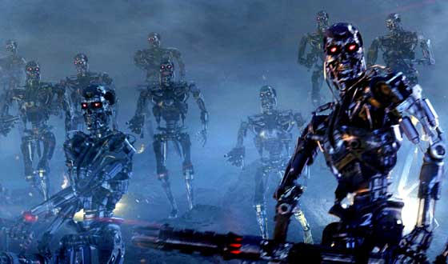
The Future
ANN's, please program responsibly!

Slide 4
Brought to you by the Human Brain
The makeup of ANN's is largely based on the Human brain
They’re presented as a system of interconnected neurons
These neurons are capable of machine learning and pattern recognition
Let's break it down…

Slide 5
The Human Brain
It's really complicated, but here's what you need to know:
  Neurons can fire electric pulses through its synaptic connections
  These pulses are received at the dendrites of other neurons
  When a neuron receives enough electric pulses through its dendrites, it activates and fires a pulse through its axon.
  This pulse is received by other neurons.

Slide 6
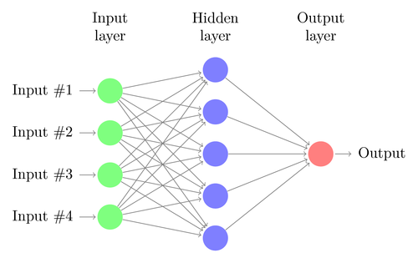
Simple Neural Network Map
They also have excellent training capabilities
ANN's are not intelligent (yet). Learning != Intelligence (Ie: Sit Boy!)
They are good for recognizing patterns and making simple rules for complex problems

Slide 7
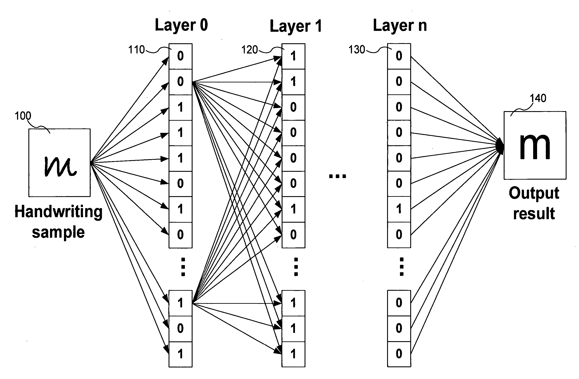
Quick Example of a NN in Action
Handwriting recognition
Defined by a set of input neurons which are activated in response to the pixels of an input image
After some algorithmic magic, these neuron activations are passed to other neurons
This process repeats until an output neuron is activated

Slide 8

The Artificial Neuron
The general mathematic definition of a neuron:
Where x is a neuron with n input dendrites(x0 ….. xn) and one output axon y(x)
(w0 ….. wn) are weights determining how much the inputs should be weighted
g is an activation function that determines how powerful the output should be from the neuron, based on the sum of the input

Slide 9
Okay, it sounds ‘cool’, but…
How can I use it?
  First a solid understanding of the underlying theory is required
  Then there are some decisions to make…
  The first is the choice of model:
  Some models are intimately associated with a particular learning algorithm or learning rule; so do some research beforehand.
  Choice of model is dependent upon the data representation and the application. More complex models tend to learn less efficiently and/or effectively.

Slide 10
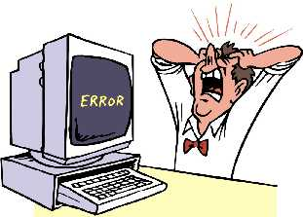
Second Choice: Learning Algorithm
While there are numerous trade-offs between different learning algorithms, almost any algorithm will work with the correct hyperparameters for training on a particular fixed data set
Remember, despite your choice, tuning an algorithm for training on unseen data requires a significant amount of experimentation. Patience is a virtue.

Slide 11
A Tale of caution -- NNs and the US Military
In the 1980s the US Military planned to hookup their tanks with a digital camera that could identify enemy tanks
They decided to employ a NN
The research team took photos of tanks hiding behind trees, and then photos of trees (with no tanks)
Half the photos from each group were placed in a vault and the other half constituted the NN's training set

Slide 12
A Tale of Caution -- Part 2
The training set was fed to the NN. At first the results were random because the NN didn't know what was going on or what it was supposed to do.
Each time it was fed a photo, it generated an answer and the scientist told it if it was right or wrong.
Each time it was wrong, the NN would randomly change its weights until it gave the correct answer.
The NN got better and better until it was getting each photo correct

Slide 13
A Tale of Caution – Part 3
The issue with NNs is that after they've been trained, you have no idea how they arrive at their answers.
To verify, the scientist fed the NN the previously unseen photos from the vault.
It was able to get each photo correct with 100% accuracy.
The pentagon was pleased yet still suspicious and commissioned another set of photos (half with tanks, half without)
These new photos generated completely random results.

Slide 14
A Tale of Caution – Part 4
Eventually someone noticed that, in the original photo set, all images with tanks had been taken on a cloudy day and all the images without tanks on a sunny day.
The NN had trained itself to separate the groups of photos the most obvious way, by looking at the color of the sky.
The military was now the proud owner of a multi-million dollar mainframe that could tell you if it was sunny or not.

Slide 15
Real-Life Applications -- Bank Loans
The NN is set up to determine whether or not to approve a loan
The NN is trained by analyzing past loan defaults and makes decisions based upon past experience.
An issue arises because the bank must justify their decision to the applicant and apparently "Because my neural network computer recommended against it" isn't a good enough excuse.

Slide 16
Real-Life Applications -- Breast Cancer
An ANN was developed to determine whether patients have breast cancer or not
Although the system cannot diagnose cancer conclusively, it helps physicians determine whether a biopsy is required.
The training set for the ANN consisted of 800 patients who were diagnosed with breast cancer definitively through biopsy.
The disease prediction rate was 90.5% accurate.

Slide 17
Real-Life Applications -- Giving Rats *Psychic* Power
Rats were trained to press a lever that activates a robotic arm to deliver a reward.
An array is then attached to the rat's brain that can record neuron activity.
The NN was trained to recognize the brain activity patterns during a lever press.
Thus, when the rat's brain activity indicates it's about to press the lever, the robotic arm moves in with a reward.
The rat must merely think about pressing the lever, not actually do so.

Slide 18
How can I give rats psychic powers and such?
There are many Models of ANN to choose from. Below, I've listed a few open source solutions and their language(s):
  Fast Artificial Neural Network (FANN) -- C/C++ plus a wrapper for C#
  PyBrain -- Python
  Encog -- Java and C#
  WEKA -- Java and C#
  PyLearn 2 -- Python
  Neural Networks for Torch 7 -- Lua, Torch 7
  Cuda-convnet -- CUDA/C++

Slide 19

Sources
Resources:
  http://link.springer.com/article/10.1007%2Fs10916-011-9768-0#page-1
  http://fann.sourceforge.net/report/node4.html
  http://en.wikipedia.org/wiki/Artificial_neural_network
  http://cs.stanford.edu/people/eroberts/courses/soco/projects/2000-01/neural-networks/Applications/index.html
  https://neil.fraser.name/writing/tank/
  http://stackoverflow.com/questions/11477145/open-source-neural-network-library
Pictures:
  http://www.google.com/url?sa=i&rct=j&q=&esrc=s&source=images&cd=&cad=rja&uact=8&ved=0CAYQjB0&url=http%3A%2F%2Fwww.cracked.com%2Ffunny-8665-what-your-favorite-apocalypse%2F&ei=v98jVcz9D4a6yQTspYGYDA&bvm=bv.89947451,d.cGU&psig=AFQjCNF3ueA2IrtcOFnNfajAELNakspZhw&ust=1428500717997410
  http://www.google.com/url?sa=i&rct=j&q=&esrc=s&source=images&cd=&cad=rja&uact=8&ved=0CAYQjB0&url=http%3A%2F%2Fwww.texample.net%2Ftikz%2Fexamples%2Fneural-network%2F&ei=PeEjVePEBpCVyAS3qYGgAw&bvm=bv.89947451,d.cGU&psig=AFQjCNFKfc2MwabdGe4QE-DWT20tIRHG2g&ust=1428501126845642
  http://www.google.com/url?sa=i&rct=j&q=&esrc=s&source=images&cd=&cad=rja&uact=8&ved=0CAYQjB0&url=http%3A%2F%2Fwww.google.com%2Fpatents%2FUS20070047802&ei=QuMjVe3dBIOkyQSW5oLQAw&bvm=bv.89947451,d.cGU&psig=AFQjCNETtP17sTtQv4wYpWfwiL4BWZcQ4g&ust=1428501672439092
  http://www.google.com/url?sa=i&rct=j&q=&esrc=s&source=images&cd=&cad=rja&uact=8&ved=0CAYQjB0&url=http%3A%2F%2Fsayeed2frnds.blogspot.com%2F&ei=cuUjVbn8DJGdyQTdjYGYBQ&bvm=bv.89947451,d.cGU&psig=AFQjCNGJwprY3LyA-an53GQBcprixRwnCQ&ust=1428502188782453

