Slide 1

Sassy CSS
Adam Knecht

Slide 2
Agenda
What is SASS?
History of SASS
Getting Started with SASS
SASS Features
Compiling SASS
SASS Tools

Slide 3

What is SASS?
Syntactically
Awesome
StyleSheets
CSS Preprocessor
  .SCSS (Sassy CSS)
  .SASS (Old SASS Indentation Style)
Maptastic Maple (3.3.4)

Slide 4
CSS with Sass
Fully CSS3-Compatible (.SCSS)
Object Oriented-ish
Modular Code
Goal: Don’t Repeat Yourself

Slide 5
History of SASS
SASS Launched in 2007
Developed by Nathan Weizenbaum and Chris Eppstein
SASS - Ruby
Alternatives:
  {less} - JavaScript
  Stylus – Node.js

Slide 6
How to get sassy…
Open up Terminal
Install Ruby
“gem install sass”
Write SASS
Compile SASS (. SCSS)
Link to CSS

Slide 7
Features of SASS
Variables
Nesting
Partials
Import
Mixins
Extend
Operators
Control Directives
Functions
Notes:
Variables allow you to create your own reusable variables. (numbers, strings, colors, booleams, lists, and maps)

Slide 8
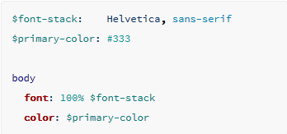
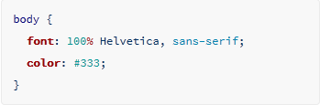
Variables

Slide 9
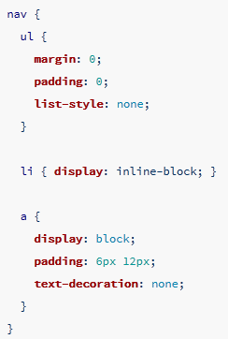
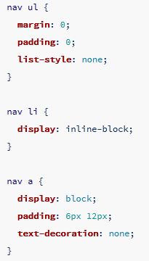
Nesting

Slide 10
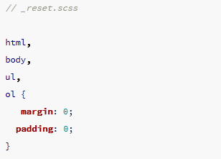
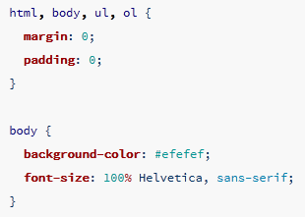
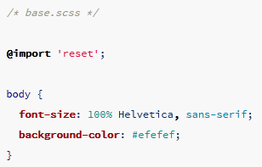
Partials \ Imports

Slide 11
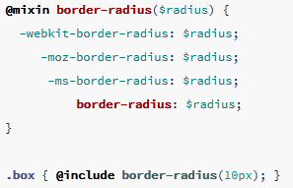
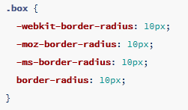
Mixins

Slide 12
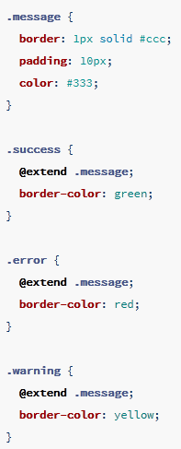
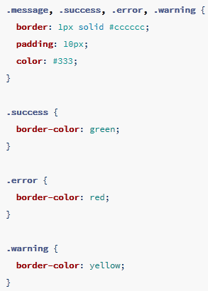
Extend

Slide 13
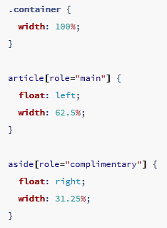
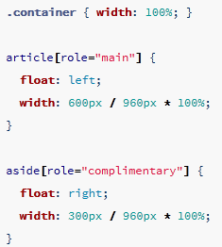
Operators

Slide 14
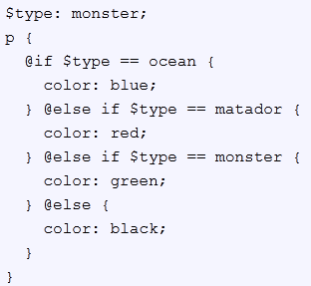

Control Directives
@for $var from <start> through <end>
@each $var in <list\map>
@while $var > <limit>

Slide 15



Functions

Slide 16
Cool SASS Functions
lighten($color, $amount)
darken($color, $amount)
to-upper-case($string)
length($list)
zip($lists…)
function-exists($name)
mixin-exists($name)

Slide 17
Compiling SASS
Compile SASS
  sass input.scss output.css
Watch SASS File
  sass --watch input.scss:output.css
Watch SASS Directory
  sass --watch app/sass:public/stylesheets

Slide 18


SASS Tools
Compass
  Mixins
Compass.App
  SASS Compile
Bourbon
  Mixins
Bourbon Neat
  Front End Framework

Slide 19

Sources (list them)
http://sass-lang.com
http://en.wikipedia.org/wiki/Sass_%28stylesheet_language%29
http://mashable.com/2013/06/11/sass-compass-tools/
http://compass-style.org/
http://bourbon.io/
http://compass.kkbox.com/

