Slide 1
THE SITE YOUR SITE COULD LOOK LIKE
Sarah Jemerson

Slide 2

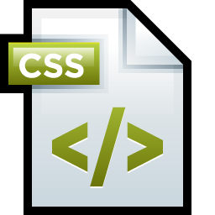

Slide 3


Bootstrap
Give your layout the boom-pow without the know-how
HTML and CSS design templates, JavaScript extensions for responsive web design.

Slide 4
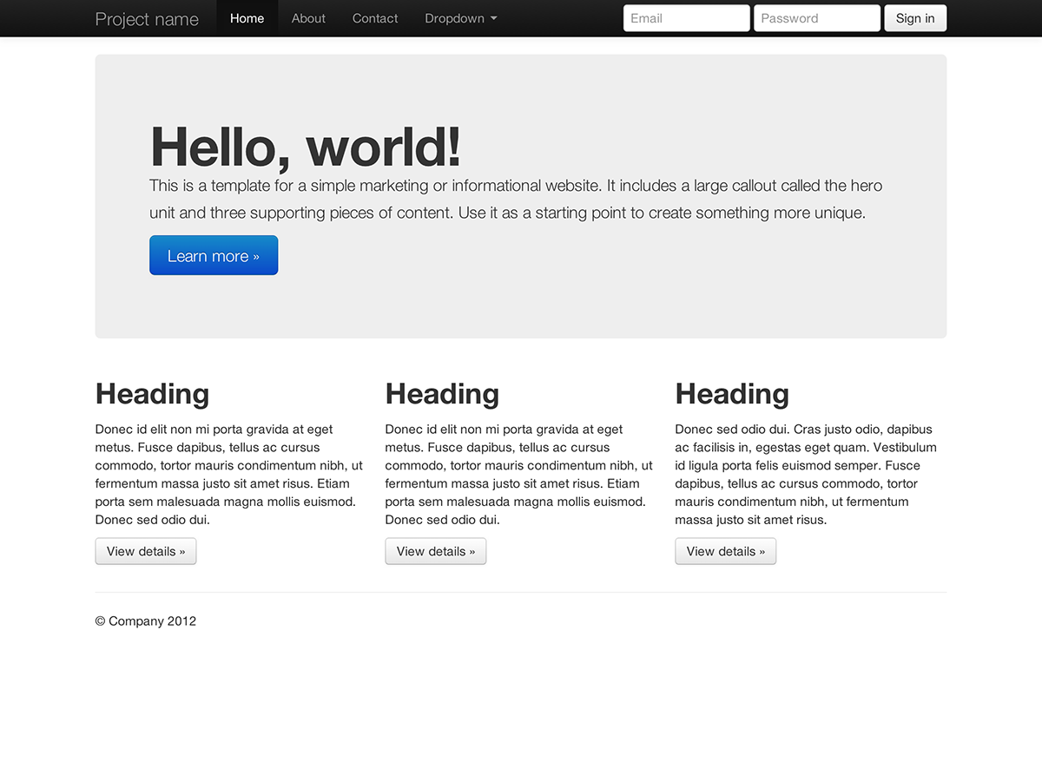

Slide 5

LayoutIt!
Need to build fast, and learning too slow.
A drag-and-drop interface for using Bootstrap’s grid system

Slide 6
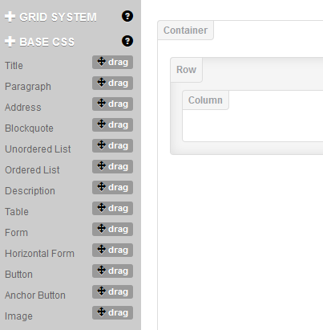

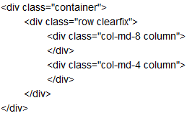
HTML!
EXPLOSION!

Slide 7

Bootswatchr
Put lipstick on that pig!
Create and edit your own Bootstrap theme with the Bootswatchr interface.

Slide 8
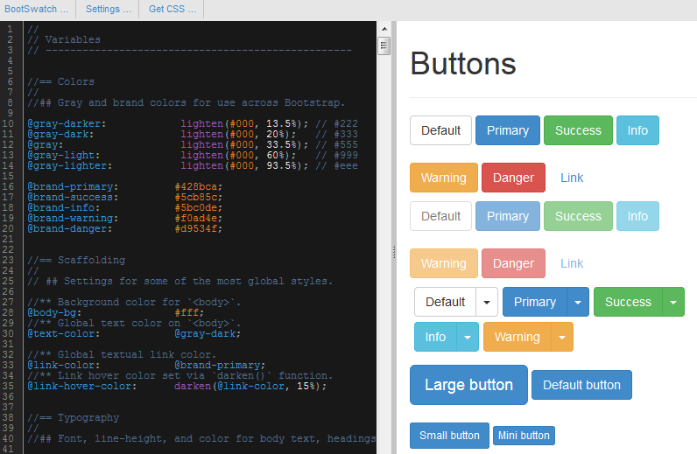

Slide 9

Colllor
Go back to 2nd grade art class!
Easily generate web color palettes and hex codes.

Slide 10
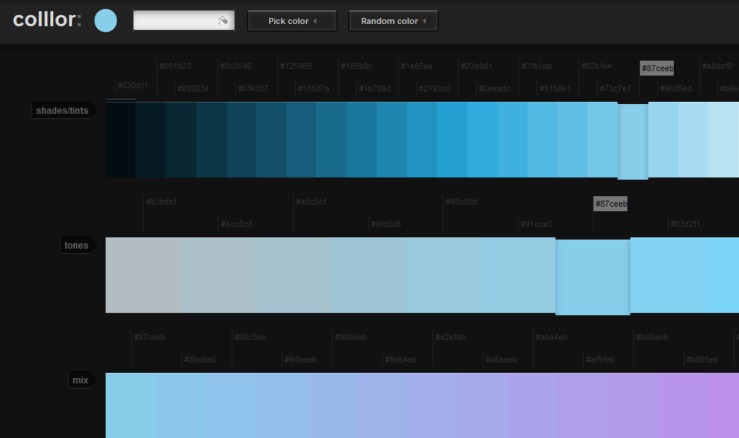

Slide 11

Bootstrap
LayoutIt!
Bootswatchr
Colllor

Slide 12


Slide 13
YOUR SITE

Slide 14
RESERVED
If I don’t have a margarita in my hand, kindly supply one at this time.

Slide 15

Sources
http://getbootstrap.com/
http://www.layoutit.com/
http://bootswatchr.com/
http://colllor.com/

