Slide 1

HTML5 =
Kweku Martin

Slide 2
HTML
HyperText Markup Language is a markup language that web browsers use to interpret and compose text, images and other material into visual or audible web pages.

Slide 3
Basic Summary
HTML has had a life-span of roughly seven years. During that time, it has evolved from a simple language with a small number of tags to a complex system of mark-up, enabling authors to create Web pages complete with animated images, sound and all manner of gimmicks.

Slide 4

Tim Berners-Lee
Tim Berners-Lee is the inventor of the Web. In 1989, Tim was working in a computing services section of CERN when he came up with the concept; at the time he had no idea that it would be implemented on such an enormous scale.

Slide 5
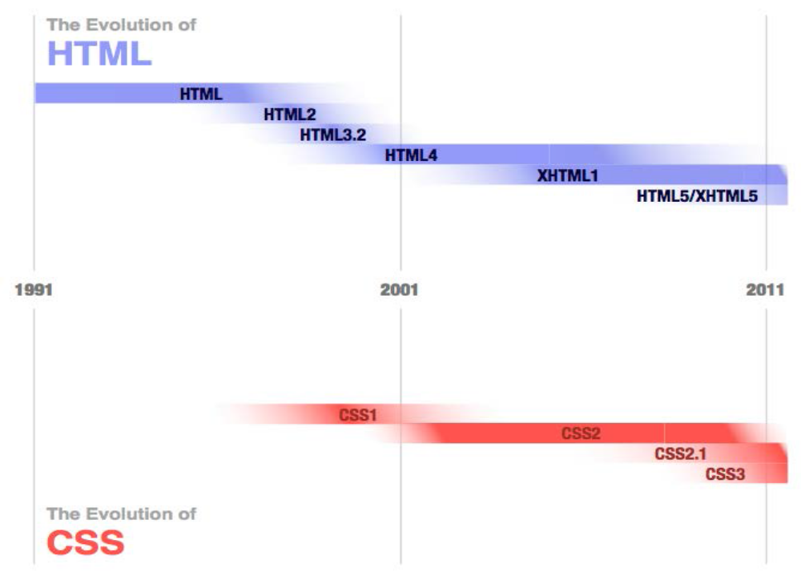
Timeline

Slide 6
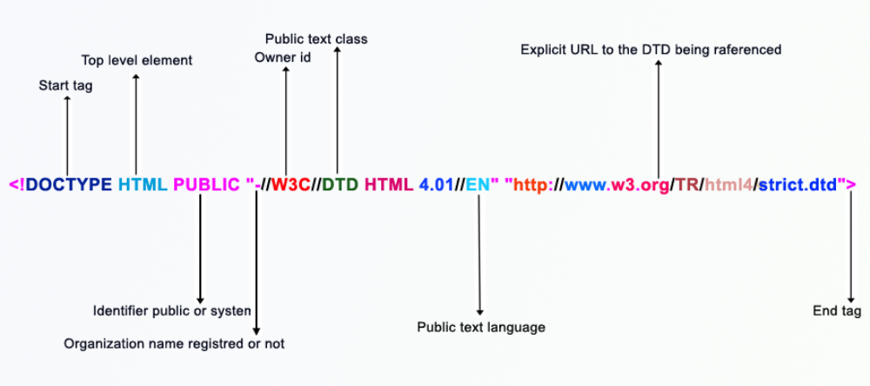
HTML 4

Slide 7
HTML 5
<!DOCTYPE HTML>
<meta charset="UTF-8">
which makes it easier to define charset
HTML5 is not based on SGML, and therefore does not require a reference to a DTD.

Slide 8
What’s New?
New parsing rules oriented towards flexible parsing and compatibility
New elements – section, video, progress, nav, meter, time, aside, canvas
New input attributes – dates and times, email, url
New attributes – ping, charset, async
Global attributes (that can be applied for every element) – id, tabindex, repeat
Deprecated elements dropped – center, font, strike

Slide 9
CSS3
CSS 3 is the modularization of Cascading Style Sheets to allow additions to the specification as well as limit the properties used in a given situation. With a specification that is modular, additions and changes to that specification become much easier.

Slide 10
CSS3 continued
CSS 3 is divided into several separate documents called "modules". Each module adds new capabilities or extends features defined in CSS 2, preserving backward compatibility. Work on CSS level 3 started around the time of publication of the original CSS 2 recommendation.

Slide 11
New attributes in CSS3
Media queries
Namespaces
Selectors
Color

Slide 12
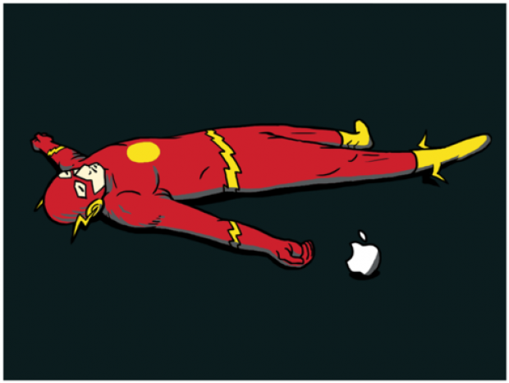
Flash is Dead!
The HTML5 <canvas> element is used to draw graphics, on the fly, via scripting (usually JavaScript).
The <canvas> element is only a container for graphics. You must use a script to actually draw the graphics.
Canvas has several methods for drawing paths, boxes, circles, text, and adding images.

Slide 13
Responsive Design
The fluid grid concept calls for page element sizing to be in relative units like percentages, rather than absolute units like pixels or points.
Media queries allow the page to use different CSS style rules based on characteristics of the device the site is being displayed on, most commonly the width of the browser.

Slide 14
Audio and Video Tags
There are also some new multimedia elements and attributes, such as <track>, that provides text tracks for the video element.
<video width="320" height="240" controls>
<source src="movie.mp4" type="video/mp4">
<source src="movie.ogg" type="video/ogg">
Your browser does not support the video tag.
</video>

Slide 15
Deprecated Tags
<acronym>,<big>,<font>,<noframes>,<u>, <strike>, <center>

Slide 16
Header and Footer Tags
<footer> are specifically marked for such. Because of this, it is unnecessary to identify these two elements with a <div> tag.

Slide 17
Validate your Site!
http://validator.w3.org/
Excellent site that checks coding standards
Validates and checks for errors in html coding

Slide 18

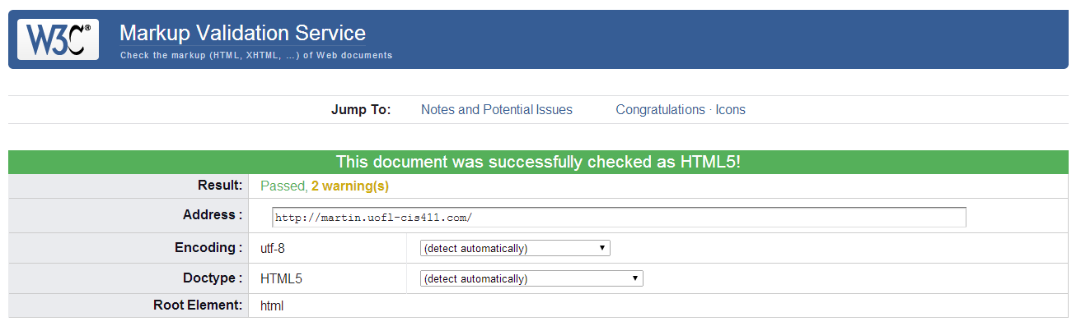
Example

Slide 19

Sources (list them)
http://stackoverflow.com/questions/134727/whats-the-key-difference-between-html-4-and-html-5
http://webdesign.about.com/od/css3/
http://www.w3schools.com/tags/tag_doctype.asp
http://inventors.about.com/od/bstartinventors/p/TimBernersLee.htm
http://en.wikipedia.org/wiki/CERN
http://www.google.com

