Slide 1
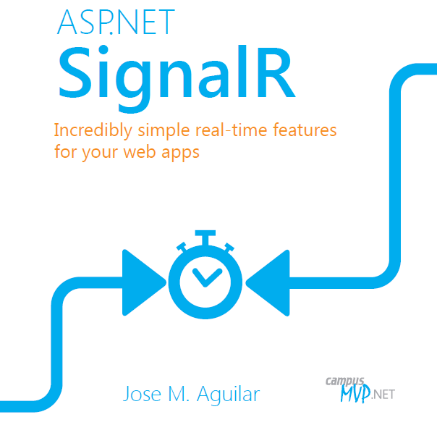
SignalR
Alex Carden

Slide 2
What is it?
SignalR is a new library for ASP.NET developers that makes it incredibly simple to add real-time web functionality to your applications.

Slide 3
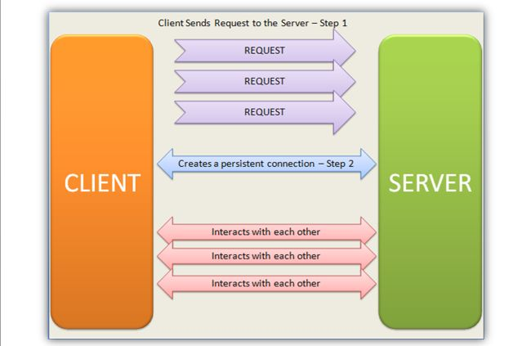
Basic Information
Server pushing Content to clients real time

Slide 4
How It Works
Uses WebSocket that enables bi-directional communication between the server and client.
Automatically selects the best transport method

Slide 5
How It Works Cont.
SignalRalso provides an api for creating server-to-client remote procedure calls (RPC).
This allows the server to call javascript functions in connected clients browsers.

Slide 6
Why Its Awesome
Pushes content to clients as soon as it becomes available.
Easy to use.
Old way was to wait for client to request new data and was unreliable.

Slide 7
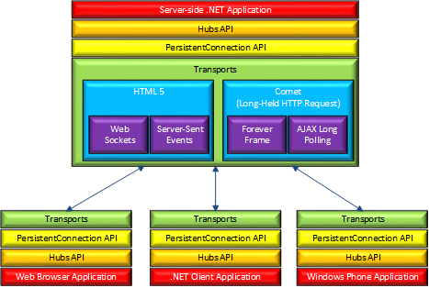
Picture

Slide 8
Uses
Any application that will require a large amount of updates or an application that listens for certain events.

Slide 9
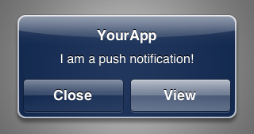
Example
Push Notifications

Slide 10

Example
Online Gaming

Slide 11
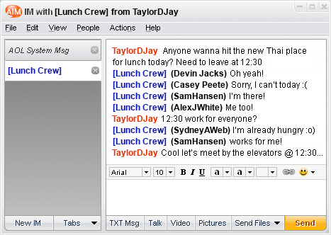
Example
Chat Rooms

Slide 12
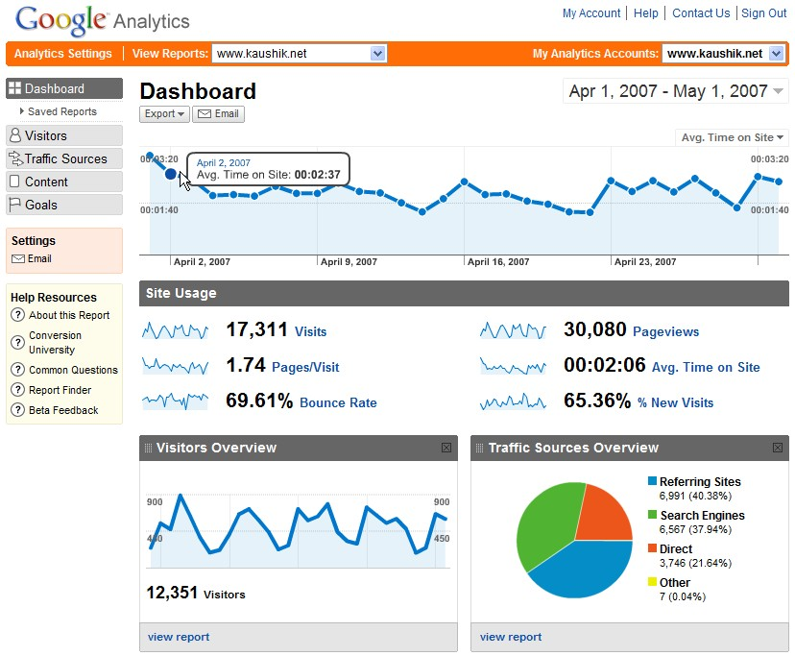
Example
Web Application Monitoring

Slide 13
Smart SignalR
Because SignalR uses websockets, you can program your application to take advantage of this.
Since SignalR is smart, it will automatically fall back to older transports if necessary.

Slide 14

Smart SignalR Cont.
A signalR connection starts out as HTTP and will be promoted to Websockets if it is available.

Slide 15
WebSockets
WebSocket is the ideal transport for SignalR, since it makes the most efficient use of server memory, has the lowest latency, and has the most underlying features (such as full duplex communication between client and server)

Slide 16
WebSockets
The only transport that establishes a true two-way persistent connection between clients and servers.
Requires the user to be using latest version of IE, Chrome, or firefox.

Slide 17
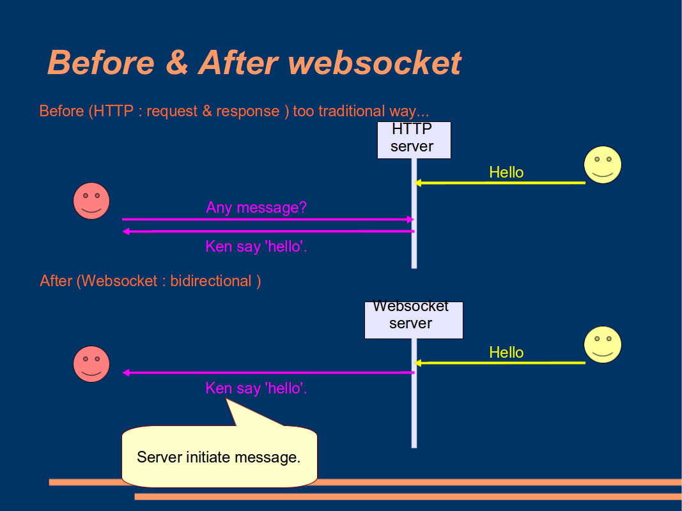
WebSocket Picture

Slide 18
Conclusion
SignalR is an awesome web technology that allows developers to constantly be able to push content to users without them even knowing or refreshing the page.
The magic is in WebSockets!

Slide 19

Sources (list them)
http://www.google.com
http://www.asp.net/signalr/overview/signalr-20/getting-started-with-signalr-20/introduction-to-signalr
http://signalr.net/
http://www.hanselman.com/blog/AsynchronousScalableWebApplicationsWithRealtimePersistentLongrunningConnectionsWithSignalR.aspx

