Slide 1


Automated jQuery RSS Feed Listing
Laci Pauley

Slide 2
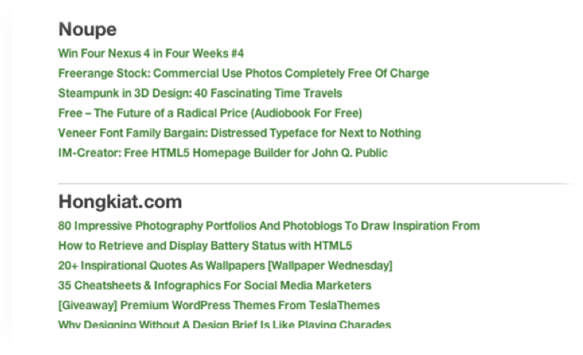
Rich Site Summary
Really Simple Syndication
Content Distribution
XML-Based
Feed

Slide 3

Back in the day…
Praise for jQuery!!!
Required some type of backend language
Ruby on Rails
PHP
Much easier and customizable method for pulling and displaying RSS feeds
Write less, do more.
Notes:
The typical process of creating a dynamic feed listing requires some type of backend language. Obviously this can work out fine if you are familiar with Rails or PHP

Slide 4
There’s just one thing…
Problem:
Accessing Ajax requests from an external server and then converting this XML info to something easier to read

Slide 5
Google Feed API
Easier than it appears
Numerous custom possibilities with options and access to other alternative themes
First, Need to display first page of feed item results each title and URL link
Once script is working, easy to customize the layout and even include a bit of content from the feed!

Slide 6
Getting Started
Make a basic HTML doc including jQuery library as a resource.
This code uses a couple of functions helping us achieve this RSS feed.
Typically when writing a webapp like this you need to access cross-domain parsing via some backend language. PHP is often the easiest solution for web developers.

Slide 7
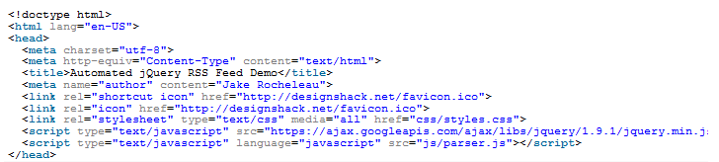
Since we are using the Google Feed API, it will take the place as our backend script.
Everything may be read via jQuery Ajax and then converted into JSON so that we can parse better.
Document header including jQuery along with a custom script parser.js.

Slide 8
Can fill in everything via JavaScript.
All internal RSS elements on the page will be written into HTML, but it will not display in the document source.
All the content is published dynamically
Can quickly edit the feed sources to change on every page reload.

Slide 9
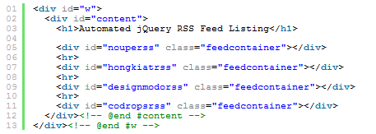
Body Contents
Each class of .feedcontainer is used to apply the same basic styles onto headings and links.
The ID names are targeted via jQuery so that we can run our custom RSS function and then append new content using the .html() method.

Slide 10
RSS Parsing in jQuery
2 functions of parser.js
1.) specifically handles RSS/JSON conversion
there are two functions where one specifically handles the RSS/JSON conversion.
2.) Capitalization function which automatically forces the RSS feed “title” attribute to stay capitalized.

Slide 11
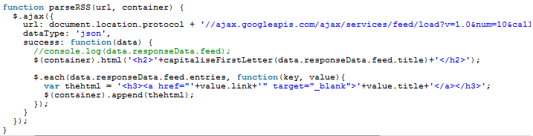

Slide 12
parseRSS()
outlines a perfect solution running only with jQuery. We do still need a server because the .ajax() method cannot be run without an HTTP stream.
Don’t need support for any other backend languages which is a huge relief. Can trust Google to keep this running indefinitely as it is a tremendous resource for developers.

Slide 13
The Response Loop
Function code is easy to understand if you are familiar with .ajax().
1.) Pass in the URL to query, which is the remote Google Feed API link. We need the dataType set as JSON
2.) After the successful ajax call we should run a new function to display the HTML contents.
Notice the parameter we pass is called data which holds the JSON response.

Slide 14
Response Loop Continued
Within the source code you will find comment at console.log(data.responseData.feed) if you want to display output of all the JSON contents. It is possible to display more than just the feed title and URL links. You do have the ability to add more stuff at your own will right from within this function.
Inside the successful ajax call function you embed an .each() loop to iterate over the items within the feed. Notice this array can be accessed through data.responseData.feed.entries which we turn into a key and value pair. It is fairly simple because we only need one string variable to hold the HTML. Then using jQuery .append() all the content is added back into the page.

Slide 15

The title output is not within this .each() loop because it should only be added once for each feed. But also it is using another custom function written to capitalize each first letter within any JavaScript string. Some of the RSS feeds will have all the title letters in lowercase which can look strange. Here is the function code, short and sweet.

Slide 16
RSS feeds can have a lot more information to publish.
Sometimes you will find thumbnail images embedded within the feed XML.
Makes it possible to include article images within your own RSS webapp!
Possibilities are practically endless with easy access to Google’s Feed APIs.

Slide 17
Final Thoughts
RSS Feeds still very popular among web developers
Common method of transferring data between websites.
Allows Internet marketers to easily publish updates on Twitter or Facebook directly from the website RSS feed.
Download a copy of source code provided
See if you can add any functionality or build a useful webapp related to popular RSS feeds.

Slide 18

Sources
http://designshack.net/articles/javascript/build-an-automated-rss-feed-list-with-jquery/
https://www.govdelivery.com/blog/2013/03/rss-test-3/

