Slide 1

Meteor.js
Arthur Blazin

Slide 2
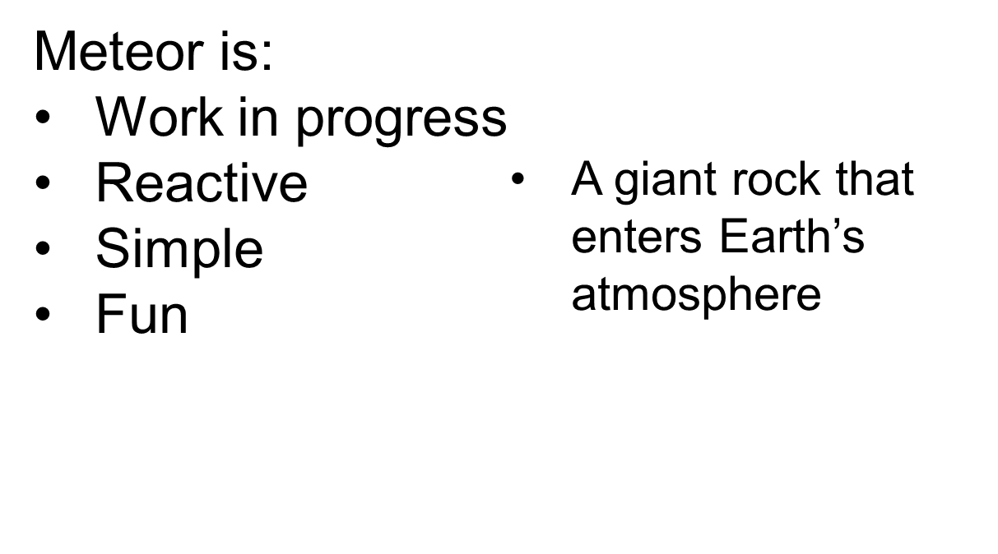
What is Meteor?
Meteor is an open-source platform for building top-quality web apps…
IN A FRACTION OF THE TIME!

Slide 3
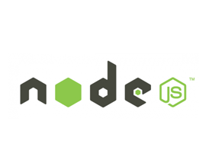
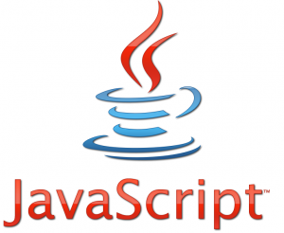


What is Meteor?
A library of packages, contain pre-written modules that one might use in developing an application

Slide 4



How easy is Meteor?
It takes a matter of
minutes to create your
first Meteor application
$ curl https://install.meteor.com | /bin/sh
$ meteor create myapp
$ cd myapp
$ meteor
=> Meteor server running on: http://localhost:3000/
$ meteor deploy myapp.meteor.com

Slide 5
That’s great – but what does it DO?
Meteor is easy to get started with, but also has useful purposes that other frameworks lack or make obscenely complex:
Reactivity
Live HTML
Templates
Data security
Namespacing
Deploying

Slide 6
Reactivity
Meteor embraces the concept of reactive programming
This means that any changes in data will automatically re-run the function associated with it
Works fluidly with Live HTML

Slide 7
Live HTML
Similar to reactive programming, Live HTML updates the webpage in real time
JavaScript event-handlers
Combined, Reactivity and Live HTML allow for users all over the world to interact with a web page simultaneously!

Slide 8
Live HTML – Preserve
Major problem with reactive websites
Element dumps every time it is re-drawn (i.e. input fields)
preserve tag holds:
  Focus
  Cursor
  Partially entered text

Slide 9
Templates
Meteor allows the use of any HTML templating language such as Handlebars or Jade
Regardless of choice, Meteor supports:
Live HTML
Reactivity
Data security

Slide 10
Data Security
Uses MongoDB
  Distributed client-side coding
  Talks to local database
Simple and secure approach
Individualized report procedure calls
In-memory, client-based database caching

Slide 11
What does all that mean?
Back-end facilitator of Reactivity
Supports functionalities such as:
  User authentication
  Input validation
  Latency compensation (doesn’t need to wait for server response)
  Element updating
All done in REAL-TIME!

Slide 12
Namespacing
Facilitates the writing of large JavaScript applications
Makes coding easier
Supports global and local variables
Makes code and variable debugging easier

Slide 13
Deploying
Meteor is a full application server and includes everything needed for online deployment
Deploying a Meteor application is incredibly simple
Can be done in 1 line of code
All the developer needs to provide is JavaScript, HTML, and CSS
Can be deployed either on Meteor’s infrastructure, your own, or a hosting provider’s

Slide 14
Deploying
On Meteor’s Infrastructure
Meteor allows the developer to publish using their servers
All you need is this line of code:
$ meteor deploy myapp.meteor.com
and the application is deployed
Meteor creates a fresh database and will maintain it if you make updates

Slide 15
Deploying
On Your Own Infrastructure
You can also run the application on your own infrastructure or any other hosting provider
All you need is this line of code:
$ meteor deploy www.myapp.com
and the application is deployed
However, if you are not using a hosting provider, this extra line of code is required for the database:
$ PORT=3000 MONGO_URL=mongodb://localhost:####/myapp node bundle/main.js

Slide 16
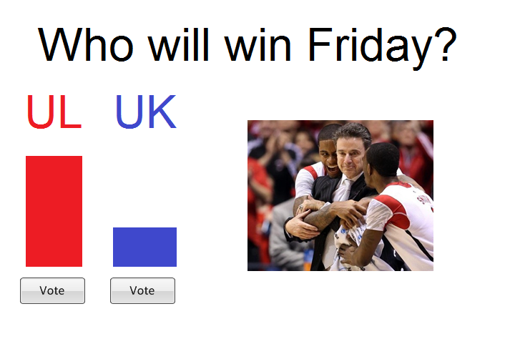
Example

Slide 17

Example

Slide 18
Support
Open-source, work-in-progress
Stack overflow
  The main resource for Meteor support
Mailing lists
  Two mailing lists, one for general support and another for requests to change Meteor’s core packages
GitHub
  Location of core packages code
  Opportunity for contribution

Slide 19

Sources
https://www.meteor.com/
https://www.meteor.com/about/mission
http://docs.meteor.com/
http://www.sympodial.com/blog/an-extremely-gentle-introduction-to-meteor.html

