Slide 1
One Web Approach
Felicity Bongo

Slide 2
Modern Technology
Living in a post – PC world.
  30% - %50 of web traffic comes from mobile devices.
  Desktop and laptop users will become a minority on the web.

Slide 3
Coding for Various Screens
One Web Approach
  Means making as far as reasonable the same information and services available to users irrespective of the device that they are using.
    Does not mean that same information has the exact same representation.

Slide 4
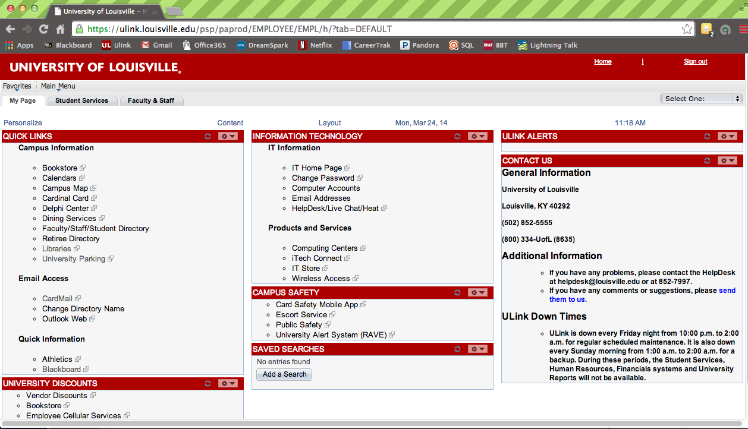
Do I really need to use a One Web Approach?

Slide 5
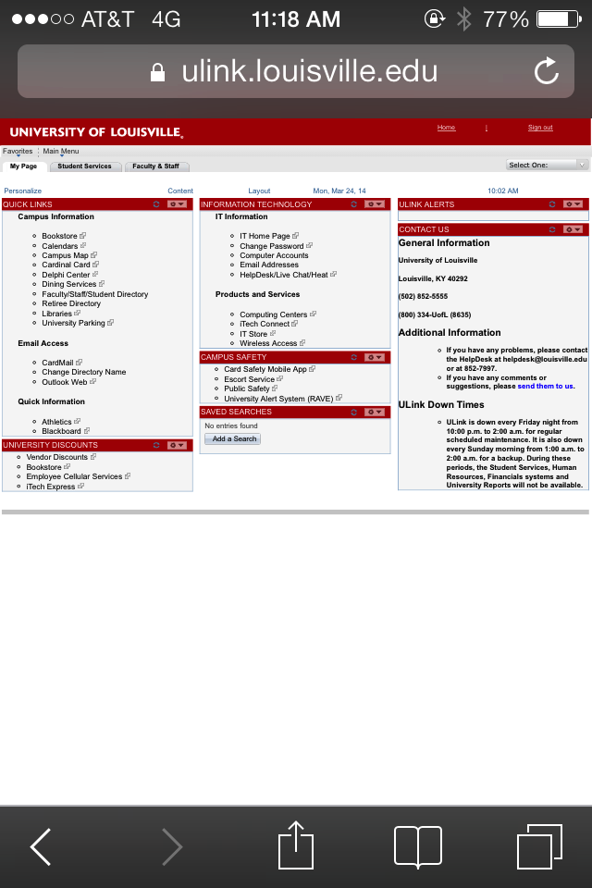
Do I really need to use a One Web Approach?

Slide 6

One Web Approach

Slide 7
Methods
Responsive Web Design
  Most common One Web approach
  Uses CSS Media Queries to modify the presentation of a website based on the size of the device display.

Slide 8
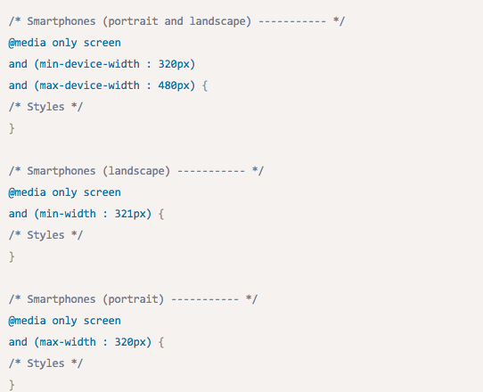
CSS Media Queries

Slide 9
Responsive Design
Disadvantages:
  Costly due to having to rebuild your site.
  All content is downloaded whether it’s used or not
  Full-Sized Images are downloaded and then resized to fit the device.

Slide 10
Methods
Adaptive design
  Like responsive design, delivers user experiences that target specific devices and contexts.
  Uses JavaScript to enrich websites with advanced functionality and customization.
    Ex: Deliver Retina-quality images only to Retina displays and lower- quality images to standard-definition displays.

Slide 11
Adaptive Cont.
Client-Side Adaptive:
  Adaptations occur on the client side, in the user’s browser.
  Gives developers the ability to reuse one set of HTML and JavaScript across devices, simplifying change management and testing
  Allows you to target particular devices
    Ex: Apple iPhone.

Slide 12
Adaptive Cont.
Server-Side Adaptive:
  Uses server-side plugins and custom user agent detection.
  Typically offers distinct templates for each device, enabling more customization.
  Keeps device-detection logic on the server, enabling smaller mobile pages that load faster.

Slide 13
Adaptive Cont.
Disadvantages to Server-Side:
  Requirement to manage multiple templates raises ongoing maintenance costs
  Can encounter performance issues when servers are under heavy load.

Slide 14
Responsive vs. Adaptive
Responsive | Adaptive
Single Template for all devices | Distinct Templates optimized for each device
Page loads slower (User has to wait for all page elements to load) | Page loads faster (Only loads required resources for user’s device)
Have to under-take site rebuild | Can be easily implemented on a pre-existing site

Slide 15
Which one is right for you?
Responsive websites
  Not a lot of difference in user intent between mobile and desktop users.
  Simple Functionality.
  One template = low maintenance

Slide 16
Which one is right for you?
Adaptive Website:
  Small budget
  User intent on mobile differs significantly
  Website performance becomes a crucial factor for determining visitor conversion and satisfaction.
    E-commerce websites

Slide 17
One Web vs Mobile Sites
Some developers may choose to redirect users to a mobile site.
  This is not using the One Web Approach
  Developers try to detect mobile browsers by using browser sniffing
    Checking the User Agent string that the browser sends to the server with every request.
    Unreliable.

Slide 18
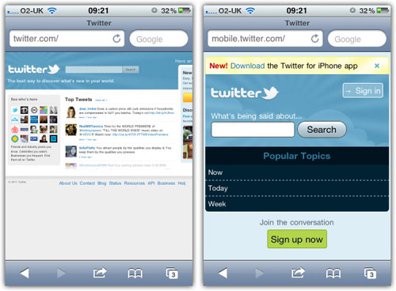
Are you feeling lucky?

Slide 19

Sources
http://visual.ly/adaptive-web-design-vs-responsive-web-design
http://www.w3.org/TR/mobile-bp/#OneWeb
http://mobile.smashingmagazine.com/2012/04/19/why-we-shouldnt-make-separate-mobile-websites/
http://coding.smashingmagazine.com/2011/01/12/guidelines-for-responsive-web-design/
http://www.webmonkey.com/2013/05/the-two-flavors-of-a-one-web-approach-responsive-vs-adaptive/

