Slide 1



You Decide…
.
By: Laura Thomas
AND?
OR?
VS?
Notes:
The evolution of the web as a platform for application delivery… HTML5 or plugins?

Slide 2
The Top 3 Platforms for Designing Web Apps
Adobe Flash
Microsoft Silverlight
HTML5

Slide 3
Plugins
Advantages
Upgrade plugin, not browser
Few cross-browser issues
Predictable runtime
Disadvantages
User required install/update
Extra load time
Integration with HTML/Javascript
Notes:
Advantages:
1. Biggest advantage of the plugin model is that it gives the plugin developers a sandbox
free from the browser itself.
2. Free from the constraints of web standards and the associated issues of cross-browser standards support, allowing plugins to provide much more ‘power’ than the HTML page that hosts them.
Disadvantages:
1. If you develop an application that runs within a plugin you are reliant on the end user actually having the target plugin installed on their browser.
2. They have an associated load-time-disrupting the browsing experience; HTML is much more immediate.
3. In the context of mixed content pages, which have a combination of static and dynamic content, you often have to work across the plugin boundaries, integrating with the HTML and JavaScript running elsewhere on the page.

Slide 4
Flash (The Good)
Pros
Perfect for animation
Works independently
Makes a catchy impression
Designer-friendly
Most widely used
Notes:
Perfect for animation.
Flash was originally designed for animation purposes, and it handles the task extremely well. Flash is also perfectly suited for games, videos, and interactive websites.
Works independently.
A flash plug-in works independently of operating systems and browsers, which means that no matter what your visitor has at their fingertips, your flash looks the way it should on their computer screen.
Makes a catchy impression.
Lets face it--flash is flashy. A bit of flash on a well-run website can add just enough visual interest to hook your visitors, and that keeps them around to look at the other information on your website. Flash can be a great way in to a more simple presentation.
Designer-friendly
Provides many developer tools; not as much coding as HTML5
Is widely used.
This means that most visitors to a Web page incorporating a Flash animation will be able to view it without downloading and installing the Player application. (In fact, probably 96% of Web users already have Flash Player installed .)

Slide 5
Flash (The Bad)
Cons
$$$
User must download the plugin
Not compatible with search engines
Not compatible on most mobile devices
Lag on page load time
CPU consumption
Apple doesn’t like it
Notes:
Perfect for animation.
Flash was originally designed for animation purposes, and it handles the task extremely well. Flash is also perfectly suited for games, videos, and interactive websites.
Works independently.
A flash plug-in works independently of operating systems and browsers, which means that no matter what your visitor has at their fingertips, your flash looks the way it should on their computer screen.
Makes a catchy impression.
Lets face it--flash is flashy. A bit of flash on a well-run website can add just enough visual interest to hook your visitors, and that keeps them around to look at the other information on your website. Flash can be a great way in to a more simple presentation.

Slide 6
Silverlight
Pros
Single, consistent runtime
.NET framework / Visual Studio
Choose your language
Cons
$$$
Current Adoption
Maturity
Interaction with HTML requires JavaScript
Framework Complexity
Notes:
Proprietary plugin

Slide 7
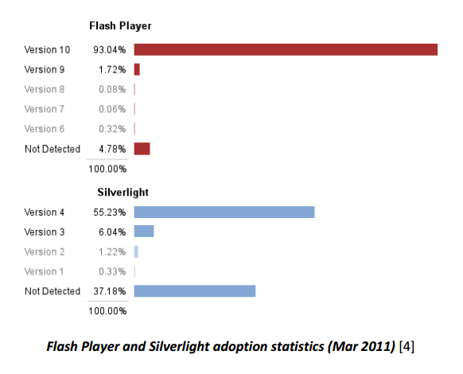
Adoption:
Flash vs. Silverlight
Notes:
Proprietary plugin

Slide 8
HTML5 Advantages
FREE
Maximum Reach (OS/Browser/Mobile)
Elegant forms, Consistency,Support Geolocation
Can deploy it on any platform
Notes:
Unlike Silverlight and Flex which are controlled exclusively by Microsoft and Adobe respectively, HTML is guided by the members of the World Wide Web Consortium (W3C) [7], which is comprised of browser manufacturers, web developers, academic and other interested parties.

Slide 9
HTML5 Downfalls
Features not available in old browsers
  Can degrade gracefully (lose features)
Less control over audio
Browser embedded video support
Lacks advanced video features
More development time
IT’S THE FUTURE, GET WITH IT!
Notes:
Older browsers
Must be upgraded to a newer version to add feature support, in contrast to the plugin model, where only the plugin runtime needs to be upgraded.
*Internet Explorer does not have a good track record for feature support.
Degrade Gracefully:
Features will be lost -- this is inferior to Flex / Silverlight where a predictable environment is always provided
Lacks advanced video features
HTML5 is more suitable for light interface enhancements, this leaves rooms for Flash to do what it does best: heavy interface enhancements, vector-based animations, advanced video and audio features, and immersive environments.
(streaming, caption, interactive features and miscellaneous video effects).
More development time
With Flash you can use their development tools and so have little actually coding to get some functionality, with HTML5 most of the changes seem to be driven by using javascript and there are few tools for that, that are specific to HTML5.

Slide 10
HTML5 Downfalls
Features not available in old browsers
  Can degrade gracefully (lose features)
Less control over audio
Browser embedded video support
Lacks advanced video features
More development time
Notes:
Older browsers
Must be upgraded to a newer version to add feature support, in contrast to the plugin model, where only the plugin runtime needs to be upgraded.
*Internet Explorer does not have a good track record for feature support.
Degrade Gracefully:
Features will be lost -- this is inferior to Flex / Silverlight where a predictable environment is always provided
Lacks advanced video features
HTML5 is more suitable for light interface enhancements, this leaves rooms for Flash to do what it does best: heavy interface enhancements, vector-based animations, advanced video and audio features, and immersive environments.
(streaming, caption, interactive features and miscellaneous video effects).
More development time
With Flash you can use their development tools and so have little actually coding to get some functionality, with HTML5 most of the changes seem to be driven by using javascript and there are few tools for that, that are specific to HTML5.

Slide 11
Flash vs. Linux and OS X
"Flash is the No. 1 reason Macs crash" -Steve Jobs
OS X:
Apple no longer bundles Flash with its OS X
Linux:
Flash no longer developed after v.11.2
Notes:
OS X:
Safari 5.1.7, which runs on OS X Snow Leopard and Lion, as well as on Windows XP, Vista and Windows 7, cripples any copy of Flash older than 10.1.102.64, which shipped in November 2010.
Linux:
Since flash will no longer be developed for Linux past 11.2, we are left to hope for solutions from Firefox, HTML5 encoding, or some other wild idea. For now, the only concrete solution is running a virtual machine
Currently builds of adobeflash-plugin (version 11.2) have broken DRM functionality via web browsers such as Firefox and Chrome.

Slide 12
Flash “Mobility”
Compatibility
Apple: No support whatsoever
Android: No longer supported
Issues with Flash on Mobile
Security Vulnerabilities
Lacks reliability
Eats up the battery
Not designed for touch-based screens
Notes:
Issues with Flash on Mobile:
Security Issues
Ads will ALWAYS cause security problems because you're giving the ad right to run along with the app, the Virus just needs to act "like an ad" and then, yay! Compromise.
Lacks reliability
Flash has been pointed to as one of the most common culprits when a Mac crashes, which is one of the major reasons why Steve Jobs took a stand against Flash coming to the iOS platform.
Eats up the battery
Considerably more than HTML5
Not designed for touch-based screens
Flash is designed for desktop and laptop PCs, which means it is designed for the same types of input found on these computers: keyboards and mice. As a touch-based device, this would cause a poor user experience for iPad users trying to use a Flash-based website or play a Flash game.
Flash support on Mobile:
Adobe dropped support for mobile Flash and switched their support to HTML 5 in 2011
No longer supported after Android v4.4 (KitKat)

Slide 13
Silverlight “Mobility”
Compatibility
Apple:
Not currently supported
(talks goin’ down between Microsoft & Apple for Silverlight plugin)
Android:
Not currently supported

Slide 14


Flash & Silverlight Alternative for Mobile
Laura’s Logic:
IF Platform_FirstChoice = FLASH OR SILVERLIGHT
AND usability = “Not Installed” OR “Banned”
AND Platform_AltChoice = HTML5
THEN
ELSE
Notes:
Most websites set Flash as their default video player, but when Flash is not installed, or in many cases, “banned” from being used, the site defaults to HTML5.
If the site can only be rendered using Flash or Silverlight, you are out of luck with viewing it via the majority of mobile devices.

Slide 15
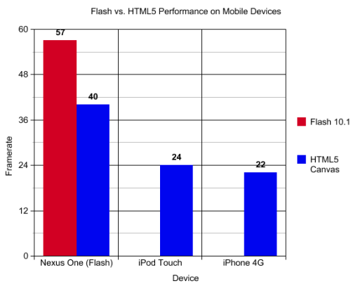
Battery Consumption on Mobile Devices
Notes:
<canvas> is an HTML element which can be used to draw graphics using scripting

Slide 16
Moving Toward HTML5
Netflix
Microsoft

Slide 17
Let’s Work Together
You can’t build a web site using only Flash
HTML5 should take advantage of Flash’s tenure
Until people begin upgrading their browsers, HTML5 will not be feasible for many
Notes:
You do not build a web site in Flash. The only way to build a website is to use HTML pages, and then to embed Flash elements in them.
Flash as been around for more than 12 years. It is a de facto standard for the publishing industry. (No Flash = no advanced features in banners).

Slide 18
Determine Best Solution
Understand the goals of the project
Who will be using your app?
How complex will it be?
What development resources and skill level do you have?
Notes:
Understand the goals of the project
What is the primary goal? Who are they trying to reach? Are they after Industry buzz or are they trying to reach a broader audience?
Who will be using your app?
The composition of the audience helps us decide if the project is desktop or tablet / mobile or both. What percentage of these users use modern browsers? Is this an internal vs. external application?
How complex will it be?
Is this a content heavy website vs. highly interactive website? Is there a large amount of internal video on the site vs. external video linking (e.g. YouTube)

Slide 19

Sources (list them)
Image Sources:
http://gorumors.com/adobe-flash-vs-html-5-for-mobile-devices-performance-test/2755487
http://upload.wikimedia.org/wikipedia/en/4/49/Smileyfacethatiswearingsunglasses.jpg
http://www.extremetech.com/computing/159960-netflix-switches-from-silverlight-to-html5-in-windows-8-1-reduces-cpu-usage-dramatically
http://blog.multimediasolutions.com/2012/03/15/does-flash-and-silverlight-have-a-future-in-the-post-html-5-world/
http://www.codeproject.com/Articles/288193/HTML-vs-FLASH-vs-SILVERLIGHT
http://www.scottlogic.com/blog/archive/2011/05/Flex-Silverlight-HTML5.pdf
http://www.forbes.com/sites/fredcavazza/2011/07/17/why-opposing-html5-and-flash-is-a-non-sense/
https://wiki.archlinux.org/index.php/Pipelight
http://www.streamingmedia.com/Articles/Editorial/Featured-Articles/Who-Still-Uses-Flash-Video-Just-About-Everybody-84335.aspx

