Slide 1
Web API
Michael Houze

Slide 2
Overview
What is an API?
What is a Web API?
What do I use one?
What are the benefits?
What kind of Web APIs are out there?

Slide 3
What is an API?
Definition: an API, or application programming interface, is a protocol that specifies how software components interact with each other.
Very broad term that is applicable to many areas of computer science

Slide 4
What is an API?
Common APIs seen by developers
  Math
    Sqrt
    Abs
  Data Structures
    Stack – push, pop, peek
    Linked List – head, next

Slide 5
What is a Web API?
Definition: an API is typically defined as a set of Hypertext Transfer Protocol (HTTP) request messages, along with a definition of the structure of response messages, which is usually in an Extensible Markup Language (XML) or JavaScript Object Notation (JSON) format.

Slide 6
What is a Web API?
What the #$&#& does that mean?
Basically, one website/application sends a request for information from another one, in a very specific format.
These requests are typically done with XML or JSON.

Slide 7
How do I use one?
Request access to the API through the developer page
Credentials provided through public-key cryptography
These credentials are used to ensure the information is being accessed by only your website/application

Slide 8
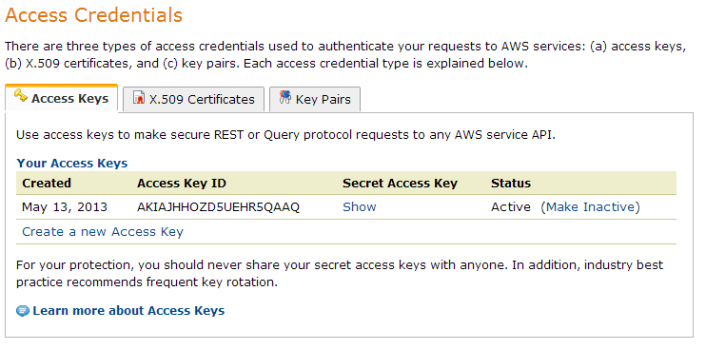
How do I use one?
Amazon’s Web Services

Slide 9
What is the big deal?
This concept provides some very powerful tools for web developers.
Why write code when some of the best developers in the world have done it for you?

Slide 10

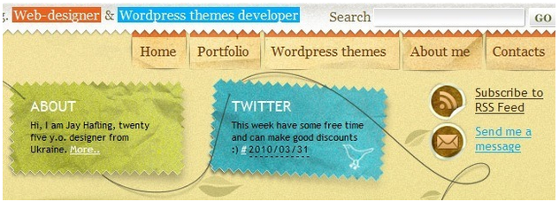
What is the big deal?
Twitter integration

Slide 11
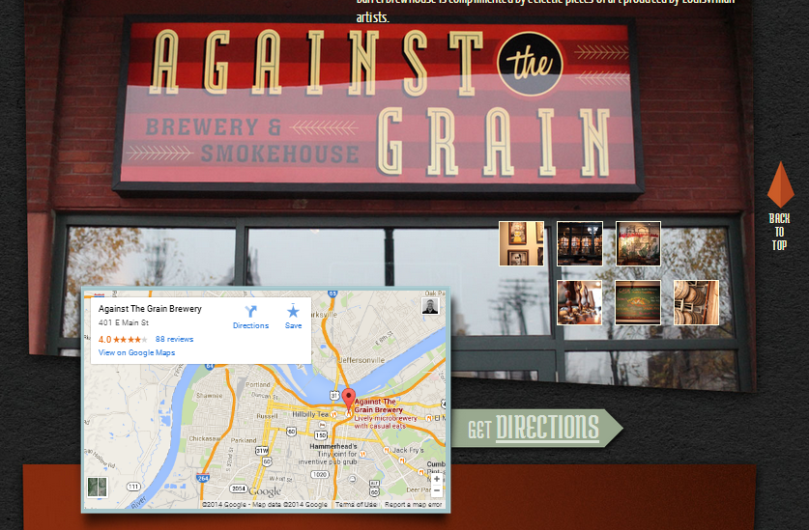
What is the big deal?
Google Maps integration

Slide 12
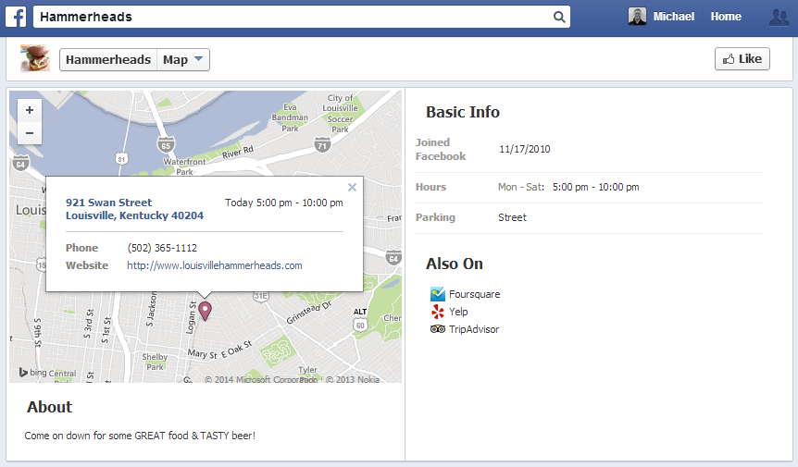
What is the big deal?
Even the large companies use each other’s web services

Slide 13
What services are out there?
Google - 53 available APIs
  Blogger
  Books
  Calender
  Cloud Storage
  Drive
  YouTube
  More…

Slide 14
What services are out there?
Facebook – 10 APIs
  Chat
  Public Feeds
  Post to Timelines
ESPN – 12 APIs
  Scores and Schedules
  Headlines
  Standings

Slide 15
In Conclusion
APIs can save you from rewriting code that already exists
They add functionality to your website/application
They can improve the UX due to using familiar software
All the cool kids are doing it

Slide 16

Sources
http://en.wikipedia.org/wiki/Api
http://en.wikipedia.org/wiki/Web_api
http://mashable.com/2010/06/09/twitter-update-display-resources/
http://en.wikipedia.org/wiki/Public-key_cryptography

