Slide 1
Why I.E. Sucks…or why Chrome doesn’t suck
Mitch McCoy

Slide 2

How many people use I.E.?
Raise your hand if you use I.E. as your default browser.

Slide 3
I.E. The Original Browser?
Version 1.0 in 1995
Based on another browser (Spyglass)
Version 11.0 Released in 2013
I.E. 6 Last Stand Alone Version

Slide 4
A few I.E. Problems
September 2013
  Emergency temporary fix released
  Allowed malicious use of deleted memory or improperly allocated memory
  Came in the fashion of drive-by downloading and/or malicious links

Slide 5
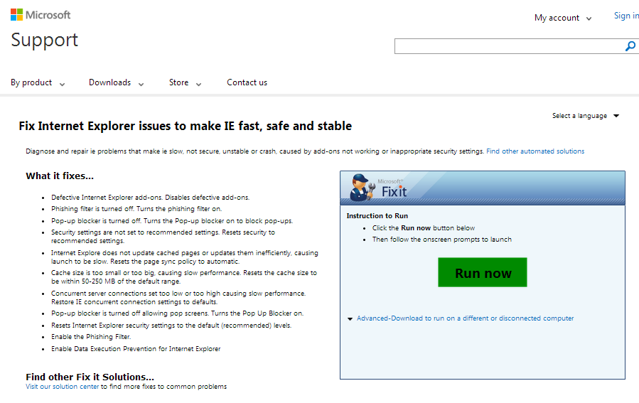
The title says it all…
Some info

Slide 6

I.E. Is useful for some things…

Slide 7
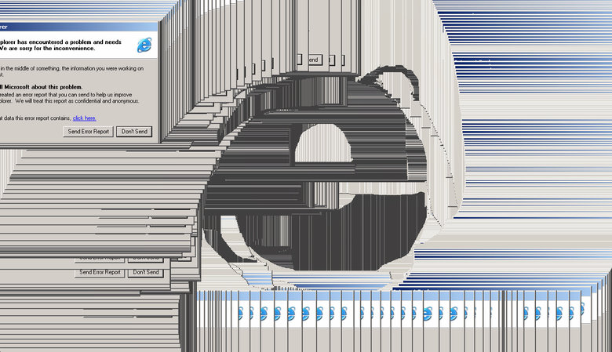
I.E. Great for Making Art!

Slide 8
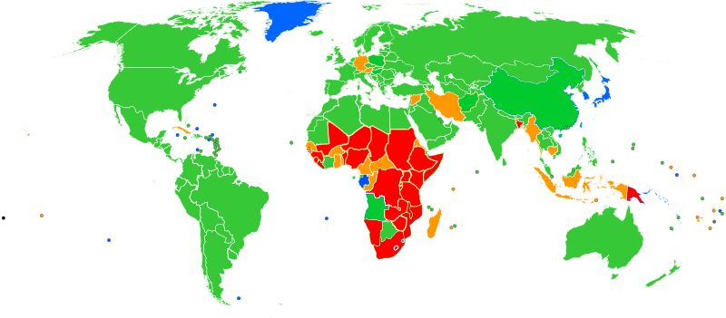
Majority Market Share of the World

Slide 9
Google Chrome
First stable public release December 2011
Most widely used browser by 2013
Google originally opposed making it’s own browser.

Slide 10
Chromium
-Began September 2008
-Open source project for Chrome
-Not Chrome, and does not have automatic updates and other features
-Used to develop for OSX and Linux

Slide 11
Why it’s better
Passes Acid 3 Test at 100%
Automatic updates for 2 different blacklists
Multiple plug-ins/add-ons available

Slide 12

Much faster than I.E.
Browser | HTML5Test.
Google Chrome 16 | 374
Firefox 11 | 335
Firefox 10 | 332
Opera 11.60 | 329
Safari 5.1 | 302
Internet Explorer 9 | 141

Slide 13
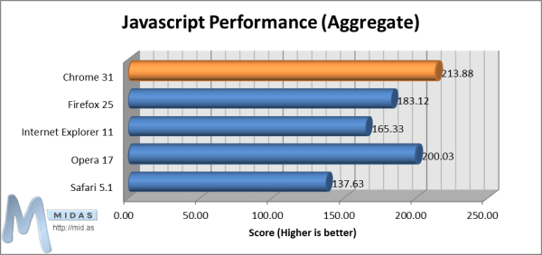
Better for Javascript

Slide 14
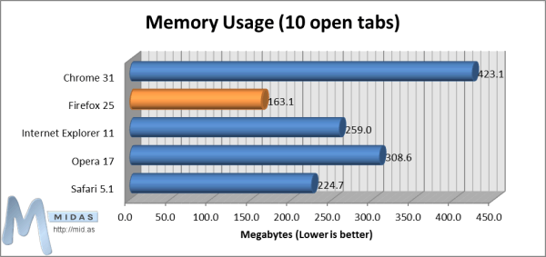
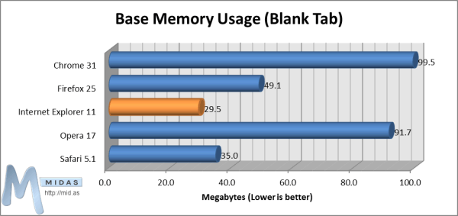
Memory Usage

Slide 15
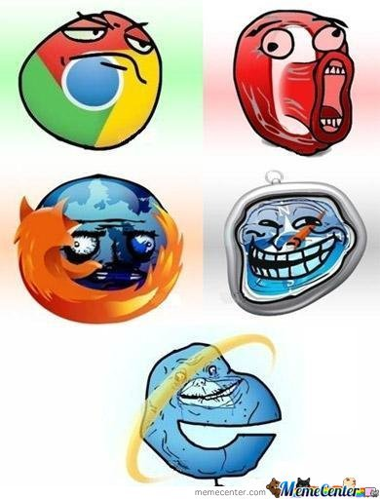
It’s Chrome

Slide 16
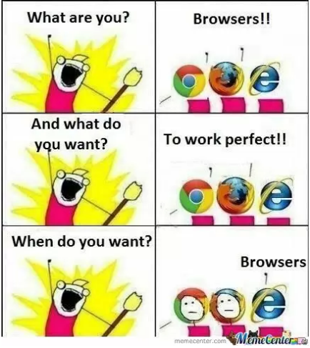
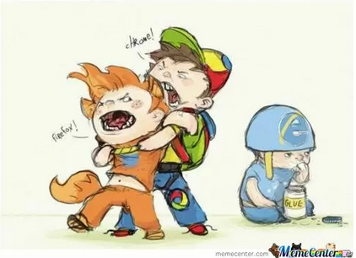
It’s not I.E.

Slide 17
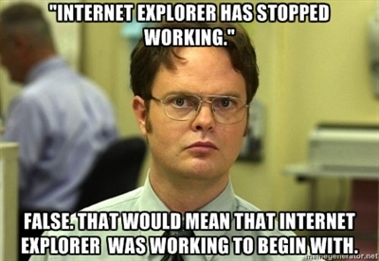
In conclusion
Numbers don’t lie

Slide 18
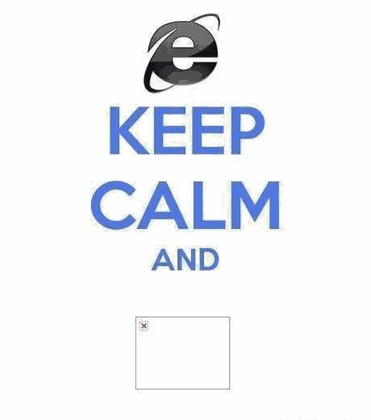
Thank you

Slide 19

Sources (list them)
http://www.google.com
www.wikipedia.org
Blog.mid.as
www.Pcmag.com
www.Darkreading.com

