Slide 1
Scirra
Simon Kay

Slide 2
Scirra
Scirra is a program that allows you to build games for the following platforms:
Web, Wii U, iOS, Android, Windows 8 & RT, Windows Phone, Windows, Mac, Linux, Blackberry, Firefox, Tizen, Facebook, Chrome, Amazon.

Slide 3
Scirra Features
Free
Requires no coding experience.
Complete user manual free online.
Instant preview of your games on Wifi.
Friendly online community to help solve problems you encounter.
Supports touch screen.

Slide 4
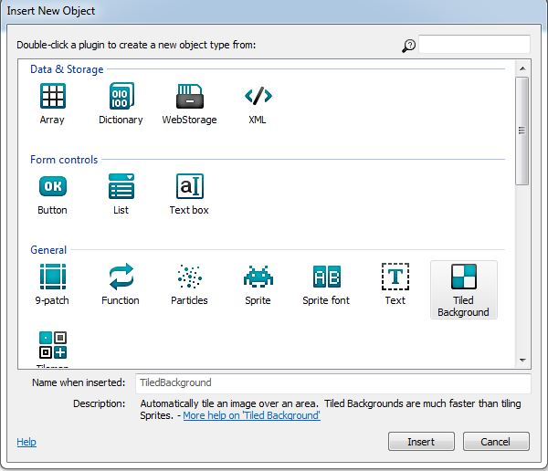
Creating your own game
Starts with layers
Can have multiple layers (background, score counter).
  Layers can be made infinite (locked).

Slide 5
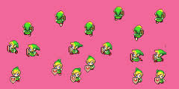
Sprites
Sprites are the images on the screen. Also called objects (sprites more fun).

Slide 6
Sprites cont.….
Sprites can begin on or off screen.
Shooter game – shooter starts on screen. Bad guys off screen.
  Off-screen sprites can be programmed to advance on screen

Slide 7
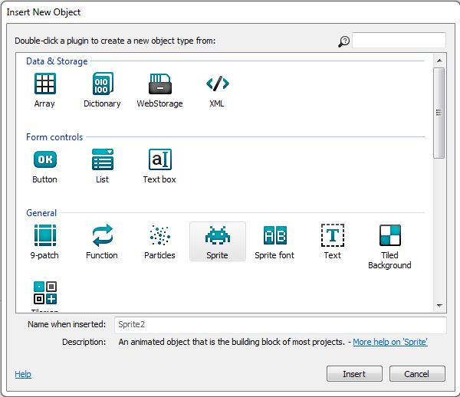
Sprites cont.….
All objects in the game are sprites.
  Shooter game: Bad guys, shooter, bullets, explosions are all Sprites

Slide 8
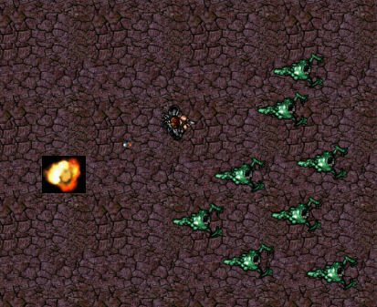
Behaviors
Everything in your game has behaviors.
  Main character (shooter) moves (behaves) when the keyboard is used.

Slide 9
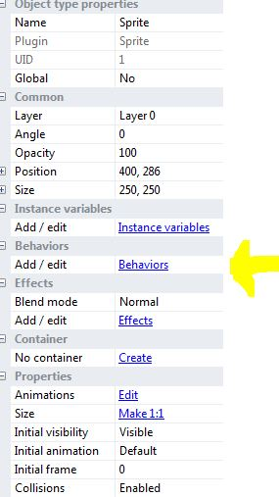
Other Behaviors
Scroll To: The world
moves with your
character.
Fade: Used when a
sprite is terminated

Slide 10
Events
Helps to determine what happens during the game.
On Click: (Shooter) Gun fires when mouse is clicked.
Collision: What happens when two objects touch.

Slide 11
Events
Events can be generated from other events
  (Shooter) Bullet collides with monster (explosion event)
    Bullet also destroys itself.
Keeping score is an event
  Each monster killed adds a point.

Slide 12
Events
Collision event continued…
Monster collides with player
  Player loses life.
    Life counter decreases by one.
All of the previous requires its own event.

Slide 13
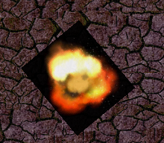
Blend Mode
Blends sprite background in with layer.
  Explosion surrounded by black.

Slide 14

Instance Variable
Has initial value that can be reset.
  Ex: (Shooter) Takes 5 bullets to kill a monster.

Slide 15
Parallax and Bound to Layout
Parallax – Layers will follow each other (scoreboard doesn’t disappear)
Bound to Layout – Everything stays on the screen.
  Monsters would turn around when they reach the edge.

Slide 16
Destroy outside Layout
Removes object that goes off screen.
  Monster that leaves the screen is destroyed.
  Bullets that miss are destroyed.

Slide 17
Physics
Things that go up come down.
Mario style game – if you jump, you land (or fall).

Slide 18
No coding experience needed
Scirra auto generates the code.
Allows you to choose the initial format (WindowsApp, Amazon, iOS etc)
Allows you to export project to start process of uploading it to appstore.

Slide 19

Sources (list them)
www.scirra.com
jakeludwig55.blogspot.com

