Slide 1
Bootstrap
Daniel Baird

Slide 2
What is Bootstrap
“The most popular front-end framework for designing responsive, mobile first projects on the web.”
Free collection of tool for developing websites and web applications
Written in HTML, CSS, and JavaScript
Released August 2011

Slide 3
Why Use Bootstrap
Open Source
Compatible with all major browsers
Responsive
Built in templates reduce development time
Well documented

Slide 4
Getting Started
Bootstrap can be downloaded from GetBootstrap.com
Move the files into your project directory, and include the JavaScript and CSS files that you need.
<script type="text/javascript" src="bootstrap.min.js"></script>
<link href="bootstrap.min.css" rel="stylesheet">
<link href="bootstrap-theme.min.css" rel="stylesheet”>

Slide 5
Using Bootstrap
Bootstrap uses a grid system to lay out it’s UI components.
The grid will rearrange itself based on the size of the viewport that it is using.
The grid is 12 columns wide, and you can set content to fill as many columns as you want.
The stacking behavior of the columns can also be easily modified.

Slide 6
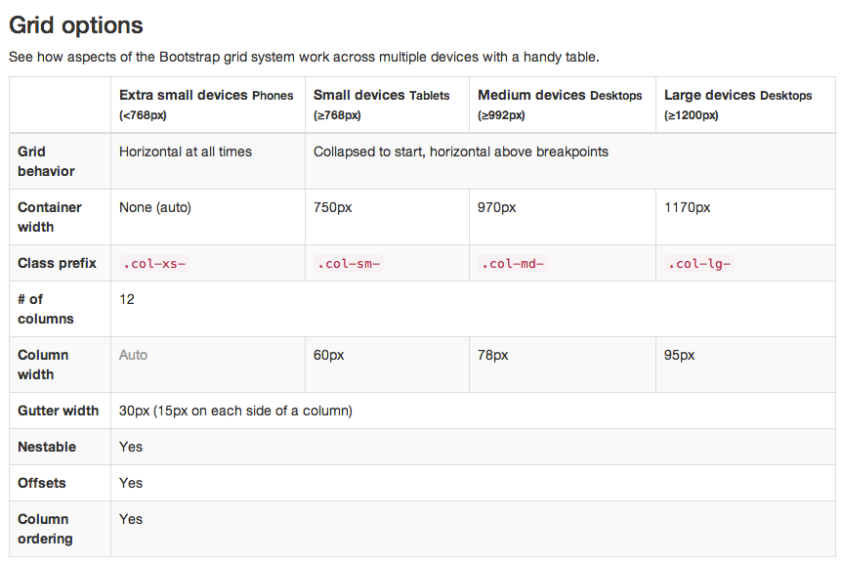
Your Title
Some info

Slide 7
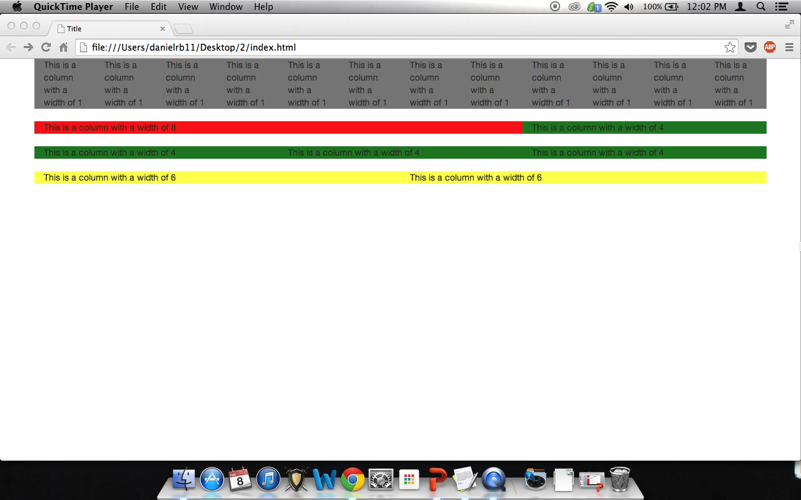
Grids in Action!
Some info

Slide 8
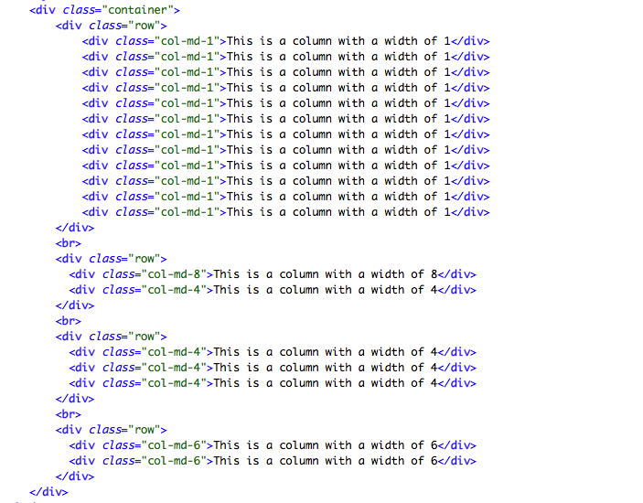
Your Title
Some info

Slide 9
UI Elements
Bootstrap has some really nice looking UI elements that are easy to modify and provide a lot of flexibility in creating your layout.
All of these controls can exist within columns and resize nicely with the rest of the viewport.

Slide 10
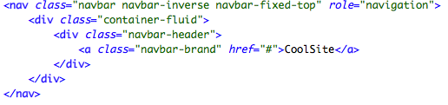
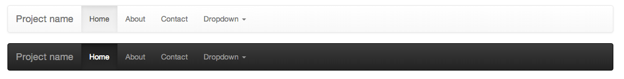
Nav Bars
A few lines of code can produce a nav bar fixed to the top of the screen with a clickable header name.

Slide 11
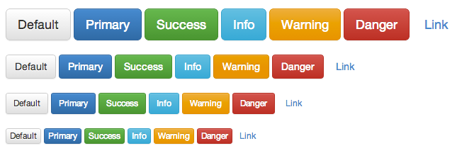
Buttons
Buttons come in many different flavors.

Slide 12

Alerts!
Alerts are easy to use, and can be made dismissible without having to write any JavaScript.
The alerts also come in several different styles.

Slide 13
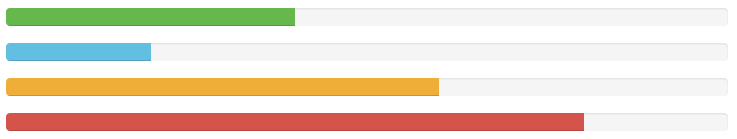
Progress Bars
Progress bars can be plain or striped, and they come in four colors.
The colors can be stacked in a single bar
Striped bars can be animated.

Slide 14


Tab Bars
As with all of the other controls, the tab bar looks nice, and it is very easy to add.

Slide 15
Bootstrap is Easy
All of the controls that I just showed can be added to a site via HTML without requiring any additional CSS to make them look nice.
All of the controls are responsive.
Though no CSS is required, the styles can also be easily modified to fit the style that you prefer for your website.

Slide 16
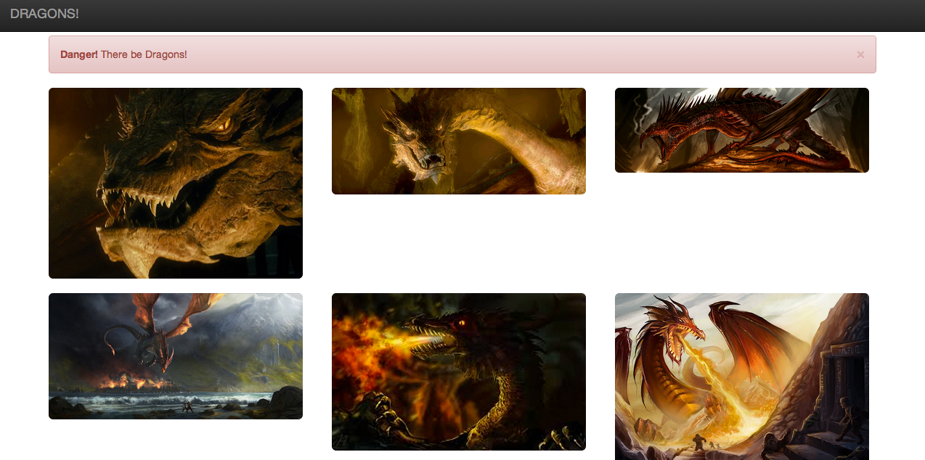
How Bootstrap should be used
For examples that actually use bootstrap well you can go here - http://expo.getbootstrap.com/

Slide 17

Sources
http://getbootstrap.com/
http://en.wikipedia.org/wiki/Bootstrap_(front-end_framework)
http://getbootstrap.com/components/

