Slide 1
CSS3 Animation
Josh Carreer

Slide 2
What are Animations in CSS3?
An animation is an effect that lets an element gradually change from one style to another.
You can change as many styles you want, as many times you want.

Slide 3
In the Beginning
To create a CSS animation sequence, you style the element you want to animate with the animation property or its sub-properties.
This lets you configure the timing and duration of the animation.
Not configure the actual appearance of the animation.
That done using @keyframes.

Slide 4
KeyFrames
Define the Sequence of the animation
Divided by percentages aka Selectors
From – Beginning
To – End

Slide 5
From and To
The animation is created by gradually changing from one set of CSS styles to another.
Specify when the change will happen in percent, or the keywords "from" and "to", which is the same as 0% and 100%.
0% is the beginning of the animation, 100% is when the animation is complete.

Slide 6
Selector
@keyframes slidein
{
from or 0%{ margin-left: 100%; width: 300%; }
Selector -> 50% {margin-left: 50%; width: 150%}
to or 100%{ margin-left: 0%; width: 100%; }
}

Slide 7
Code Example
H1
{
animation-duration: 3s;
animation-name: slidein;
}
@keyframes slidein
{
from or 0%{ margin-left: 100%; width: 300%; }
to or 100%{ margin-left: 0%; width: 100%; }
}

Slide 8
Animation-delay
How long it takes to start the animation after it is applied to the element.
You can use Negative value in this to start the animation part way through its cycle.
Syntax: animation-delay: 3s

Slide 9
Animation-direction
This indicates whether the animation should play in reverse on alternate cycles.
Value for this are normal, alternate, reverse and alternate-reverse.
Syntax: animation-direction: normal

Slide 10
Animation-duration
How long it takes animation to finish one cycle.
A value of 0s, which is the default value, indicates that no animation should occur.
Syntax: animation-duration: 6s

Slide 11
Animation-name:
Specifies a list of animations that should be applied to the selected element.
Each name indicates a @keyframes at-rule that defines the property values for the animation sequence.

Slide 12
Animation-iteration-count
The number of times the animation repeats
Values: any whole number and infinite
Infinite will cause the animation to repeat forever

Slide 13
Animation-play-state
This determines whether an animation is running or paused.
You can query this property's value to determine whether or not the animation is currently running; in addition, you can set its value to pause and resume playback of an animation

Slide 14
Animation-timing-function
How the animation transitions through keyframes, by establishing acceleration curves.
The timing function applies between keyframes rather than over the entire animation.
Values: ease, ease-in, ease-out, ease-in-out, linear, cubic-bezier, step-start, and step-end.

Slide 15
Using Animation Events
More control over animation
Represented by the Animation Event object
Event includes: time it occurred and the animation that triggered the event

Slide 16
Animation Events Code
function setup() {
var e = document.getElementById("watchme");
e.addEventListener("animationstart", listener, false);
e.addEventListener("animationend", listener, false);
e.addEventListener("animationiteration", listener, false); e.className = "slidein";
}

Slide 17
Receiving the Events
function listener(e) {
var l = document.createElement("li");
switch(e.type) {
case "animationstart": l.innerHTML = "Started: elapsed time is " + e.elapsedTime;
break;
case "animationend": l.innerHTML = "Ended: elapsed time is " + e.elapsedTime;
break;
case "animationiteration": l.innerHTML = "New loop started at time " + e.elapsedTime;
break;
}
document.getElementById("output").appendChild(l);
}

Slide 18
The HTML Code
<body onload="setup()">
<h1 id="watchme">Watch me move</h1>
<p>This example shows how to use CSS animations to make <code>H1</code> elements move across the page.
</p>
<p>In addition, we output some text each time an animation event fires, so you can see them in action.
</p>
<ul id="output"> </ul>
</body>

Slide 19
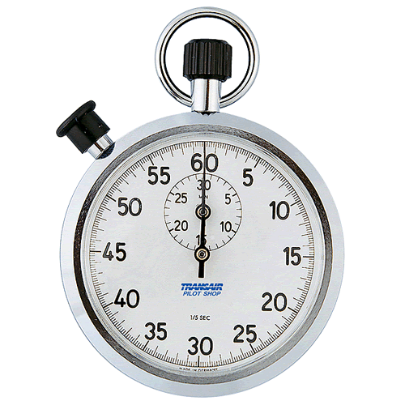

Time’s Up!
About your speaker:
  Name: Josh Carreer
  Resourse:
    https://developer.mozilla.org/en-US/docs/Web/Guide/CSS/Using_CSS_animations
    http://www.w3schools.com/css/css3_animations.asp

