Slide 1
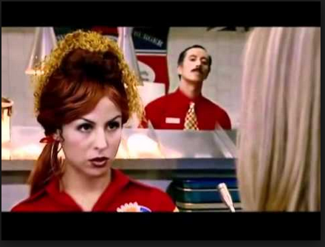
Security
Anna Kelley

Slide 2

End User Vs Developer
Notes:
End user – strong passwords…teach about phishing

Slide 3
Bug (Software Vulnerability)
Everything has them
OWASP (Open Web Application Security Project)
  Provides tools and material to help developers design, develop, test, and deploy

Slide 4
OWASP
Not-for-profit, open organization of many different people (developers, security pros, project managers)
Focus on application and web security
Notes:
Top 10 list influences next slides….security in a not as expensive way

Slide 5
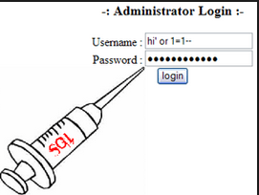
Injections
Untrusted data sent to an interpreter as part of command or query
Notes:
Unintentionally execute unintended, malicious commands to access unauthorized data

Slide 6
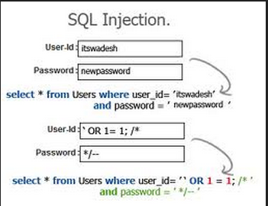
SQL Injection
Could use trial and error to grab information on your database
Notes:
Ex: remember dashes in sql comment stuff out….could comment out the behind the scenes sql

Slide 7
What OWASP doesn’t recommend
Blacklisting (blocking a list of forbidden options)
Whitelisting (accepting a list of allowed options)
Notes:
Some things you don’t want to always blacklist

Slide 8
What they do recommend
Input validation
Don’t display too much information
Parameterized queries instead of sending directly to interpretor
Notes:
Check type, length ,value, if it follows business rules.. Don’t let them see WHAT exception occurred.

Slide 9
Cross Site Scripting (XSS)
User tricked into executing code from other malicious site
Notes:
When a user views this message on their own page, they load bad-script.js into their page, and that script could do anything it wanted, for example, it could steal the contents of document.cookie, and then use that to impersonate the user and possibly send spam from their account, or more subtly, change the contents of the HTML page to do nasty things, possibly installing malware onto the reader’s computer. Remember thatbad-script.js now executes in the context of www.mybiz.com.

Slide 10
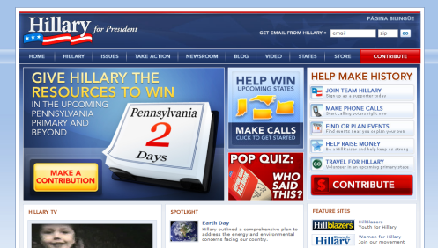
Site redirect
Notes:
Going to community blog has site redirect to hillary’s page through javascript

Slide 11
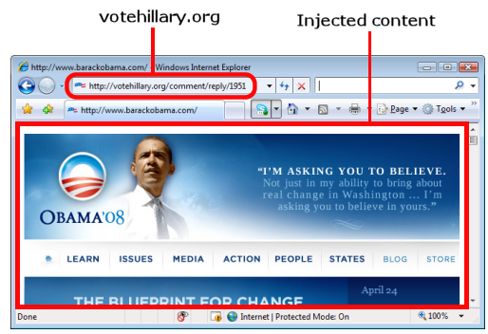
Post request to inject iframe
Notes:
Finnish researcher found vulnerabilities on votehillary to use post request in inject iframe

Slide 12
Cross Site Request Forgery (CSRF)
Malicious site tricks users into carrying out action on different site
Notes:
A CSRF (sometimes abbreviated as XSRF) is an attack where a malicious site tricks our visitors into carrying out an action on our site. This can happen if a user logs in to a site that they use a lot (e.g. e-mail, Facebook, etc.), and then visits a malicious site without first logging out. If the original site is susceptible to a CSRF attack, then the malicious site can do evil things on the user’s behalf. Let’s take the same example as above.
Now all the attacker needs to do, is get users of mybiz.com to visit their site. This is fairly easily accomplished by, for example, hosting a game, or pictures of cute baby animals. When the user visits the attacker’s site, their browser sends a GET request towww.mybiz.com/post_message. Since the user is still logged in to www.mybiz.com, the browser sends along the user’s cookies, thereby posting an advertisement for cheap medicine to all the user’s friends.

Slide 13
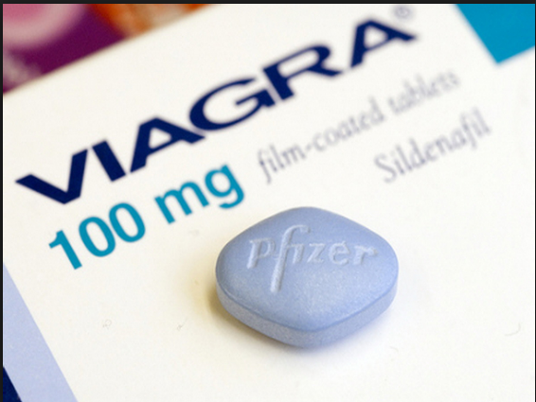
Example
Viagra on your facebook!!

Slide 14
Solution
Single use token assigned to user
Token can be validated to seen where a command originates

Slide 15
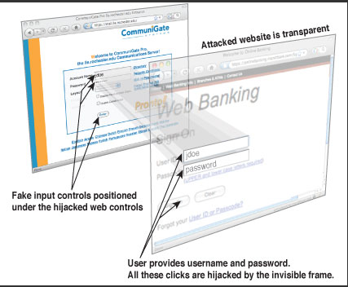
Click-Jacking
Notes:
Use iframe with opacity of 0 and use javascript to move around a submit button

Slide 16
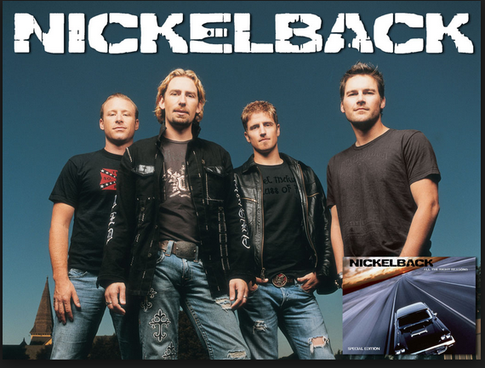

Ex: Facebook Like Button

Slide 17
Shell Injection
Use input string to gain shell access to web server
Notes:
With shell access, they can do a lot more like add javascript to pages or gain access to internal systems

Slide 18
Solution
Validate!
Don’t pass untreated user input to the shell
  System()
  Exec()
  ``

Slide 19

Sources (list them)
http://www.google.com
http://blog.sucuri.net/2012/08/secure-website-development-importance-of-developing-securely.html
http://www.innovationmanagement.se/2011/06/08/innovation-understanding-the-strategic-role-of-the-end-users/
https://www.owasp.org/index.php/Main_Page
http://coding.smashingmagazine.com/2010/10/18/common-security-mistakes-in-web-applications/
http://news.netcraft.com/archives/2008/04/24/clinton_and_obama_xss_battle_develops.html
http://news.netcraft.com/archives/2008/04/21/hacker_redirects_barack_obamas_site_to_hillaryclintoncom.html
http://erickerr.com/like-clickjacking

