Slide 1
Effin’ Fonts, How Do They Work? by
Zach Woodward

Slide 2
Effin’ Fonts, How Do They Work
Step 1: Learn from a professional
Well, what does a professional look like?

Slide 3

Effin’ Fonts, How Do They Work

Slide 4


Effin’ Fonts, How Do They Work
Step 2: For God’s sake, please make it readable
    Not too small
    Not too ugly

Slide 5
Effin’ Fonts, How Do They Work
Step 3: Know your font types

Slide 6

Effin’ Fonts, How Do They Work
Serif fonts

Slide 7

Effin’ Fonts, How Do They Work
Sans serif fonts

Slide 8
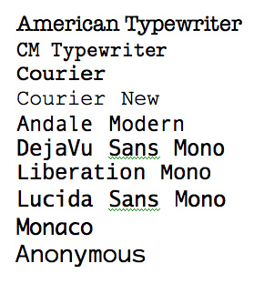
Effin’ Fonts, How Do They Work
Monospace fonts

Slide 9

Effin’ Fonts, How Do They Work
Script fonts

Slide 10
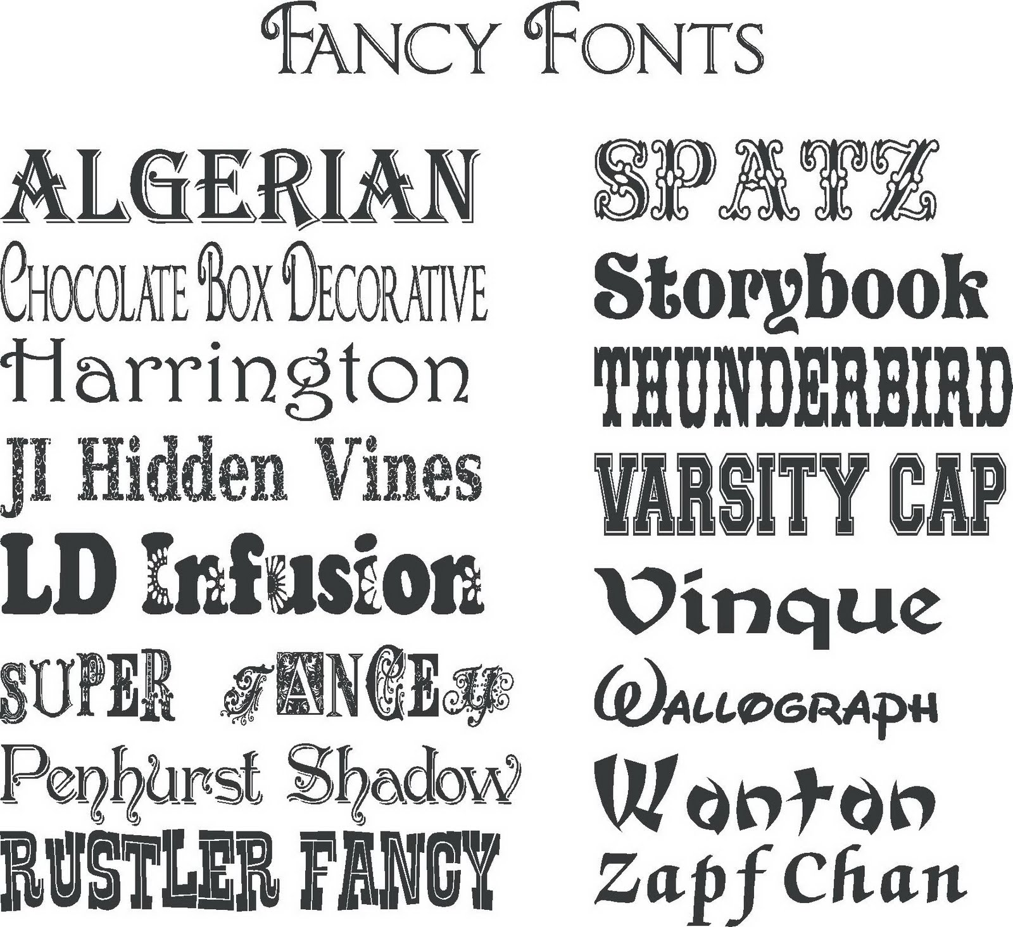
Effin’ Fonts, How Do They Work
Fancy fonts

Slide 11
Effin’ Fonts, How Do They Work
Step 4: Find a good pair for your font

Slide 12
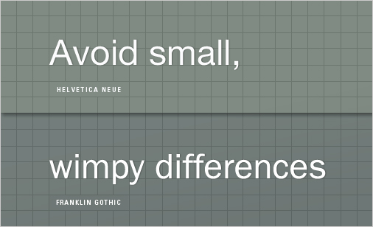

Effin’ Fonts, How Do They Work
First rule: keep it the same, or change it a lot

Slide 13
Effin’ Fonts, How Do They Work
A practical example:
We want something flashy for our Thai menu we’re making

Slide 14

Effin’ Fonts, How Do They Work
Let’s use the Sho font!
What would happen if we applied that font to the entire menu?

Slide 15
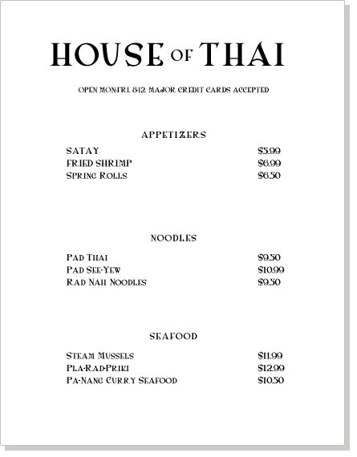
Effin’ Fonts, How Do They Work

Slide 16
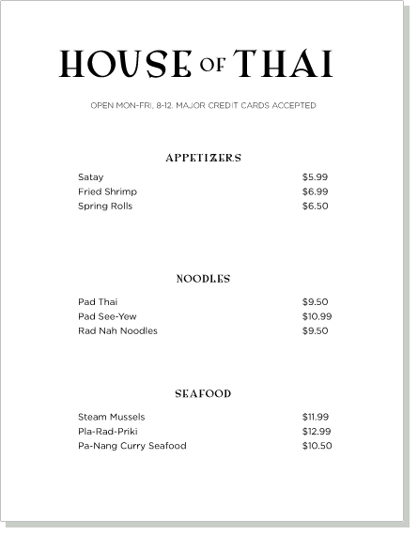
Effin’ Fonts, How Do They Work

Slide 17
Effin’ Fonts, How Do They Work
Final Step: Don’t fall for the fallacy that there are rules.
    Seriously, there aren’t rules, just conventions.
    You can always find (or create) a font that breaks all conventions, but still looks good

Slide 18
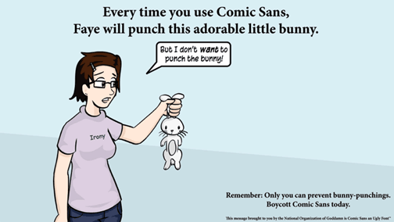
Effin’ Fonts, How Do They Work
So, in conclusion, what have we learned?

Slide 19

Sources (list them)
webdesign.tutsplus.com
www.smashingmagazine.com
www.j6design.com.au
Google Image Search

