Slide 1
Docker
Alex Shelton

Slide 2
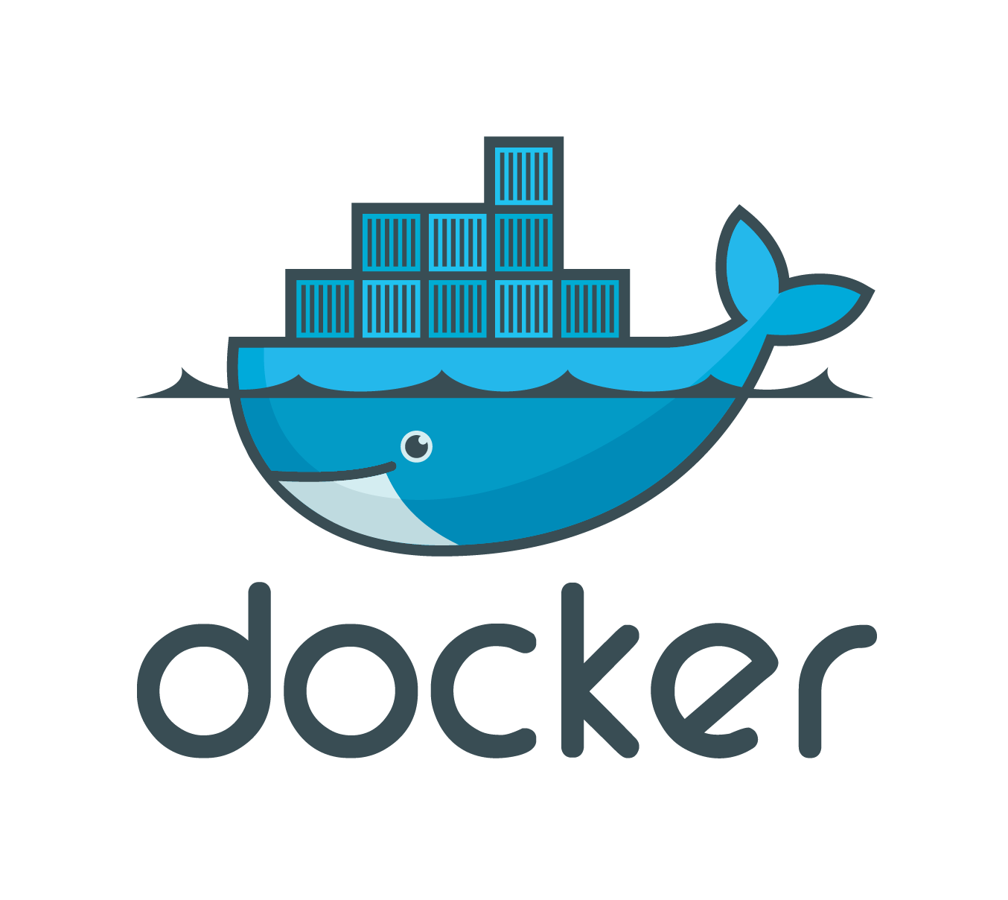
What is Docker?
Docker is an open platform for distributed applications for developers and system Admins
It Consists of a Docker Engine, a runtime packaging tool, and Docker Hub, a cloud service for sharing applications

Slide 3
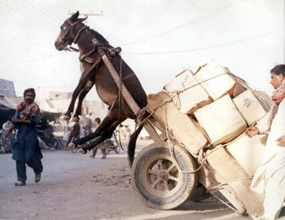
Shipping is Hard
People needed a better way to ship items
Too much to worry about, separate products, damage, skill of workers
Thus the shipping container was born

Slide 4
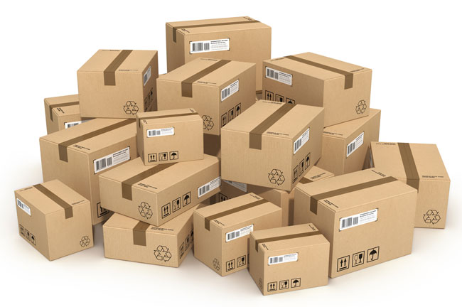
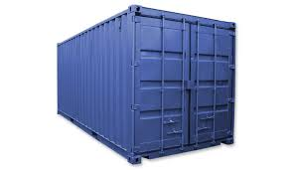
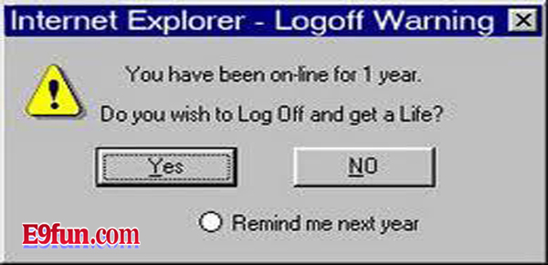
Analogy
Shipping Container : Packages
Docker : Code

Slide 5
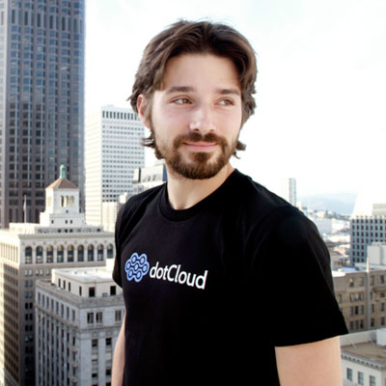
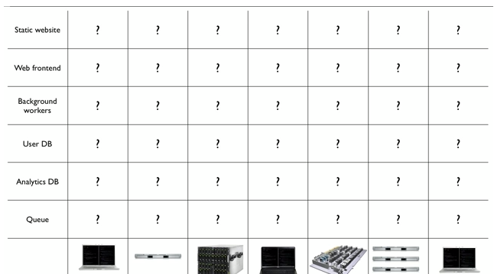
The Founder Himself
Founder = Soloman Hykes
Every software component times
everywhere it may need to run
Docker Helps!

Slide 6
Docker Makes Infrastructure EZ
  Load Software into container
  Different teams get containers
  It doesn’t matter what's on the inside

Slide 7
Back to the container
Containers have a standard shape, size, weight, labels etc.
A Docker “container” sets the standard for software
All the ship captain has to worry about is the container not the contents

Slide 8
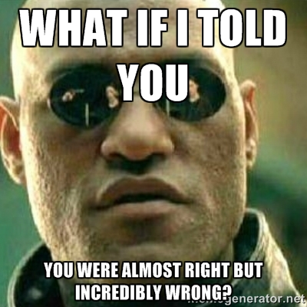
Sounds kind of like a VM right?
A virtual machine not only holds your application which may be very small in size, but it can also hold an entire guest OS which can be 10 GB and very heavy

Slide 9
How is Docker Different
The Docker engine runs as an isolated process on the OS
It shares the kernel with other “containers”
It has the resource isolation and allocation of a VM
It is much more portable and efficient

Slide 10
Who Uses Docker?
Notable Docker Users
Yelp
Spotify
Ebay
Cambridge Healthcare

Slide 11
Coding Tutorial
Docker has a great online tutorial
Tutorial uses Docker Hub
The Hub is easy to learn
Similar to others we have learned about

Slide 12


Yay Some Actual Code…
Search for tutorial
Use pull request to download images (Several Layers)

Slide 13
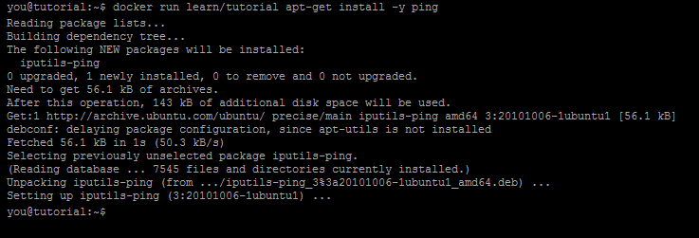
YAY More Actual CODE!
Install the utility “ping” in our container
This installed a program on our base image

Slide 14

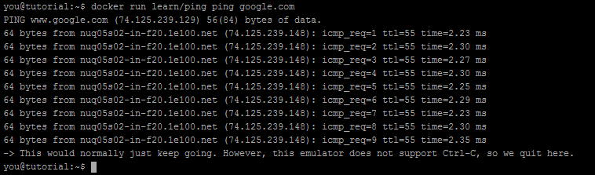
EVEN MORE CODE
NO WAY
Commit changes to container
Now we have a self contained image with ping installed on it. We can run the image on any host that runs docker. So I do a command to ping google.com

Slide 15
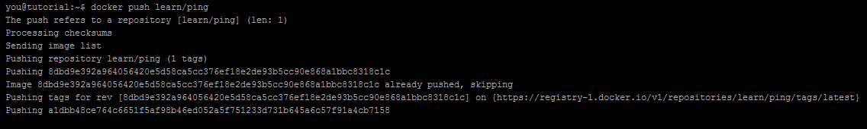
I'm sick of code…
(Last one I Promise)
Our own ping image
Only one thing left to do.. Push our image out to the registry for others to share!

Slide 16
How much does it cost?
I bet it costs millions of dollars to harness the kind of power Docker can offer right?
Wrong…
Its Actually Free. Unless you want private repos. You have to pay for that

Slide 17
Docker Specs
The Docker service is written in Golang
Golang is a technology used to build server side applications (But we can save that for another lightning talk)
It basically uses zero memory / CPU

Slide 18
Sum it all up
It’s a container for software
Standardizes software shipping
Makes shipping software to servers easy and effcient

Slide 19

Sources (list them)
https://www.youtube.com/watch?v=m-YyWw12fTc
Docker.com
Docker.com/tryit

