Slide 1


Exploring Bitcoin
Nick Wolf

Slide 2

Bitcoin is a Cryptocurrency
a digital currency in which encryption techniques are used to regulate the generation of units of currency and verify the transfer of funds, operating independently of a central bank.
There are many cryptocurrency out there today:
Bitcoin : $ 252.93
Dash: $ 4.01
Coinye: ?

Slide 3
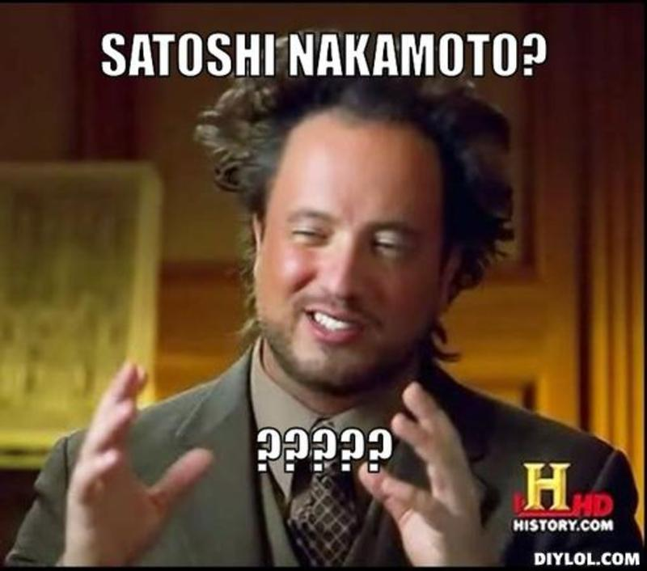
The Creator
      Satoshi Nakamoto
Nobody knows exactly who he is
On his P2P Foundation profile, he claimed to be a 37-year-old male who lived in Japan
published a paper on a Cryptography Mailing list describing the Bitcoin digital currency

Slide 4
Satoshi Nakamoto
released the first Bitcoin software that launched the network and the first units of the Bitcoin currency
Believed to have roughly one million bitcoins which equals about $ 255 million now.

Slide 5
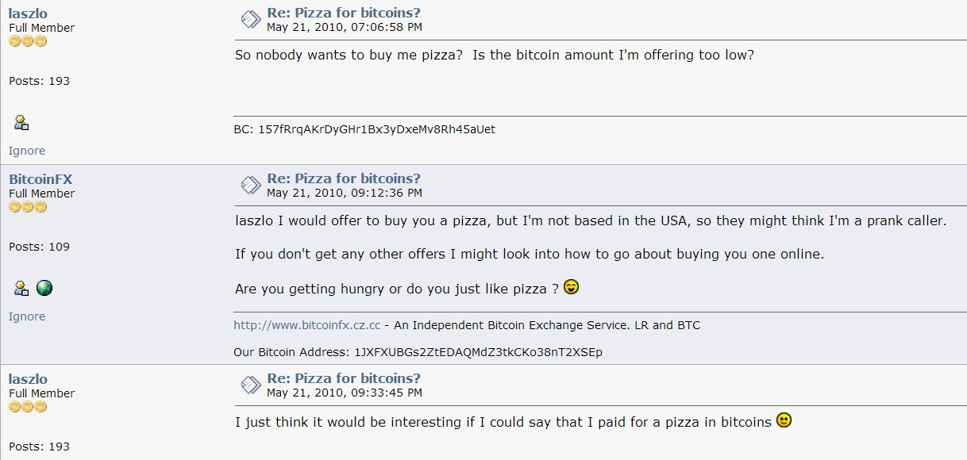
The first transaction
A programmer living in Florida bought a $25 pizza for 10,000 Bitcoins
That’s now worth 2,550,100.00

Slide 6
What make Bitcoin, Bitcoin?
There is no printed version.
Bitcoin is decentralized.
No single institution controls the bitcoin network.
All open source and completely transparent
Easy to start.

Slide 7
The transparencies
Bitcoin stores details of every transaction in a huge version of a general ledger.
This is called the block chain which is visible to everyone.
This huge ledger or block chain is what makes mining possible and keeps Bitcoin going.

Slide 8
Maintaining Bitcoin
The block chain is made up of a long list of blocks that hold transactions.
These blocks are out in the network for everyone to see.
Bitcoin mining ensures that these blocks of transactions are not tampered with.

Slide 9
What do miners do?
Miners take the information in the block, and apply a mathematical formula to it.
The formula turns it into a random sequence of letters and numbers known as a hash.
The hash makes the block encrypted which prevents tampering.

Slide 10
Why the miner do it?
Miners use special computers and software to complete this mining process.
Once complete the miner is rewarded around 25 new Bitcoins.
These 25 Bitcoins are new to the market, which adds to the overall supply of the Bitcoins.

Slide 11
The problem is that it’s very easy to produce a hash
One person could be hashing hundreds of transaction blocks each second
All of the blocks would be mined in minutes adding tons of new Bitcoins, which inflates the market.
To prevent this, Bitcoin has something called ‘proof of work’, which makes it more difficult to mine.

Slide 12
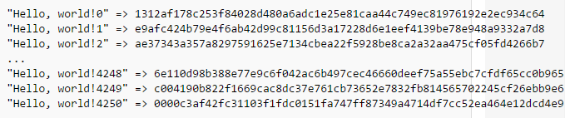
Proof of Work
To get paid for their hash, a miner must find a hash that starts with a certain sequence. (for example, 000)
This extends the amount of time the miner must spend on each block

Slide 13
The Finite Supply
Bitcoins are created each time a user mines a new block.
The number of Bitcoins generated per block is set to decrease by 50% every four years.
Leading to a cap of 21 million Bitcoins by around 2140.

Slide 14
The growth of Bitcoin
In 2011, Wikileaks gets cut off from banks; they turn to Bitcoin in order to continue receiving donations.
A few year later, companies like Overstock.com, Newegg, and Microsoft start accepting Bitcoins also.

Slide 15
Bitcoin can be anonymous
Bitcoin payments are made through “addresses”
Addresses are created from Bitcoin software and around 33 characters in length
Addresses can be changed with every payment as well

Slide 16

Silk Road
A deep web site that is known as a platform for selling illegal drugs.
The transaction were only accepted in Bitcoins.
4.5% to 9% of all Bitcoin transactions were for drug trades on Silk Road.

Slide 17
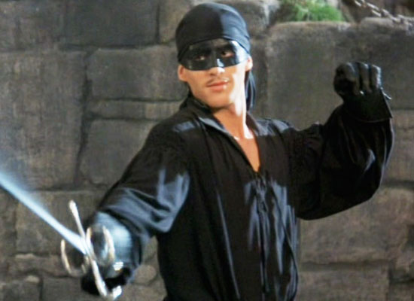
Fall of Silk Road,
Rise of Bitcoin
In 2013, U.S. Marshals seized almost 30,000 bitcoins from Silk Road and arrested the founder named “Dread Pirate Roberts”.
They then auctioned the Bitcoins off for almost $20 million.
The auction was said to increase legitimacy of the currency.

Slide 18
Bitcoin Today
The current Bitcoin exchange rate is around 255 US Dollar for every 1 Bitcoin.
In 2014, a U.S. regulatory agency approved a Bitcoin financial product for the first time.
For now, Bitcoin’s future looks bright.

Slide 19

Sources (list them)
en.bitcoin.it
coindesk.com
bitcoin.org
wikipedia.org/wiki/History_of_Bitcoin
wikipedia.org/wiki/Silk_Road_(marketplace)
forbes.com
bitcoinmining.com
The Rise and Rise of Bitcoin (2014)
www.coindesk.com

