Slide 1
Express.js
Todd Lasley

Slide 2
What?
Web application framework for Node.js
Built by Node.js Foundation
“E” in the MEAN stack
Notes:
Express.js is a web application framework for Node.js and is a project that has been put together by the Node.js Foundation.
You may recognize it when I mention that it is the “E” in the MEAN stack, which also consists of MongoDB, Angular.js, and Node.js.

Slide 3
Why use it?
Minimal and flexible
Great for building web APIs
Utilizes various middleware packages
Notes:
Why should you use express?
It is minimal and flexible, not to mention great for building web APIs and it utilizes various middleware packages to offer excellent functionality.

Slide 4
Functionality
Parsing HTTP headers, request parameters, and bodies
Parsing cookies
Automatic response headers
Routing
Notes:
Some of that functionality involves parsing HTTP headers, request parameters and bodies, parsing cookies, automatic response headers based on data types, and utilizing middleware.

Slide 5
Installing Express
NPM:
  npm install express
Exercise: Basic routing
Notes:
If you have Node Package Manager installed, you can install Express using the following command:
npm install express
With Express installed, you can jump right into some simple exercises.

Slide 6
Hello World Example
Require the Express.js library
Notes:
Because we are new to Express, we simply must start with a Hello world example.
To begin an application in JavaScript that uses Express, we need to require the Express library, which can be shown with the following syntax.

Slide 7

Hello World Example
Apply Express.js instance to variable
Notes:
Next, we will need to call that express variable like a method and store the Express instance within a variable that we will call “app” for this example, using the following syntax.

Slide 8

Hello World Example
Utilize “app” for basic routing.
Notes:
Now that we’ve done this, we can use this variable called app to perform some basic functions that are offered with Express.
For our first example, we will utilize the app variable and do some routing using the .get() method.

Slide 9

Hello World Example
Code will handle GET request
Notes:
With the following code, we are making the server respond to a GET request for root access, which is indicated by the forward slash in single quotes.
The get routing method is also being passed a function that accepts a request and response variable.
For this example, we will utilize the response and send “Hello world” from the server to the browser.

Slide 10

Hello World Example
Designate a port
Notes:
In order to wrap up this application, we need to specify a port for this server to broadcast from.
We will do so with the following code, where we specify port 3000.

Slide 11
Running the app
In Node.js command prompt:
  node app.js
Two ways to test the app:
  Browser
  cURL
Notes:
To run the app, we can use the Node command prompt from the directory that the file is located.
Let’s say that we’ve named it “app.js”, so our command would simply be:
node app.js
With this server running, we can test it one of two ways: using the browser and performing a cURL.

Slide 12
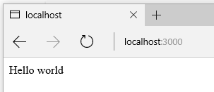
Testing the app
In browser, at http://localhost:3000/
Using cURL in command prompt
  curl http://localhost:3000/
Notes:
We can simply open a browser and go to this address and, sure enough, the browser reads “Hello world”.
We can also issue a request using cURL in the command prompt like this
curl http://localhost:3000

Slide 13
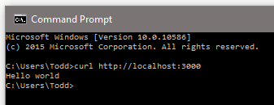
cURL Result
Notes:
and you can see that, immediately after the command is entered, we would get “Hello world” as a response just like we designated.
Next, we can learn about Express and its relationship with Node.

Slide 14
Express.js and Node.js
Express.js inherits from Node.js
  “request” and “response” objects
Node.js methods in Express.js
Notes:
What’s great about Express is that it inherits from Node HTTP objects.
In our previous example, the request and response objects that we used actually inherited from Node.
Through this inheritance, we can call Node methods in Express.

Slide 15
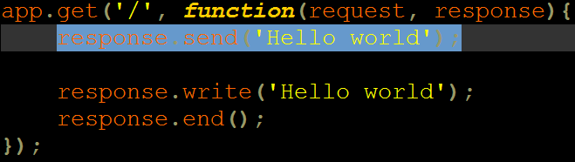
Using Node.js Methods
Notes:
In this code snippet, we take the previous get method that we used and replace the send (the line that is highlighted) with two Node functions, write and end, that will effectively do the same thing as our previous example.

Slide 16
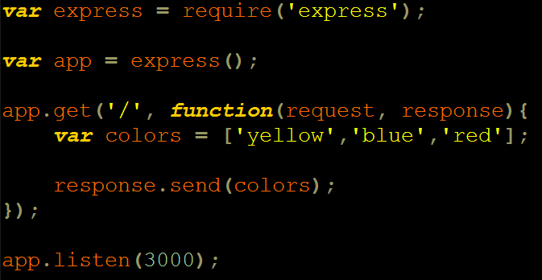
Converting Objects to JSON
Notes:
Another cool feature of Express that comes with the send function is that it can convert objects and arrays into JSON.
With the following code, everything is the same as the previous example, except within our get method, we have created an array of colors and we send that array directly as the response.

Slide 17
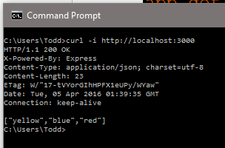
Testing
cURL
  curl -i http://localhost
Notes:
To truly test this, we need to use cURL again but this time with a slight variation.
After we have run the app, our curl will look like this:
curl –i http://localhost:3000/
The –i is used to print response headers, and we know it was successful because it recognized JSON:

Slide 18
Only scratching the surface
More routing methods
Redirecting to relative paths
Utilizing middleware
Notes:
As you can imagine, we have barely scratched the surface when it comes to learning about Express.js.
There is much more functionality that you can look into with more routing methods, redirecting to relative paths of a URL, utilizing middleware, and much more.

Slide 19

Sources
Express.js Website
YouTube: Express.js Crash Course
Code School: Building Blocks of Express.js
Notes:
If you are looking for more resources, you can always check out the Express.js website, this YouTube video that I watched, or you can look at a course that is offered by Code School, called “Building Blocks of Express.js”.

