Slide 1

Foundation
Khang Dinh

Slide 2
Agenda
What is Foundation?
How to get Foundation
Example
Foundation vs. Bootstrap
Brands using Foundation
Sources

Slide 3

What is Foundation?
Responsive front-end framework
First front-end framework for developing fully responsive web apps
Collection of HTML, CSS, JavaScript containing design patterns
Open source

Slide 4

What is Foundation?
Developed by (2011)
A product design company based in Campbell, California
Provides responsive grid for HTML and CSS User Interface components, templates, typography, forms, buttons, as well JavaScript extensions

Slide 5
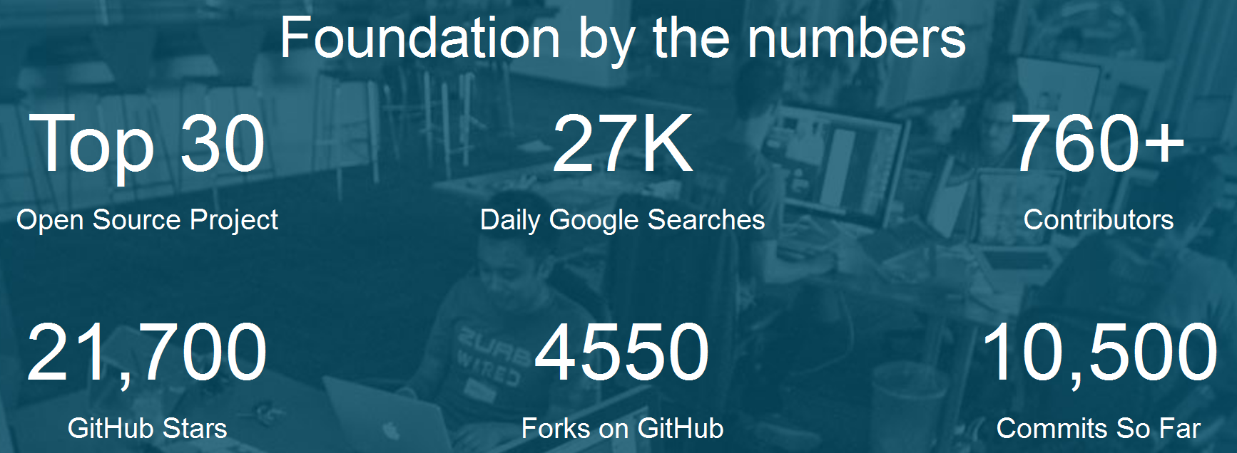
What is Foundation?
Makes it easy to design responsive websites, emails, and apps
Its semantic, readable, flexible, and completely customizable

Slide 6
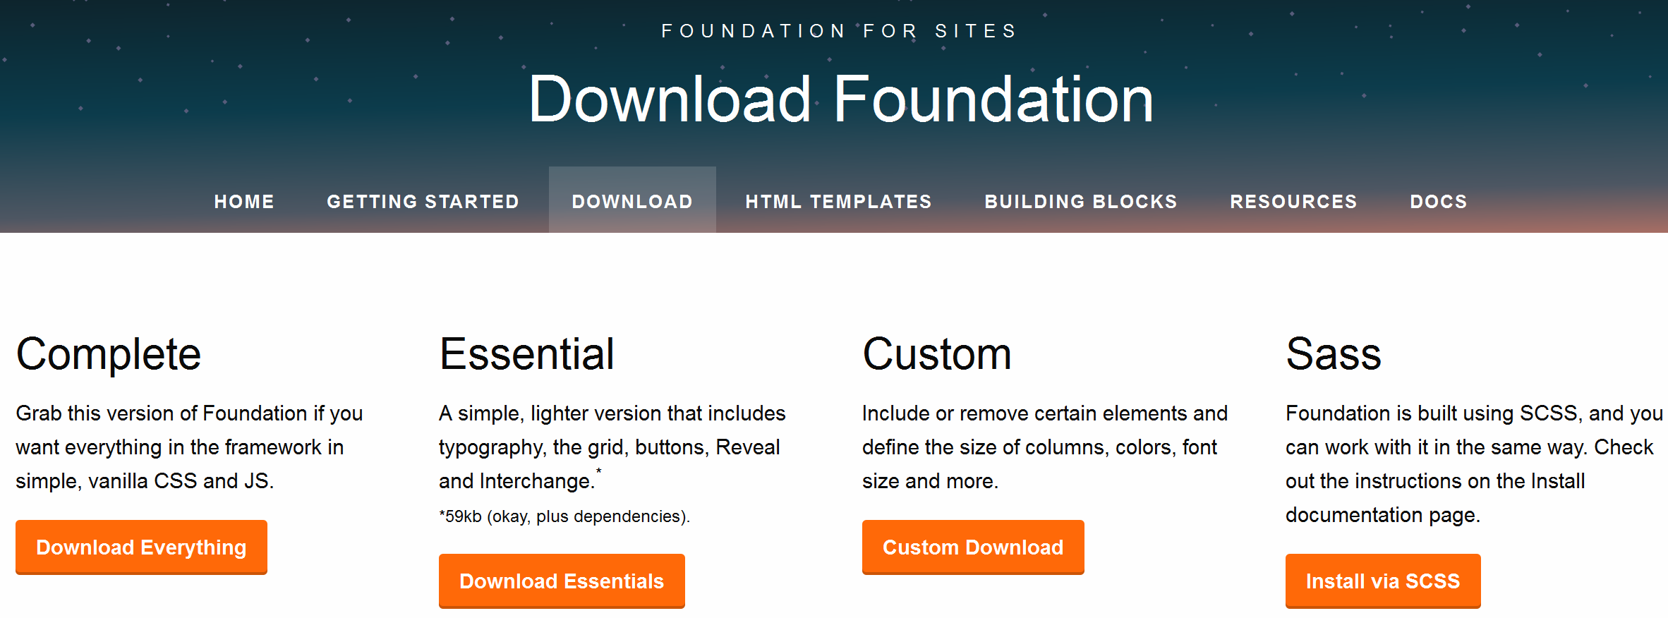

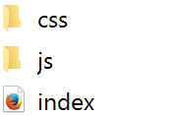
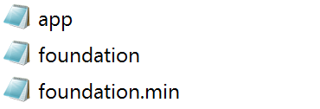

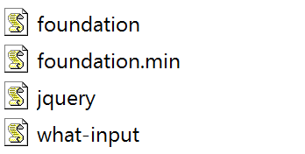
How to get Foundation

Slide 7
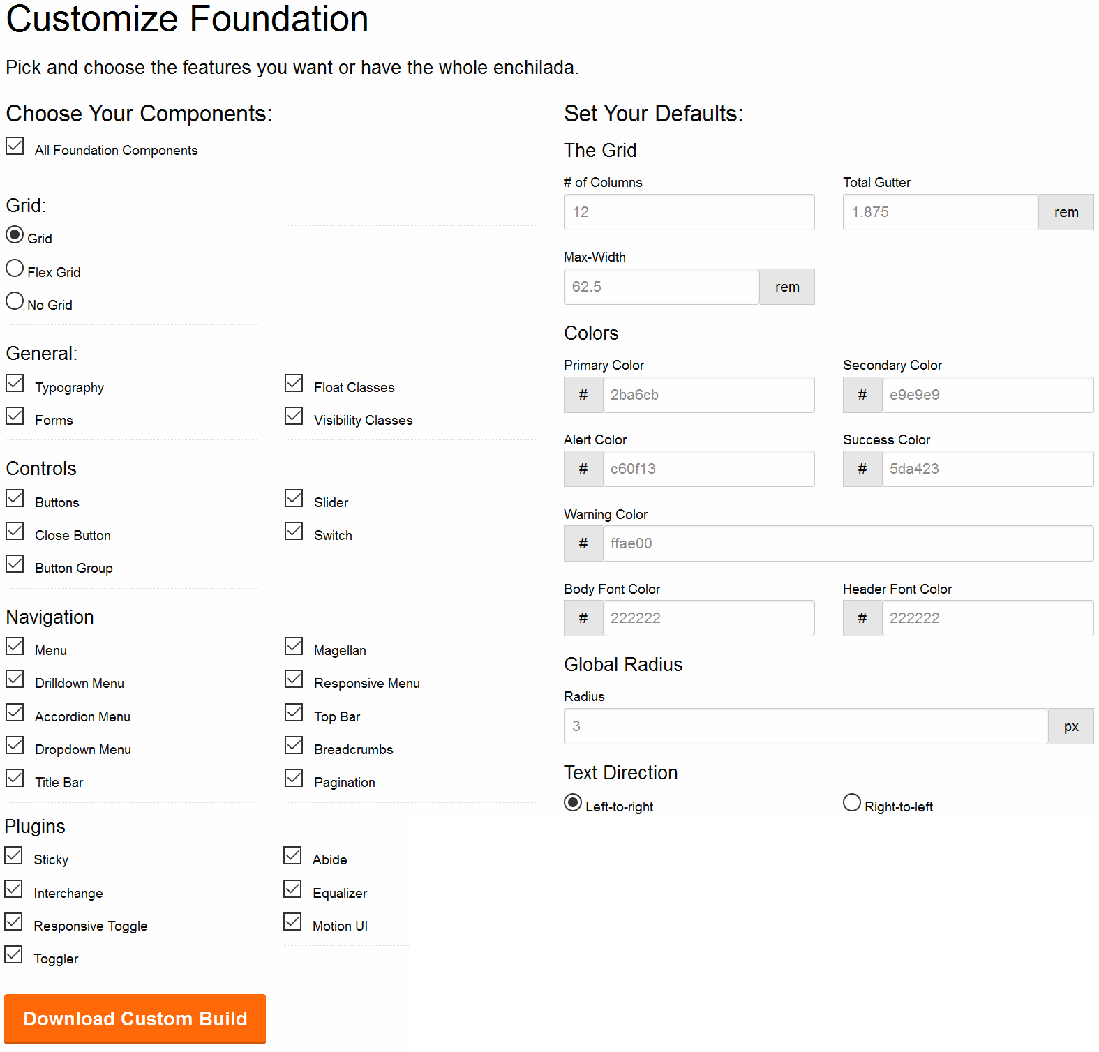
How to get Foundation

Slide 8
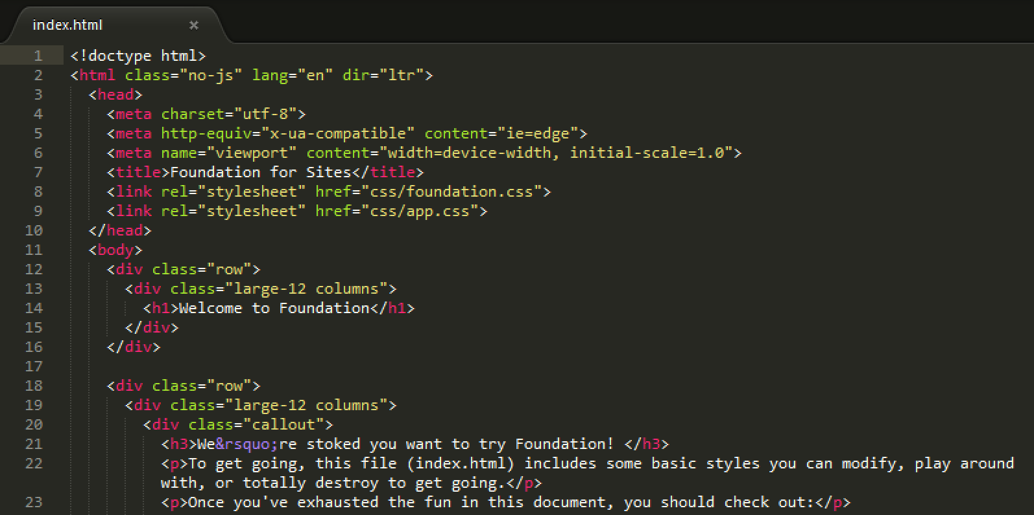
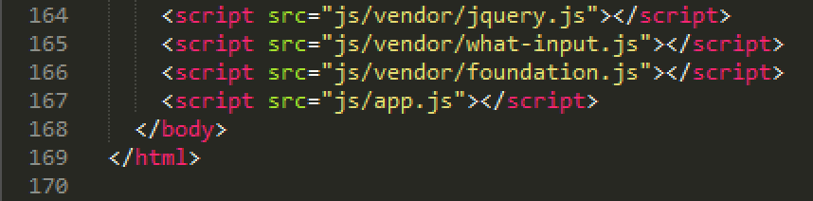
How to get Foundation
index.html

Slide 9
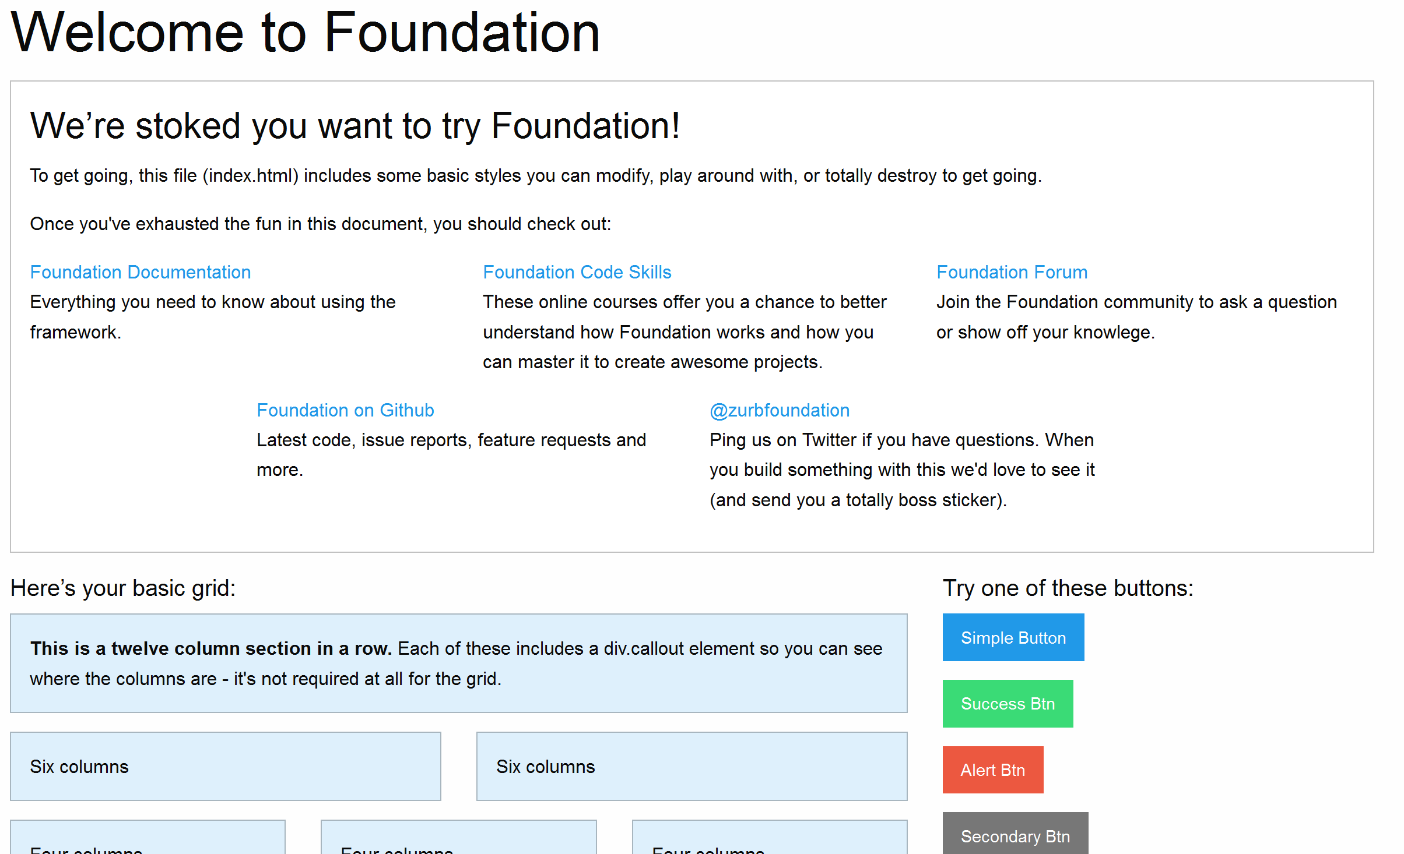
How to get Foundation

Slide 10
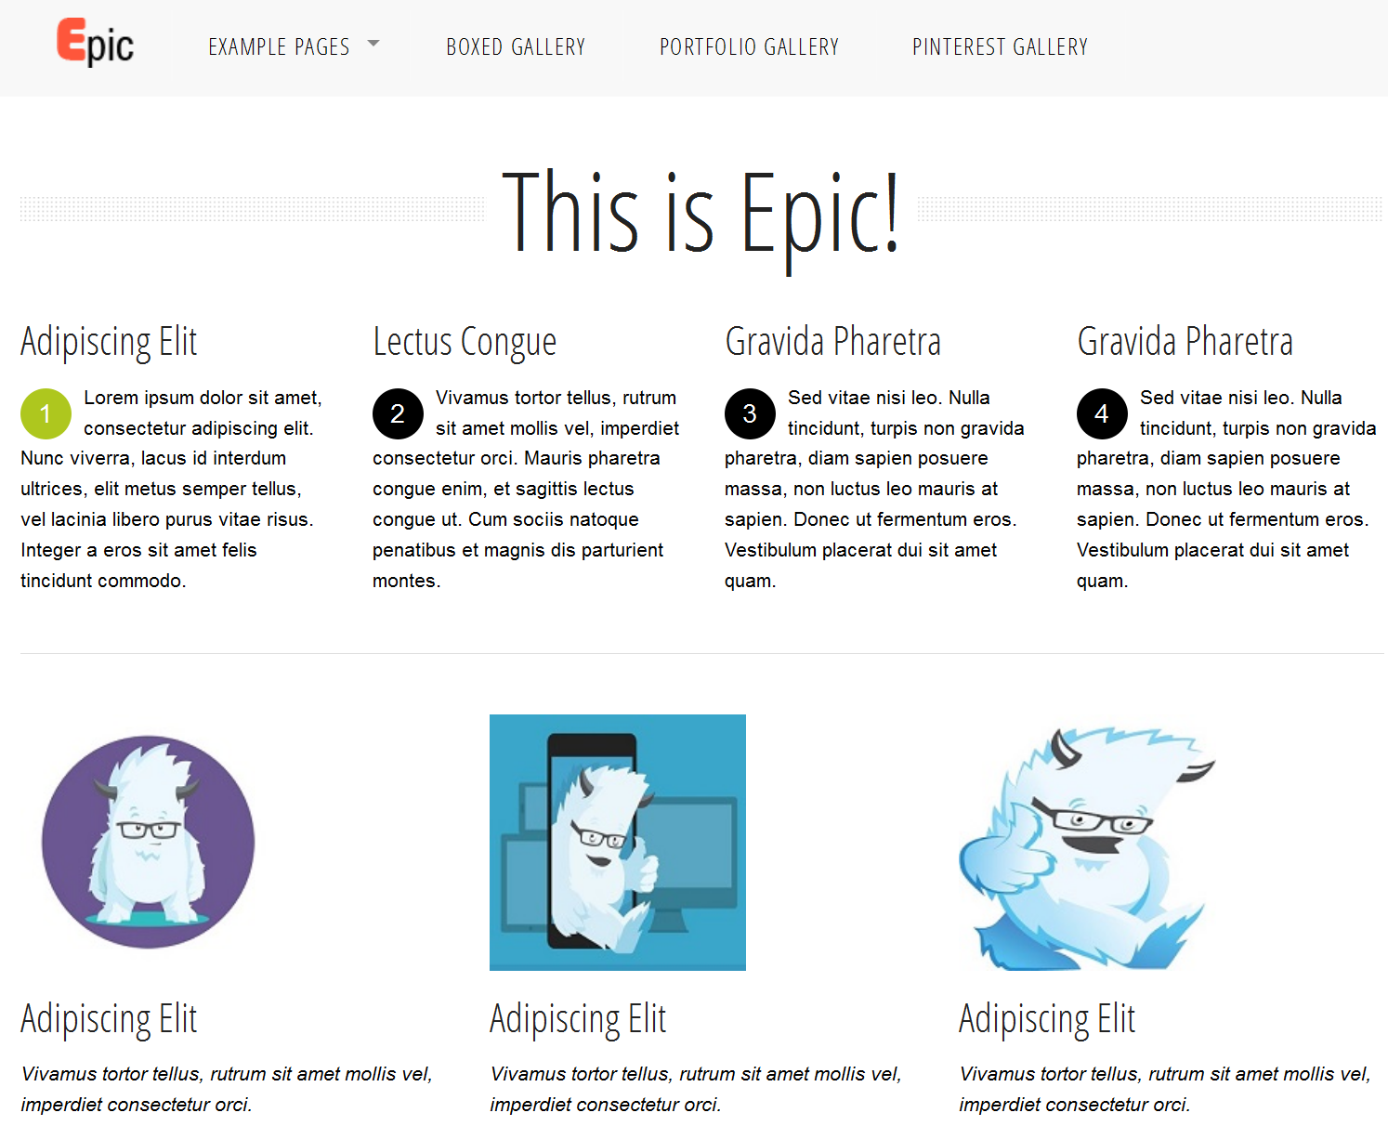
Example

Slide 11
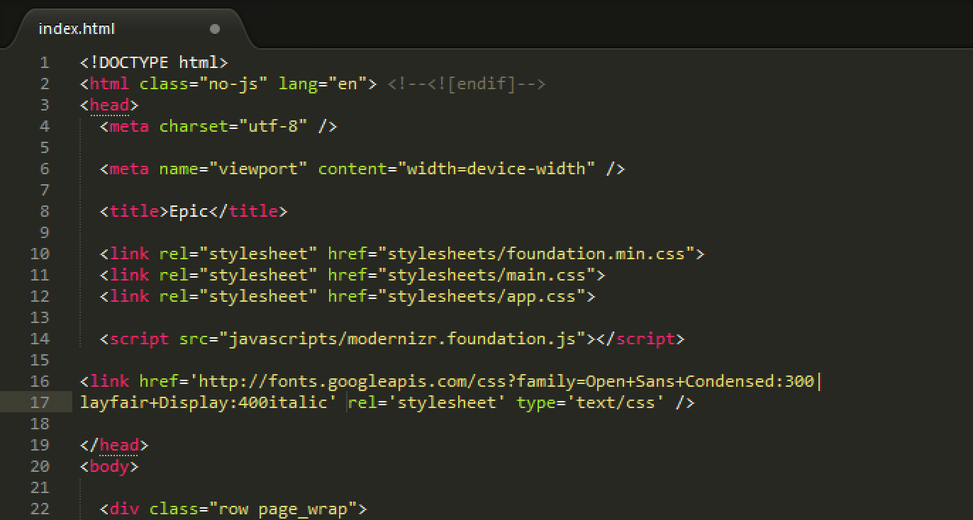
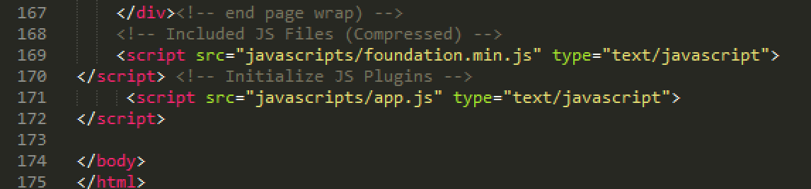
Example

Slide 12

Example

Slide 13
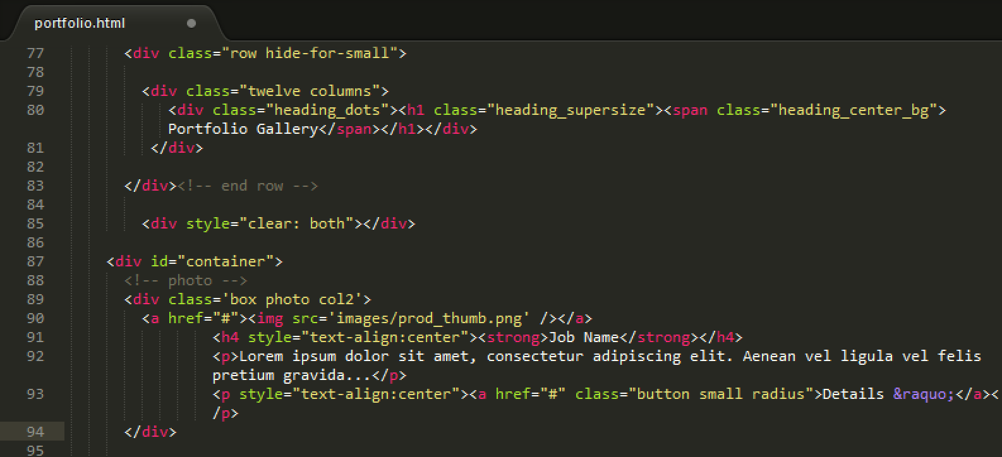
Example

Slide 14
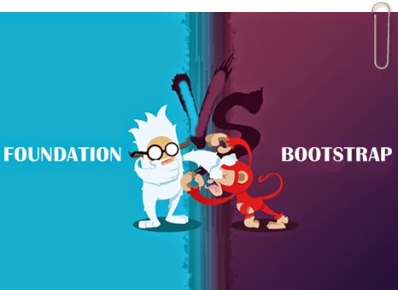
Foundation vs. Bootstrap
Zurb Twitter
Foundation mobile-first approach
Syntaxes are a little different
For example rem vs. pixel

Slide 15
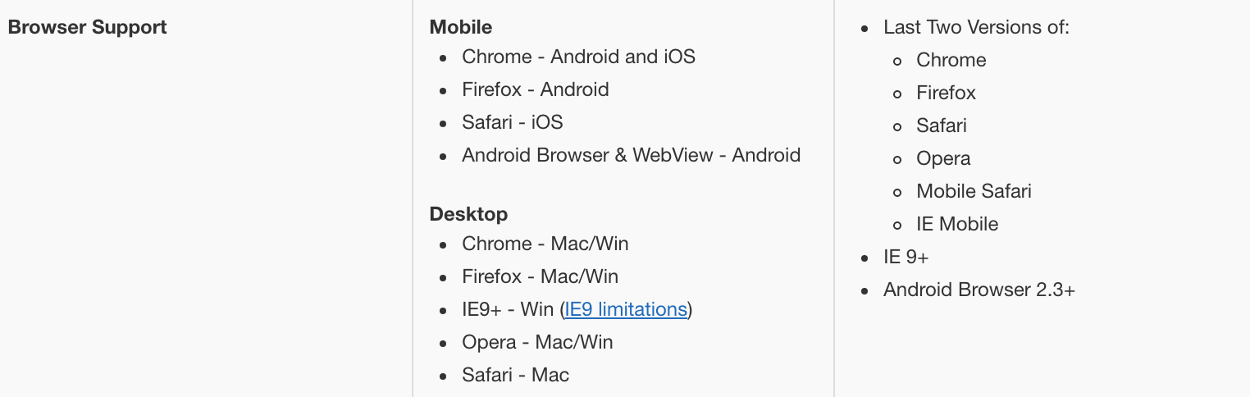
Foundation vs. Bootstrap
Community: Bootstrap community is bigger and therefore has more support
Browser Compatibility:

Slide 16
Foundation vs. Bootstrap
Design/Customization: Bootstrap is more polished/customizable and has significant more available themes
Grid: Foundation has better grid system -> is cleaner
Forms: Bootstrap has better forms, validation icons, icon labels etc.

Slide 17
Foundation vs. Bootstrap
Menus: Foundation has more variants such as off-canvas navigation, drilldown menu, vertical dropdowns etc.
JavaScript: Bootstrap components are simpler, less bloated, well tested.
It’s a preference thing! ¯\_(ツ)_/¯

Slide 18







Brands using Foundation
Adobe
Amazon
Cisco
Disney
Ebay
Macy’s
Samsung

Slide 19

Sources (list them)
http://www.google.com
http://foundation.zurb.com/
http://zurb.com/about
http://blog.templatemonster.com/2014/01/09/free-zurb-foundation-templates/
http://dannyherran.com/2016/03/state-of-affairs-bootstrap-4-vs-foundation-6/
http://customwebsitedevelopement.blogspot.com/2016/01/best-css-frameworks-bootstrap-vs-foundation-vs-skeleton.html
http://responsive.vermilion.com/compare.php
https://en.wikipedia.org/wiki/Foundation_(framework)
https://yellowpencil.com/blog/foundation-vs-bootstrap/

