Slide 1

Ruby on Rails
Eythan Decker

Slide 2
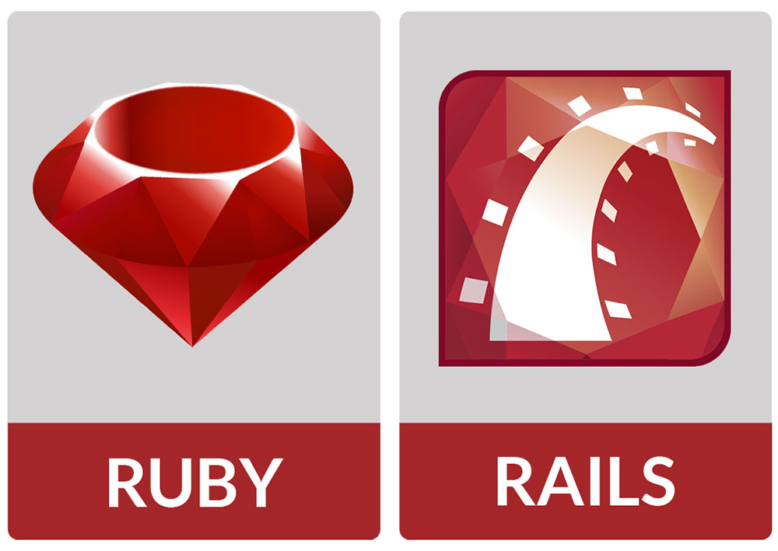
RoR Overview
Open Source Web Framework
Written in Ruby language.
  Object Oriented
MVC framework
First appeared in Github in December 2005

Slide 3
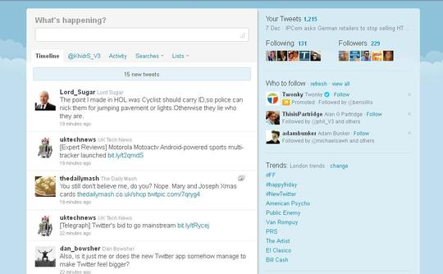



Popular Applications
Twitter
Github
Groupon
Bleacher Report

Slide 4
Have an Idea for a Startup?
RoR makes it easy to bring it to reality
Open Source. Completely free to download Rails Framework
Focuses on Convention over Configuration
  Developers who use Rails conventions shave massive amounts of time out of the coding process
  DRY(Don’t Repeat Yourself)
Trying to solve a big problem? See if a Ruby “Gem” is available that solves that”
  Gems are libraries you can add on to your project
Large online community of developers with plenty of documentation.

Slide 5
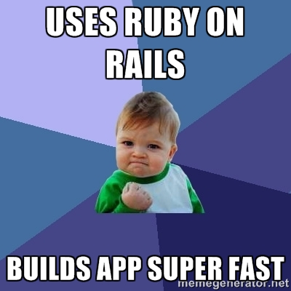
Deploy Fast with RoR
Bundle your Gems
Migrate DB
Scaffold your app
Push to a free Cloud Service like Heroku.
Profit!

Slide 6
Model View Controller(MVC)
RoR uses separation of concerns
Model
  Maintains the relationship between the objects and the database and handles validation, association, transactions, and more.
View
  Client side presentation. HTML, CSS, JavaScript. Uses Embedded Ruby in pages to display data from controllers
Controller
  The facility within the application that directs traffic, on the one hand, querying the models for specific data, and on the other hand, organizing that data (searching, sorting, messaging it) into a form that fits the needs of a given view.

Slide 7

Sounds a lot like ASP.NET
ASP.NET

Slide 8

RoR

Slide 9
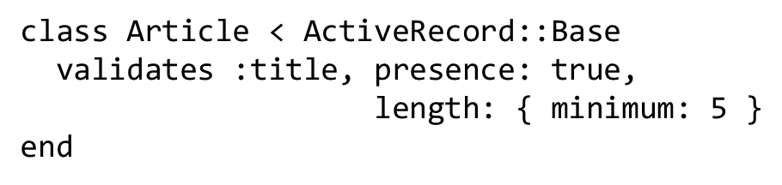
Model Example

Slide 10
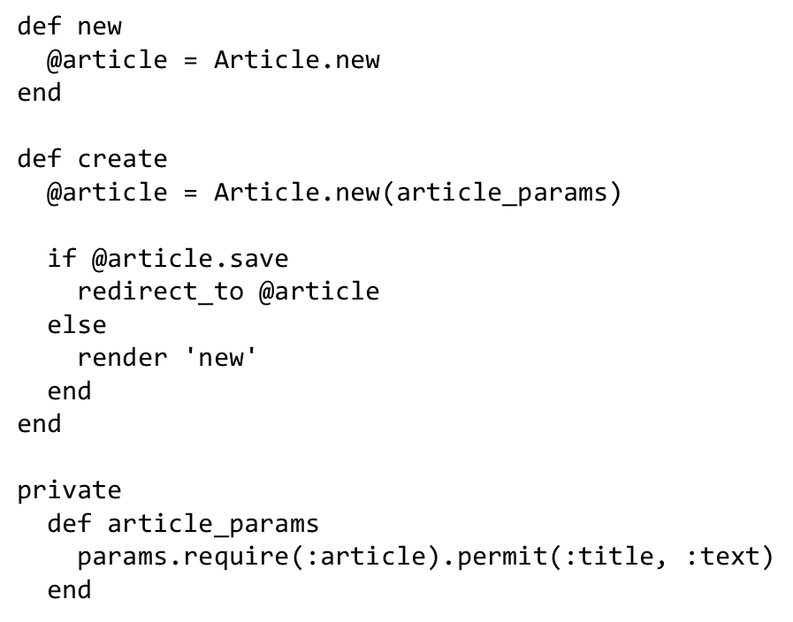
Controller Example

Slide 11
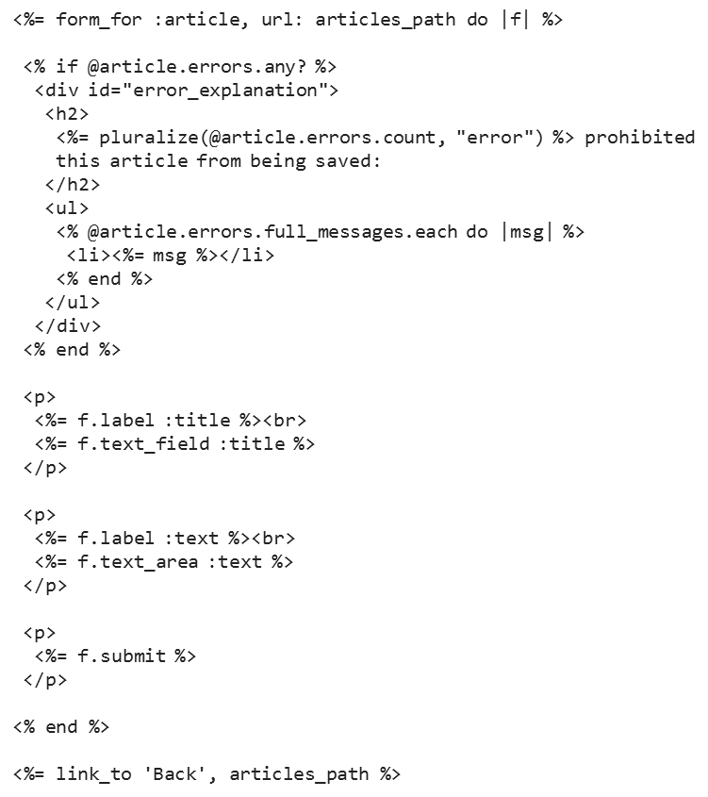
View Example

Slide 12
Web API
class MessagesController < ApplicationController
Respond_to :json
def index @messages = current_user.messages render json: @messages
end
end
[
{ "sender_id":1, "id":1, "recipient_id":2, "body":"YOLO", "created_at":"2015-02-03T21:05:12.908Z", "updated_at":"2015-02-03T21:05:12.908Z"
},
{ "recipient_id":1, "id":2, "sender_id":2, "body":"Hello, world!", "created_at":"2015-02-03T21:05:51.309Z", "updated_at":"2015-02-03T21:05:51.309Z“
}
]

Slide 13
Rails Makes Routing Easier
This one line creates all of your standard RESTful routes
HTTP Verb | Path | Controller#Action | Used for
GET | /photos | photos#index | display a list of all photos
GET | /photos/new | photos#new | return an HTML form for creating a new photo
POST | /photos | photos#create | create a new photo
GET | /photos/:id | photos#show | display a specific photo
GET | /photos/:id/edit | photos#edit | return an HTML form for editing a photo
PATCH/PUT | /photos/:id | photos#update | update a specific photo
DELETE | /photos/:id | photos#destroy | delete a specific photo
resources :photos

Slide 14
DontRepeatYourself
DRY
Create all the Routes for your app
ActionController::Routing::Routes.draw do
Resources :users, :pets, :employees, :vets
end

Slide 15
Active Record/ Database
No need for a database context
Active Record facilitates the creation and use of business objects whose data requires persistent storage to a database
Every Model inherits from Active Record
class Product < ActiveRecord::Base
end
Model / Class | Table / Schema
Article | articles
LineItem | line_items
Deer | deers
Mouse | mice
Person | people

Slide 16
Code Migrations
Have to use Code Migrations to create/update/delete DB
class CreatePublications < ActiveRecord::Migration def change create_table :publications do |t| t.string :title t.text :description t.references :publication_type t.integer :publisher_id t.string :publisher_type t.boolean :single_issue t.timestamps null: false end add_index :publications, :publication_type_id end end

Slide 17
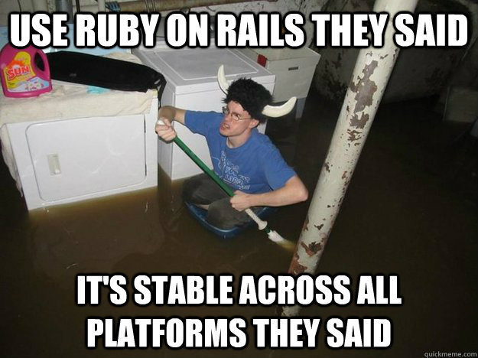
Cons
Have to use command line.
  Create Models, Migrations, console, run server, bundle gems, etc
Not friendly for Windows users
Runtime speed becomes issue for larger applications
Perfect for basic CRUD use-cases. Not practical for more complicated use-cases

Slide 18
Learning / Resources
http://guides.rubyonrails.org/
https://www.railstutorial.org/book
https://www.codecademy.com/learn/learn-rails
http://railsforzombies.org/
  From the same guys who did Angular.js Flatlanders store

Slide 19

Sources (list them)
http://guides.rubyonrails.org/
https://coderfactory.com/posts/top-15-sites-built-with-ruby-on-rails
https://blog.engineyard.com/2015/active-model-serializers
http://blog.41studio.com/dont-repeat-yourself-dry-in-ruby-on-rails/
http://nerdfortress.com/2008/05/13/ruby-on-rails-pros-cons-lets-get-real/

