Slide 1
Ionic Framework
Brett Heil

Slide 2

Performance

Slide 3

Performance
Minimal DOM Manipulation
Hardware Accelerated Transitions

Slide 4

Angular + Ionic

Slide 5

User Friendly

Slide 6
User Friendly
HTML
CSS
JavaScript

Slide 7

Native Focused

Slide 8
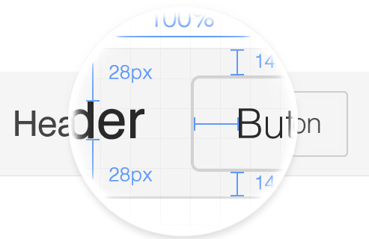
Design

Slide 9
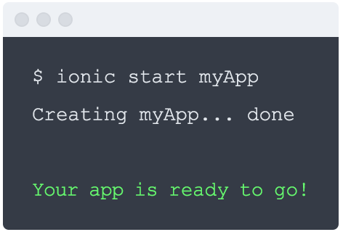
CLI

Slide 10


Slide 11

Install Ionic
$ npm install -g cordova ionic

Slide 12

Start Project
$ ionic start myApp tabs

Slide 13

Run It
$ cd myApp
$ ionic platform add ios
$ ionic build ios
$ ionic emulate ios

Slide 14



Ecosystem
Ionic Lab
Live Reload
Icon/Splash Generation

Slide 15



Ecosystem
Ionic View
NgCordova
Ionic.io Platform

Slide 16

Songhop

Slide 17

Songhop

Slide 18
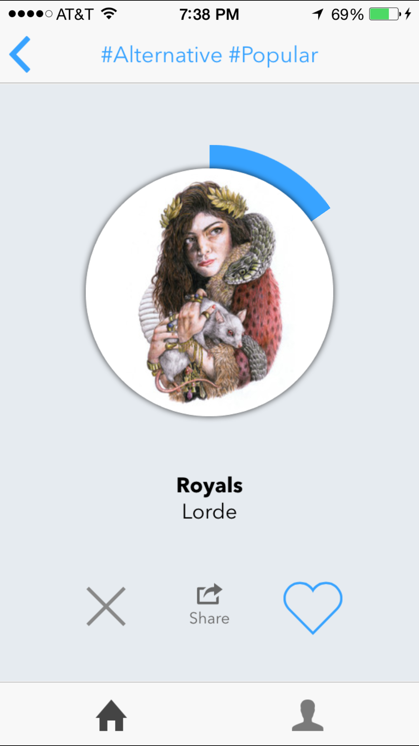
Songhop

Slide 19
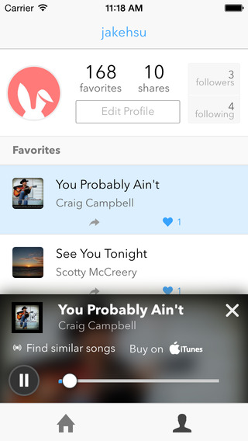
Songhop

Slide 20

Sources
http://ionicframework.com/

