Slide 1
Entity Relationship Diagrams
Carsten Schürmann

Slide 2

Motivating Example
University Administration System
Courses
Teachers
Transcripts
Etc.
Queries
What grades did a student achieve?
When is the final exam?
Who is the censor?
Etc.

Slide 3
How to Tackle This Problem?
Requirements and Security Analysis
Conceptual Design
Logical Design
Schema Refinement
Physical Design
Security Design

Slide 4
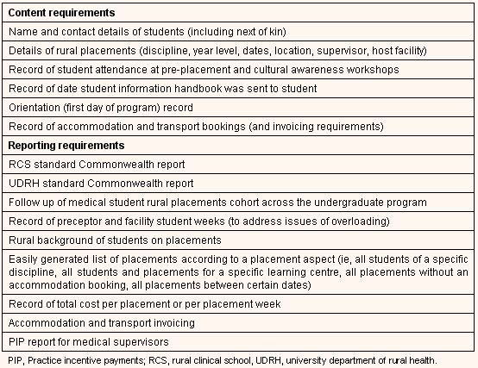
How to Tackle This Problem?
Requirements and Security Analysis
Conceptual Design
Logical Design
Schema Refinement
Physical Design
Security Design

Slide 5
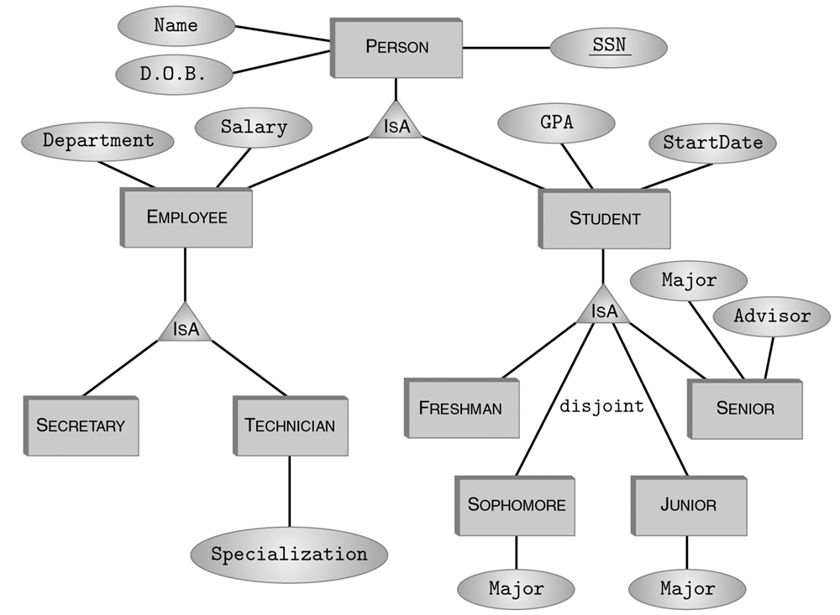
How to Tackle This Problem?
Requirements and Security Analysis
Conceptual Design
Logical Design
Schema Refinement
Physical Design
Security Design

Slide 6
How to Tackle This Problem?
Requirements and Security Analysis
Conceptual Design
Logical Design
Schema Refinement
Physical Design
Security Design
Person(CPR, Name, Address)
Takes(CPR, Name, Adress, CID, Year, Grade
CID, CourseName, ECTS)
Teaches(CPR, CID, PERCENT)

Slide 7
How to Tackle This Problem?
Requirements and Security Analysis
Conceptual Design
Logical Design
Schema Refinement
Physical Design
Security Design
Person(CPR, Name, Address)
Takes(CPR, Name, Adress, CID, Year, Grade)
Courses (CID, Name, ECTS)
Teaches(CPR, CID, PERCENT)

Slide 8
How to Tackle This Problem?
Requirements and Security Analysis
Conceptual Design
Logical Design
Schema Refinement
Physical Design
Security Design
B*-Index on CPR
Hash-index on CID

Slide 9
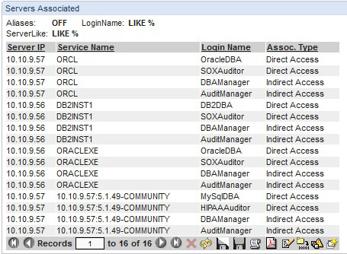
How to Tackle This Problem?
Requirements and Security Analysis
Conceptual Design
Logical Design
Schema Refinement
Physical Design
Security Design

Slide 10
What do you Prefer as a new Database Administrator?
drop table if exists student;
create table student (
cpr int,
name varchar(20));
drop table if exists takes;
create table takes (
cpr int,
cid varchar(10),
grade int);
Student
Takes
Course

Slide 11
In this Lecture
Entity Relationship Diagrams
Benefits:
Initial database design
Documentation
Limited utility when too big
Translatable into schemas
Student
Takes
Course

Slide 12
Entities
Entity (Entity set)
Relationship (mapping constraints)
Attributes
n
m
p

Slide 13
ER Methodology
“At ITU students take course, offered by teachers. A course may have multiple labs; one teacher per lab.”
Nouns: Entities
Verbs: Relationship

Slide 14
“At ITU students take course, offered by teachers. A course may have multiple labs; one teacher per lab.”
Primary Key
Name
CPR
Student
n
Name
SID
takes
CID
m
Lab
1
has
n
Course
n
offered
CPR
1
Teacher

Slide 15
Cardinalities
1:1
m:1
1:n

Slide 16
Cardinalities
Country
1
has
1
Capital
Person
1
owns
n
Car
Student
n
takes
m
Section

Slide 17
Cardinalities (Book)
Country
has
Capital
Person
owns
Car
Student
takes
Section

Slide 18
“At ITU students take course, offered by teachers. A course may have multiple labs; one teacher per lab.”
Primary Key
Name
CPR
No Key
Student
n
Name
SID
takes
CID
m
Lab
1
has
n
Course
n
offered
CPR
1
Teacher

Slide 19
Weak Entities
Weak entities: Need to borrow a key
Here: CID + SID is a key for labs
Partial key: Dash underline
Other examples: Bills/Items, Employee/Dependent
Name
SID
CID
1
Lab
has
n
Course

Slide 20
Self Relationship
Person/isChild, Employee/Manages
Manages
1
n
Employee

Slide 21
3-way and k-way Relationship
Examples:
Employee uses tool in project
Employee
n
Uses
m
Project
p
Tool

Slide 22
Specialization/Generalization
Name
Course
IS-A
Undergraduate Course
Candidate Course
PhD Course
Language
Single Subject
Demark’s PhD database

Slide 23
Summary
Specialization and generalization are opposites
Analogy: Sub-classing in Object Oriented Programming
Hierarchy
Be careful with attribute naming

Slide 24
Specialization/Generalization
Constraints
Overlapping Constraints
No overlap
With overlap
Covering Constraints
Partial Coverage
Total Coverage
A
IS-A
B
C
D

Slide 25
Specialization/Generalization
Constraints
Overlapping Constraints
No overlap
With overlap
A
C
B
IS-A
D
B
C
D
C
B
D

Slide 26
Specialization/Generalization
Constraints
Covering Constraints
Partial Coverage
Total Coverage
A
C
IS-A
B
D
B
C
D
D
B
C

Slide 27
Aggregation
Relationships as entities
compatible
CPU
RAM
offered
Manufacturer

Slide 28

Common Challenges
Entity or attribute?
Entity or relationship?
Binary or ternary relationsships?
When to use aggregation?

Slide 29
Entity or Attribute?
Consider the potential queries your diagram is expected to answer + structure
Parent of a student?
Dependents of a teacher?
Auditoria, Rooms?
Final exams?
Name
CPR
Student
n
Name
SID
takes
CID
m
Lab
n
has
1
Course
n
offered
CPR
1
Teacher

Slide 30
Entity or Relationship?
Student
1
Student
Stakes
n
n
takes
takes
m
n
Lab
takesL
1
Lab

Slide 31
Binary or Ternary Relationships?
Examples:
Employee uses tool in project
Employee are highly specialized in one tool
Problematic, because now employees work only on one project!
Employee
Uses
Project
Tool

Slide 32
Binary or Ternary Relationships?
Examples:
Employee uses tool in project
Employee are highly specialized in one tool
WorksOn
Employee
Project
Uses
Tool

Slide 33
Binary or Ternary Relationships?
Be aware: Not all ternary relationships can be expressed by binary ones.
In practice, we often turn ternary relationship into an entity, and the links into relationships

Slide 34
Entity or Relationship?
Employee
1
Employee
R1
n
n
p
Uses
p
R3
Uses
Project
m
1
n
Tools
R2
Project
1
Tools
Simliar trick for aggregation

Slide 35
Translating Entity Relationship Diagrams into Relations

Slide 36
Overall plan
Table 1
Table 3
Name
CPR
Student
Table 4
n
Name
SID
takes
CID
m
Lab
1
has
n
Course
n
offered
Table 2
CPR
1
Teacher

Slide 37
Keys
Primary Key
Foreign Key
Integrity constraint
A superkey identifies a tuple uniquely
A key is a minimal (fewest number of attributes) superkey
If there are several keys, we call one the primary key, the other candidate keys
cpr | name | address
140298-1234 | Jesper | Copenhagen
041297-5367 | Nikoline | Aarhus
cpr | course | grade
140298-1234 | SIDD | 10
041297-5367 | SIDD | 12

Slide 38
Strong Entities
Name
Address
CPR
Relational Schema: Student (cpr, name, address)
SQL
Student
cpr | name | address
140298-1234 | Jesper | Copenhagen
041297-5367 | Nikoline | Aarhus
create table student(
cpr int,
name varchar(20),
address name varchar(99),
primary key (cpr)
);
Key Constraint

Slide 39
Integrity Constraints
Uniqueness
Not NULL
Foreign key
DBMS enforces referential integrity!
create table student(
cpr int not null,
name varchar(20),
address name varchar(99),
unique (cpr),
);
create table takes(
cpr int,
…
foreign key (cpr) references
student;
);

Slide 40
Deletion
create table student(
cpr int not null,
name varchar(20),
address name varchar(99),
on delete no action
);
create table student(
cpr int,
name varchar(20),
address name varchar(99),
on delete set null
);

Slide 41
Many-to many
Takes(cpr, cid, year)
Class (cid, name)
Name
Address
create table takes (
cpr int,
cid int,
year date,
primary key(cpr,cid,year),
foreign key(cpr) references student,
foreign key(cid) references class
);
CPR
Student
n
Year
takes
m
CID
Class
Name
create table class(
cid int,
name varchar(10),
primary key(cid),
);

Slide 42
1-many (Alternative 1)
CID
Course
Name
1
offers
Year
n
CPR
Teacher
Name
Offers(cpr, year, cid)
create table offers(
cpr int,
year int,
cid int,
primary key(cid)
foreign key(cpr)
references teacher
foreign key(cid)
references course
);
Course(cid, name)
create table course(
cid int,
name varchar(20),
primary key(cid)
);

Slide 43
1-many (Alternative 2)
CID
Course
Name
1
offers
Year
n
CPR
Teacher
Name
CourseOffered(cpr, year, cid), name
create table courseOffered(
cpr int,
year int,
cid int,
name varchar(20),
primary key(cid)
foreign key(cpr)
references teacher
);

Slide 44
Key Summary
Strong entities
Key becomes the primary key
Recipe for translating relationships
1-1. Key of either relation
many-1. Key of the “many” relation
many-many. Key of both relations
CPR

Slide 45
Weak Entities
Abbrev
hasLab(cid, sid, abbrev)
“on delete cascade”
When course is deleted, the labs are deleted as well.
Name
SID
CID
Lab
1
has
n
Course
create hasLAB (
cid int,
sid int,
abbrev varchar(20),
primary key(cid,sid)
foreign key(cid)
references course
on delete cascade
);

Slide 46
ISA Hierarchies
Can be done in different ways
Treat like any other relationship
All relations use the same primary key the key of the top entity type
A single relation for the whole hierarchy with attribute(s) defining the entity type(s)
Binary (indicate all memberships), or
Identifier for the most specific entity type.

Slide 47
Next time: Normalization
Requirements and Security Analysis
Conceptual Design
Logical Design
Schema Refinement
Physical Design
Security Design

