Slide 1
Query Evaluation and Tuning
Carsten Schürmann

Slide 2
Cost-Based Query Subsystem
Parser
Query Optimizer
Plan Generator
Plan Cost Estimator
Catalogue Manager
Schema
Statistics
Plan Evaluator

Slide 3
Query Processing
Collect information
Use predictive algorithms about sizes
Use clever algorithms
Exploit equivalences in relational algebra
Computer different plans, abstractly evaluate them, pick the best

Slide 4
Lufthansa Cargo Flight Database
FLIGHTS AIRCRAFT
Flights(id, date, fnr, dep, arr, actype)
Aircraft(actype, actypefullname, ag)
id | fnr | dep | arr | actype | date
1 | LH001 | HAM | FRA | 321 | 1.1.16
2 | LH002 | FRA | HAM | 735 | 1.1.16
3 | LH002 | FRA | HAM | 321 | 3.1.16
4 | LH008 | FRA | HAM | 733 | 1.1.16
actype | Actypefullname | ag
321 | Airbus A321-100/200 | W
735 | Boing 737-500pax | O
320 | Airbus A320-100/200 | W
733 | Boing 737-300pax | O

Slide 5
Part 1: Selection

Slide 6
Single-Table Selection
What is the best way to execute query?
Indexes
Access Paths
Expected Size of the tables
select *
From Flights
where arr < "F%"
σ_{arr<“F%”}
Flights

Slide 7
Access Path
File Scan
Sequential scan to retrieve tuples
Index Scan
B+-tree index (last lecture)
Hash index (next lecture)
Definition: Selectivity
The selectivity of an access path refers to the percentage of pages retrieved

Slide 8
Covering Indexes
This index is covering because all relevant fields of the query appear in the index.
Select F.arr
From Flights F
where F.actype = “321”
CREATE INDEX MyIndex ON Flights (actype, arr)

Slide 9
Simple Selections
Size of result (of a query on relation R) can be approximated as:
(size of relation) x selectivity
Example: Flights requires 100 reads for a “full table scan” and selectivity = 50% then we need approximately 50 read to determine the result.

Slide 10
Selection Options
No Index, Unsorted Data
No Index, Sorted Data
B+ Tree Index

Slide 11
1. No Index, Unsorted Data
“Full table scan” is necessary
Selectivity 100%
select *
From Flights
where arr < "F%"

Slide 12
2. No Index, Sorted Data
Cost of binary search + number of pages
select *
From Flights
where arr < "F%"

Slide 13
3. B+-Tree Index
With an index on “arr”, find qualifying data entry and then retrieve the corresponding data records.
select *
From Flights
where arr < "F%"

Slide 14
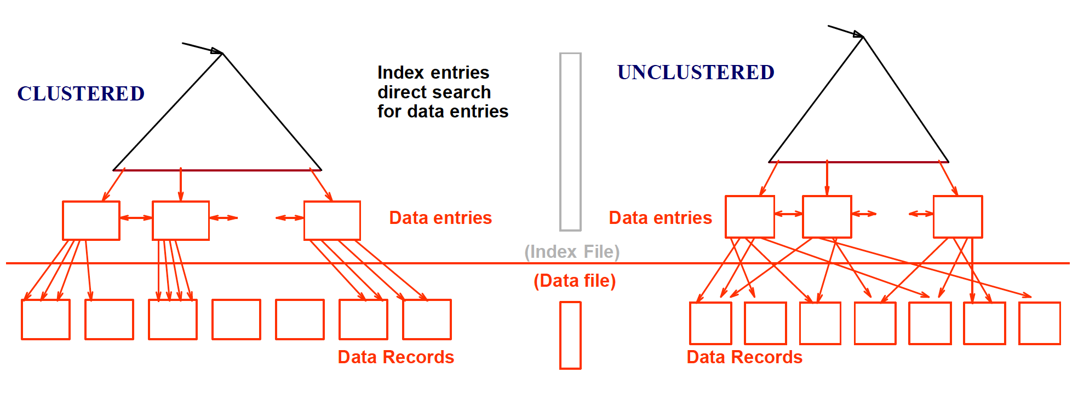
3. B+-Tree Index
Key -> Rid
(Rid = Record Identifier)
Rid-> Data

Slide 15
3. B+-Tree Index
Flights: 1000 pages
If 10% of the Flights satisfy the “where” condition then
Clustered index: Only 100 pages retrieved
Unclustered index: more than 1000 pages retrieved (Optimization: First compute all rids, sort and retrieve)
select *
From Flights
where arr < "F%"

Slide 16
Selection Condition
What are we going to do?
SELECT *
FROM Flights
WHERE (arr = “FRA”
AND fnr= “LH004”)
OR id = 5
OR date = “1.1.16”

Slide 17
Conjunctive Normal Form
SELECT *
FROM Flights
WHERE (arr = “FRA”
AND fnr= “LH004”)
OR id = 5
OR date = “1.1.16”
… (arr = “FRA” OR id = 5 OR date = “1.1.16”)
and (fnr= “LH004”OR id = 5 OR date = “1.1.16”)

Slide 18
Selection Conditions
A B+-tree index matches a list of terms that are included in a prefix of the key of the index
Example: If the index is <id, bnr, date> then it matches <Id>, <Id, bnr>, and <Id, bnr, date> but not <bnr> or <bnr, Id>, or <date> ….

Slide 19
Approach 1 to Selection
Find the cheapest access path, retrieve tuples using it, and apply any remaining terms that don’t match the index:
Cheapest access path: An index or file scan with fewest I/Os.
Terms that match this index reduce the number of tuples retrieved
Other terms help discard some retrieved tuples, but do not affect number of tuples/pages fetched.

Slide 20
Lufthansa Cargo Flight Database
FLIGHTS AIRCRAFT
Flights(id, date, fnr, dep, arr, actype)
Aircraft(actype, actypefullname, ag)
id | fnr | dep | arr | actype | date
1 | LH001 | HAM | FRA | 321 | 1.1.16
2 | LH002 | FRA | HAM | 735 | 1.1.16
3 | LH002 | FRA | HAM | 321 | 3.1.16
4 | LH008 | FRA | HAM | 733 | 1.1.16
actype | Actypefullname | ag
321 | Airbus A321-100/200 | W
735 | Boing 737-500pax | O
320 | Airbus A320-100/200 | W
733 | Boing 737-300pax | O

Slide 21
Example of Approach 1
(id = 5 AND date = “1.1.16” AND arr = “FRA”)
Index <id, date, fnr> can be used on <id, date>
Term arr = “FRA” can then be used to restrict the answer set further
Other indexes can also be used <id>, <id, date>

Slide 22
Approach 2 to Selection
Using two (or more) indexes.
Get rids from each index;
Intersect all these rids sets;
Retrieve the records

Slide 23
Example of Approach 2
(id = 5 AND date = “1.1.16” AND arr = “FRA”)
Available indexes: <id> and <date>
Rids of <id>
Resulting
set of
Rids
Rids of <date>

Slide 24
Remark on Implementation
All this can easily be implemented using
Bitmaps
Hashtables (next lecture)
Or other nifty datastructures

Slide 25
Summary
Any DBMS will use indexes as much as possible
Only in case that there is nothing to work with, the DBMS will revert to full table scans
Help your DBMS by giving it the right indexes

Slide 26
Part 2: Joins

Slide 27

Joins

Slide 28
Joins
Algorithms for implementing joins
Nested Loop Joins
Index Nested Loop Joins
Sort-Merge Joins
Hash Joins

Slide 29
Joins
Algorithms for implementing joins
Nested Loop Joins
Index Nested Loop Joins
Sort-Merge Joins
Hash Joins

Slide 30
Lufthansa Cargo Flight Database
FLIGHTS AIRCRAFT
Statistcs
Flights: M pages, pF tuples per page , m tuples
Aircraft: N pages, pA tuples per page, n tuples
id | fnr | dep | arr | actype | date
1 | LH001 | HAM | FRA | 321 | 1.1.16
2 | LH002 | FRA | HAM | 735 | 1.1.16
3 | LH002 | FRA | HAM | 321 | 3.1.16
4 | LH008 | FRA | HAM | 733 | 1.1.16
actype | Actypefullname | ag
321 | Airbus A321-100/200 | W
735 | Boing 737-500pax | O
320 | Airbus A320-100/200 | W
733 | Boing 737-300pax | O

Slide 31
Simple Nested Loop Join
Algorithm #0:
Cost: M + (pF * M) * N
select *
From Flights F, Aircraft A
where F.actype = A.actype
Outer Relation
foreach tuple f of F
foreach tuple a of A
output, if they match
Inner Relation

Slide 32
Ideas for Improvement
Let the outer relation be the smaller
Read blocks instead of tuples

Slide 33
Block Nested Loop Join
One buffer for each relation + one for the output relation
Algorithm #1:
Cost: M + M* N
select *
From Flights F, Aircraft A
where F.actype = A.actype
Read block from F
Read block from A
output, if tuples match

Slide 34
Block Nested Loop Join
B buffers
Algorithm #1:
Cost: M + ceil(M/(B-2)) x N
select *
From Flights F, Aircraft A
where F.actype = A.actype
Read B-2 blocks from F
Read block from A
output, if tuples match

Slide 35
Joins
Algorithms for implementing joins
Nested Loop Joins
Index Nested Loop Joins
Sort-Merge Joins
Hash Joins

Slide 36
Index Nested Loop Joins
Basic loop joins perform badly?
For every tuple/page in the outer relation we need to traverse all tuples of the inner relation!
If we only had an index to help with the inner relation!
Use an existing one or build one one the fly.

Slide 37
Index Nested Loop Join
Index on Aircraft!
Algorithm #2:
Cost: M + m x C (C lookup cost)
select *
From Flights F, Aircraft A
where F.actype = A.actype
Read B-2 blocks from F
Read block from A where F.actype = A.actype
output

Slide 38
Summary
Pick the smallest relation as outer relation
Pack as much into memory as you can
Loop over the inner relation

Slide 39
Joins
Algorithms for implementing joins
Nested Loop Joins
Index Nested Loop Joins
Sort-Merge Joins
Hash Joins

Slide 40
Sort-Merge Joins
What if both tables Flights and Aircraft are sorted on the joined key?
Step through both in parallel!

Slide 41
Sort-Merge Joins
Index on Aircraft!
Algorithm #3:
Cost: (2M log M) + (2N log N) + M + N
select *
From Flights F, Aircraft A
where F.actype = A.actype
Read B-2 blocks from F
And blocks from A maintaing F.actype = A.actype
output
Sorting Flights
Sorting Aircraft

Slide 42
Example
C
id | fnr | dep | arr | actype | date
1 | LH001 | HAM | FRA | 321 | 1.1.16
3 | LH002 | FRA | HAM | 321 | 3.1.16
4 | LH008 | FRA | HAM | 733 | 1.1.16
2 | LH002 | FRA | HAM | 735 | 1.1.16
actype | Actypefullname | ag
320 | Airbus A320-100/200 | W
321 | Airbus A321-100/200 | W
733 | Boing 737-300pax | O
735 | Boing 737-500pax | O

Slide 43
Joins
Algorithms for implementing joins
Nested Loop Joins
Index Nested Loop Joins
Sort-Merge Joins
Hash Joins (see book)

Slide 44
Explain!

Slide 45
SQL Statement
When you precede a SELECT statement with the keyword EXPLAIN, the DBMS displays information from the optimizer about the statement execution plan.
The system “explains” how it would process the query, including how tables are joined and in which order

Slide 46
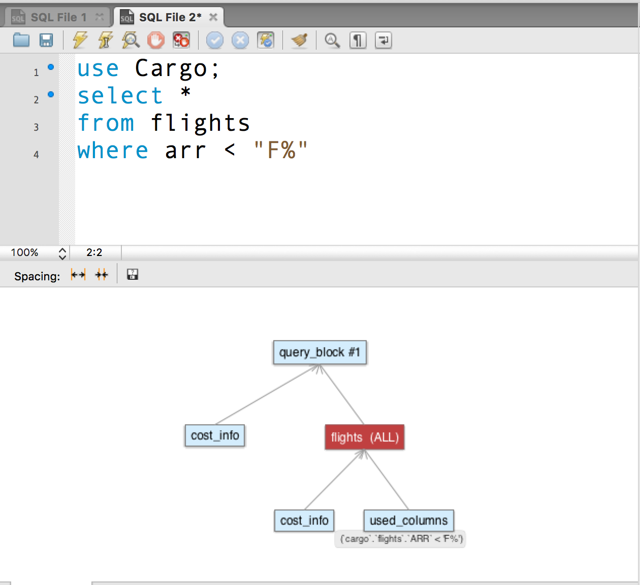

Slide 47
Without Workbench
EXPLAIN
SELECT *
FROM Flights
WHERE arr < "F%"
mysql> explain select *
-> from flights
-> where arr < "F%";
+----+-------------+---------+------------+------+---------------+------+---------+------+-------+----------+-------------+
| id | select_type | table | partitions | type | possible_keys | key | key_len | ref | rows | filtered | Extra |
+----+-------------+---------+------------+------+---------------+------+---------+------+-------+----------+-------------+
| 1 | SIMPLE | flights | NULL | ALL | NULL | NULL | NULL | NULL | 25401 | 33.33 | Using where |
+----+-------------+---------+------------+------+---------------+------+---------+------+-------+----------+-------------+
1 row in set, 1 warning (0,00 sec)

Slide 48
Denormalization
Normalization reduces redundancy and avoids anomalies
Normalization can improve performance
Less redundancy => more rows/page => less I/O
Decomposition => more tables => more clustered indexes => smaller indexes
The price of normalization:
Need to do more joins.
Fewer indexing possibilities.

Slide 49
Partitioning of Tables
A table might be a performance bottleneck
If it is heavily used, causing locking contention (more on this later in course)
If its index is deep (table has many rows or search key is wide), increasing I/O
If rows are wide, increasing I/O
Table partitioning might be a solution to this problem.

Slide 50
Horizontal Partitioning
If accesses are confined to disjoint subsets of rows, partition table into smaller tables containing the subsets
Geographically (e.g., by state), organizationally (e.g., by department), active/inactive (e.g., current students vs. grads)
Advantages:
Spreads users out and reduces contention
Rows in a typical result set are concentrated in fewer pages
Disadvantages:
Added complexity
Difficult to handle queries over all tables

Slide 51
Vertical Partitioning
Split columns into two subsets, replicate key
Useful when table has many columns and
it is possible to distinguish between frequently and infrequently accessed columns
different queries use different subsets of columns
Example: Employee table
Columns related to compensation (tax, benefits, salary) split from columns related to job (department, projects, skills).
DBMS trend (analytics): Column stores, where full vertical partitioning is done.

