Slide 1
Measuring media bias on facebook with computer-assisted text analysis
Ryan Wesslen
ITCS 8050 - May 5, 2017

Slide 2
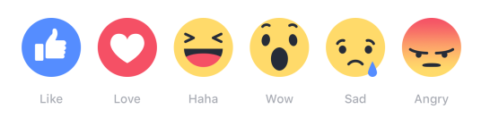
Problem: measuring media bias
Content-based: Structural Topic Modeling (Roberts, Stewart, and Airoldi, 2016)
Selection coverage or “issue filtering” (Budak, Goel, and Rao, 2016)
Example: Cover some topics more than others (prevalent covariates)
How issues are presented or “issue framing” (Budak, Goel, and Rao, 2016)
Example: “Obamacare vs Affordable Care Act” (content covariates)
Audience-based: User interactions
Assumes consumers patronize outlet closest to ideology (Mullainathan and Shleifer, 2008)
Can user interactions provide hints on outlet’s political leanings?
Example: Do right leaning outlets’ (e.g., Breitbart) followers express more disappointment (sads) in response to AFA topics?

Slide 3

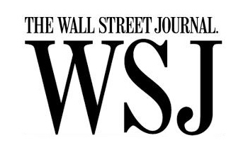
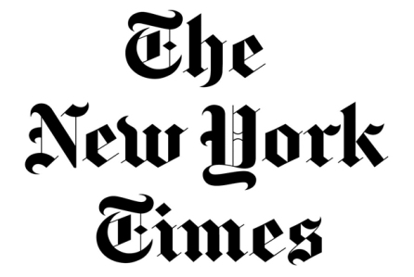



Dataset & modeling
~14,500 public Facebook posts through Facebook API
Six media outlets (see right)
Feb 15 – Apr 7, 2017 (pulled on April 8, 2017)
Ran 52 topic structural topic model (R stm)
Content covariates: media outlet
Prevalance covariates: media outlet, day

Slide 4
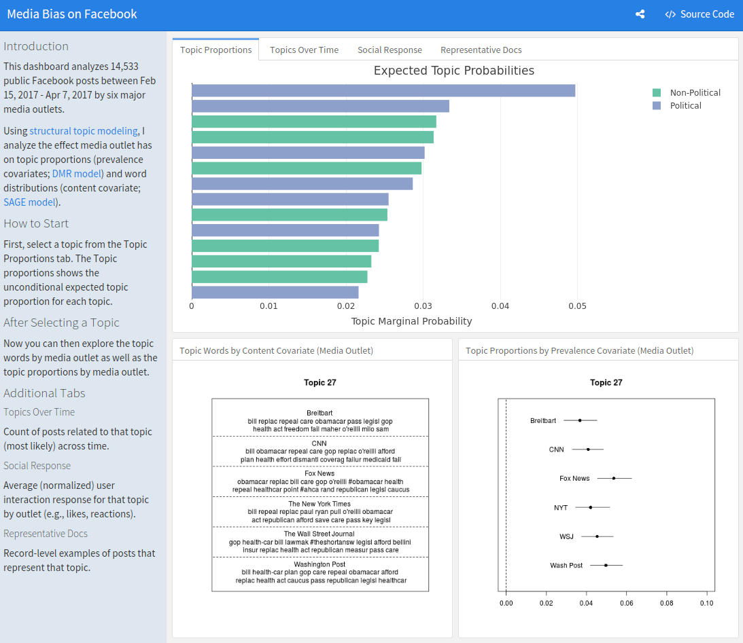
https://wesslen.shinyapps.io/mediabias
R Shiny / flexdashboard App

Slide 5
Example: “Obamacare/aca” topic
Issue Framing
Issue Filtering

Slide 6
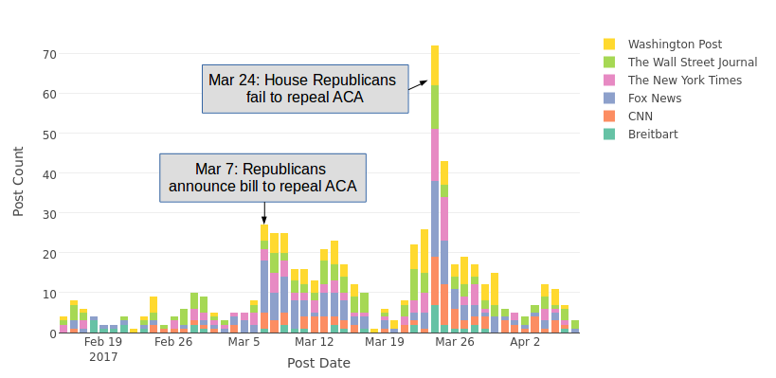
Example: “Obamacare/aca” topic

Slide 7
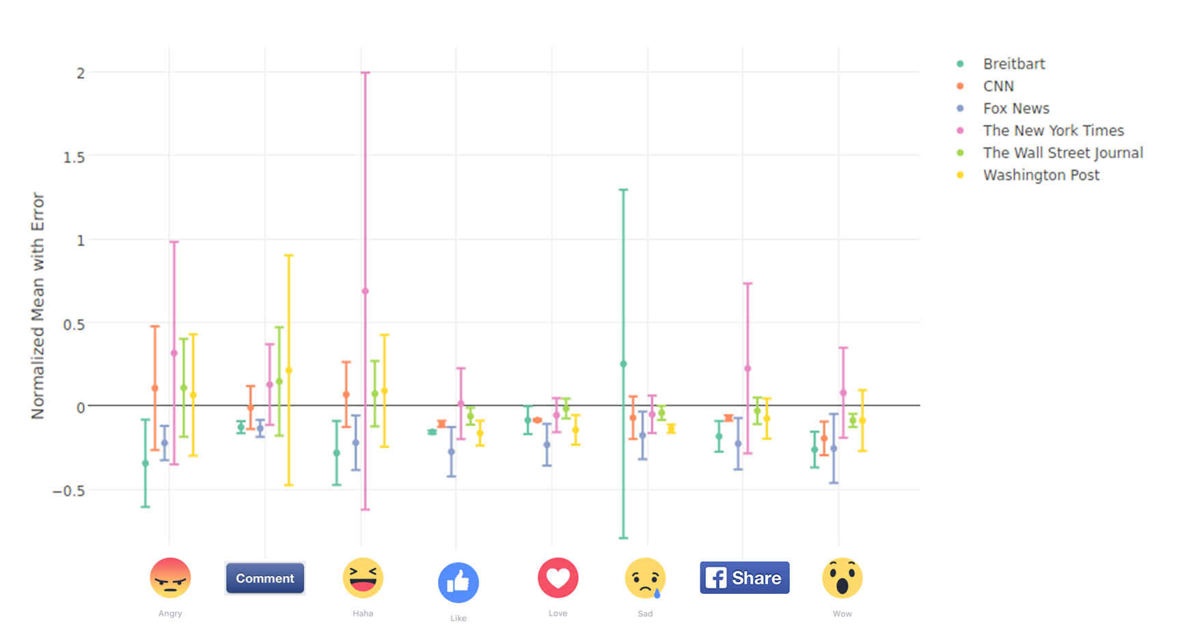
Example: “Obamacare/aca” topic

Slide 8
Further observations
Regardless of outlet, higher than normal “sad” and “wow” and lower than normal “haha”, “loves” for London Attack (Mar 22) and US-Syrian Air Strikes topics.
“Sad” had a lot of variance regardless of topic and outlet.
Average posts have few “sads” but some are very large.
High levels of “angry” by Breitbart and Fox News in immigration topic.
High levels of “likes” and “loves” by both for Muslim Ban topic.
Most user interactions had too large of confidence intervals.
Suggest need for more data or temporal effects (e.g., change over time).

Slide 9
Criticism & possible solutions
Only analyzes six media outlets for two months.
Solution: A wider, larger set of media outlets over a longer time.
Posts are very short leading to poor topics.
Solution: Web-scrape linked articles; include image/videos.
Analysis between topics and interactions is limited.
Solution: Build a supervised classifier to predict interactions.

Slide 10
Thank you
https://wesslen.shinyapps.io/mediabias

Slide 11
References
Budak, C., Goel, S., & Rao, J. M. (2016). Fair and balanced? quantifying media bias through crowdsourced content analysis. Public Opinion Quarterly, 80(S1), 250-271.
Mullainathan, S., & Shleifer, A. (2008). The market for news. In Economics, Law and Individual Rights (pp. 90-122). Routledge.
Roberts, M. E., Stewart, B. M., & Airoldi, E. M. (2016). A model of text for experimentation in the social sciences. Journal of the American Statistical Association, 111(515), 988-1003.

