Slide 1

Twitter Data Acquisition via Twitter’s Public API and R
Project Mosaic Workshop
Date 10/13/2016
Ryan Wesslen, Computing & Informatics
rwesslen@uncc.edu

Slide 2
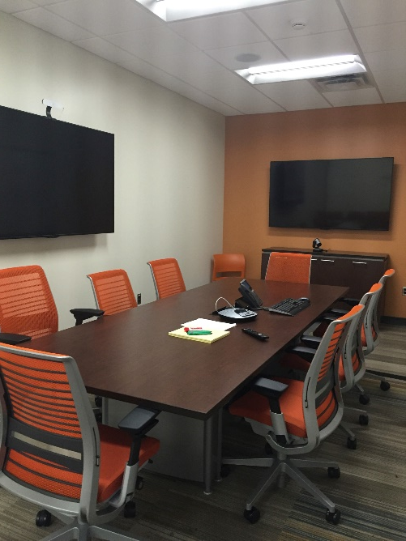
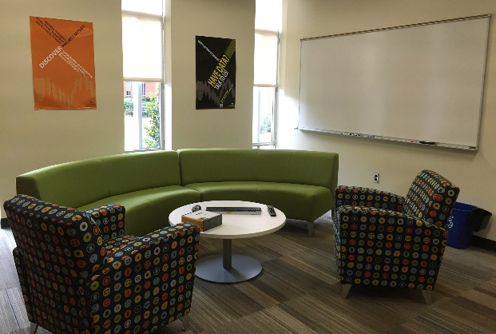
Project Mosaic
Project Mosaic: What do we do?
Build research methods capability in social sciences
Facilitate research across social science disciplines
Promote social science research
Project Mosaic Services
Social sciences research incubator
Facilitate connections
Bring people together to exchange ideas and pursue external funding
Information sharing on research funding opportunities
Consulting
Free to UNC Charlotte faculty, staff and graduate students
Workshops
Open to entire campus community
Provides cutting-edge tools for research and a forum for researchers to network within campus

Slide 3
Workshop Agenda
Overview of Acquiring Twitter Data via API
Example 1: TwitteR and StreamR packages
Example 2: Facebook API (FacebookR)
Example 3: NY Times API

Slide 4
Learning Objectives
Level | Background | Learning Objective
Beginner | No experience with API’s and/or Twitter data | Learn API terminology, Twitter API functionality and rate limits to better craft research questions given data constraints.
Intermediate | Some API and/or Twitter data experience | Ability to rerun code independently and learn the associated R packages functionality.
Advanced | Proficient in API’s and/or Twitter data | Ability to generalize code to loop and sleep to maximize rate limits of potential data.

Slide 5
Workshop materials
All workshop materials can be found here:
https://github.com/wesslen/social-media-workshop
These materials were created by Pablo Barberá
(not me) and he deserves all credit for the materials.

Slide 6
More About Services
Research Incubator
Affiliates Program
Faculty Affiliates are hand picked for their research expertise
Our affiliates leverage the core functionality and expertise of Project Mosaic
Seed Grants Program
Geared towards the formation of new teams of researchers in the social, behavior and economic sciences
Aim is to pursue external funding
Consulting
Project Mosaic offers three types of consulting:
Software-centric
Dissertation/thesis assistance
Research collaboration
Workshops
Our workshops fulfill a commitment to enhance data literacy and analytical capabilities of UNC Charlotte researchers
Make an appointment on our website!
Find workshops online on our Events List.

Slide 7
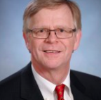
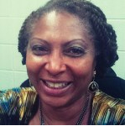

Contact Project Mosaic
Jean-Claude Thill is the director of Project Mosaic. A broadly trained geographer, he is a ‘Knight’ Distinguished Professor of Public Policy at UNC Charlotte.
Contact Jean-Claude:
Email: Jean-Claude.Thill@uncc.edu
Phone: 704-687-5931 ext. 75909
Leonora is the Administrative Support for Project Mosaic. She manages our not-so-massive paperwork, coordinates meetings and assists with administrative functions.
Contact Leonora:
Email: projectmosaic@uncc.edu
Phone: 704-687-5931
Visit our website!
Projectmosaic.uncc.edu

Slide 8
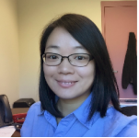
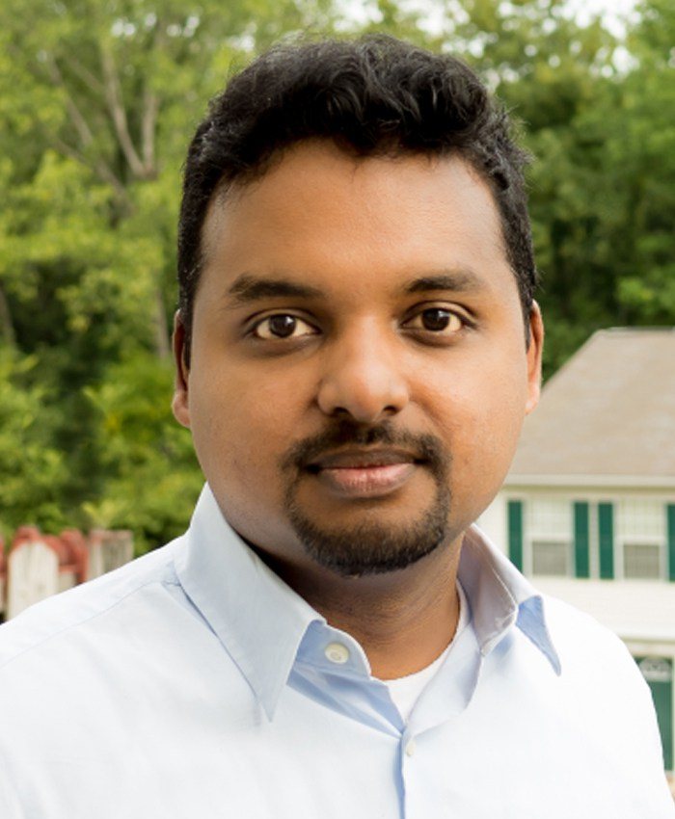
Additional Resources: Consultants
Shaoyu Li is the head consultant in the Center of Statistics and Applied Mathematics Consulting Center (CSAMC) and works with Project Mosaic to coordinate consulting requests for statistical and mathematical expertise.
Contact Shaoyu:
Email: shaoyu.li@uncc.edu
Kailas Venkitasubramanian is a research methodologist and manages the consulting service and the workshop program of Project Mosaic. Kailas is experienced in a variety of applied statistical techniques and works fluently on multiple software platforms.
Contact Kailas:
Email: kvenkita@uncc.edu
Notes:
https://projectmosaic.uncc.edu/make-a-consulting-appointment/

Slide 9
Questions?

