Slide 1
Threading & threadpool

Slide 2
Threading
A thread in Java is the path followed when executing a program. All Java programs have at least one thread, known as the main thread, which is created by the Java Virtual Machine (JVM) at the program’s start, when the main() method is invoked.
A single-threaded application has only one Java thread and can handle only one task at a time. To handle multiple tasks in parallel, multi-threading is used: multiple Java threads are created, each performing a different task.

Slide 3
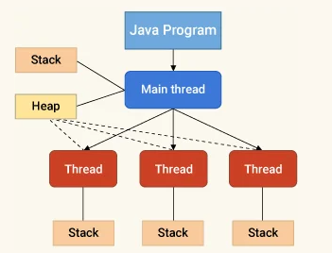
Java Thread vs. Java Process
A Java process is a program in execution. A Java thread is a subset of a Java process.
A Java process consists of multiple threads and a Java thread is often regarded as a light-weight process.
While a Java process has its own address space, a Java thread uses the process’ address space and shares it with other threads of that process.
A thread can communicate with other threads of the same process using methods like wait(), notify(), notifyAll(). Global variables can also be used to pass data between threads. On the other hand, a process can only communicate with other process by using inter-process communication techniques like sockets, files, etc.

Slide 4
Threading
There are two ways to create a thread:
By extending Thread class
By implementing Runnable interface.
Thread class:
Thread class provide constructors and methods to create and perform operations on a thread.Thread class extends Object class and implements Runnable interface.
Commonly used Constructors of Thread class:
Thread()
Thread(String name)
Thread(Runnable r)
Thread(Runnable r,String name)

Slide 5
Threading
Execution of multiple threads of the same process simultaneously is known as multithreading. Multithreading reduces the time taken by the process for task completion and maximizes CPU utilization. All the threads of a process share a common memory space.
In Java multithreading a thread can be created in the following two ways:
By extending the thread class
By implementing a Runnable interface

Slide 6
Lifecycle and States of a Thread in Java
A thread in Java at any point of time exists in any one of the following states. A thread lies only in one of the shown states at any instant:
New-a newly created thread that has not yet started the execution
Runnable-either running or ready for execution but it's waiting for resource allocation
Blocked-waiting to acquire a monitor lock to enter or re-enter a synchronized block/method
Waiting-waiting for some other thread to perform a particular action without any time limit
Timed Waiting- waiting for some other thread to perform a specific action for a specified period
Terminated - has completed its execution

Slide 7
Threading
Some of the useful methods of Thread Class that we are going to use:
start() - It starts the execution of the thread in a separate path and then calls the run() method.
run() - It performs the action determined in the run() method.
isAlive() - It returns true if the execution of the thread is not terminated, else it returns false.
join() - It waits for the thread to die.
sleep() - To suspend a thread for a certain period.

Slide 8
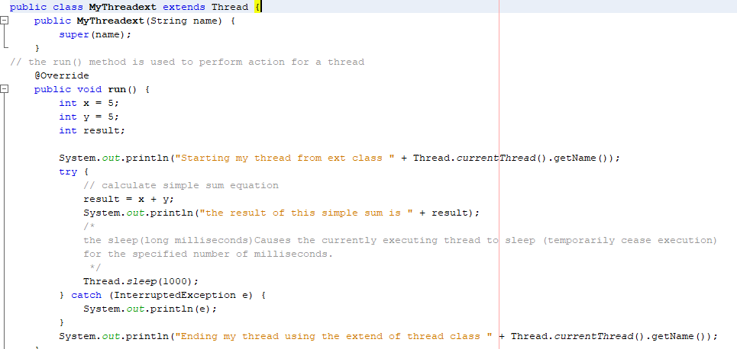
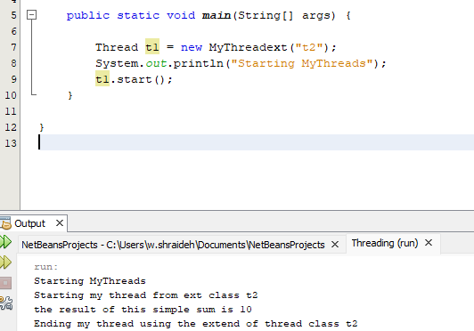
by extending the Thread class
In java multithreading, a thread can be created by extending java. lang.Thread class. We first create a class that extends Thread and overrides the run() method. Now thread can be created by creating the object of our newly created class and calling the run() method.

Slide 9
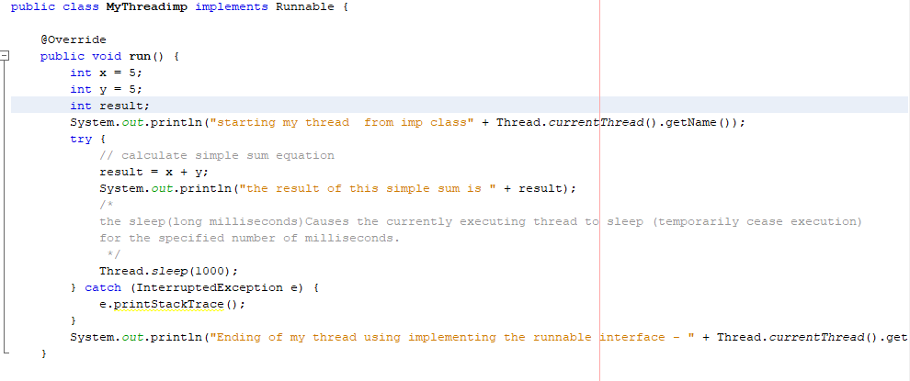
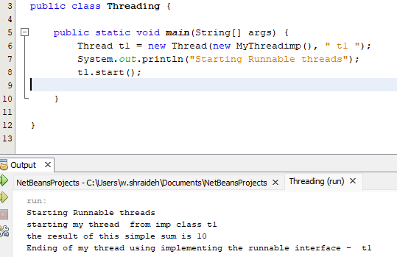
By implementing Runnable interface
To make a class runnable, we can implement java.lang.Runnable interface and provide implementation in public void run() method. To use this class as Thread, we need to create a Thread object by passing object of this runnable class and then call start() method to execute the run() method in a separate thread. Here is a java thread example by implementing Runnable interface.

Slide 10
Java Thread Pool
Java Thread pool represents a group of worker threads that are waiting for the job and reused many times.
In the case of a thread pool, a group of fixed-size threads is created. A thread from the thread pool is pulled out and assigned a job by the service provider. After completion of the job, the thread is contained in the thread pool again.

Slide 11
Thread pool methods
Thread Pool Methods
newFixedThreadPool(int s): The method creates a thread pool of the fixed size s.
newCachedThreadPool(): The method creates a new thread pool that creates the new threads when needed but will still use the previously created thread whenever they are available to use.
newSingleThreadExecutor(): The method creates a new thread.

