Slide 1


HVAC Insights: Rooftop Unit and Terminal Unit Analysis
Bini Chandra, Brian West, Cody Snow
April 17th, 2025

Slide 2
Introduction - Who We Are
Team members:
Brian West – BS Computer Engineering, Electrical Engineer
Cody Snow – BS Computer Science, Software Engineer
Bini Chandra – B.Tech in Computer Science & Engineering, Software Engineer
Client:
Jeff Kimmel @ Elipsa - an AI company that helps buildings save energy

Slide 3
Project Overview
Problem Statement:
We don’t know which terminal units are fed by which roof-top units.
Why It’s Important:
Without that mapping, troubleshooting takes too long and energy gets wasted.
Expected Outcomes:
Cleaned and aligned sensor datasets
An automated, data-driven mapping method
Clear visuals and a final report for the client

Slide 4
Data Summary and Preparation
Files Provided: A set of Terminal Unit and Rooftop Unit files
Volume:
47 Terminal Units - 206277 Data points collected over 51 Days
3 Terminal Units- 4781 Data points collected over 51 Days per unit
Variables overview: Airflow rate, Discharge air temperature, Damper position, Heating & cooling setpoints etc.
Data quality Notes:
A few missing timestamps
Some sensors stuck at a constant value
Occasional gaps in setpoint readings
Data cleaning steps performed
Forward Filled “Set Point” Variables
Remove variables
Drop rows with missing values
Variables we dropped and rationale
Terminal Units:
Jeff’s Email: Air_Flow_Diff, Room_Temperature_Diff, VAV_Temperature_Diff, SaTemp, oppMode
0 Standard Deviation: EffOcc, Heating_Stg_Cmd, OccCmd, SuplFanCmd, SuplFanState, Cooling_Stg_Cmd, AirflowSpRht, RmCo2
Roof Top Units:
0 Standard Deviation: ClgStgCmd02, EconEna, EconEnaSp, EffRmSp, ExhAirDmprFbk, FltAlm, HtgAlm, HtgPct, HtgStgCmd01, HtgStgCmd02, OccCmd, OccStatus, SuplAirHtgSp,, SuplAirTempAlm, SuplAirTempSp, SuplFanAlm, UnoccHtgSp, oppMode
Variables we kept and why they matter
Everything else was kept because it described the system in some capacity that could be used to associate TUs with RTUs.

Slide 5
Analysis Methodology
Principal Component Analysis:
Reduce the dimensions of data to focus on only the ones that describe the data the most.
Reduce “noise” of data and make further analysis easier.
K-Means Clustering:
Choose number of clusters.
Randomly place center of clusters.
Calculate distance of center to each data point
Assign data point to closest cluster center.
Move cluster center to average distance between every data point that got assigned to it.
Repeat a number of times.
Goal: Clustering terminal units together that belong to the same roof top unit.
Correlation:
Determine the relationship between two variables
Goal: Determine terminal unit variables that have strong correlation to roof top unit variables, to help determine which roof top unit a terminal unit belongs to.

Slide 6
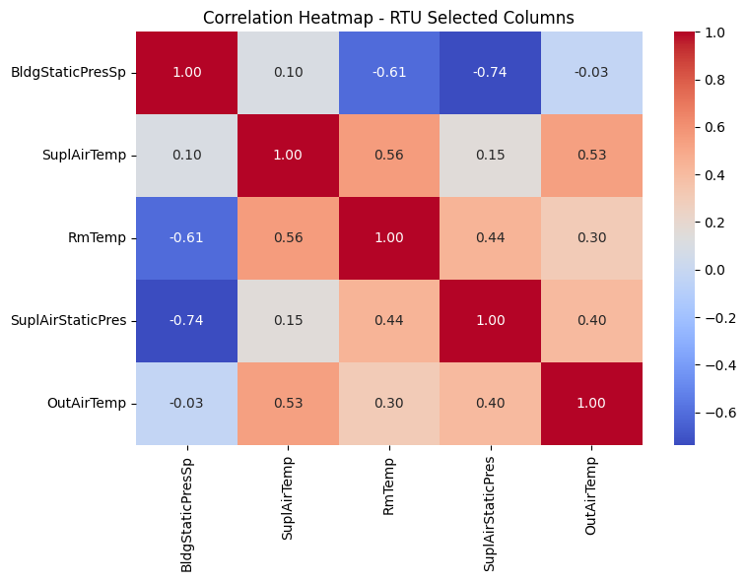
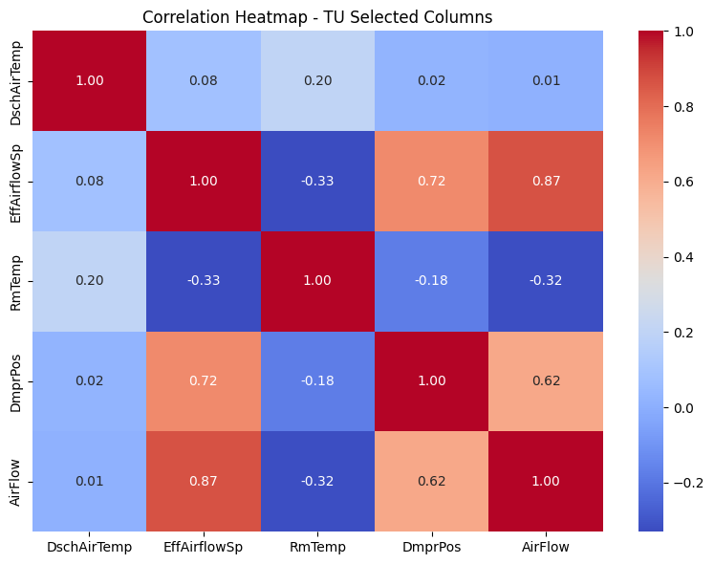
Data Visualizations

Slide 7
Key Findings & Results
Principal Component Analysis:
'RTU_RmTemp', 'TU_RmTemp', 'RTU_SuplAirTemp', 'TU_DschAirTemp', 'RTU_OutAirFlow', 'TU_AirFlow'
These variables contributed the most to describing the data.
K-Means Clustering of terminal units:
Using two clusters we got 65% accuracy of grouping terminal units together.
Other approaches are currently being worked on to improve accuracy.
Correlation between terminal unit variables and roof top unit variables:
Correlation was mostly weak
Where stronger correlation occurred, it about equally strong with both roof top units.
Other approaches are currently being worked on to improve accuracy.

Slide 8
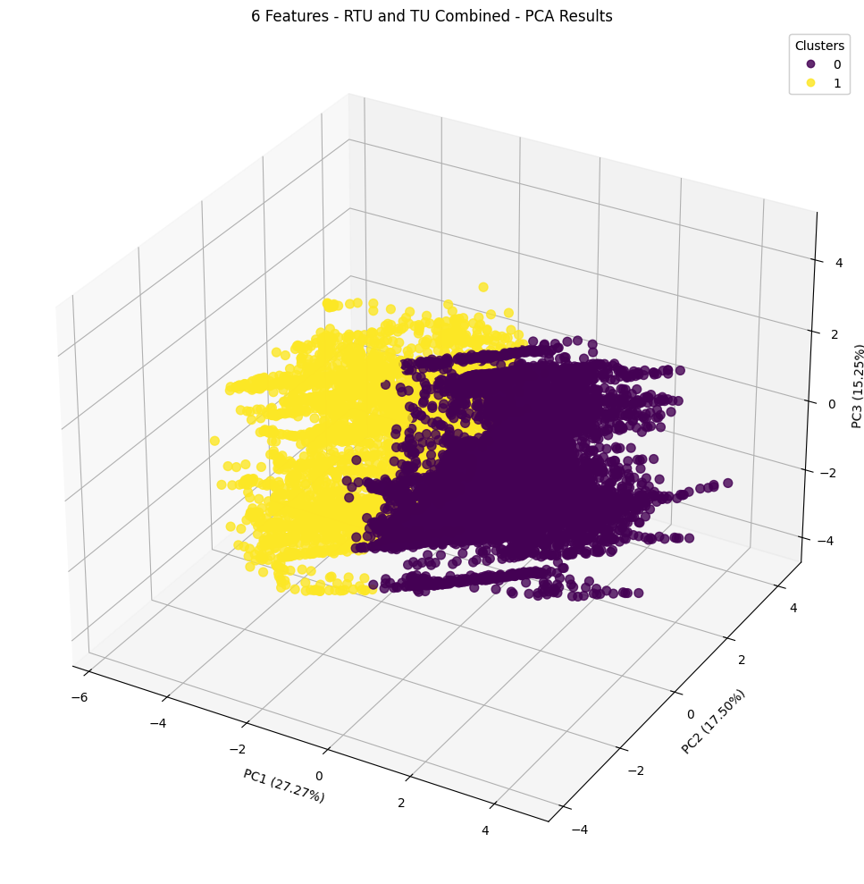
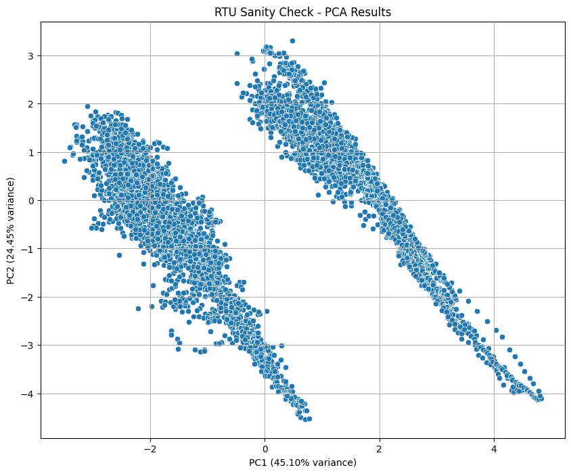
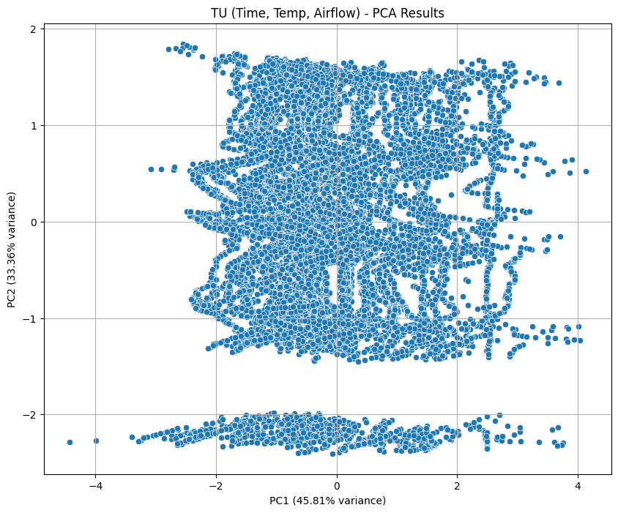

Slide 9
Challenges & Future Work
Obstacles encountered during analysis
Large portion of data was missing values
Lacking domain knowledge
What we would do with more time
Attempt supervised analysis methods
Additional data we recommend collecting
Air Pressure within the system, if available
Suggested monitoring metrics for ongoing assessment
Create purposeful variance in set points across the system and monitor the responses over time to improve correlation

Slide 10
Next Steps & Q&A
Summary
Alternative data cleaning and preparation may provide improved results
PCA and clustering show promise in discovering equipment relationships
Supervised learning techniques may provide better insights into relationships between RTUs and TUs
Q&A session

