Slide 1

KVaC : Key-Value Commitments for Blockchains and Beyond (ASIACRYPT 2020)
西安邮电大学
XI'AN UNIVERSITY OF POSTS
& TELECOMMUNICATIONS
汇报人：李佳薇

Slide 2
西安邮电大学
XI'AN UNIVERSITY OF POSTS
& TELECOMMUNICATIONS
Introduction
UTXO set in Bitcoin
Account ledger in Ethereum
VC and KVC
Accumlator
KVC : Key-Value Commitments

Slide 3
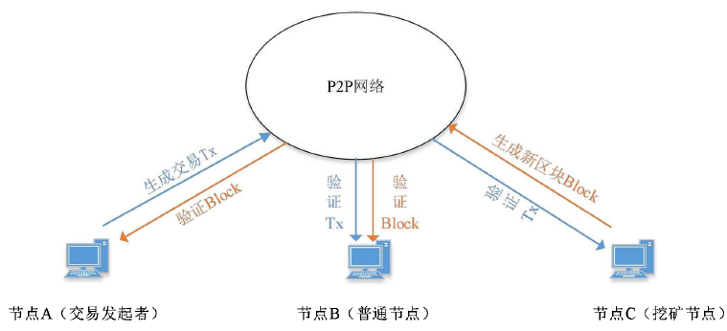
西安邮电大学
XI'AN UNIVERSITY OF POSTS
& TELECOMMUNICATIONS
Introduction
Key Players in Blockchain
Users generate transactions
Miners generate blocks
Validators verify blocks
Validators Job
Verify the state of the system
UTXO set in Bitcoin
Account ledger in Ethereum
Store the state of the system

Slide 4


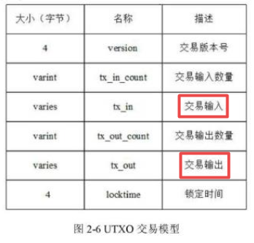
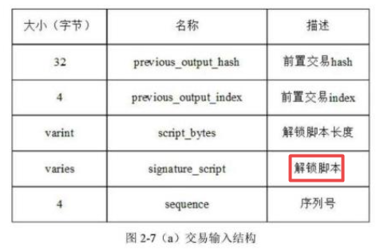
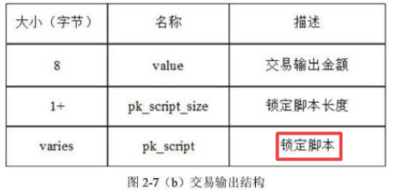
西安邮电大学
XI'AN UNIVERSITY OF POSTS
& TELECOMMUNICATIONS
Introduction
UTXO set in Bitcoin
Account ledger in Ethereum
UTXO池
交易hash
1.交易结构各字段序列化为字节数组
2.把字节数组拼接为支付串
3.对支付串计算两次SHA256得到交易hash
锁定时间一般被设置成0，表示立即执行。
解锁脚本：签名和公钥，用于验证前置交易和index所指向的UTXO的锁定脚本

Slide 5


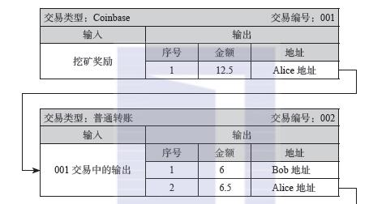
西安邮电大学
XI'AN UNIVERSITY OF POSTS
& TELECOMMUNICATIONS
UTXO set
UTXO set in Bitcoin
Account ledger in Ethereum
UTXO池
12.5
A
6.5
6
B

Slide 6

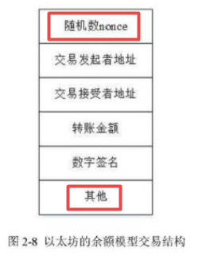


西安邮电大学
XI'AN UNIVERSITY OF POSTS
& TELECOMMUNICATIONS
Account ledger
UTXO set in Bitcoin
Account ledger in Ethereum
10-4-3=3
A
B
C
2+4=6
2+3=5
Nonce:计数，防止双花
其他：余额字段

Slide 7
西安邮电大学
XI'AN UNIVERSITY OF POSTS
& TELECOMMUNICATIONS
Introduction
Validators Job
Verify the state of the system
UTXO set in Bitcoin
Account ledger in Ethereum
Store the state of the system
UTXO set ----Accumlator
A compressed representation of the UTXO set
Users provide proofs of membership to spend UTXO set
Validates verify the proofs
Account ledger ----KVC
A compressed representation of the account ledger (Key-value map)
Users provide proof of value and use key to update the corresponding value
Validates verify the proofs

Slide 8
西安邮电大学
XI'AN UNIVERSITY OF POSTS
& TELECOMMUNICATIONS
Introduction
The problem
More and more ethereum accounts and users
The size of the key-value map grows
Verify work is too hard
A Solution
Compress the state in a verifiable way
Accumulators [BCD+17,LLX07,BBF19]
Vector Commitments [CF13,KSS+16,LM19,BBF19]
Key-value Commitments [BBF19]
Users need to work and help verifiy
Provide Proofs
Keep Proofs up-to-date
[BBF19] Dan Boneh, Benedikt B¨unz. Batching techniques for accumulators with applications to IOPs and stateless blockchains
[BCD+17] Foteini Baldimtsi, Jan Camenisch, Maria Dubovitskaya, Accumulators with applications to anonymity-preserving revocation
[CF13] Dario Catalano and Dario Fiore. Vector commitments and their applications.
[KSS+16] Johannes Krupp, Dominique Schr¨oder, Mark Simkin. Nearly optimal verififiable data streaming.
[LLX07] Jiangtao Li, Ninghui Li, and Rui Xue. Universal accumulators with effiffifficient nonmembership proofs
[LM19] Russell W. F. Lai and Giulio Malavolta. Subvector commitments with application to succinct arguments.

Slide 9

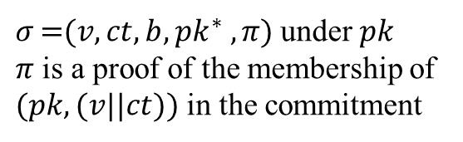





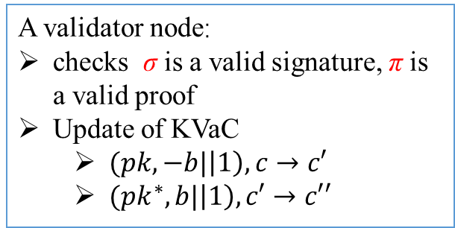

西安邮电大学
XI'AN UNIVERSITY OF POSTS
& TELECOMMUNICATIONS
Stateless validation of cryptocurrencies
$$tx=(pk,σ,v,ct,b,{pk}^{∗},π)$$
$${pk}^{∗}$$
$$(pk,sk)$$
$${(pk}^{∗},{sk}^{∗})$$
$$(b,{pk}^{∗})$$
$$(pk,v||ct)$$
$$({pk}^{∗},v||ct)$$
Alice
Bob
$σ \text{=}(v, ct, b, {pk}^{∗} , π)$under $pk$
$π$ is a proof of the membership of $(pk,(v||ct))$in the commitment
A validator node:
checks σ is a valid signature, π is a valid proof
Update of KVaC
$(pk,−b|\left|1\right),c→c′$
$({pk}^{∗},b|\left|1\right),c′→c′′$

Slide 10
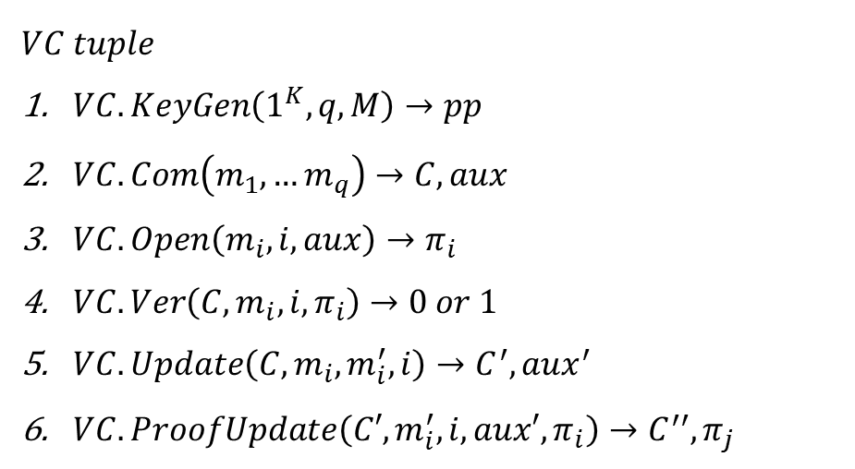
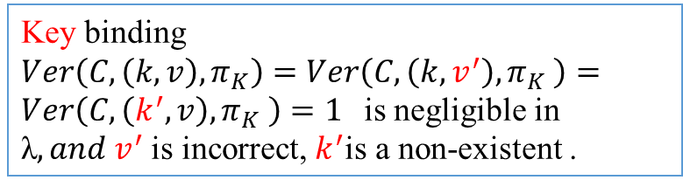
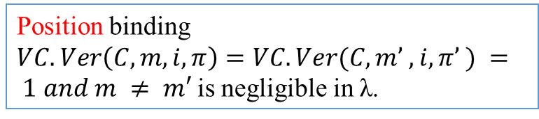
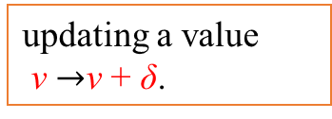
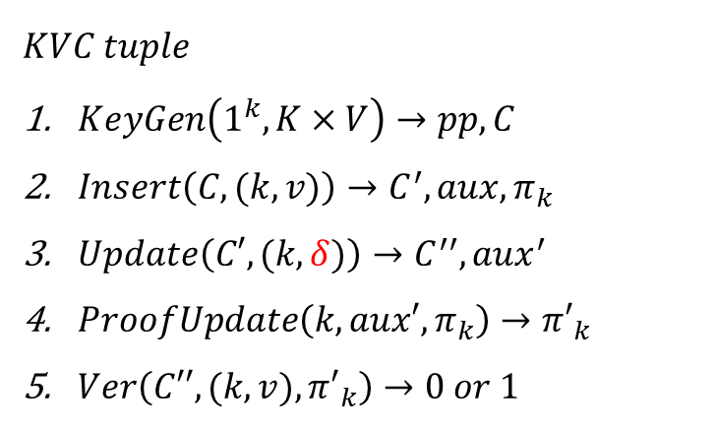
西安邮电大学
XI'AN UNIVERSITY OF POSTS
& TELECOMMUNICATIONS
VC and KVC
$$VC tuple$$
$VC. KeyGen\left(1^{K},q,M\right)→pp$
$VC. Com\left(m_{1},…m_{q}\right)→C,aux$
$VC. Open\left(m_{i},i,aux\right)→π_{i}$
$VC. Ver\left({C,m}_{i},i,π_{i}\right)→0 or 1$
$VC. Update\left(C,m_{i},m_{i}^{′},i\right)→C^{′},aux^{′}$
$VC. ProofUpdate\left(C′,m_{i}^{′},i,aux′,π_{i}\right)→C^{′′},π_{j}$
$$KVC tuple$$
$KeyGen\left(1^{k},K×V\right)→pp,C$
$Insert\left(C,(k,v)\right)→C^{′},aux,π_{k}$
$Update\left(C′, (k,δ)\right)→C^{′′},aux^{′}$
$ProofUpdate\left(k,aux′,π_{k}\right)→{π′}_{k}$
$Ver\left(C′′,(k,v),{π′}_{k}\right)→0 or 1$
updating a value
v $→$v + δ.
Key binding
$Ver\left(C,\left(k, v\right),π_{K}\right)=Ver\left(C,\left(k, v^{′}\right),π_{K} \right)=Ver\left(C,\left(k^{′}, v\right),π_{K} \right)=1$is negligible in λ$, and v^{′}$is incorrect, $k^{′}$is a non-existent .
Position binding
$VC.Ver\left(C, m, i, π\right)=VC.Ver(C, m’ , i, π’ ) = 1 and m ≠ m′$is negligible in λ.

Slide 11
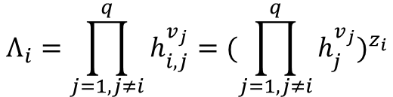
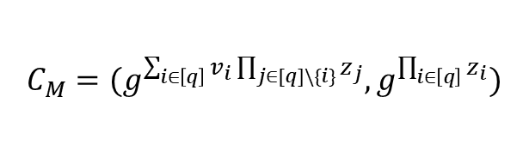
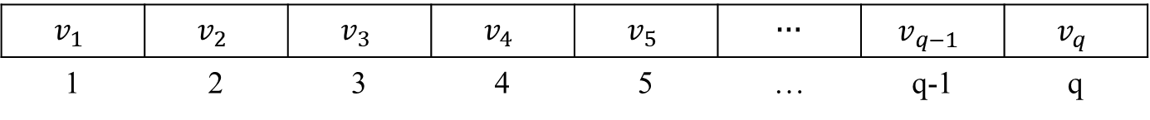


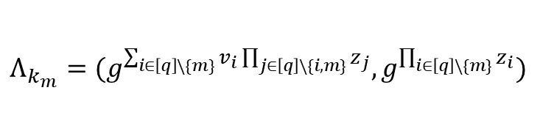
西安邮电大学
XI'AN UNIVERSITY OF POSTS
& TELECOMMUNICATIONS
Compare
VC [CF13]
value Map
$$v_{1}$$ | $$v_{2}$$ | $$v_{3}$$ | $$v_{4}$$ | $$v_{5}$$ | … | $$v_{q−1}$$ | $$v_{q}$$
1 | 2 | 3 | 4 | 5 | … | q-1 | q
3、4、5、7、…1
$$Λ_{i}=\prod_{j=1,j≠i}^{q}{h_{i,j}^{v_{j}}}{=(\prod_{j=1,j≠i}^{q}{h_{j}^{v_{j}}})}^{z_{i}}$$
$$C=h_{1}^{v_{1}}h_{2}^{v_{2}}⋯h_{q}^{v_{q}}$$
KVC
Key-value Map
$$k_{1}$$ | $$k_{2}$$ | $$k_{3}$$ | $$k_{4}$$ | $$k_{5}$$ | … | $$k_{q−1}$$ | $$k_{q}$$ | …
$$v_{1}$$ | $$v_{2}$$ | $$v_{3}$$ | $$v_{4}$$ | $$v_{5}$$ | … | $$v_{q−1}$$ | $$v_{q}$$ | …
($k_{1},v_{1}$),$\left(k_{2},v_{2}\right)……(k_{q},v_{q})$
$$C_{M}=(g^{\sum_{i∈\left[q\right]}{v_{i}\prod_{j∈[q]\backslash \{i\}}{z_{j}}}},g^{\prod_{i∈\left[q\right]}{z_{i}}})$$
$$Λ_{k_{m}}=(g^{\sum_{i∈\left[q\right]\backslash \{m\}}{v_{i}\prod_{j∈\left[q\right]\backslash \{i,m\}}{z_{j}}}},g^{\prod_{i∈\left[q\right]\backslash \{m\}}{z_{i}}})$$

Slide 12
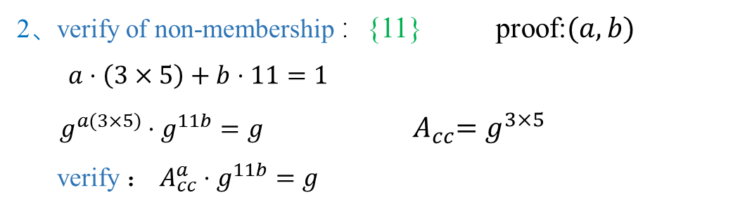
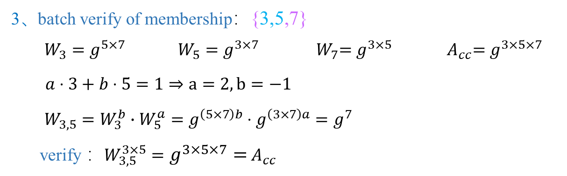
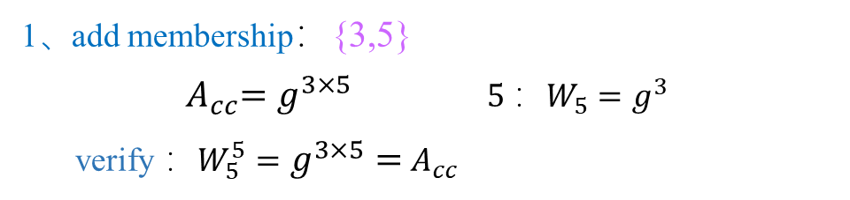
西安邮电大学
XI'AN UNIVERSITY OF POSTS
& TELECOMMUNICATIONS
Accumlator
1、add membership：{3,5}
${ A}_{cc}=g^{3×5}$ $5 ：W_{5}=g^{3}$
verify ：$W_{5}^{5}=g^{3×5}={ A}_{cc}$
2、verify of non-membership ：{11} proof:$(a,b)$
$a⋅\left(3×5\right)+b⋅11=1$
$g^{a(3×5)}⋅g^{11b}=g$ ${ A}_{cc}=g^{3×5}$
verify ： $A_{cc}^{a}⋅g^{11b}=g$
3、batch verify of membership：{3,5,7}
$W_{3}=g^{5×7}$ $W_{5}=g^{3×7}$ ${ W}_{7}=g^{3×5}$ ${ A}_{cc}=g^{3×5×7}$
$a⋅3+b⋅5=1⇒a=2,b=−1$
$W_{3,5}=W_{3}^{b}∙W_{5}^{a}=g^{\left(5×7\right)b}⋅g^{\left(3×7\right)a}=g^{7}$
verify ：$W_{3,5}^{3×5}=g^{3×5×7}={ A}_{cc}$

Slide 13
西安邮电大学
XI'AN UNIVERSITY OF POSTS
& TELECOMMUNICATIONS
Introduction
KVC : Key-Value Commitments
insert-only key-value commitment
Increment-only key-value commitment

Slide 14
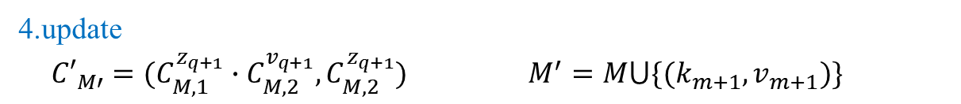
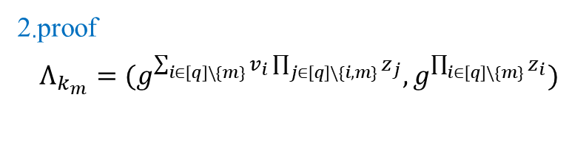
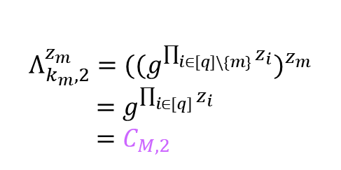
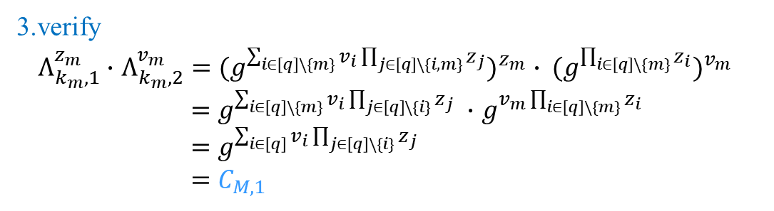

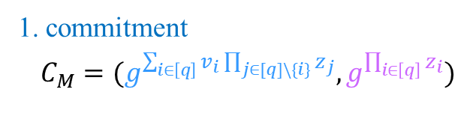
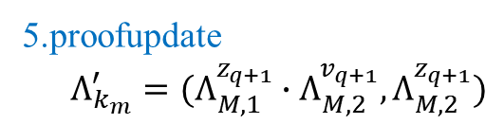
西安邮电大学
XI'AN UNIVERSITY OF POSTS
& TELECOMMUNICATIONS
insert-only key-value commitment
1. commitment
$C_{M}=(g^{\sum_{i∈\left[q\right]}{v_{i}\prod_{j∈[q]\backslash \{i\}}{z_{j}}}},g^{\prod_{i∈\left[q\right]}{z_{i}}})$
$$M={\{(k_{i},v_{i})\}}_{i∈[q]}⊆K×V$$
2.proof
$Λ_{k_{m}}=(g^{\sum_{i∈\left[q\right]\backslash \{m\}}{v_{i}\prod_{j∈\left[q\right]\backslash \{i,m\}}{z_{j}}}},g^{\prod_{i∈\left[q\right]\backslash \{m\}}{z_{i}}})$
3.verify
$Λ_{k_{m},1}^{z_{m}}∙$ $Λ_{k_{m},2}^{v_{m}}{=(g^{\sum_{i∈\left[q\right]\backslash \{m\}}{v_{i}\prod_{j∈\left[q\right]\backslash \{i,m\}}{z_{j}}}})}^{z_{m}} ∙ {{(g}^{\prod_{i∈\left[q\right]\backslash \{m\}}{z_{i}}})}^{v_{m}}$
$=$ $g^{\sum_{i∈\left[q\right]\backslash \{m\}}{v_{i}\prod_{j∈\left[q\right]\backslash \{i\}}{z_{j}}}} ∙$ $g^{v_{m}\prod_{i∈\left[q\right]\backslash \{m\}}{z_{i}}}$
$=$ $g^{\sum_{i∈\left[q\right]}{v_{i}\prod_{j∈\left[q\right]\backslash \{i\}}{z_{j}}}}$
$=C_{M,1}$
$$Λ_{k_{m},2}^{z_{m}}={({(g}^{\prod_{i∈\left[q\right]\backslash \{m\}}{z_{i}}})}^{z_{m}}$$
$=$ $g^{\prod_{i∈\left[q\right]}{z_{i}}}$
$=C_{M,2}$
4.update
${C′}_{M′}=(C_{M,1}^{z_{q+1}}∙C_{M,2}^{v_{q+1}},C_{M,2}^{z_{q+1}})$ $M^{′}=M⋃\{(k_{m+1},v_{m+1})\}$
5.proofupdate
$Λ_{k_{m}}^{′}=(Λ_{M,1}^{z_{q+1}}∙Λ_{M,2}^{v_{q+1}},Λ_{M,2}^{z_{q+1}})$
Proof update is an insertion
Verification is an insertion

Slide 15

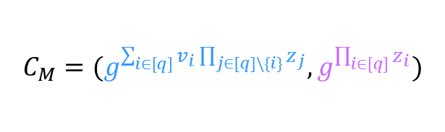

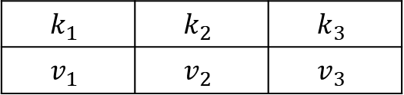
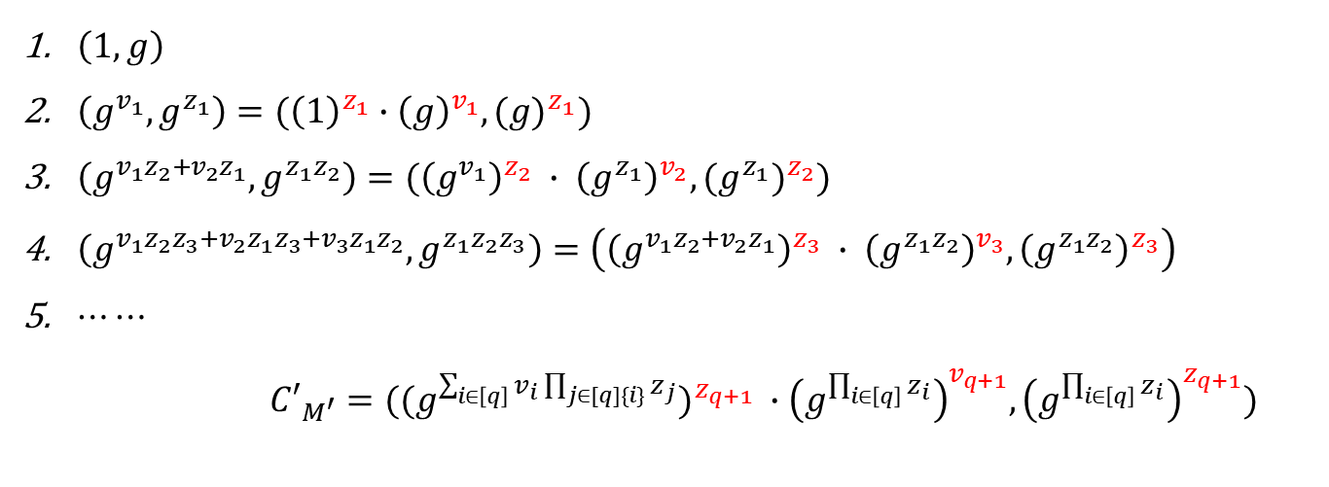
西安邮电大学
XI'AN UNIVERSITY OF POSTS
& TELECOMMUNICATIONS
insert-only key-value commitment
$$k_{1}$$ | $$k_{2}$$ | $$k_{3}$$
$$v_{1}$$ | $$v_{2}$$ | $$v_{3}$$
$$M=\{\left(k_{1},v_{1}\right),\left(k_{2},v_{2}\right),\left(k_{3},v_{3}\right)\}$$
$$C_{M}=(g^{\sum_{i∈\left[q\right]}{v_{i}\prod_{j∈[q]\backslash \{i\}}{z_{j}}}},g^{\prod_{i∈\left[q\right]}{z_{i}}})$$
$$z_{i}=H(k_{i})$$
$\left(1,g\right)$
$\left(g^{v_{1}},g^{z_{1}}\right)=({\left(1\right)}^{z_{1}}∙{\left(g\right)}^{v_{1}},{(g)}^{z_{1}})$
$\left(g^{v_{1}z_{2}+v_{2}z_{1}},g^{z_{1}z_{2}}\right)=({\left(g^{v_{1}}\right)}^{z_{2}} ∙ {\left(g^{z_{1}}\right)}^{v_{2}},{(g^{z_{1}})}^{z_{2}})$
$\left(g^{v_{1}z_{2}z_{3}+v_{2}z_{1}z_{3}+v_{3}z_{1}z_{2}},g^{z_{1}z_{2}z_{3}}\right)=\left({\left(g^{v_{1}z_{2}+v_{2}z_{1}}\right)}^{z_{3}} ∙ {\left(g^{z_{1}z_{2}}\right)}^{v_{3}},{\left(g^{z_{1}z_{2}}\right)}^{z_{3}}\right)$
$⋯⋯$
${C′}_{M^{′}}=({{(g}^{\sum_{i∈\left[q\right]}{v_{i}}\prod_{j∈[q]\{i\}}{z_{j}}})}^{z_{q+1}} ∙{\left(g^{\prod_{i∈\left[q\right]}{z_{i}}}\right)}^{v_{q+1}},{\left(g^{\prod_{i∈\left[q\right]}{z_{i}}}\right)}^{z_{q+1}})$

Slide 16
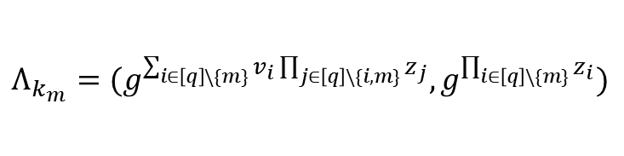
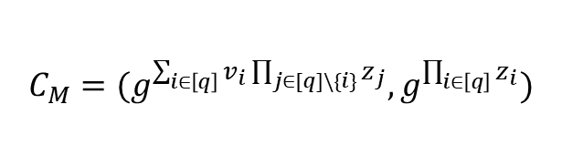
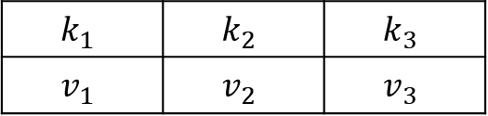
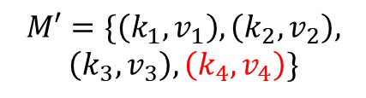
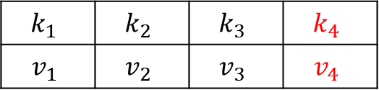
西安邮电大学
XI'AN UNIVERSITY OF POSTS
& TELECOMMUNICATIONS
insert-only key-value commitment
$$k_{1}$$ | $$k_{2}$$ | $$k_{3}$$
$$v_{1}$$ | $$v_{2}$$ | $$v_{3}$$
$$k_{1}$$ | $$k_{2}$$ | $$k_{3}$$ | $$k_{4}$$
$$v_{1}$$ | $$v_{2}$$ | $$v_{3}$$ | $$v_{4}$$
$$M′=\{\left(k_{1},v_{1}\right),\left(k_{2},v_{2}\right),$$
$$\left(k_{3},v_{3}\right),\left(k_{4},v_{4}\right)\}$$
$$C_{M}=(g^{\sum_{i∈\left[q\right]}{v_{i}\prod_{j∈[q]\backslash \{i\}}{z_{j}}}},g^{\prod_{i∈\left[q\right]}{z_{i}}})$$
$$Λ_{k_{m}}=(g^{\sum_{i∈\left[q\right]\backslash \{m\}}{v_{i}\prod_{j∈\left[q\right]\backslash \{i,m\}}{z_{j}}}},g^{\prod_{i∈\left[q\right]\backslash \{m\}}{z_{i}}})$$
$$C_{M}= \left(g^{v_{1}z_{2}z_{3}+v_{2}z_{1}z_{3}+v_{3}z_{1}z_{2}},g^{z_{1}z_{2}z_{3}}\right)=(C_{M,1},C_{M,2})$$
$$Λ_{k_{1}}=\left(g^{v_{2}z_{3}+v_{3}z_{2}},g^{z_{2}z_{3}}\right)=(Λ_{k_{1},1},Λ_{k_{1},2})$$
$C_{M′}^{′}=\left(g^{v_{1}z_{2}z_{3}z_{4}+v_{2}z_{1}z_{3}z_{4}+v_{3}z_{1}z_{2}z_{4}+v_{4}z_{1}z_{2}z_{3}},g^{z_{1}z_{2}z_{3}z_{4}}\right)$ $=\left({\left(g^{v_{1}z_{2}z_{3}+v_{2}z_{1}z_{3}+v_{3}z_{1}z_{2}}\right)}^{z_{4}} ∙ {\left(g^{z_{1}z_{2}z_{3}}\right)}^{v_{4}},{\left(g^{z_{1}z_{2}z_{3}}\right)}^{z_{4}}\right)$
$={(C_{M,1})}^{z_{4}}∙ {\left(C_{M,2}\right)}^{v_{4}},$ ${\left(C_{M,2}\right)}^{z_{4}}$
$Λ_{k_{1}}^{′}=\left(g^{v_{2}z_{3}z_{4}+v_{3}z_{2}z_{4}+v_{4}z_{2}z_{3}},g^{z_{2}z_{3}z_{4}}\right)=$ $({\left(g^{v_{2}z_{3}+v_{3}z_{2}}\right)}^{z_{4}} ∙ {\left(g^{z_{2}z_{3}}\right)}^{v_{4}},$ ${\left(g^{z_{2}z_{3}}\right)}^{z_{4}})$
$={(Λ_{k_{1},1})}^{z_{4}} ∙ {\left(Λ_{k_{1},2}\right)}^{v_{4}},{\left(Λ_{k_{1},2}\right)}^{z_{4}})$

Slide 17

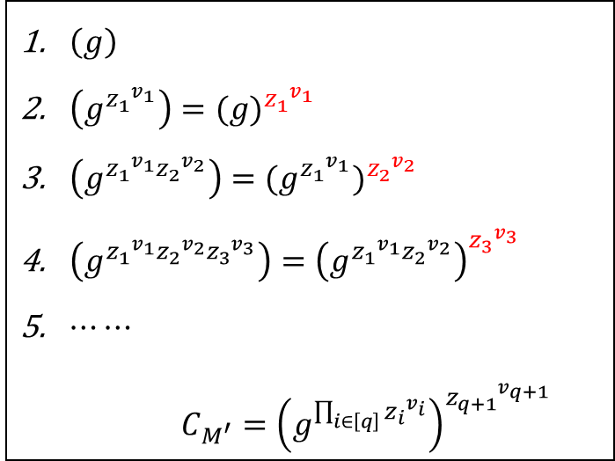

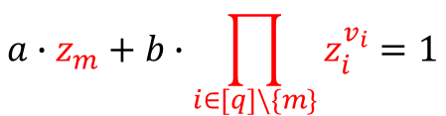
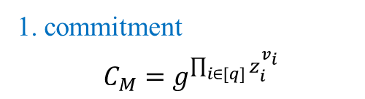
西安邮电大学
XI'AN UNIVERSITY OF POSTS
& TELECOMMUNICATIONS
Increment-only key-value commitment
1. commitment
$$C_{M}=g^{\prod_{i∈[q]}{z_{i}^{v_{i}}}}$$
3.non-membership proofs
$$a∙z_{m}+b∙\prod_{i∈[q]\backslash \{m\}}{z_{i}^{v_{i}}}=1$$
2.Proof
$$Λ_{k_{m}}=g^{\prod_{i∈[q]\backslash \{m\}}{z_{i}^{v_{i}}}}$$
$\left(g\right)$
$\left(g^{{z_{1}}^{v_{1}}}\right)={(g)}^{{z_{1}}^{v_{1}}}$
${\left(g^{{z_{1}}^{v_{1}}{z_{2}}^{v_{2}}}\right)=(g^{{z_{1}}^{v_{1}}})}^{{z_{2}}^{v_{2}}}$
$\left(g^{{z_{1}}^{v_{1}}{z_{2}}^{v_{2}}{z_{3}}^{v_{3}}}\right)={\left(g^{{z_{1}}^{v_{1}}{z_{2}}^{v_{2}}}\right)}^{{z_{3}}^{v_{3}}}$
$⋯⋯$
$C_{M^{′}}={\left(g^{\prod_{i∈\left[q\right]}{{z_{i}}^{v_{i}}}}\right)}^{{z_{q+1}}^{v_{q+1}}}$
Proof
Proof update is an insertion
Verification is an “insertion”
$$Λ_{k_{m}}^{{z_{m}}^{v_{m}}}=C_{M}$$

Slide 18

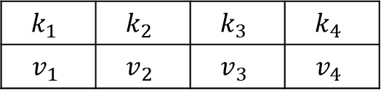


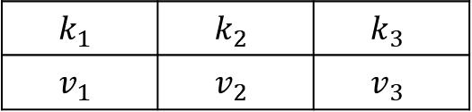

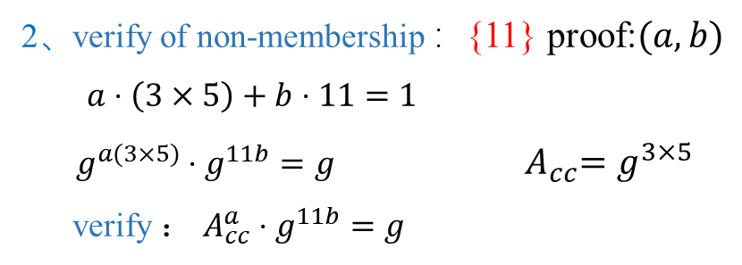

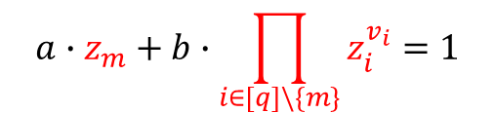

西安邮电大学
XI'AN UNIVERSITY OF POSTS
& TELECOMMUNICATIONS
Increment-only key-value commitment
$$C_{M}=g^{\prod_{i∈[q]}{z_{i}^{v_{i}}}}$$
$$k_{1}$$ | $$k_{2}$$ | $$k_{3}$$ | $$k_{4}$$
$$v_{1}$$ | $$v_{2}$$ | $$v_{3}$$ | $$v_{4}$$
$$k_{1}$$ | $$k_{2}$$ | $$k_{3}$$
$$v_{1}$$ | $$v_{2}$$ | $$v_{3}$$
$$Λ_{k_{m}}=g^{\prod_{i∈[q]\backslash \{m\}}{z_{i}^{v_{i}}}}$$
$$a∙z_{m}+b∙\prod_{i∈[q]\backslash \{m\}}{z_{i}^{v_{i}}}=1$$
$$C_{M}= \left(g^{{z_{1}}^{v_{1}}{z_{2}}^{v_{2}}{z_{3}}^{v_{3}}{z_{4}}^{v_{4}}}\right)={\left(g^{{z_{1}}^{v_{1}}{z_{2}}^{v_{2}}{z_{3}}^{v_{3}}}\right)}^{{z_{4}}^{v_{4}}}$$
$$C_{M}= \left(g^{{z_{1}}^{v_{1}}{z_{2}}^{v_{2}}{z_{3}}^{v_{3}}}\right)$$
$Λ_{k_{1}}=$ $g^{{z_{2}}^{v_{2}}{z_{3}}^{v_{3}}{z_{4}}^{v_{4}}}$
$Λ_{k_{1}}=$ $g^{{z_{2}}^{v_{2}}{z_{3}}^{v_{3}}}$
verify non-membership {$\left(k_{4},v_{4}\right)$}
2、verify of non-membership ：{11} proof:$(a,b)$
$a⋅\left(3×5\right)+b⋅11=1$
$g^{a(3×5)}⋅g^{11b}=g$ ${ A}_{cc}=g^{3×5}$
verify ： $A_{cc}^{a}⋅g^{11b}=g$
$$a∙z_{4}+b∙({z_{1}}^{v_{1}}{z_{2}}^{v_{2}}{z_{3}}^{v_{3}})=1$$
$g^{a(z_{4})}⋅g^{b({z_{1}}^{v_{1}}{z_{2}}^{v_{2}}{z_{3}}^{v_{3}})}=g$
$g^{a(z_{4})}⋅{C_{M}}^{b}=g$

Slide 19
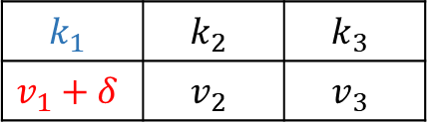

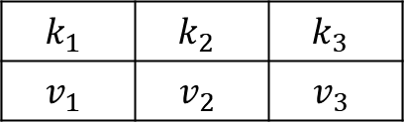

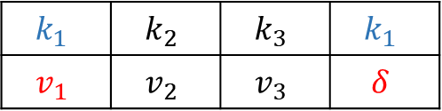
西安邮电大学
XI'AN UNIVERSITY OF POSTS
& TELECOMMUNICATIONS
All together key-value commitment
$$k_{1}$$ | $$k_{2}$$ | $$k_{3}$$
$$v_{1}$$ | $$v_{2}$$ | $$v_{3}$$
$$k_{1}$$ | $$k_{2}$$ | $$k_{3}$$
$$v_{1}+δ$$ | $$v_{2}$$ | $$v_{3}$$
$$k_{1}$$ | $$k_{2}$$ | $$k_{3}$$ | $$k_{1}$$
$$v_{1}$$ | $$v_{2}$$ | $$v_{3}$$ | $$δ$$
$$C_{M}=(g^{\left(\sum_{i∈\left[q\right]}{v_{i}\prod_{j∈[q]\backslash \{i\}}{z_{j}}}\right)∙\prod_{i∈\left[q\right]}{z_{i}^{u_{i}}}},g^{\prod_{i∈[q]}{{z_{i}}^{u_{i}+1}}})$$
$$Λ_{k_{m}}=(g^{\left(\sum_{i∈\left[q\right]\backslash \{m\}}{v_{i}\prod_{j∈\left[q\right]\backslash \{i,m\}}{z_{j}}}\right)∙\prod_{i∈\left[q\right]\backslash \{m\}}{z_{i}^{u_{i}}}},g^{\prod_{i∈[q]\backslash \{m\}}{{z_{i}}^{u_{i}+1}}})$$
$\left(1,g\right)$
$\left(g^{v_{1}},g^{z_{1}}\right)=({\left(1\right)}^{z_{1}}∙{\left(g\right)}^{v_{1}},{(g)}^{z_{1}})$
$\left(g^{v_{1}z_{2}+v_{2}z_{1}},g^{z_{1}z_{2}}\right)=({\left(g^{v_{1}}\right)}^{z_{2}} ∙ {\left(g^{z_{1}}\right)}^{v_{2}},{(g^{z_{1}})}^{z_{2}})$
$\left(g^{v_{1}z_{2}z_{3}+v_{2}z_{1}z_{3}+v_{3}z_{1}z_{2}},g^{z_{1}z_{2}z_{3}}\right)=\left({\left(g^{v_{1}z_{2}+v_{2}z_{1}}\right)}^{z_{3}} ∙ {\left(g^{z_{1}z_{2}}\right)}^{v_{3}},{\left(g^{z_{1}z_{2}}\right)}^{z_{3}}\right)$
$\left(g^{({(v}_{1}{+δ)∙z}_{2}z_{3}+v_{2}z_{1}z_{3}+v_{3}z_{1}z_{2})z_{1}},g^{{z_{1}}^{2}z_{2}z_{3}}\right)=\left({\left(g^{v_{1}z_{2}z_{3}+v_{2}z_{1}z_{3}+v_{3}z_{1}z_{2}}\right)}^{z_{1}} ∙ {\left(g^{z_{1}z_{2}z_{3}}\right)}^{δ},{\left(g^{z_{1}z_{2}z_{3}}\right)}^{z_{1}}\right)$
……
$$C_{M^{′}}=({{(g}^{\sum_{i∈\left[q\right]}{v_{i}}\prod_{j∈[q]\{i\}}{z_{j}}})}^{z_{q+1}} ∙{\left(g^{\prod_{i∈\left[q\right]}{z_{i}}}\right)}^{δ},{\left(g^{\prod_{i∈\left[q\right]}{z_{i}}}\right)}^{z_{q+1}})$$
$$C_{M′}=(C_{M,1}^{z_{m}}∙C_{M,2}^{δ},C_{M,2}^{z_{m}})$$

Slide 20
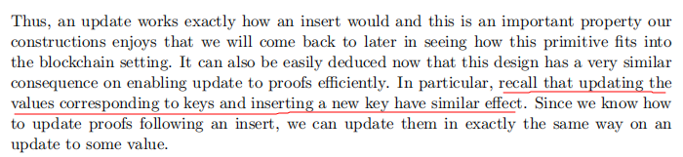

西安邮电大学
XI'AN UNIVERSITY OF POSTS
& TELECOMMUNICATIONS
All together key-value commitment
$$C_{M}=(g^{\left(\sum_{i∈\left[q\right]}{v_{i}\prod_{j∈[q]\backslash \{i\}}{z_{j}}}\right)∙\prod_{i∈\left[q\right]}{z_{i}^{u_{i}}}},g^{\prod_{i∈[q]}{{z_{i}}^{u_{i}+1}}})$$
$$C_{M′}=(C_{M,1}^{z_{m}}∙C_{M,2}^{δ},C_{M,2}^{z_{m}})$$
Update=Insert
Inc-only KVC of the number of updates

Slide 21
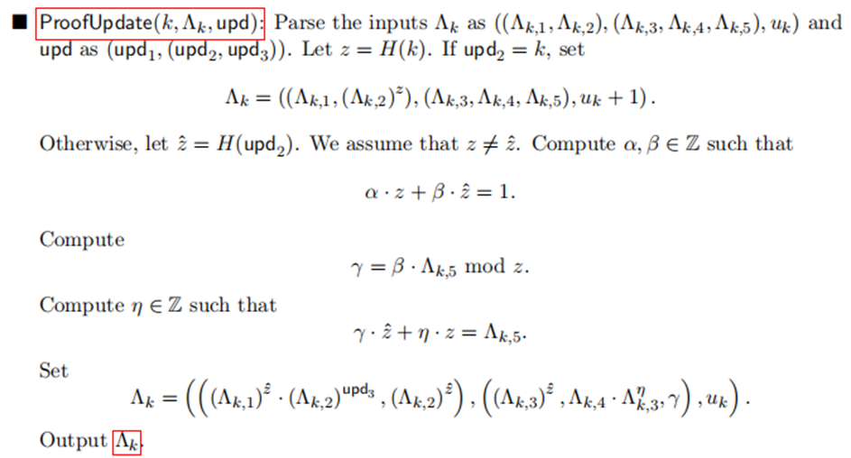
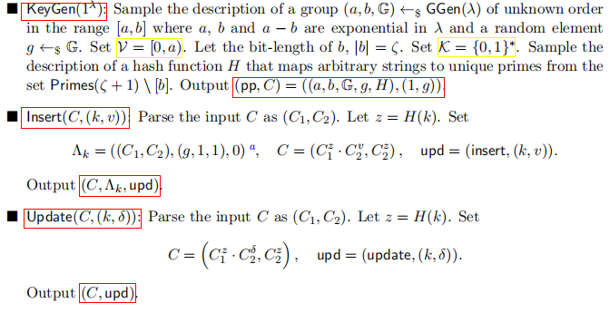
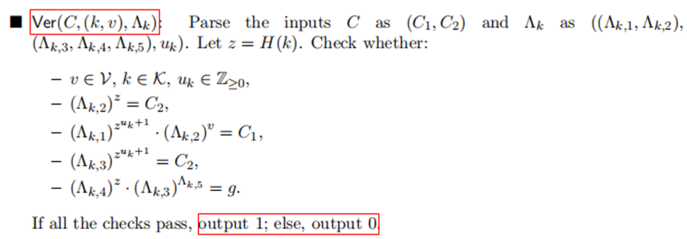
西安邮电大学
XI'AN UNIVERSITY OF POSTS
& TELECOMMUNICATIONS
KVC construction

Slide 22
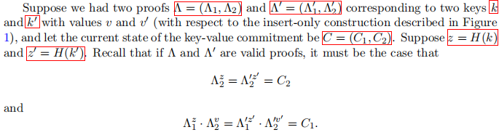

西安邮电大学
XI'AN UNIVERSITY OF POSTS
& TELECOMMUNICATIONS
Aggregating Proofs
Aggregate proofs and batch-verify
proofs corresponding to multiple keys can be combined into a single proof and “batch” verified in one shot
combined proofs cannot be combined further
Inc-only KVC has a “non-membership proof”

Slide 23









西安邮电大学
XI'AN UNIVERSITY OF POSTS
& TELECOMMUNICATIONS
Aggregating Proofs
$$k_{1}$$ | $$k_{2}$$ | $$k_{3}$$
$$v_{1}$$ | $$v_{2}$$ | $$v_{3}$$
$$M=\{\left(k_{1},v_{1}\right),\left(k_{2},v_{2}\right),\left(k_{3},v_{3}\right)\}$$
$$C_{M}=(g^{\sum_{i∈\left[q\right]}{v_{i}\prod_{j∈[q]\backslash \{i\}}{z_{j}}}},g^{\prod_{i∈\left[q\right]}{z_{i}}})$$
$$Λ_{k_{m}}=(g^{\sum_{i∈\left[q\right]\backslash \{m\}}{v_{i}\prod_{j∈\left[q\right]\backslash \{i,m\}}{z_{j}}}},g^{\prod_{i∈\left[q\right]\backslash \{m\}}{z_{i}}})$$
$$C_{M}= \left(g^{v_{1}z_{2}z_{3}+v_{2}z_{1}z_{3}+v_{3}z_{1}z_{2}},g^{z_{1}z_{2}z_{3}}\right)=(C_{M,1},C_{M,2})$$
Aggregate proofs
$\left(k_{1},v_{1}\right)$proof:
$$Λ_{k_{1}}=\left(g^{v_{2}z_{3}+v_{3}z_{2}},g^{z_{2}z_{3}}\right)=(Λ_{k_{1},1},Λ_{k_{1},2})$$
$$Λ_{k_{1},k_{2}}=\left(Λ_{k_{1},k_{2},1},Λ_{k_{1},k_{2},2}\right)=(g^{v_{3}},g^{z_{3}})$$
$\left(k_{2},v_{2}\right)$proof:
$Λ_{k_{2}}=\left(g^{v_{1}z_{3}+v_{3}z_{1}},g^{z_{1}z_{3}}\right)$ $=(Λ_{k_{2},1},Λ_{k_{2},2})$
batch-verify
verify:
$$Λ_{k_{1},2}^{z_{1}}=Λ_{k_{2},2}^{z_{2}}=C_{M,2}$$
$$Λ_{k_{1},k_{2},2}^{z_{1}z_{2}}=C_{M,2}$$
$$Λ_{k_{1},1}^{z_{1}}∙Λ_{k_{1},2}^{v_{1}}=Λ_{k_{2},1}^{z_{2}}∙Λ_{k_{2},2}^{v_{2}}=C_{M,1}$$
$Λ_{k_{1},k_{2},1}^{z_{1}z_{2}}∙Λ_{k_{1},k_{2},2}^{v_{1}z_{2}+v_{2}z_{1}}=$ $C_{M,1}$

Slide 24
西安邮电大学
XI'AN UNIVERSITY OF POSTS
& TELECOMMUNICATIONS
Conclusion
KVC with efficient
Update
Proof Update
Proof Verification
Independent of the size of the map
KVC properties
Succinct encoding
Succinct proofs & fast verification
Fast updates
Trustless set-up
Aggregation & batching

