Slide 1

Optimal Verifiable Data Streaming
Protocol with Data Auditing
Jianghong Wei
ESORICS 2021
汇报人：武盼汝

Slide 2















回顾
$Setup\left(1^{λ}\right)→\left(pk,sk\right)$
$Append(sk,d)→(sk′)$
$Query(pk,DB,i)→(d_{i},π_{i} )$
$Verify\left(pk,i,π_{i},d_{i}\right)→\left(1,0\right)$
$Update(pk,DB,sk,i,d^{′})→(d^{′},pk^{′},sk′)$
Nearly Optimal Verifiable Data Streaming（PKC 2016）
签名＋双线性映射累加器构造VDS-2
Batching Techniques for Accumulators with Applications to IOPs and Stateless Blockchains （CRYPTO 2019）
批处理RSA累加器
Optimal Verifiable Data Streaming Protocol with Data Auditing（本文）
使用批处理累加器替代双线性映射累加器
增加审计功能
$$s_{1}$$
$$s_{3}$$
$$acc=g^{s_{1}∗s_{3}}$$
$$σ←Sign(ssk,m)$$
$$s_{1}′$$
$$s_{2}$$
$$s_{3}′$$
$$s_{4}$$
$$…$$
$$m=s_{i}||tag||cnt$$
$$1$$
$$2$$
$$3$$
$$4$$

Slide 3
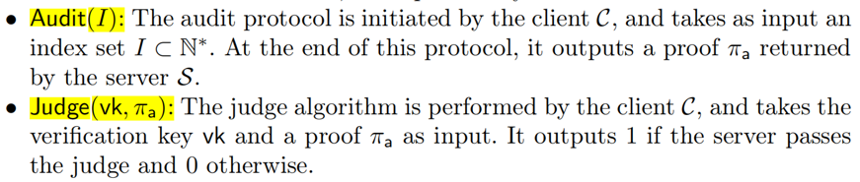
VADS

Slide 4
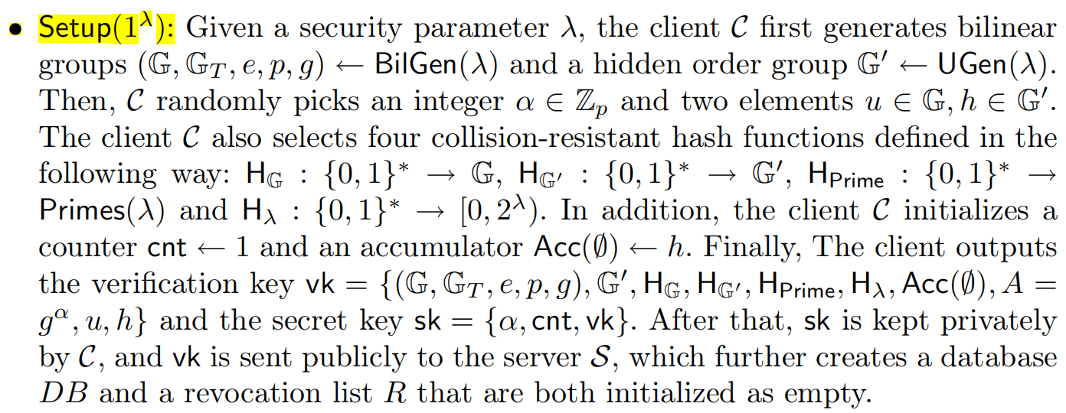







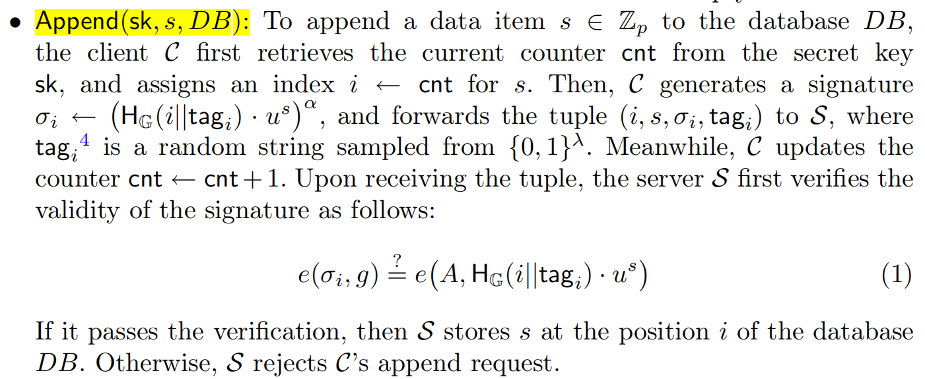








VADS
$$=1$$
$$cnt=2$$
DB:
$$s_{1}$$
…
1
$$cnt=4$$
DB:
$$s_{1}$$
$$s_{2}$$
$$s_{4}$$
$$s_{4}$$
i=1
3
2
4

Slide 5
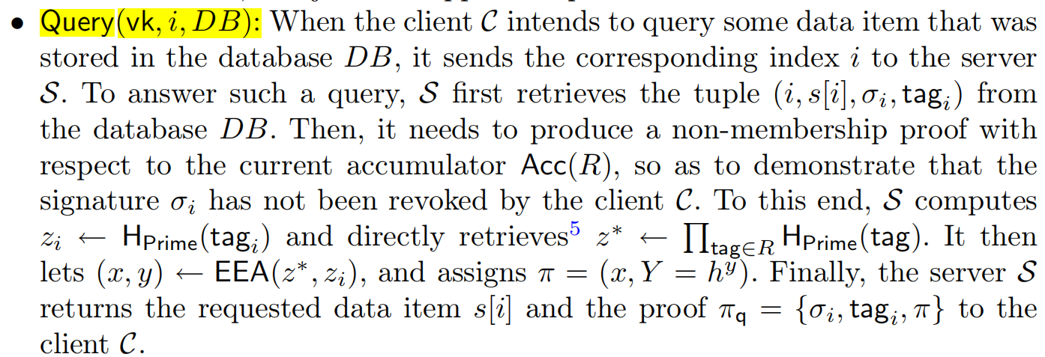




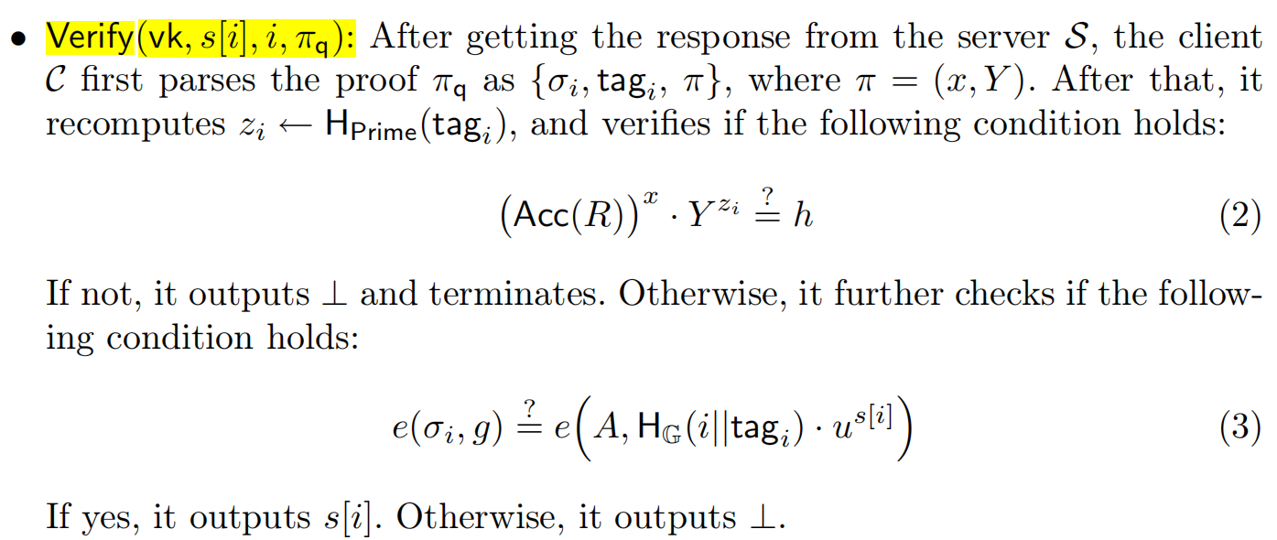





VADS
i=1
$$cnt=4$$
DB:
$$s_{1}$$
$$s_{2}$$
$$s_{4}$$
$$s_{4}$$
i=1
3
2
4

Slide 6
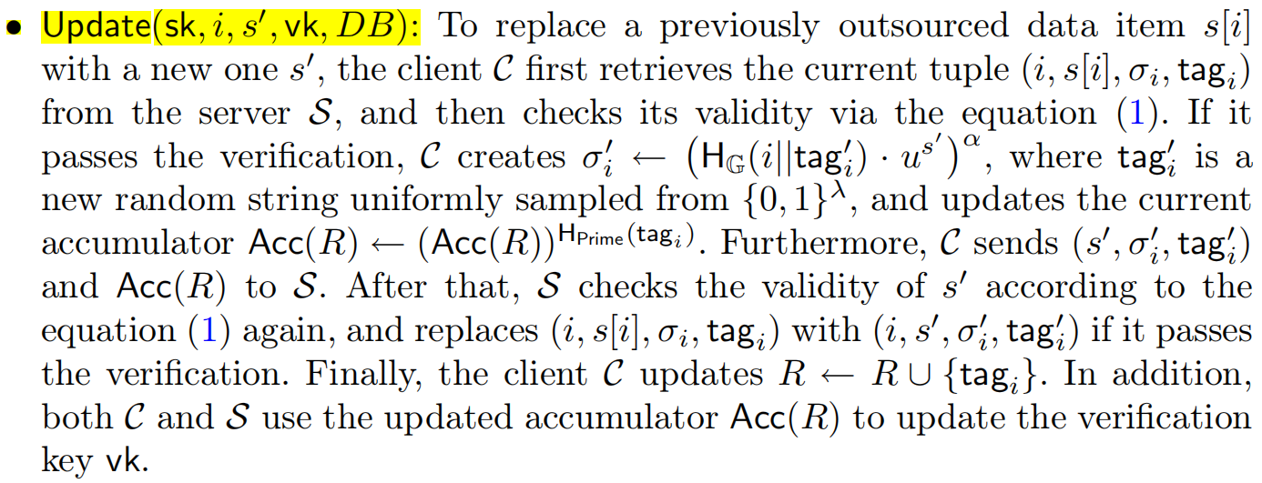









VADS
i=1
$$cnt=4$$
DB:
$$s_{1}′$$
$$s_{2}$$
$$s_{4}$$
$$s_{4}$$
$$s_{1}$$
i=1
3
2
4
$$acc=g^{s_{1}}$$

Slide 7
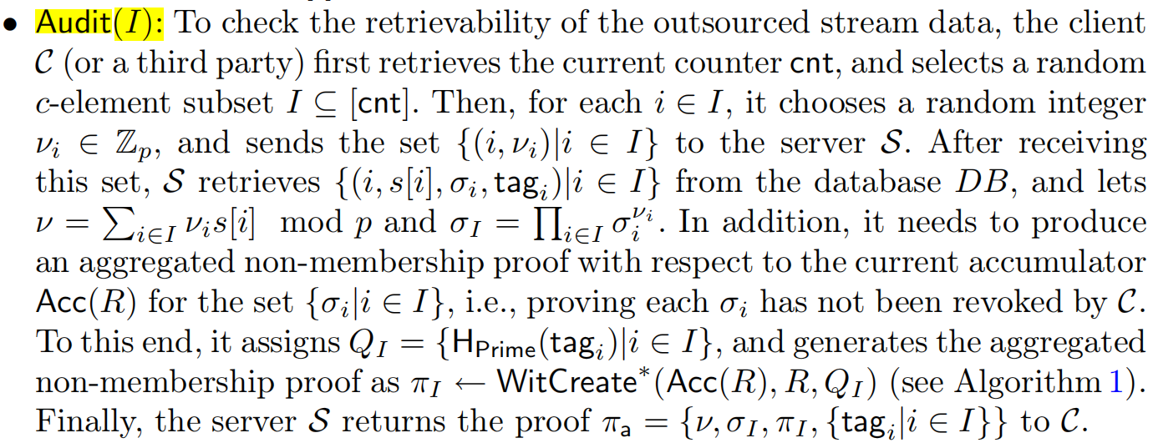
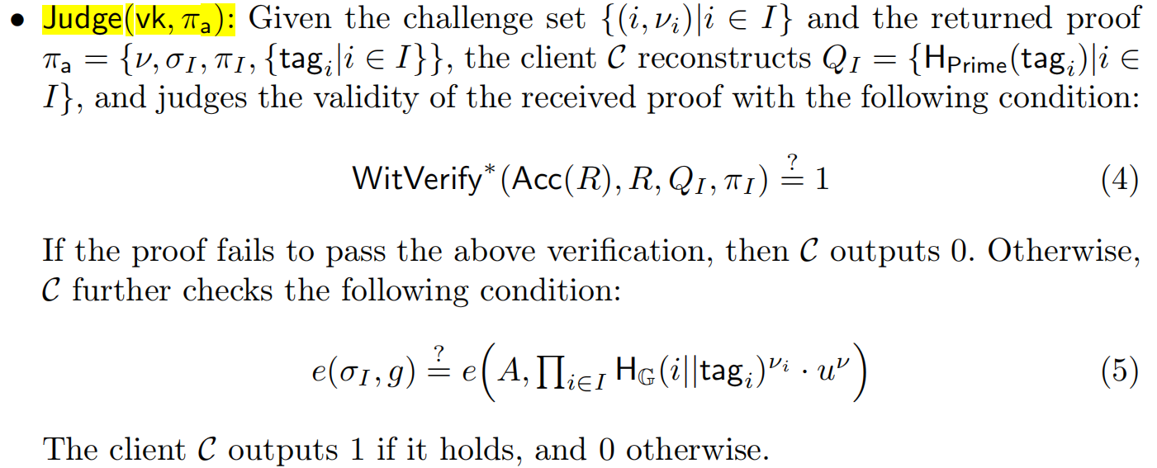
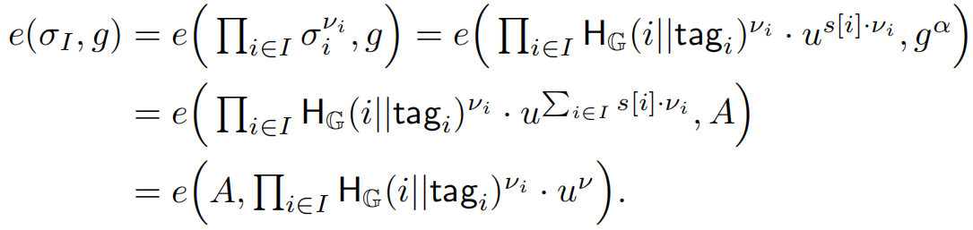











VADS
$$I=\left[1,2\right]⊆[cnt]$$
$$\{\left(1,v_{1}\right),\left(2,v_{2}\right)\}$$
$$\{\left(1,s\left[1\right],σ_{1},{tag}_{1}\right),$$
$$\left(2,s\left[2\right],σ_{2},{tag}_{2}\right)\}$$
$ν=Σ_{iεI}$ $v_{i}s\left[i\right] mod p$
$= v_{1}s\left[1\right]+v_{2}s\left[2\right]$
$σ_{I}=σ_{1}^{ν_{1}}$ $σ_{2}^{ν_{2}}$
$$Q_{I}=\{H_{prime}({tag}_{I})\}$$
DB:
$$s_{1}′$$
$$s_{2}′$$
$$s_{4}$$
$$s_{4}$$
i=1
3
2
4
$$s_{2}$$
$$acc=$$
$$s_{1}$$

Slide 8
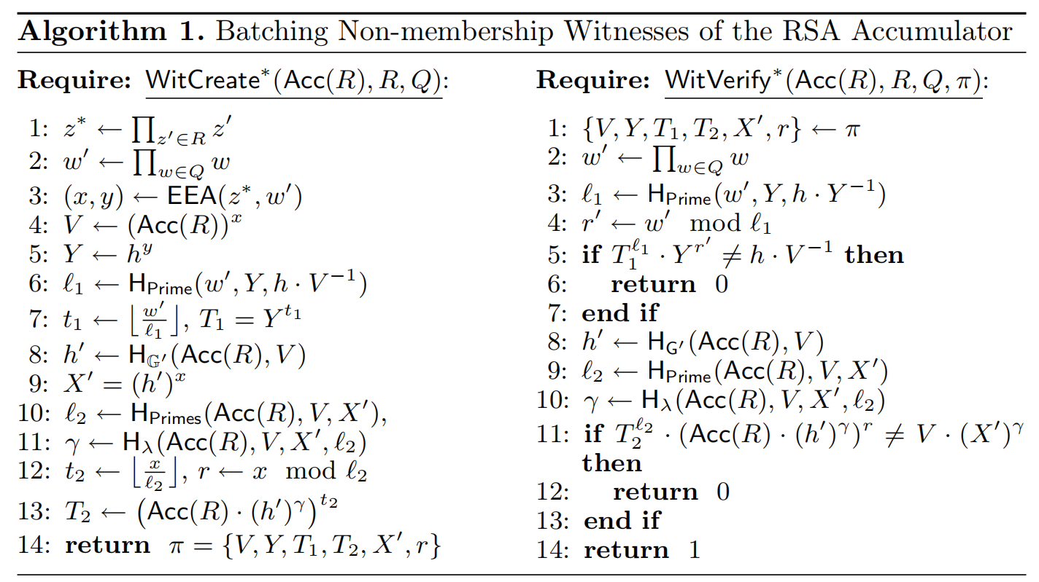
VADS

