Slide 1

Publicly Verifiable Databases with All Efficient
Updating Operations
X. Chen et al
IEEE Transactions on Knowledge and Data Engineering
汇报人：武盼汝

Slide 2
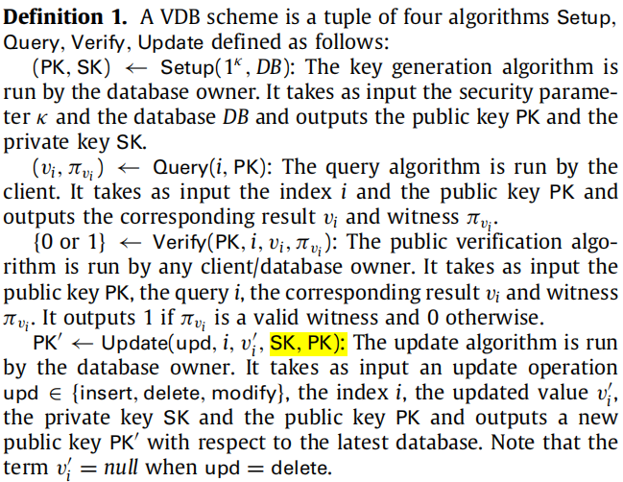
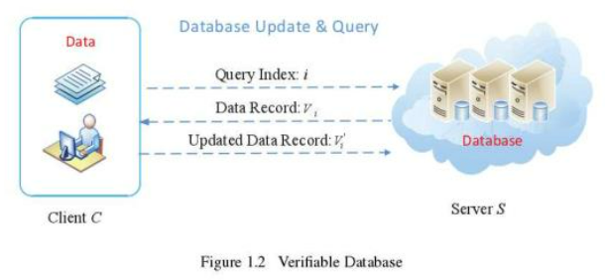
VDB(Verifiable Database)

Slide 3

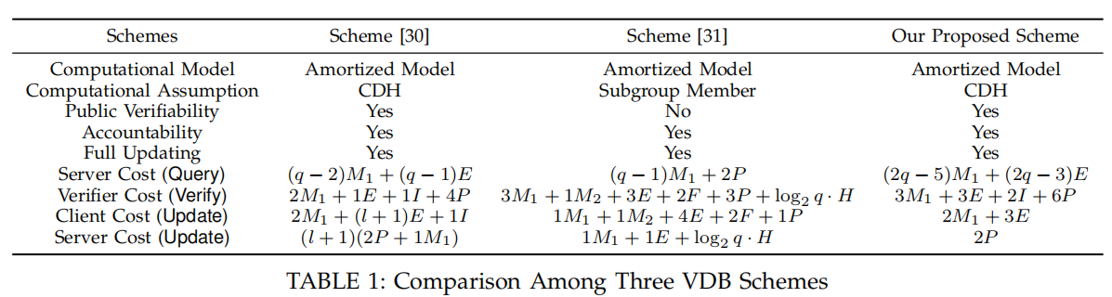

Related work
[30] M. Miao, J. Wang, J. Ma, Publicly verifiable databases with efficient insertion/deletion operations, 2017.
[31] M. Miao, J. Ma, Efficient verifiable databases with insertion/deletion operations from delegating polynomial functions, 2018.

Slide 4
目录
VDB：
CIBF和Increasing CIBF构造
BF CBF IBF
IBF+VC构造CIBF
VDB 1(使用CIBF)
VDB 2(使用Increasing CIBF)
不能删除？

Slide 5

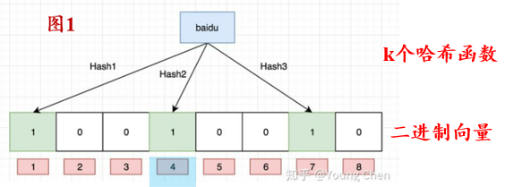
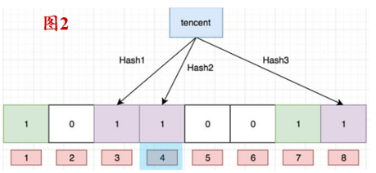
BF (bloom filter)
1. 判断key在集合时，一定概率key其实不在集合中
2. 无法删除，如何解决？？
3. 适用于静态集合
Query abc，映射为1、5、8
Query abd，映射为1、3、4
Notes:
随增加值越多，被置为 1 的 bit 位也越多，某个值 tao即使没被存储过，但万一哈希函数返回三个 bit 位都被其他值置为了 1 ，那么程序还是会判断tao这个值存在。

Slide 6

CBF (Counting BF)
只能用0/1
计数器
支持删除
2
2
2
2
4
4
2
2
2
1
2
1
2
2
1
4
1
2
1
2
2
2
1
1
1
2
1
1
1
2
1
1
1
3
1
1
3
1
2
1
2
2
1
2
1
1
1
1
1
2
2
2
2
2
3
3
3
3
3
4
4
4
4
4
5
5
5
5
5
6
6
6
6
6
7
7
7
7
1
7
1
1
1
1
2
2
2
2
2
3
3
3
3
3
4
4
4
4
4
5
5
5
5
5
6
6
6
6
6
7
7
7
7
7
BF
CBF
删除
计数器
2
1
2
2
3
4
1
2
2
2
1
2
1
1
2
1
1
3
1
2
1
2
添加删除元素到CBF中
1
1
1
1
1
2
2
2
2
2
3
3
3
3
3
4
4
4
4
4
5
5
5
5
5
6
6
6
6
6
7
7
7
7
Ren：1，3，5
7
CBF删除Ren
Sheng：1，3，6
删除Ren后，query Ren：
Ru：2，3，6
Xi：2，3，5

Slide 7



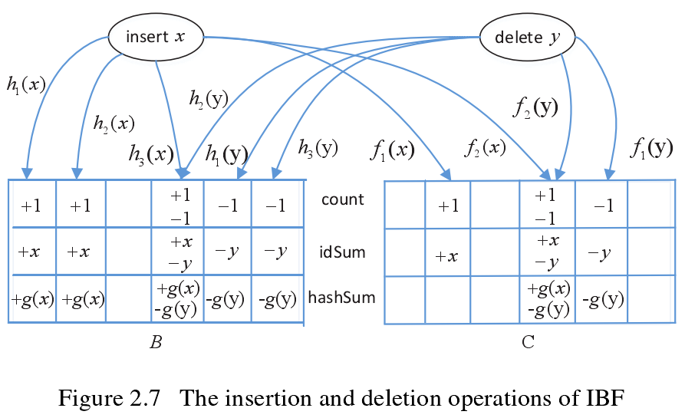
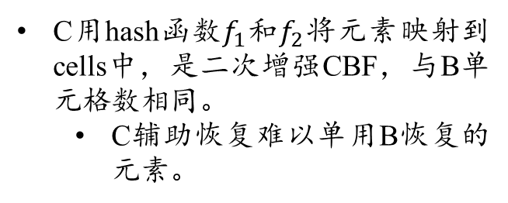
IBF (Invertible Bloom filter)
IBF：
C用hash函数$f_{1}$和$f_{2}$将元素映射到cells中，是二次增强CBF，与B单元格数相同。
C辅助恢复难以单用B恢复的元素。
BF
辅助BF

Slide 8




















IBF (Invertible Bloom filter)
1
2
3
4
5
6
1
2
3
4
5
6
2 1
2
4 3
2 1
2
count
1
3 2
1 0
1
1
1
ab
cd
abcd
ad
bc
idsum
b
abd
a
c
c
d
$$g\left(a\right)$$
$$g\left(c\right)$$
$$g\left(a\right)$$
$$g\left(a\right)$$
$$g\left(b\right)$$
$$g\left(a\right)$$
$$g\left(b\right)$$
$$g\left(b\right)$$
$$g\left(d\right)$$
hashsum
$$g\left(d\right)$$
$$g\left(d\right)$$
$$g\left(c\right)$$
$$g\left(c\right)$$
$$g\left(b\right)$$
$$g\left(b\right)$$
$$g\left(a\right)$$
$$g\left(c\right)$$
$$g\left(c\right)$$
$$g\left(d\right)$$
$$g\left(d\right)$$
C
B
为测试cells是否纯，用它的hashsum
纯cells中，计算此等式成立，不纯不成立
a： C:1，3，5 B：2，3
b： C：1，3，6 B：1，2
c： C：2，3，6 B：4，5
d： C：2，3，5 B：2，6
非成员e：C: 2,3,6 B: 1,4

Slide 9
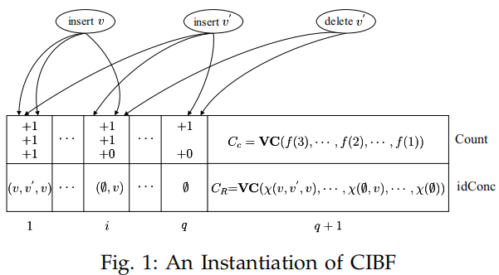

CIBF和IBF
哈希函数
CIBF:
IBF:
Field
CIBF：idConc：存储有序元素的连接值
IBF：idSum
原因：每个数据记录应该被存在服务器中
Field
CIBF：不需要，因为不需要逆向找具体元素，因为服务器知道所有元素
IBF：hashSum
存储
CIBF：存储前面值的承诺
VC
VC

Slide 10

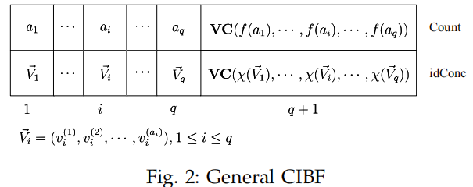
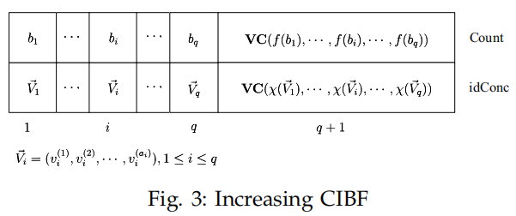








committed invertible Bloom filter (CIBF)（实例化）
缺点：公开所有$a_{i}$，开销大。
解决：Increasing CIBF:
B[i].count中所有元素都是递增序列。
Query index $\overline{x}=5$
$3<5≤5$则x=2
$3<5≤5$则x=2
在第2个中位置
$$l=5−3=2$$
$$b_{1}=3$$
$b_{2}=$5
$$b_{3}=6$$

Slide 11
目录
VDB：
CIBF和Increasing CIBF构造
VDB 1(使用CIBF)
VDB 2(使用Increasing CIBF)

Slide 12
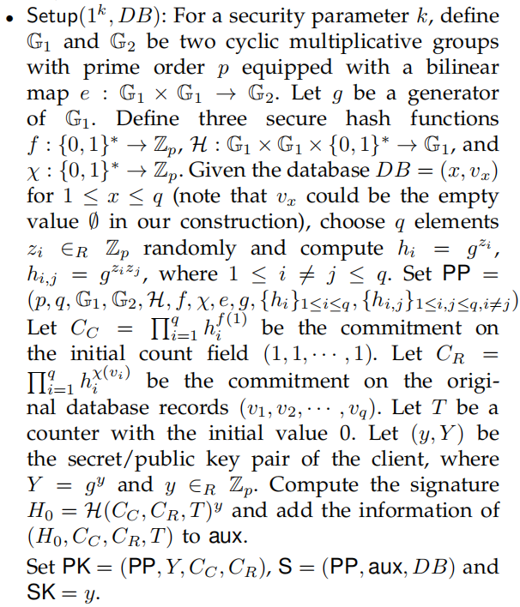










CIBF构造VDB方案
初始数据库：
例：初始数据库q=4，T=0，签名
1
1
1
1
$$C_{C}=$$
$$g^{z_{1}f\left(1\right)+z_{2}f\left(1\right)+z_{3}f\left(1\right)+z_{4}f\left(1\right)}$$
$$C_{R}=$$
$$g^{z_{1}x\left(v_{1}\right)+z_{2}x\left(v_{2}\right)+z_{3}x\left(v_{3}\right)+z_{4}x\left(v_{4}\right)}$$
$$v_{1}$$
$$v_{2}$$
$$v_{3}$$
$$v_{4}$$

Slide 13

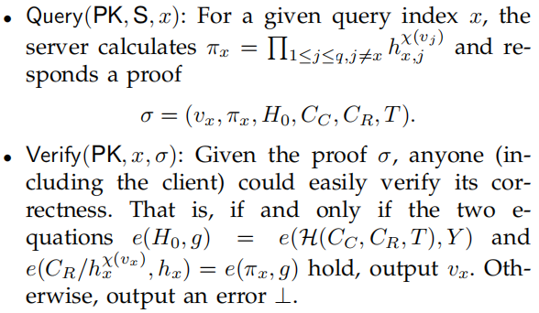







例：初始数据库q=4，T=0，
1
1
1
1
$$C_{C}=$$
$$g^{z_{1}f\left(1\right)+z_{2}f\left(1\right)+z_{3}f\left(1\right)+z_{4}f\left(1\right)}$$
$$C_{R}=$$
$$g^{z_{1}x\left(v_{1}\right)+z_{2}x\left(v_{2}\right)+z_{3}x\left(v_{3}\right)+z_{4}x\left(v_{4}\right)}$$
$$v_{1}$$
$$v_{2}$$
$$v_{3}$$
$$v_{4}$$
Query x=3
=$h_{3,1}^{x(v_{1})}$ $h_{3,2}^{x(v_{2})}$ $h_{3,4}^{x(v_{4})}$
=($v_{3}$,$π_{3}$, $H_{0},C_{c}$, $C_{R}$,T=0)
Verify
验证签名
验证该数据是否存在VDB中

Slide 14

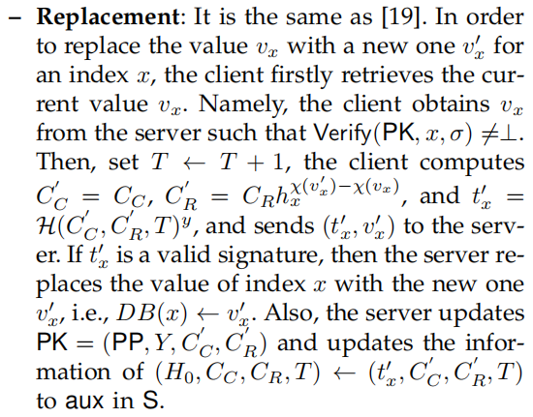





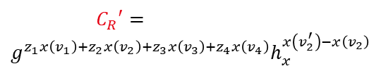



例：初始数据库q=4，T=1，
1
1
1
1
$$C_{C}′= C_{C}=$$
$$g^{z_{1}f\left(1\right)+z_{2}f\left(1\right)+z_{3}f\left(1\right)+z_{4}f\left(1\right)}$$
$$C_{R}′=$$
$$g^{z_{1}x\left(v_{1}\right)+z_{2}x\left(v_{2}\right)+z_{3}x\left(v_{3}\right)+z_{4}x\left(v_{4}\right)}h_{x}^{x\left(v_{2}^{′}\right)−x\left(v_{2}\right)}$$
$$v_{1}$$
$v_{2}$’
$$v_{3}$$
$$v_{4}$$
=$g^{z_{1}x\left(v_{1}\right)+z_{2}x\left(v_{2}\right)+z_{3}x\left(v_{3}\right)+z_{4}x\left(v_{4}\right)}g_{}^{z_{2}x\left(v_{2}^{′}\right)−x\left(v_{2}\right)}$
$$=g^{z_{1}x\left(v_{1}\right)+z_{2}x\left(v_{2}′\right)+z_{3}x\left(v_{3}\right)+z_{4}x\left(v_{4}\right)}$$
例：初始数据库q=4，T=2。
删除$v_{2}$’：
1
1
1
1
$$C_{C}′= C_{C}=$$
$$g^{z_{1}f\left(1\right)+z_{2}f\left(1\right)+z_{3}f\left(1\right)+z_{4}f\left(1\right)}$$
$$C_{R}′=$$
$$g^{z_{1}x\left(v_{1}\right)+z_{2}x\left(∅\right)+z_{3}x\left(v_{3}\right)+z_{4}x\left(v_{4}\right)}$$
$$v_{1}$$
$$v_{3}$$
$$v_{4}$$

Slide 15
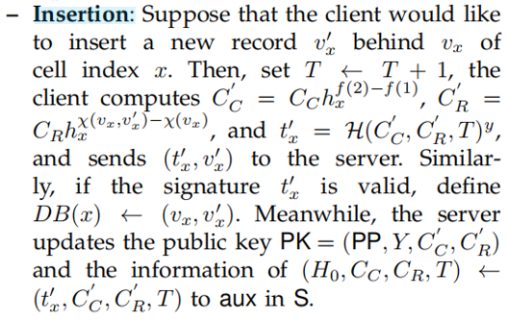





例：初始数据库q=4，T=3。
添加$v_{1}$’：
a=2
1
1
1
$$C_{C}′=$$
$$g^{z_{1}f\left(2\right)+z_{2}f\left(1\right)+z_{3}f\left(1\right)+z_{4}f\left(1\right)}$$
$${\{v}_{1},v_{1}\text{’}\}$$
$$C_{R}′=$$
$$g^{z_{1}x\left(v_{1},v_{1}′\right)+z_{2}x\left(∅\right)+z_{3}x\left(v_{3}\right)+z_{4}x\left(v_{4}\right)}$$
$$v_{3}$$
$$v_{4}$$
Query x=3
$$a_{1}<3≤a_{1}+a_{2}$$

Slide 16
目录
VDB：
CIBF和Increasing CIBF构造
VDB 1(使用CIBF)
VDB 2(使用Increasing CIBF)

Slide 17
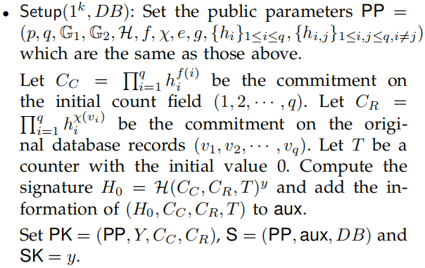

Increasing CIBF构造VDB
例：初始数据库q=4，T=0，
1
2
3
4
$$C_{C}=$$
$$g^{z_{1}f\left(1\right)+z_{2}f\left(2\right)+z_{3}f\left(3\right)+z_{4}f\left(4\right)}$$
$$C_{R}=$$
$$g^{z_{1}x\left(v_{1}\right)+z_{2}x\left(v_{2}\right)+z_{3}x\left(v_{3}\right)+z_{4}x\left(v_{4}\right)}$$
$$v_{1}$$
$$v_{2}$$
$$v_{3}$$
$$v_{4}$$

Slide 18
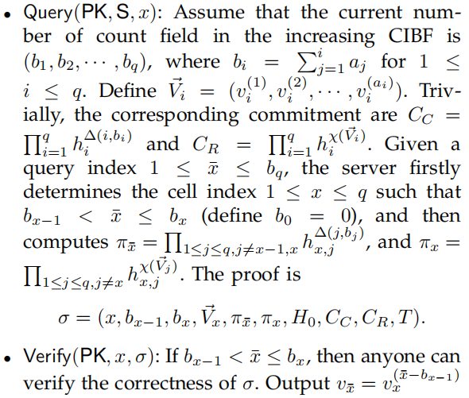


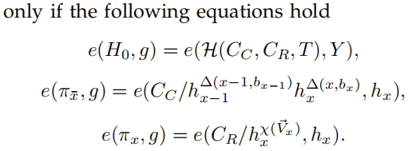

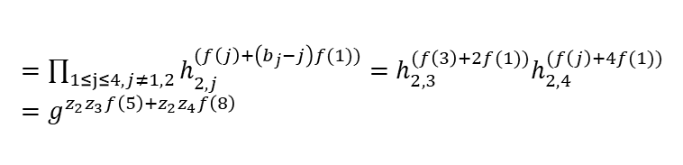


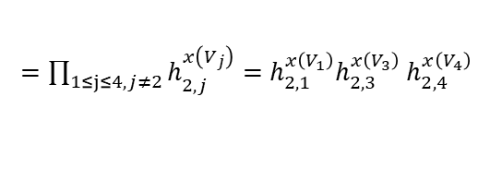




Increasing CIBF构造VDB
例：初始数据库q=4，T=0，
1
3
5
8
$$C_{C}=$$
$$g^{z_{1}f\left(1\right)+z_{2}f\left(3\right)+z_{3}f\left(5\right)+z_{4}f\left(8\right)}$$
$${v_{2},v}_{2′}$$
$${{v_{4},v}_{4′},v}_{4′′}$$
$$C_{R}=$$
$$g^{z_{1}x\left(V_{1}\right)+z_{2}x\left(V_{2}\right)+z_{3}x\left(V_{3}\right)+z_{4}x\left(V_{4}\right)}$$
$$v_{1}$$
$${v_{3′},v}_{3}$$
Query $\overline{x}$=3,x=2
$=\prod_{1≤j≤4,j≠1,2}{h_{2,j}^{(f\left(j\right)+\left(b_{j}−j\right)f(1))}}=$ $h_{2,3}^{(f\left(3\right)+2f(1))}h_{2,4}^{(f\left(j\right)+4f(1))}$
$$=g^{z_{2}z_{3}f\left(5\right)+z_{2}z_{4}f\left(8\right)}$$
$=\prod_{1≤j≤4,j≠2}{h_{2,j}^{x\left(V_{j}\right)}}=$ $h_{2,1}^{x\left(V_{1}\right)}h_{2,3}^{x\left(V_{3}\right)}$ $h_{2,4}^{x\left(V_{4}\right)}$
上个构造的证据
Verify:

Slide 19
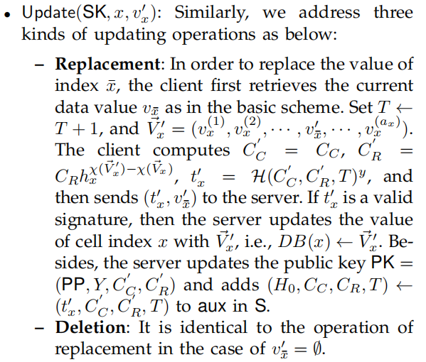










Increasing CIBF构造VDB
例：初始数据库q=4， T=1
替换$v_{1}$
1
3
5
8
$$C_{C}=$$
$$g^{z_{1}f\left(1\right)+z_{2}f\left(3\right)+z_{3}f\left(5\right)+z_{4}f\left(8\right)}$$
$${v_{2},v}_{2′}$$
$${{v_{4},v}_{4′},v}_{4′′}$$
$$C_{R}=$$
$$g^{z_{1}x\left(V_{1}’\right)+z_{2}x\left(V_{2}\right)+z_{3}x\left(V_{3}\right)+z_{4}x\left(V_{4}\right)}$$
$$v_{1}′$$
$${v_{3′},v}_{3}$$
删除$v_{1}′$
T=2
1
3
5
8
$$C_{C}=$$
$$g^{z_{1}f\left(1\right)+z_{2}f\left(3\right)+z_{3}f\left(5\right)+z_{4}f\left(8\right)}$$
$${v_{2},v}_{2′}$$
$${{v_{4},v}_{4′},v}_{4′′}$$
$$C_{R}=$$
$$g^{z_{1}x\left(V_{1}‘\right)+z_{2}x\left(V_{2}\right)+z_{3}x\left(V_{3}\right)+z_{4}x\left(V_{4}\right)}$$
$${v_{3′},v}_{3}$$

Slide 20

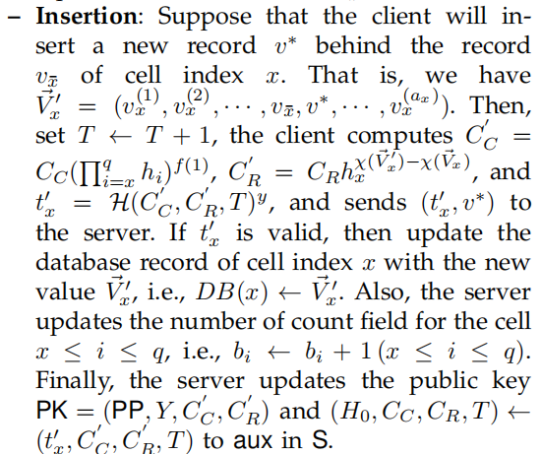











Increasing CIBF构造VDB
添加$v_{1}$ T=3
1
3
5
8
$$C_{C}=$$
$$g^{z_{1}f\left(1\right)+z_{2}f\left(3\right)+z_{3}f\left(5\right)+z_{4}f\left(8\right)}$$
$${v_{2},v}_{2′}$$
$${{v_{4},v}_{4′},v}_{4′′}$$
$$C_{R}=$$
$$g^{z_{1}x\left(V_{1}‘\right)+z_{2}x\left(V_{2}\right)+z_{3}x\left(V_{3}\right)+z_{4}x\left(V_{4}\right)}$$
$${v_{3′},v}_{3}$$
2
4
6
9
$$C_{C}=$$
$$g^{z_{1}f\left(2\right)+z_{2}f\left(4\right)+z_{3}f\left(6\right)+z_{4}f\left(9\right)}$$
$${,v}_{1}$$
$${v_{2},v}_{2′}$$
$${{v_{4},v}_{4′},v}_{4′′}$$
$$C_{R}=$$
$$g^{z_{1}x\left(V_{1}‘\right)+z_{2}x\left(V_{2}\right)+z_{3}x\left(V_{3}\right)+z_{4}x\left(V_{4}\right)}$$
$${v_{3′},v}_{3}$$
化简

Slide 21
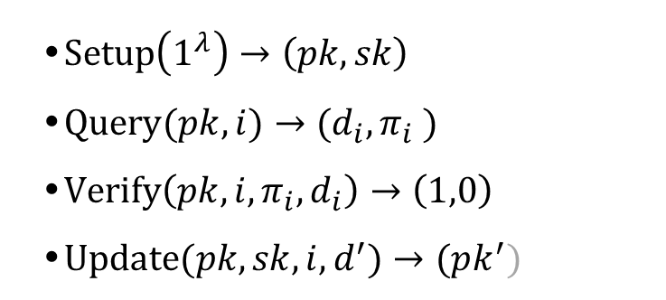
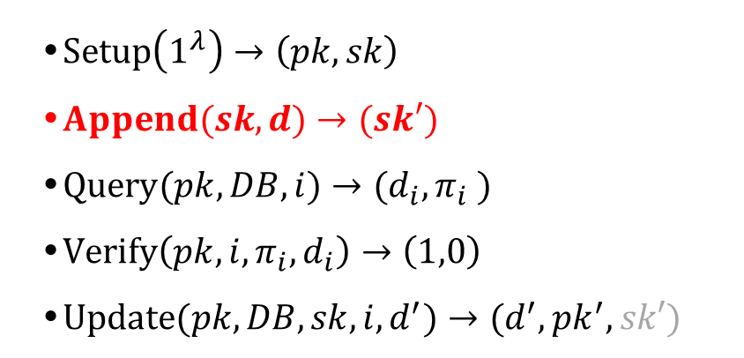
Increasing CIBF构造VDB
$$VDB=(Setup,Query,Verify,Update)$$
给S
$Setup\left(1^{λ}\right)→\left(pk,sk\right)$
$Append(sk,d)→(sk′)$
$Query(pk,DB,i)→(d_{i},π_{i} )$
$Verify\left(pk,i,π_{i},d_{i}\right)→\left(1,0\right)$
$Update(pk,DB,sk,i,d^{′})→(d^{′},pk^{′},sk′)$
$Setup\left(1^{λ}\right)→\left(pk,sk\right)$
$Query(pk,i)→(d_{i},π_{i} )$
$Verify\left(pk,i,π_{i},d_{i}\right)→\left(1,0\right)$
$Update(pk,sk,i,d^{′})→(pk^{′})$
给C
可能会变

Slide 22
























构造VDB
存储数据的二叉树采取中序遍历法
累加值
$$A_{0}$$
$$A_{1}$$
$$A_{2}$$
$$A_{3}$$
2
总数
左子树总数+层数
Level 1
7
数据
$$1,2$$
$$3$$
$$5,8$$
$$4,9$$
1,3
1,3
第三层开始存数据+层数
Level 2
3
4
在5后添加7
5,3
8,3
累加值
$$A_{0}$$
$$A_{1}$$
$$A_{2}$$
$$A_{3}$$
Level 3
2
1
2
2
在5后插入7
数据
$$1,2$$
$$3$$
$$5,7,8$$
$$4,9$$
$$n_{0}$$
$$n_{1}$$
$$n_{2}$$
$$n_{3}$$
$$k=2$$
[0-1]
[2-2]
[3-4]
[5-6]
在5后添加0，6
3
累加值
$$A_{0}$$
$$A_{1}$$
$$A_{2}$$
$$A_{3}$$
2,3
1,3
数据
$$1,2$$
$$3$$
$$5,0,6,7,8$$
$$4,9$$
5,3
7,3
8
Level 1
8
5
在5后插入6
query x=6
在树中是第3个位置
Level 2
3
5
3,5
1,3
4
3,4
1,3
Level 3
2
1
3
2
5,5
7,3
8
在5后
插入0
$$k=2$$
$$n_{0}$$
$$n_{1}$$
$$n_{2}$$
$$n_{3}$$
6,5
5,4
7,3
8
[0-1]
[2-2]
[3-5]
[6-7]
0,5
6,4

