Slide 1
Publicly verifiable database scheme with efficient keyword search
Meixia Miao, Jianfeng Wang
INFORMATION SCIENCES，sci一区

Slide 2







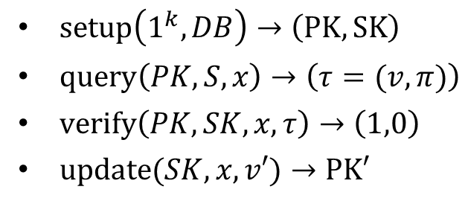









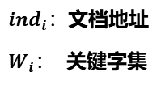




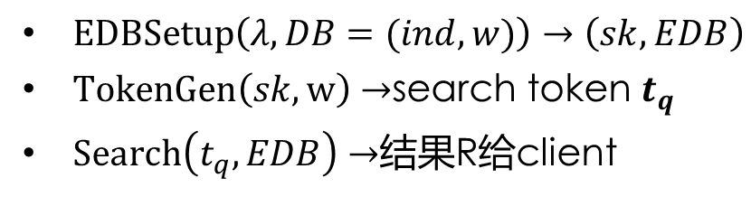



VDB定义
SSE定义
$setup\left(1^{k},DB\right)→\left(PK,SK\right)$
$query\left(PK,S,x\right)→\left(τ=(v,π)\right)$
$verify\left(PK,SK,x,τ\right)→\left(1,0\right)$
$update(SK,x,v′)→PK′$
$EDBSetup\left(λ,DB=(ind,w)\right)→\left(sk,EDB\right)$
$TokenGen\left(sk,w\right)$ $→$search token $t_{q}$
$Search\left(t_{q},EDB\right)$ $→$结果R给client
$${ind}_{1}$$
$${ind}_{2}$$
$${ind}_{3}$$
$${ind}_{4}$$
${ind}_{i}：$文档地址
$W_{i}：$ 关键字集
Query x=1
$$W_{1}$$
$$W_{2}$$
$$W_{3}$$
$$W_{4}$$
$$v_{1},π$$
关键词$W_{1}$
检索陷门
update x=1,$v_{1}$’
$$1$$
$$2$$
$$3$$
$$4$$
$${ind}_{1}$$
检索结果
$$v_{1}′$$
$$v_{2}$$
$$v_{3}$$
$$v_{4}$$
$$W_{1}$$

Slide 3

















SSE具体构造（cash等[1]的Tset）
$${ind}_{1}$$
$$w_{1}$$
$$w_{2}$$
$$w_{1}$$
$${ind}_{1}$$
Stag($w_{1})$
$${ind}_{2}$$
$$w_{2}$$
$$w_{2}$$
$${ind}_{1}$$
$${ind}_{2}$$
$${ind}_{3}$$
$${ind}_{3}$$
$$w_{2}$$
$$w_{3}$$
$$w_{3}$$
$${ind}_{3}$$
正排索引
倒排索引(Tset)
[1] D. Cash, Highly-scalable searchable symmetric encryption with support for boolean queries, CRYPTO’13

Slide 4































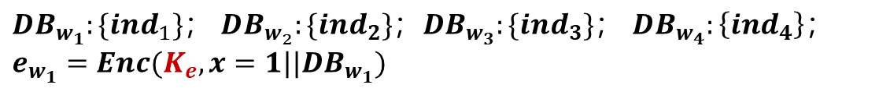

VDB + TSet构造
$$keywords$$
$$w_{1}$$
$$w_{2}$$
$$w_{3}$$
$$w_{4}$$
$$w_{1}$$
$$e_{w_{1}}$$
$$w_{2}$$
$$e_{w_{2}}$$
$$ind$$
$$1$$
$$2$$
$$3$$
$$4$$
初始VDB
$$doc$$
$$v_{1}$$
$$v_{2}$$
$$v_{3}$$
$$v_{4}$$
$$w_{3}$$
$$e_{w_{3}}$$
$$w_{4}$$
$$e_{w_{4}}$$
$${DB}_{w_{1}}$$
$${DB}_{w_{2}}$$
$${DB}_{w_{3}}$$
$${DB}_{w_{4}}$$
$$T sets$$
$$e_{w_{1}}$$
$$e_{w_{2}}$$
$$e_{w_{3}}$$
$$e_{w_{4}}$$
${DB}_{w_{1}}:\{{ind}_{1}\}；$ ${DB}_{w_{2}}:\{{ind}_{2}\}；{DB}_{w_{3}}:\{{ind}_{3}\}；$ ${DB}_{w_{4}}:\left\{{ind}_{4}\right\}；$
$$e_{w_{1}}=Enc(K_{e},x=1||{DB}_{w_{1}})$$

Slide 5
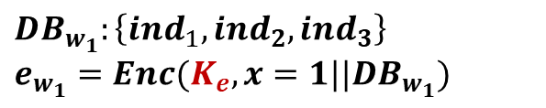
VDB + TSet构造
$$keywords$$
$$w_{1}$$
$$w_{2}$$
$$w_{3}$$
$$w_{4}$$
$$w_{1}$$
$$e_{w_{1}}$$
$$w_{2}$$
$$e_{w_{2}}$$
$$ind$$
$$1$$
$$2$$
$$3$$
$$4$$
初始VDB
$$doc$$
$$v_{1}$$
$$v_{2}$$
$$v_{3}$$
$$v_{4}$$
$$w_{3}$$
$$e_{w_{3}}$$
$$w_{4}$$
$$e_{w_{4}}$$
$${DB}_{w_{1}}$$
$${DB}_{w_{2}}$$
$${DB}_{w_{3}}$$
$${DB}_{w_{4}}$$
$$T sets$$
$$e_{w_{1}}$$
$$e_{w_{2}}$$
$$e_{w_{3}}$$
$$e_{w_{4}}$$
$${DB}_{w_{1}}:\left\{{ind}_{1},{ind}_{2},{ind}_{3}\right\}$$
$$e_{w_{1}}=Enc(K_{e},x=1||{DB}_{w_{1}})$$

Slide 6














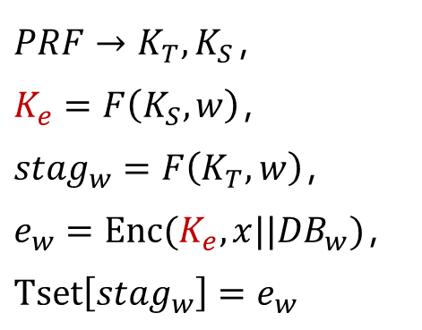




具体构造
$$sⅇtup\left(1^{k},DB\right):$$
1. Client生成Tset：
$$PRF→K_{T},K_{S}，$$
$$K_{e}=F\left(K_{S},w\right)，$$
$${stag}_{w}=F\left(K_{T},w\right)，$$
$$e_{w}=Enc(K_{e},x||{DB}_{w})，$$
$$Tset\left[{stag}_{w}\right]=e_{w}$$
$$w_{1}$$
$$e_{w_{1}}$$
$$w_{2}$$
$$e_{w_{2}}$$
$$w_{3}$$
$$e_{w_{3}}$$
$$w_{4}$$
$$e_{w_{4}}$$
文档地址
关键字
$${ind}_{1}$$
$${ind}_{2}$$
$${ind}_{3}$$
$${ind}_{4}$$
$$w_{1}$$
$$w_{2}$$
$$w_{3}$$
$$w_{4}$$
$$DB$$

Slide 7



具体构造
$$sⅇtup\left(1^{k},DB\right):$$
2. Client：$生成$布隆过滤器BF
${stag}_{w}$放进BF中
${stag}_{w_{1}}=F(K_{T},w_{1})$， ${stag}_{w_{2}}=F(K_{T},w_{2})$， ${stag}_{w_{3}}=F(K_{T},w_{3})$， ${stag}_{w_{4}}=F(K_{T},w_{4})$
BF
1
1
1
1
1
1
1
1
1
1
2
3
4
5
6
7
8
9
10
查询关键词$w_{5}$
$${stag}_{w_{5}}=F(K_{T},w_{5})$$
BF
1
1
1
1
1
1
1
1
1
1
2
3
4
5
6
7
8
9
10

Slide 8































具体构造
$$sⅇtup\left(1^{k},DB\right):$$
3. Client：生成MHT，叶节点为$h(x_{i}|\left|w_{i}\right||n_{i})$， 其中$n_{i}是{DB}_{w_{i}}$中文件的数量
$$keywords$$
$$w_{1}$$
$$w_{2}$$
$$w_{3}$$
$$w_{4}$$
$$h_{1,2,3,4}$$
$$ind$$
$$1$$
$$2$$
$$3$$
$$4$$
$$h_{1,2}$$
$$h_{3,4}$$
$$doc$$
$$v_{1}$$
$$v_{2}$$
$$v_{3}$$
$$v_{4}$$
$$h(1|\left|w_{1}\right||1)$$
$$h(2|\left|w_{2}\right||1)$$
$$h(3|\left|w_{3}\right||1)$$
$$h(4|\left|w_{4}\right||1)$$
$${DB}_{w_{1}}$$
$${DB}_{w_{2}}$$
$${DB}_{w_{3}}$$
$${DB}_{w_{4}}$$
$$e_{w_{1}}$$
$$e_{w_{2}}$$
$$e_{w_{3}}$$
$$e_{w_{4}}$$

Slide 9





















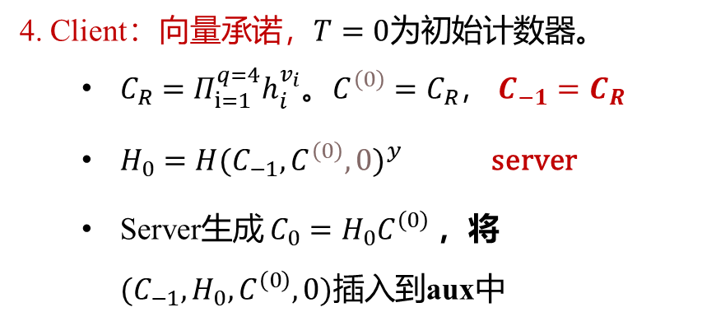







具体构造
$$sⅇtup\left(1^{k},DB\right):$$
私钥
$$keywords$$
$$w_{1}$$
$$w_{2}$$
$$w_{3}$$
$$w_{4}$$
4. Client：向量承诺，$T=0$为初始计数器。
$C_{R}=Π_{ⅈ=1}^{q=4}h_{i}^{v_{i}}$。$C^{\left(0\right)}=C_{R}$， $C_{−1}=$ $C_{R}$
$H_{0}={H(C_{−1},C^{\left(0\right)},0)}^{y}$ server
Server生成 $C_{0}=H_{0}C^{\left(0\right)}$ ，将${(C}_{−1},H_{0},C^{\left(0\right)},0)插入$到aux中
$$ind$$
$$1$$
$$2$$
$$3$$
$$4$$
$$doc$$
$$v_{1}$$
$$v_{2}$$
$$v_{3}$$
$$v_{4}$$
$${DB}_{w_{1}}$$
$${DB}_{w_{2}}$$
$${DB}_{w_{3}}$$
$${DB}_{w_{4}}$$
$$e_{w_{1}}$$
$$e_{w_{2}}$$
$$e_{w_{3}}$$
$$e_{w_{4}}$$
到服务器辅助信息：上传

Slide 10







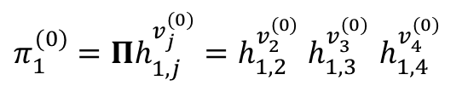


























具体构造
$$Query\left(PK,S,w\right):$$
2$. 在$Tset中查找
1. Query包含$w_{1}所有文档，{stag}_{w_{1}}=F(K_{T},w_{1})$
3$. t=Tset\left[{stag}_{w_{1}}\right]=e_{w_{1}}$
$$w_{1}$$
$$e_{w_{1}}$$
5. Query x= $1$
$$w_{1}$$
$$e_{w_{2}}$$
7.
$$w_{1}$$
$$e_{w_{3}}$$
4. Compute $K_{e}={F(K}_{S},w_{1})$
解密： $x||{DB}_{w_{1}}$=$Dec\left(K_{e},e_{w_{1}}\right)=1|{|DB}_{w_{1}}$ 注:（加密：$e_{w_{1}}=Enc(K_{e},x={ind}_{1}||{DB}_{w_{1}})$）
$$w_{4}$$
$$e_{w_{4}}$$
Tset
$$keywords$$
$$w_{1}$$
$$w_{2}$$
$$w_{3}$$
$$w_{4}$$
6. Compute
$$ind$$
$$1$$
$$2$$
$$3$$
$$4$$
$π_{1}^{(0)}=Πh_{1,j}^{v_{j}^{(0)}}=h_{1,2}^{v_{2}^{(0)}}$ $h_{1,3}^{v_{3}^{(0)}}$ $h_{1,4}^{v_{4}^{(0)}}$
$$doc$$
$$v_{1}$$
$$v_{2}$$
$$v_{3}$$
$$v_{4}$$
$${DB}_{w_{1}}$$
$${DB}_{w_{2}}$$
$${DB}_{w_{3}}$$
$${DB}_{w_{4}}$$
$$e_{w_{1}}$$
$$e_{w_{2}}$$
$$e_{w_{3}}$$
$$e_{w_{4}}$$

Slide 11










具体构造
Verify$\left(PK,x, \right):$
7.
$验证{DB}_{w_{1}}$完整性
搜索结果为空时，检查BF(${stag}_{w_{1}}$)=1是否成立。不则终止，客户端接受搜索结果。
不空时，检查$h(1|\left|w_{1}\right||1)$, $n_{x}$通过解密密文获得
$${stag}_{w_{5}}=F(K_{T},w_{5})$$
BF
1
1
1
1
1
1
1
1
1
1
2
3
4
5
6
7
8
9
10
$$h_{1,2,3,4}$$
$$h_{1,2}$$
$$h_{3,4}$$
$$h(1|\left|w_{1}\right||1)$$
$$h(2|\left|w_{2}\right||1)$$
$$h(3|\left|w_{3}\right||1)$$
$$h(4|\left|w_{4}\right||1)$$

Slide 12
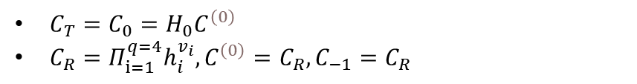






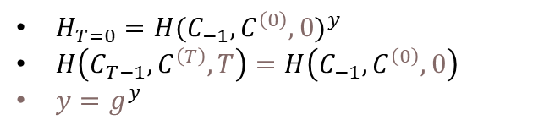


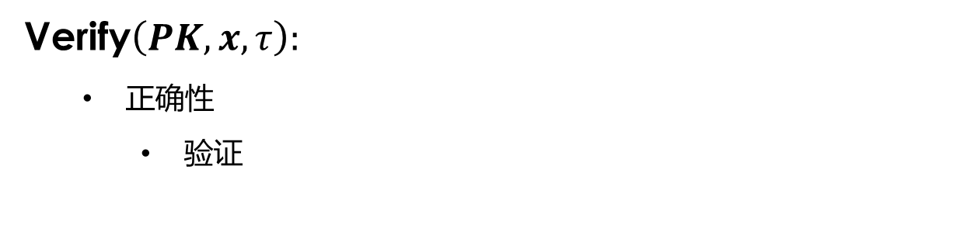


具体构造
${(C}_{−1},H_{0},C^{\left(0\right)},0)插入$到aux中
Verify$\left(PK,x,τ\right):$
正确性
验证
$e\left(H_{0},g \right)$（等式左边）
$$=e({H\left(C_{−1},C^{\left(0\right)},0\right)}^{y},g)$$
$$=e(H\left(C_{−1},C^{\left(0\right)},0\right),g^{y})$$
=等式右边
验证最新承诺值的正确性
$e(C_{T}$/ $H_{T}h_{1}^{v_{1}^{(T)}},h_{1})$
$$={e(H}_{0}C^{\left(0\right)}\text{/} H_{0}h_{1}^{v_{1}^{(0)}},h_{1})$$
$$={e(C}_{R}\text{/} h_{x}^{v_{x}^{(0)}},h_{x})$$
$$=e\left(\frac{Π_{ⅈ=1}^{q=4}h_{i}^{v_{i}}}{h_{1}^{v_{1}^{\left(0\right)}}},g^{z_{1}}\right)$$
$$=右边$$
证明$v_{1}$确实存储在第一个位置
$H_{T=0}={H(C_{−1},C^{\left(0\right)},0)}^{y}$
$H\left(C_{T−1},C^{\left(T\right)},T\right)=H\left(C_{−1},C^{\left(0\right)},0\right)$
${y=g}^{y}$
$C_{T}=C_{0}=H_{0}C^{\left(0\right)}$
$C_{R}=Π_{ⅈ=1}^{q=4}h_{i}^{v_{i}},C^{\left(0\right)}=C_{R},C_{−1}=$ $C_{R}$
$$1$$
$$2$$
$$3$$
$$4$$
$$v_{1}$$
$$v_{2}$$
$$v_{3}$$
$$v_{4}$$

Slide 13




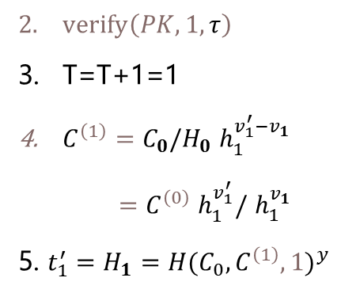




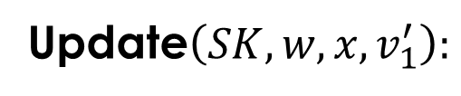




具体构造
Update$\left(SK,w,x,v_{1}^{′}\right):$
1$. v_{1}，τ$
6$. {(t}_{1}^{′},v_{1}^{′})$
$verify\left(PK,1,τ\right)$
T=T+1=1
$C^{\left(1\right)}=C_{0}/H_{0}$ $h_{1}^{v_{1}^{′}−v_{1}}$
$=C^{\left(0\right)}$ $h_{1}^{v_{1}^{′}}/$ $h_{1}^{v_{1}}$
5. $t_{1}^{′}=H_{1}={H(C_{0},C^{\left(1\right)},1)}^{y}$
7. 生成$C_{1}=H_{1}C^{\left(1\right)}$
update:
$：$ $C_{0}=H_{0}C^{\left(0\right)}$
替换$v_{x}^{′}$在位置1。插入
$$1$$
$$2$$
$$3$$
$$4$$
$$v_{1}‘$$
$$v_{2}$$
$$v_{3}$$
$$v_{4}$$

Slide 14
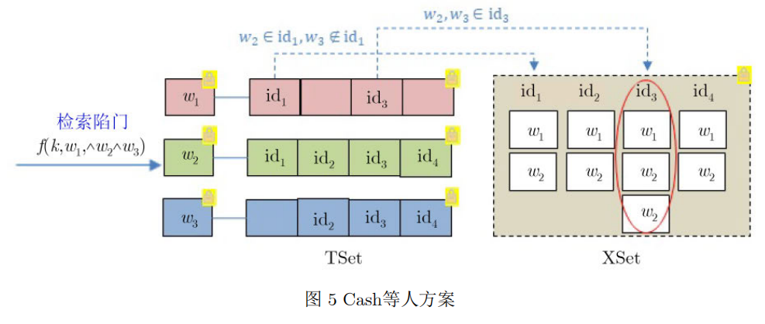
方案改进
单关键字检索
改进：使用OXT
多关键字检索

Slide 15



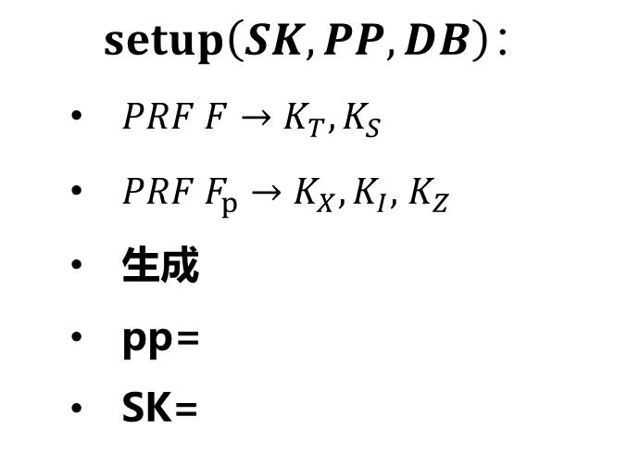

















初始化算法
$$setup\left(SK,PP,DB\right)：$$
$PRF F→K_{T},K_{S}$
$PRF F_{p}→K_{X},K_{I},$ $K_{Z}$
生成
pp=
SK=
$$keywords$$
$$w_{1}$$
$$w_{2}$$
$$w_{3}$$
$$ind$$
$$1$$
$$2$$
$$3$$
$$4$$
$$doc$$
$$ν_{1}$$
$$ν_{2}$$
$$ν_{3}$$
$$ν_{4}$$
$${DB}_{w_{1}}$$
$${DB}_{w_{2}}$$
$${DB}_{w_{3}}$$
$$e_{w_{1}}$$
$$e_{w_{2}}$$
$$e_{w_{3}}$$

Slide 16
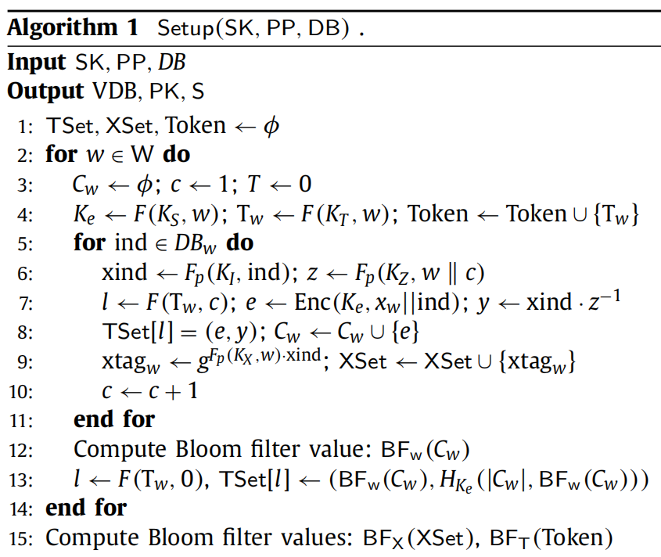








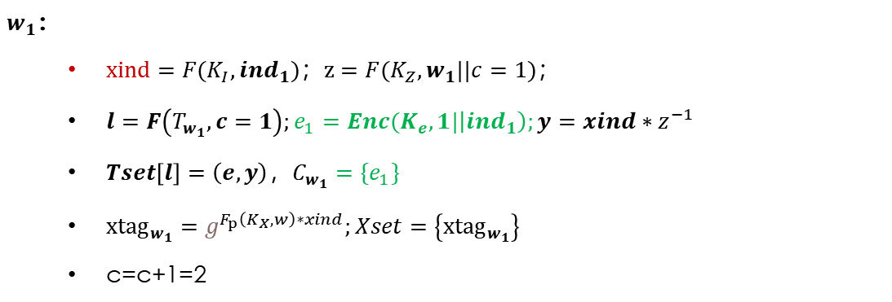


初始化算法
$${ind}_{1}$$
$${ind}_{2}$$
$${ind}_{3}$$
$${ind}_{4}$$
$$w_{1}$$
$$e_{1},y$$
$$e_{3},y$$
$$w_{1}$$
$$w_{1}$$
$$c=1$$
Tset
Xset
$w_{1}$：
$xind=F(K_{I},{ind}_{1})；z=F(K_{Z},w_{1}||c=1)；$
$l=F\left(T_{w_{1}},c=1\right);e_{1}=Enc(K_{e},1|\left|{ind}_{1}\right);y=xind∗z^{−1}$
$Tset\left[l\right]=\left(e,y\right)，C_{w_{1}}=\{e_{1}\}$
${xtag}_{w_{1}}=g^{F_{p}\left(K_{X},w\right)∗xind};Xset=\left\{{xtag}_{w_{1}}\right\}$
c=c+1=2

Slide 17




















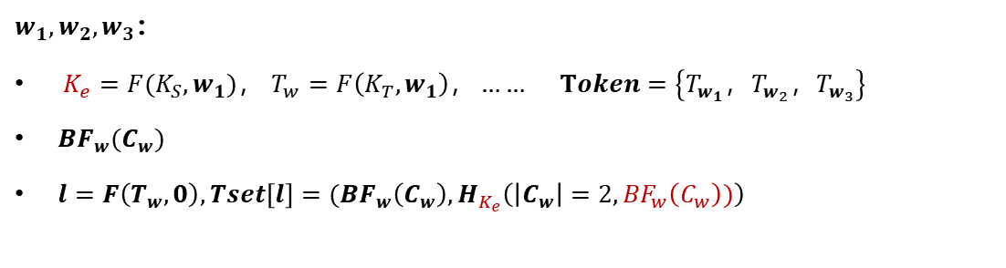




初始化算法
$${ind}_{1}$$
$${ind}_{2}$$
$${ind}_{3}$$
$${ind}_{4}$$
$$0$$
$$1$$
$$2$$
$$3$$
$$4$$
$$w_{1}$$
$$e_{1},y$$
$$e_{3},y$$
$$w_{1}$$
$$w_{1}$$
$$w_{2}$$
$$e_{1},y$$
$$e_{2},y$$
$$e_{3},y$$
$$e_{4},y$$
$$w_{2}$$
$$w_{2}$$
$$w_{2}$$
$$w_{2}$$
$$w_{3}$$
$$e_{2},y$$
$$e_{3},y$$
$$e_{4},y$$
$$w_{3}$$
$$w_{3}$$
$$w_{3}$$
Tset
Xset
$w_{1},w_{2},w_{3}$：
$K_{e}=F(K_{S},w_{1})，$ $T_{w}=F\left(K_{T},w_{1}\right)，…… Token=\left\{T_{w_{1}}，T_{w_{2}}，T_{w_{3}}\right\}$
${BF}_{w}(C_{w})$
$l=F\left(T_{w},0\right),Tset\left[l\right]=({BF}_{w}\left(C_{w}\right),H_{K_{e}}\left(\left|C_{w}\right|=2,{BF}_{w}\left(C_{w}\right))\right)$

Slide 18























初始化算法
$${ind}_{1}$$
$${ind}_{2}$$
$${ind}_{3}$$
$${ind}_{4}$$
$$0$$
$$1$$
$$2$$
$$3$$
$$4$$
$$w_{1}$$
$$e_{1},y$$
$$e_{3},y$$
$$w_{1}$$
$$w_{1}$$
$$w_{2}$$
$$e_{1},y$$
$$e_{2},y$$
$$e_{3},y$$
$$e_{4},y$$
$$w_{2}$$
$$w_{2}$$
$$w_{2}$$
$$w_{2}$$
$$w_{3}$$
$$e_{2},y$$
$$e_{3},y$$
$$e_{4},y$$
$$w_{3}$$
$$w_{3}$$
$$w_{3}$$
Tset
Xset
$$e_{1}$$
$$e_{3}$$
BF
1
1
1
1
1
1
1
2
3
4
5
6
7
8
9
10
$${BF}_{w_{1}}(C_{w_{1}})$$
$$Xset$$
BF
1
1
1
1
2
3
4
5
6
7
8
9
10
$${BF}_{X}(Xset)$$
$$T_{w_{1}}$$
$$T_{w_{2}}$$
$$T_{w_{3}}$$
BF
1
1
1
1
1
1
1
1
1
2
3
4
5
6
7
8
9
10
$${BF}_{T}(Token)$$

Slide 19
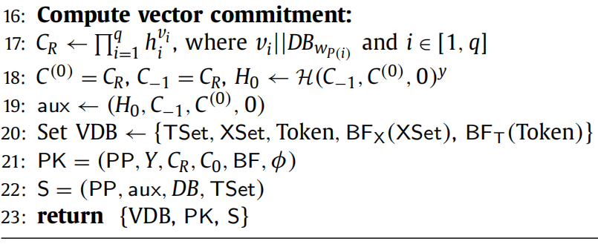
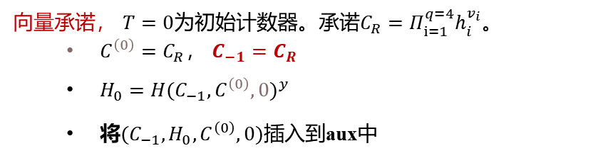









初始化算法
$$q=4$$
$$1$$
$$2$$
$$3$$
$$4$$
$$ν_{1}$$
$$ν_{2}$$
$$ν_{3}$$
$$ν_{4}$$
向量承诺， $T=0$为初始计数器。承诺$C_{R}=Π_{ⅈ=1}^{q=4}h_{i}^{v_{i}}$。
$C^{\left(0\right)}=C_{R}$， $C_{−1}=$ $C_{R}$
$H_{0}={H(C_{−1},C^{\left(0\right)},0)}^{y}$
将${(C}_{−1},H_{0},C^{\left(0\right)},0)插入$到aux中

Slide 20
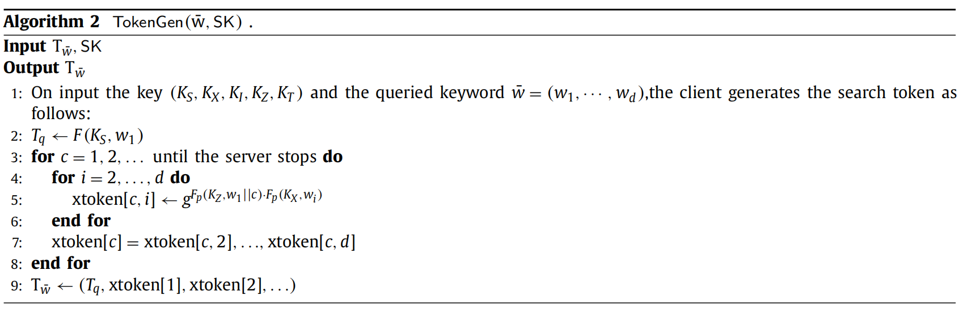













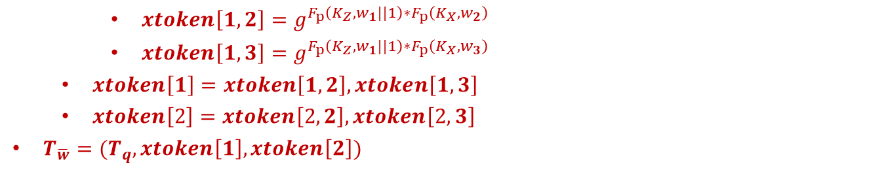









Token生成算法
假设$查询关键字集为\overline{w}=\{w_{1}，w_{2}，w_{3}\}$
$${ind}_{1}$$
$${ind}_{2}$$
$${ind}_{3}$$
$${ind}_{4}$$
$$0$$
$$1$$
$$2$$
$$3$$
$$4$$
$$w_{1}$$
$$e_{1},y$$
$$e_{3},y$$
$$w_{1}$$
$$w_{1}$$
$$w_{2}$$
$$e_{1},y$$
$$e_{2},y$$
$$e_{3},y$$
$$e_{4},y$$
$$w_{2}$$
$$w_{2}$$
$$w_{2}$$
$$w_{2}$$
$$w_{3}$$
$$e_{2},y$$
$$e_{3},y$$
$$e_{4},y$$
$$w_{3}$$
$$w_{3}$$
$$w_{3}$$
$xtoken\left[1,2\right]=g^{F_{p}\left(K_{Z},w_{1}||1\right)∗F_{p}\left(K_{X},w_{2}\right)}$
$xtoken\left[1,3\right]=g^{F_{p}\left(K_{Z},w_{1}||1\right)∗F_{p}\left(K_{X},w_{3}\right)}$
$xtoken\left[1\right]=xtoken\left[1,2\right],xtoken\left[1,3\right]$
$xtoken\left[2\right]=xtoken\left[2,2\right],xtoken\left[2,3\right]$
$T_{\overline{w}}=(T_{q},xtoken\left[1\right],xtoken\left[2\right])$
Tset
Xset
$w_{1}∩w_{2}，$ $w_{1}∩w_{3}$
$w_{1}∩w_{2}，$ $w_{1}∩w_{3}$

Slide 21
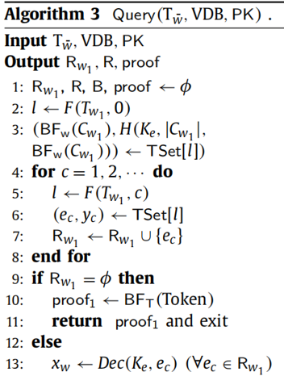







查询算法
假设$查询关键字集为\overline{w}=\{w_{1}，w_{2}，w_{3}\}$
$$C_{w_{1}}=\left\{e_{1}，e_{3}\right\}$$
$${ind}_{1}$$
$${ind}_{2}$$
$${ind}_{3}$$
$${ind}_{4}$$
$$0$$
$$1$$
$$2$$
$$3$$
$$4$$
$$w_{1}$$
$$e_{1},y$$
$$e_{3},y$$
$$w_{1}$$
$$w_{1}$$
Tset
$$w_{2}$$
$$w_{2}$$
$$w_{2}$$
$$w_{2}$$
$$R_{w_{1}}=\left\{e_{1}，e_{3}\right\}$$
$$w_{3}$$
$$w_{3}$$
$$w_{3}$$
Xset
$$T_{w_{1}}$$
BF
1
1
1
1
1
1
1
1
1
2
3
4
5
6
7
8
9
10
$${BF}_{T}(Token)$$

Slide 22
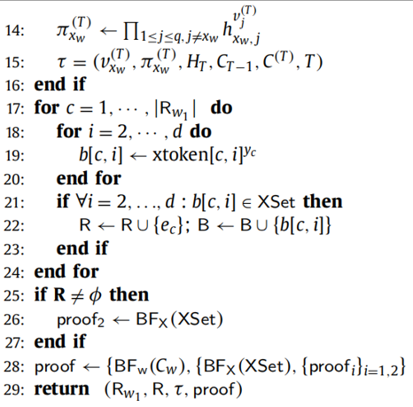

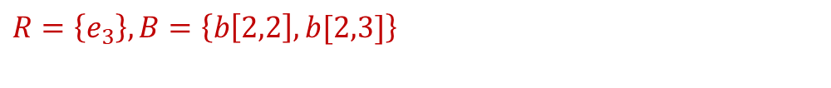










查询算法
假设$关键字集为\overline{w}=\{w_{1}，w_{2}，w_{3}\}$
$${ind}_{1}$$
$${ind}_{2}$$
$${ind}_{3}$$
$${ind}_{4}$$
$$0$$
$$1$$
$$2$$
$$3$$
$$4$$
$$w_{1}$$
$$e_{1},y$$
$$e_{3},y$$
$$w_{1}$$
$$w_{1}$$
$$w_{2}$$
$$e_{1},y$$
$$e_{2},y$$
$$e_{3},y$$
$$e_{4},y$$
$$w_{2}$$
$$w_{2}$$
$$w_{2}$$
$$w_{2}$$
$$w_{3}$$
$$e_{2},y$$
$$e_{3},y$$
$$e_{4},y$$
$$w_{3}$$
$$w_{3}$$
$$w_{3}$$
Tset
$$R=\left\{e_{3}\right\},B=\left\{b\left[2,2\right],b[2,3]\right\}$$
Xset
$$q=4$$
$$1$$
$$2$$
$$3$$
$$4$$
$$ν_{1}$$
$$ν_{2}$$
$$ν_{3}$$
$$ν_{4}$$

Slide 23

查询算法
假设$关键字集为\overline{w}=\{w_{1}，w_{2}，w_{3}\}$
$${ind}_{1}$$
$${ind}_{2}$$
$${ind}_{3}$$
$${ind}_{4}$$
$$0$$
$$1$$
$$2$$
$$3$$
$$4$$
$$w_{1}$$
$$e_{1},y$$
$$e_{3},y$$
$$w_{1}$$
$$w_{1}$$
$$w_{2}$$
$$e_{1},y$$
$$e_{2},y$$
$$e_{3},y$$
$$e_{4},y$$
$$w_{2}$$
$$w_{2}$$
$$w_{2}$$
$$w_{2}$$
$$w_{3}$$
$$e_{2},y$$
$$e_{3},y$$
$$e_{4},y$$
$$w_{3}$$
$$w_{3}$$
$$w_{3}$$
Tset
$$R=\left\{e_{3}\right\},B=\left\{b\left[2,2\right],b[2,3]\right\}$$
Xset
$$Xset$$
BF
1
1
1
1
2
3
4
5
6
7
8
9
10

Slide 24
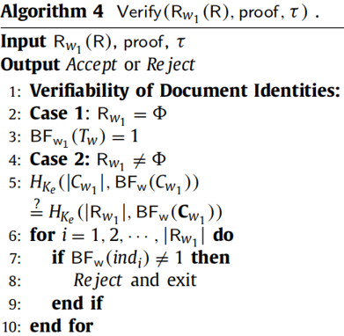
验证算法
$${ind}_{1}$$
$${ind}_{2}$$
$${ind}_{3}$$
$${ind}_{4}$$
$$0$$
$$1$$
$$2$$
$$3$$
$$4$$
$$w_{1}$$
$$e_{1},y$$
$$e_{3},y$$
$$w_{1}$$
$$w_{1}$$
Tset
$$w_{2}$$
$$w_{2}$$
$$w_{2}$$
$$w_{2}$$
$$w_{3}$$
$$w_{3}$$
$$w_{3}$$
Xset

Slide 25
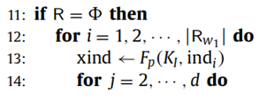
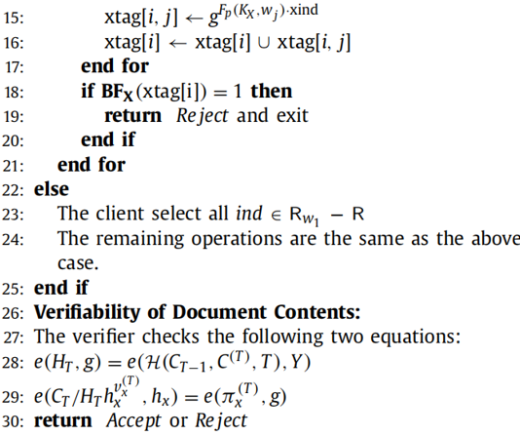
验证算法

Slide 26
更新算法

