Slide 1
Battle of Neighborhoods
Shyam Sundar N

Slide 2
Objective and Problem Description
To help someone choose
The best neighborhood to live
Choosing a rental apartment/house
Buy a house/apartment
Start a Super market
Start a Playschool
Start a gymnasium
These could be based on the distribution of various facilities available around the neighborhood.
As an example, this project would compare 2 randomly picked neighborhoods and analyze the top 10 most common venues in each of those two neighborhoods

Slide 3
Target Audience
Target audiences for this are not limited to an individual or a group of people who are looking for the information. It could be anyone who wishes to rent a place, buy a house or anyone who wishes to open a new business.

Slide 4
Methodology
The project proposes to use K-mean clustering unsupervised machine learning algorithm to cluster the venues based on the place category such as restaurants, park, coffee shop, gym, clubs etc.
This would give a better understanding of the pros and cons between the two chosen neighborhoods and present the much wanted insights into the neighborhoods and conclude which one is better and which has the edge over the other.

Slide 5
Data Sources and the Approach
The data requirements for this project would be satisfied by multiple sources
Kaggle Dataset – By using this data set, neighbourhoods, co-ordinates of each neighbourhood
Geocoder python - Neighbourhood coordinates of each locality of Bangalore city
Foursquare API - By using this API, we will get all the venues in each neighbourhood
Population data for each neighbourhood in Bangalore – This is a difficult one to get but have taken approximate values given the size of Bangalore today which is around 12 million
Housing prices in Bangalore
Get the no.of clusters using K-means clustering
Compare the neighbourhoods using the above data and K-means Clustering
Find the best neighbourhood
Kaggle Dataset for Bangalore
Bangalore Neighborhoods - EDA
Foursquare API
K-means Clustering
Clusters
Best Place

Slide 6
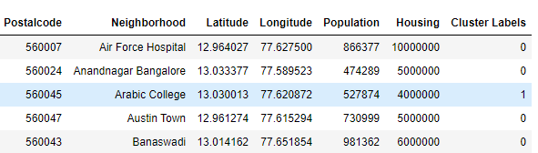
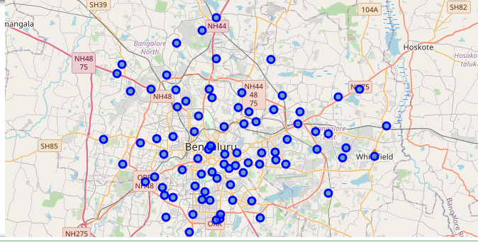
Exploratory Data Analysis
Data Extraction from Data set
Folium Map of Bangalore

Slide 7
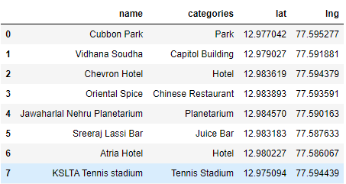
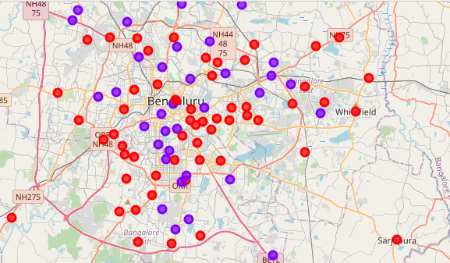
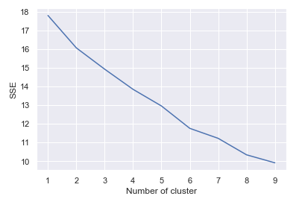
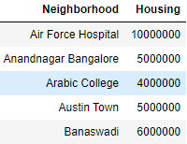
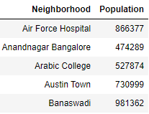
Foursquare API usage and K-Means
Get the venues nearby
Clusters

Slide 8
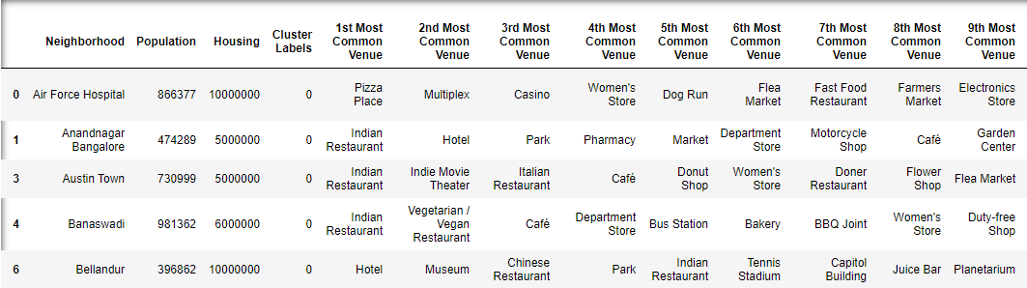
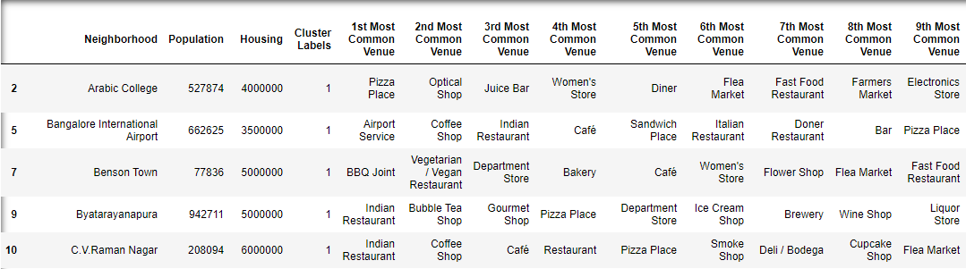
Clusters
Cluster 1
Cluster 2

Slide 9
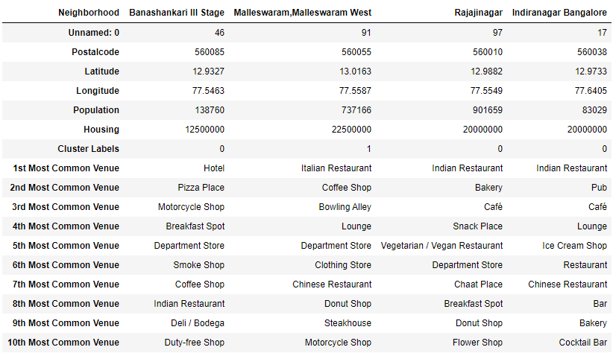
How the different neighborhoods fare

Slide 10
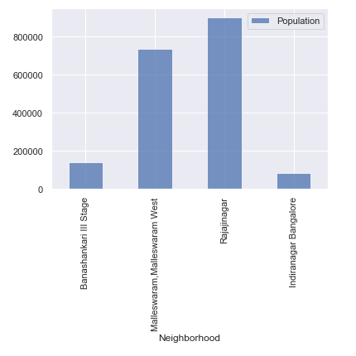
Population Filter

Slide 11
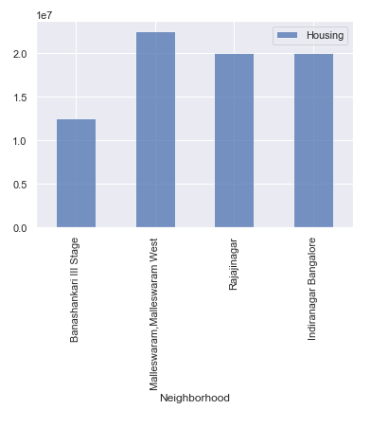
Housing Filter

Slide 12
Conclusion
This analysis concludes that Banashankari III Stage, Bangalore is a better place to live than other 3 places in terms of population, Housing prices, kind of amenities available in the neighborhood etc

