Slide 1
CERTIFICATION PROGRAM IN APPLIED GENERATIVE AI AND AGENTIC AI
Customer Review Insights & Response Generator
Read reviews in six languages, find what is going wrong, and draft the reply.
Group 5 | TalentSprint capstone final presentation | 11 October 2026
Notes:
Introduce the project in one sentence: a pipeline that turns multilingual customer reviews into insights, alerts and draft replies.

Slide 2
WHO WE ARE
Team
SK
JK
SR
S
Srinivasan K
Jyothi Kawalli
Shishir Rai
Shyam
SV
VB
BS
Sai Vamsi Krishna Posani
Vinay Bommireddy
Bandi Shivani
Group 5 | Customer Review Insights & Response Generator
Notes:
Introduce each member and what they built. Replace the role lines with real contributions.

Slide 3
PROBLEM STATEMENT
Multilingual reviews outpace the team reading them
Example | How it is handled today | Where it fails
A 3-star review: “I love the sound but it turns itself back on.” | Counted as a neutral star in an average | The product fault is invisible in the average
“Arrived late and the box was crushed.” | An agent reads it and replies by hand, or it is skipped | Two issues mixed, reply late and generic
A Japanese review with one annoying flaw | Copied into a translator by whoever reads Japanese | Slow, not repeatable, reply in the wrong language
A week of delayed-shipment complaints | Found in a monthly report | Alert arrives weeks late
6
~24 h
1,000+
languages: English, German, Spanish, French, Japanese, Chinese
typical time to a reply when handled by hand
reviews a day the team should be able to handle
Group 5 | Customer Review Insights & Response Generator
Notes:
Walk through each example. We come back to these four situations in the demo.

Slide 4
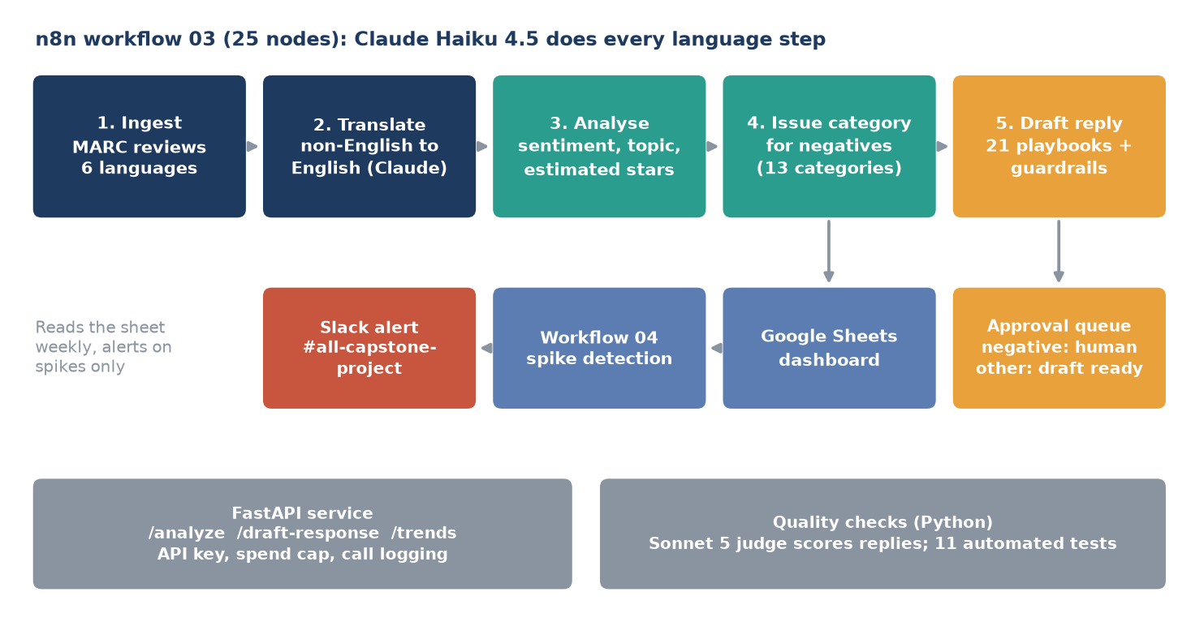
PROPOSED SOLUTION
Our solution: one pipeline from review to reply to alert
Design choices
Claude Haiku 4.5 for every language step: fast and cheap
Claude Sonnet 5 judges the replies, so no model grades itself
Negative replies always wait for a human
Versioned prompts, spend cap, every call logged
Tools: n8n, Claude API, Google Sheets, Slack, FastAPI, sentence-transformers
Group 5 | Customer Review Insights & Response Generator
Notes:
Read the diagram left to right: ingest, translate, analyse, issue category, draft reply. Outputs: approval queue, dashboard, spike alert in Slack. The judge and the API sit alongside.

Slide 5
DATA AND PIPELINE DESIGN
Real reviews in six languages, and what the data lacks
1,200
960
240
1,560
reviews in the main sample: 200 per language, 240 per star
held-out test reviews, scored once, never tuned on
development reviews used to choose prompts
analysed reviews on the dashboard
Dataset
What the data does not have
Multilingual Amazon Reviews Corpus (Kaggle copy)
Sentiment labels come from stars: 1-2 negative, 3 neutral, 4-5 positive
Stratified sample: the source files are sorted by star
No review dates: trend stage uses simulated weeks with planted spikes
Stars are a noisy proxy for text sentiment
No human labels for topics or issues
Group 5 | Customer Review Insights & Response Generator
Notes:
Be upfront: dates are simulated, so the trend results show the detector works, not real customer behaviour.

Slide 6
COMPONENT 1: TRANSLATE
Translation: Claude is as good as Groq and steadier
40 reviews, 5 languages | Groq Qwen 27B | Claude Haiku 4.5
Valid JSON, ids match, language right | 40/40 | 40/40
Latency per batch of 8 | 1.5 s to 58 s | 5.6 s to 21.7 s
Cost | Free tier | $0.54 per 1,000 reviews
Why Claude only
Predictable latency
Groq dropped its Llama chat models
One model family keeps the pipeline simple
In the n8n workflow
8 reviews per call, 3 retries, failures recorded per review
120 reviews: 100 translated, 20 English skipped, 0 failed
Invalid API key: run finishes and marks every review failed
Group 5 | Customer Review Insights & Response Generator
Notes:
Emphasise the failure test: the pipeline does not crash when the API key is wrong.

Slide 7
COMPONENT 2: ANALYSE
Sentiment: two-way target met, three-way not
What we found
88.4% positive vs negative: target of 85% met
78.1% three-way: target not met
The gap is the neutral class (3 stars): recall only 37%, because 3-star reviews are truly mixed
A stacking model added nothing (75-78%)
Star error 0.47; 95.6% within one star
Ground truth is derived from star ratings, which is a noisy proxy. We report the limit instead of tuning around it.
Group 5 | Customer Review Insights & Response Generator
Notes:
Explain why three-way accuracy is capped: the 3-star label is often mixed. 101 of 192 neutral reviews were called negative. Chinese is the weakest language for Claude (binary 81.2%).

Slide 8
COMPONENT 3: FIND THE ISSUES
Clustering: describe the issue in English, then group
13 named issue categories, mixing all six languages
Delayed or missing shipments and poor support
Damaged packaging and product
Wrong item received; missing parts
Product fails soon after purchase
Connectivity and performance issues
Design flaws and uncomfortable fit
Overpriced and rapid price drops ... and 6 more
Translate-then-analyse beats native text (1.6x). HDBSCAN found mostly noise, so we use k-means with k = 13. Inside n8n, Claude assigns the category (43% agreement with k-means; k-means is not ground truth).
Group 5 | Customer Review Insights & Response Generator
Notes:
The absolute silhouette is low, as expected for short phrases about very different products. The clusters read clearly.

Slide 9
COMPONENT 4: ALERT
Spike detection: 3 planted spikes found, 1 false alarm
88.6%
94.3%
precision
recall
How it works
z-score vs the last 4 weeks, z >= 3.5 and >= 8 reviews
About 0.5 false alarms per 12 weeks
4 alerts posted to Slack
Dates are simulated and the threshold was tuned on the same simulation, so these numbers are optimistic. The fourth alert (missing parts) was not planted: a false alarm.
Group 5 | Customer Review Insights & Response Generator
Notes:
Show the Slack channel with the alert message. Lesson learned: our first version said sent even when nothing reached Slack, because Slack's docs page returned HTTP 200. We now require the reply 'ok'.

Slide 10
COMPONENT 5: RESPOND
Replies: guardrails plus an independent judge
79.2%
0
judge-acceptable with prompt v2 (v1: 68.8%)
wrong-language replies; 0 promised outcomes with v2
Guardrails
Reply in the reviewer's language, 40 to 90 words
Only facts from the review; no refund, replacement or date promised
Negative replies always go to a human
Human acceptance was not measured: the 79.2% is a model's opinion. Weakest cases: neutral reviews (58%) and Japanese (62%).
Group 5 | Customer Review Insights & Response Generator
Notes:
Be clear about the proxy: the judge is Claude Sonnet 5, a different model from the drafter. The team skipped the human acceptance test.

Slide 11
PUTTING IT TOGETHER
End to end in n8n, with an API and a dashboard
n8n workflow 03
FastAPI service
Dashboard and Slack
25 nodes, retries, continue on error
120 reviews in 81 s
About $0.30 per 120 reviews
No hard failures on n8n Cloud
/analyze, /draft-response, /trends
API key and hard spend cap
Every Claude call logged
11 automated tests
Google Sheets: sentiment, topics, issues, spikes
Workflow 04 posts spikes to Slack
Costs nothing to run
~$2.50
~11 min
< $4
per 1,000 reviews (replies $1.40, translation $0.50, analysis $0.60)
to process 1,000 reviews (0.68 s per review)
estimated total Claude spend for the whole project (budget $5)
Group 5 | Customer Review Insights & Response Generator
Notes:
Throughput was measured on 120 reviews and extrapolated to 1,000. Total spend estimate is $2.8 to $3.7 including runs whose cost was not recorded.

Slide 12
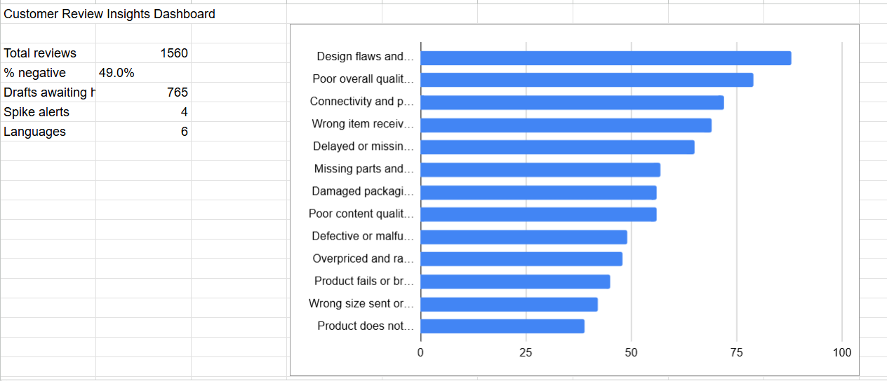
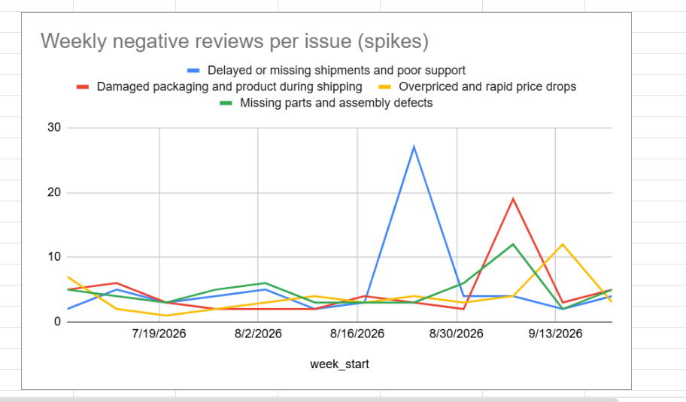
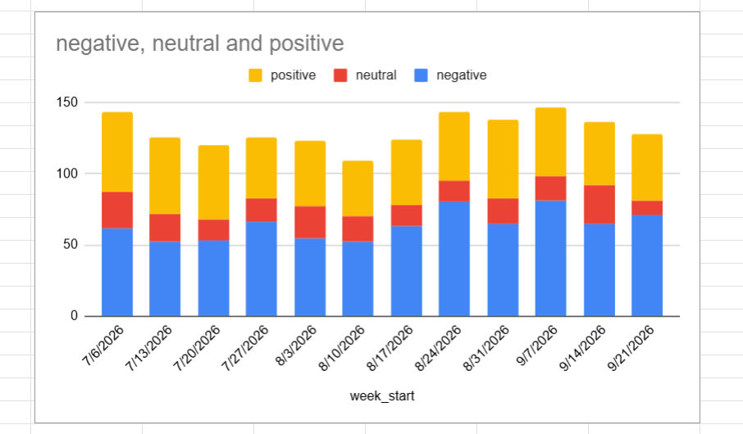
DASHBOARD
Dashboard: what the team sees in Google Sheets
Reading the dashboard
Top left: 1,560 reviews, 49.0% negative, 765 drafts awaiting a human
Top right: weekly negative reviews per issue; the peaks are the 4 Slack alerts
Bottom left: sentiment mix per week; dates are simulated
Group 5 | Customer Review Insights & Response Generator
Notes:
Dates in the sheet are simulated, with three planted spikes. The fourth alert (missing parts) is a false alarm. The topic pie chart is also on the Dashboard tab.

Slide 13
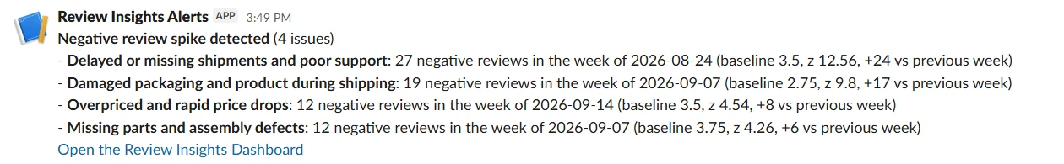
ALERT
Slack alert: the team hears about a spike straight away
How it works
Workflow 04 reads the dashboard sheet
Flags weeks with z >= 3.5 and at least 8 reviews
Posts one message with counts, baseline and a link to the dashboard
Success is confirmed only when Slack answers 'ok'
4
z 12.56
$0
spikes flagged in the 12 simulated weeks
largest: delayed shipments, 27 reviews
to run: no Claude calls
The missing-parts alert was not planted, so it is a false alarm.
Group 5 | Customer Review Insights & Response Generator
Notes:
Live demo: run workflow 04 and show this message arriving in #all-capstone-project.

Slide 14
METHODS TRIED AND CHALLENGES
What went wrong along the way, and how we fixed it
Challenge | What happened | How we overcame it
Sorted dataset | First N rows were all 1-star reviews | Stratified sample per star and language
No dates in the data | Cannot test trend detection on real weeks | Simulated weeks with planted spikes, said openly
Groq free tier | Latency from 1.5 to 58 s; Llama models gone | Compared on 40 reviews, chose Claude only
Neutral class stuck near 37% recall | Prompt v3 and a stacking model gave no real gain | Kept the simple model, explained the star-proxy limit
Clusters too diffuse | HDBSCAN returned mostly noise | Cluster Claude's English issue phrase with k-means
Judge mistakes | Flagged the supplied name as invented; thinking block broke parsing | Told it the name is system-provided; parse the first text block
Slack said 'sent' but nothing arrived | Placeholder URL returned an HTML page with HTTP 200 | Require the exact reply 'ok'; tested three cases
n8n Cloud limits | No local files or embedding model; trial limited (current account to ~16 Oct) | Claude classifies into 13 categories; workflow JSON kept in the repo
Group 5 | Customer Review Insights & Response Generator
Notes:
Pick two or three to tell as short stories: the sorted dataset, the false 'sent', and the neutral-class ceiling.

Slide 15
OUTCOME
Results against the targets
Target | Measured | Status
1,000+ reviews per day | ~11 minutes per 1,000 reviews (measured on 120) | Met on speed
85%+ sentiment accuracy | 88.4% positive vs negative; 78.1% three-way | Two-way met, three-way not
Reply in 3 h instead of 24 h | Draft in about a minute; human approval time not measured | Automation met
Star error at most 0.15 | 0.47; 95.6% within one star | Not met, unrealistic
80% of drafts accepted | 79.2% by the LLM judge; no human test | Close, proxy only
Find sudden spikes | Precision 88.6%, recall 94.3% on simulated weeks; Slack alert works | Met on simulated data
We report the misses instead of tuning until the numbers looked good.
Group 5 | Customer Review Insights & Response Generator
Notes:
Read the table top to bottom. The two honest misses are three-way sentiment and star error; both trace back to noisy star labels.

Slide 16
LIVE DEMO
Demo plan: five tasks, from easy to hardest
1
Easy
Classify one review: “arrived late and the box was crushed”
Answers: Late, generic handling
2
Medium
Japanese neutral review: translate, classify, draft a Japanese reply
Answers: Language barrier
3
Hard
Run n8n workflow 03 on a six-language batch
Answers: Manual reading at volume
4
Hard
The mixed 3-star review about the device that restarts itself
Answers: Stars hide the reason
5
Hardest
Run workflow 04: spike found, Slack message arrives
Answers: Spikes found late
Group 5 | Customer Review Insights & Response Generator
Notes:
Each task ties back to a problem example on slide 3. Run task 4 once before the demo to confirm the output. Backup: recorded outputs and exported n8n JSON, in case the n8n Cloud trial (current account valid to about 16 October) or the network fails.

Slide 17
LIMITATIONS AND FUTURE SCOPE
Limitations and where we go next
Limitations
Future scope and scaling
Simulated dates; threshold tuned on the same simulation
Three-way sentiment 78.1%, neutral class weak
No human test of reply quality
Neutral and Japanese replies are weakest
Issue categories in n8n agree 43% with k-means
Small test sets; results move by a few points
Sheet updated by paste; not deployed publicly
Connect a real dated review feed and retune spikes
Human evaluation with support staff
Add a separate 'mixed' flag for neutral reviews
Self-updating dashboard and Looker Studio
Batch and caching to cut the $2.50 per 1,000 reviews
More languages; send approved replies by Slack or email
Learn from edited replies
Group 5 | Customer Review Insights & Response Generator
Notes:
Limitations first, then what we would do with more time.

Slide 18
BUSINESS PERSPECTIVE
Business view: cheap, fast, and a human stays in charge
$75
11 min
~33 h
per month of model usage at 1,000 reviews a day
of automated processing for a day's 1,000 reviews
of manual work for the same reviews at 2 min each (assumption)
Value
Risks we manage
Replies in the customer's own language
Early warning on delivery, packaging and price problems
Shared view of why customers rate low
Over-promising replies: guardrails, judge, human approval
Cost surprises: spend cap and call log
Weak neutral sentiment: flag borderline reviews
Group 5 | Customer Review Insights & Response Generator
Notes:
The 2 minutes per review is an illustration, not a measurement. Replace it with the team's own figure before presenting.

Slide 19
Thank you
Questions?
Code: github.com/west01srinivas-hue/Capstone_Project_Group_5
Full report and experiment log are in the repository and on the LMS.

