Slide 1
Pumping vs drought storage losses
Preliminary: depth partition & mid-stress regen proxies
(no pumping recovery years yet)
Potomac & Wolf · 3-year pumping tests · August 2026

Slide 2
1. Framing
Why drought temporary/persistent proxies should change under pumping

Slide 3
Ensemble contrast
Droughts
Pumping (3-year tests)
• Stress = duration (1 / 3 / 10 / 50 yr)
• Losses begin at the water table / near surface
• Recovery years define temporary vs persistent
• Temporary ≈ near-surface (top 2 m); persistent ≈ deep
• High-overland cells regenerate a near-surface skin
• Stress = rate (1e-7 … 1e-4 m/h domain-avg)
• Extraction at layer 2 (deep), including wet cells
• Ends while still pumping — no recovery on disk yet
• Proxies: early (yr1) vs buildup (yr2–3); NS rebound vs deep ratchet
• Expect deep memory even where drought would stay temporary

Slide 4
Proxies used here (until recovery exists)
• Near-surface vs deep deficit: split at 2 m (z≥6 vs z<6), same as drought shielding
• Mid-pump regen: near-surface ΔS pulses with average-year P; deep ΔS ratchets
• Fast / temp proxy: mean mid-year near-surface rebound (max − year-start)
• Persist-like proxy: mean deep net loss per pump year
• Drought-style onset spike ≈ 0 under pumping — deficit grows from ~0
See pumping_shallow_deep_proxies_summary.md

Slide 5
2. Drought reminder
Temporary ≈ near-surface regenerating skin; persistent ≈ deep

Slide 6
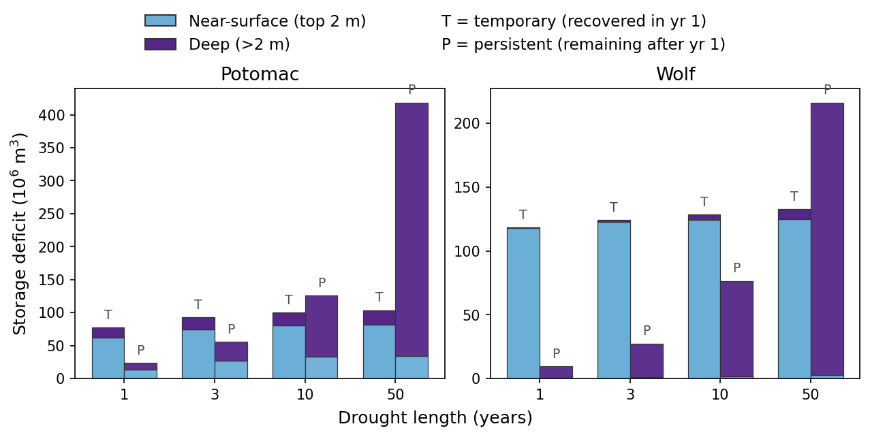
Drought: temporary ≈ near-surface; persistent ≈ deep

Slide 7
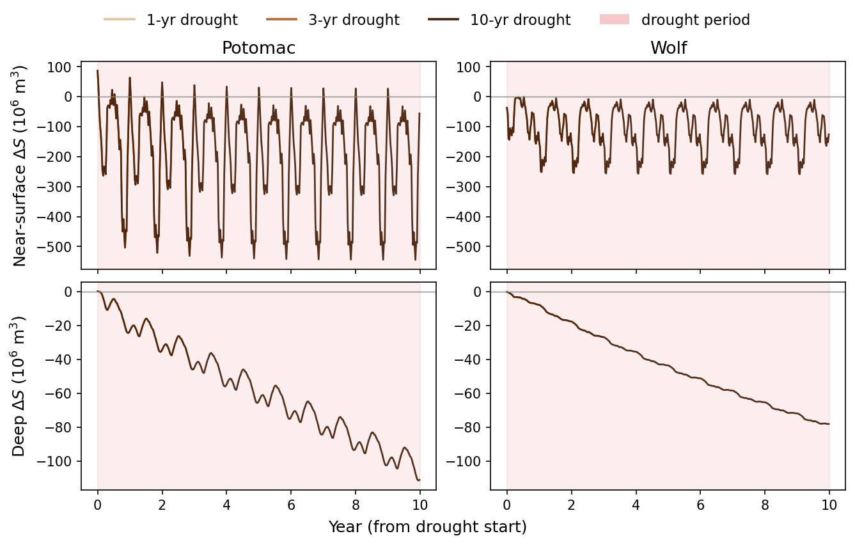
Drought: mid-stress near-surface regenerates, deep ratchets

Slide 8
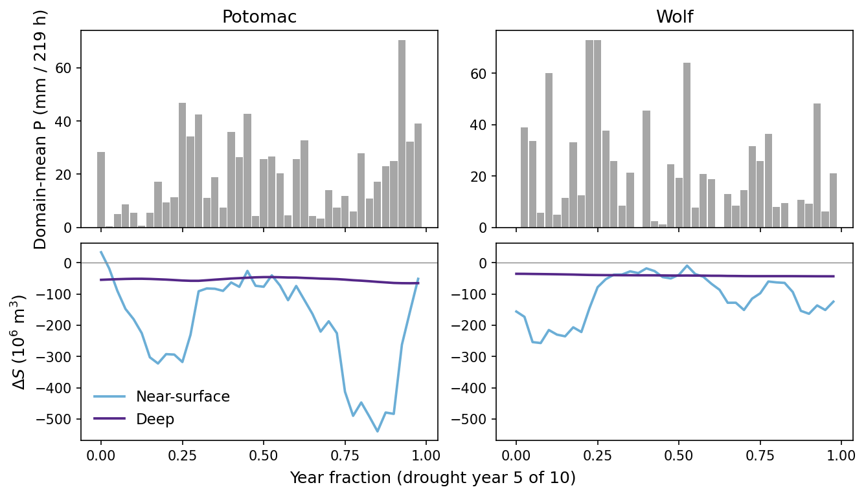
Drought year pulse: storage tracks precip only near the surface

Slide 9
3. Pumping response
Rates during 3-year pumping (early vs buildup)

Slide 10
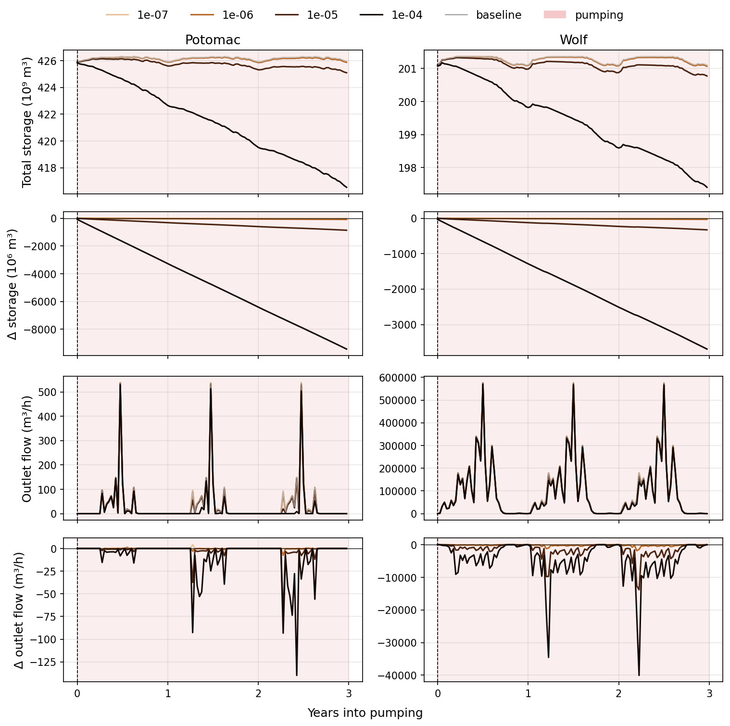
During pumping: storage & flow by rate

Slide 11
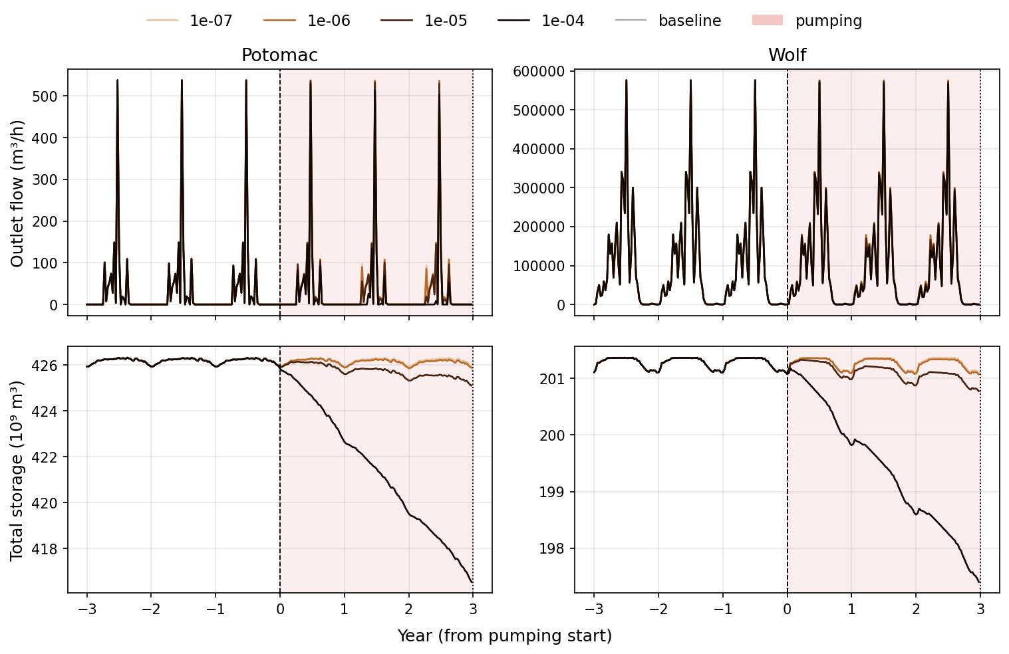
Pumping course (spinup → 3 yr pump)

Slide 12
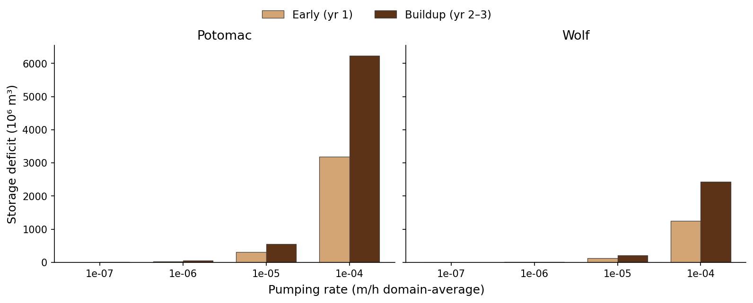
Early (yr1) vs buildup (yr2–3) storage deficits

Slide 13
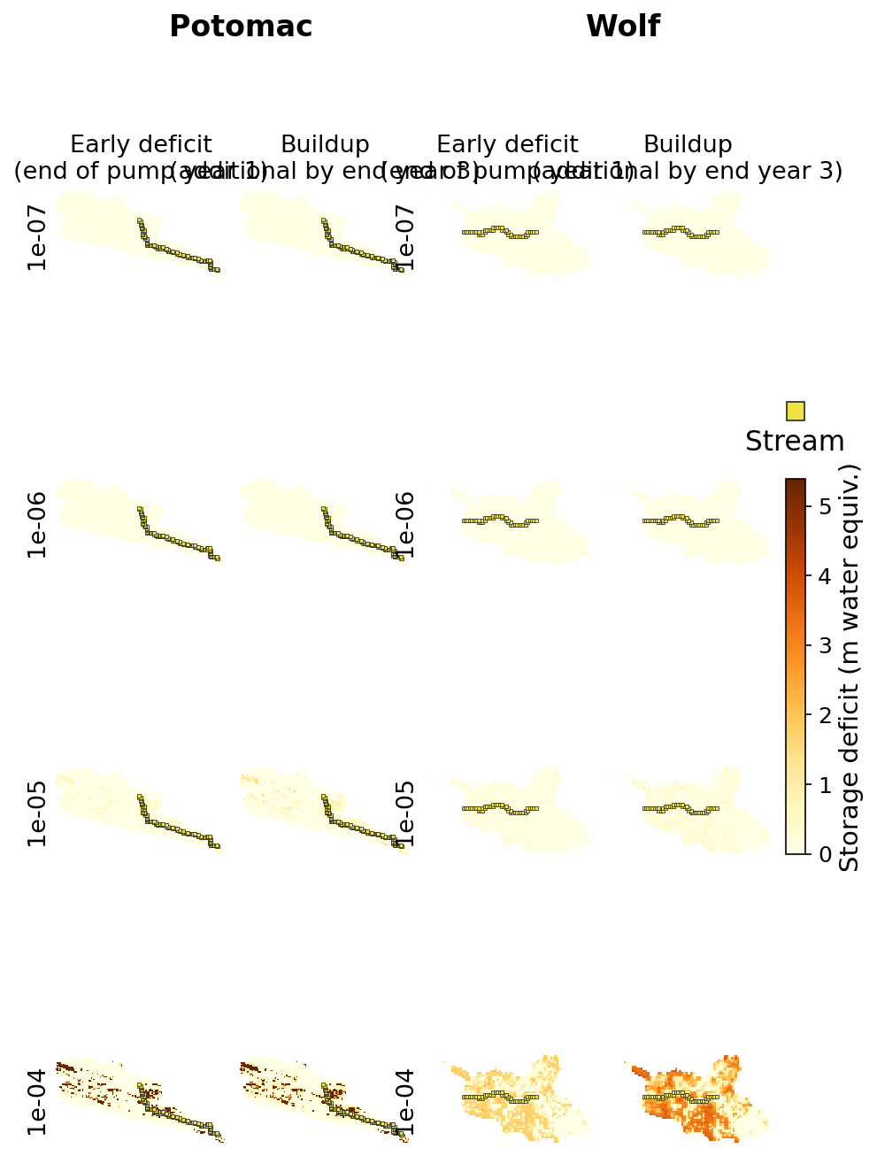
Early vs buildup storage deficit maps

Slide 14
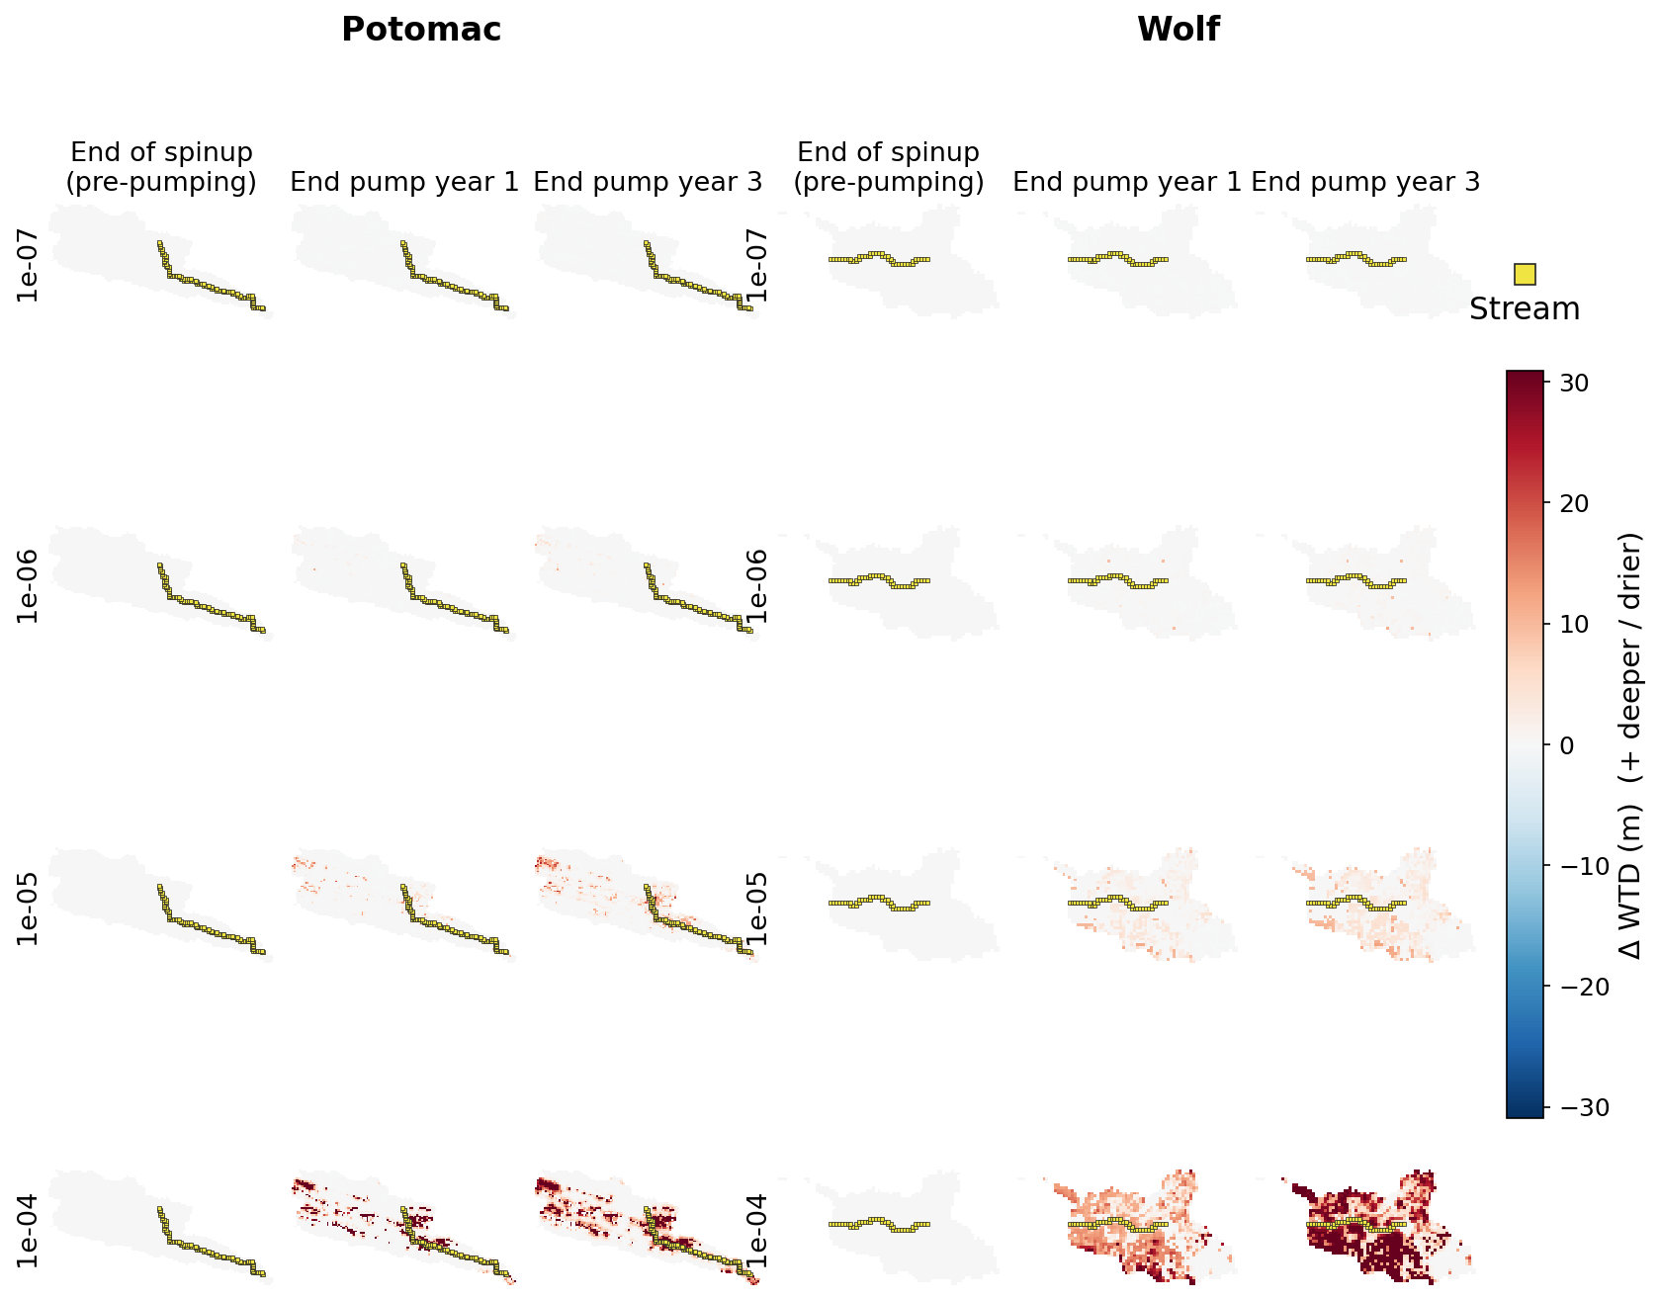
WTD anomaly maps through pumping

Slide 15
4. Depth contrast
Under pumping, end-of-stress deficit is almost all deep

Slide 16
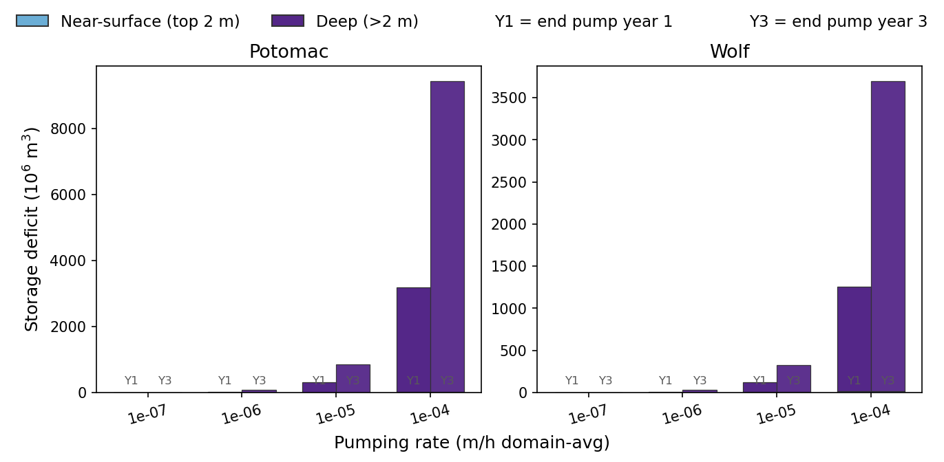
Pumping: end yr1 / yr3 deficit near-surface vs deep

Slide 17
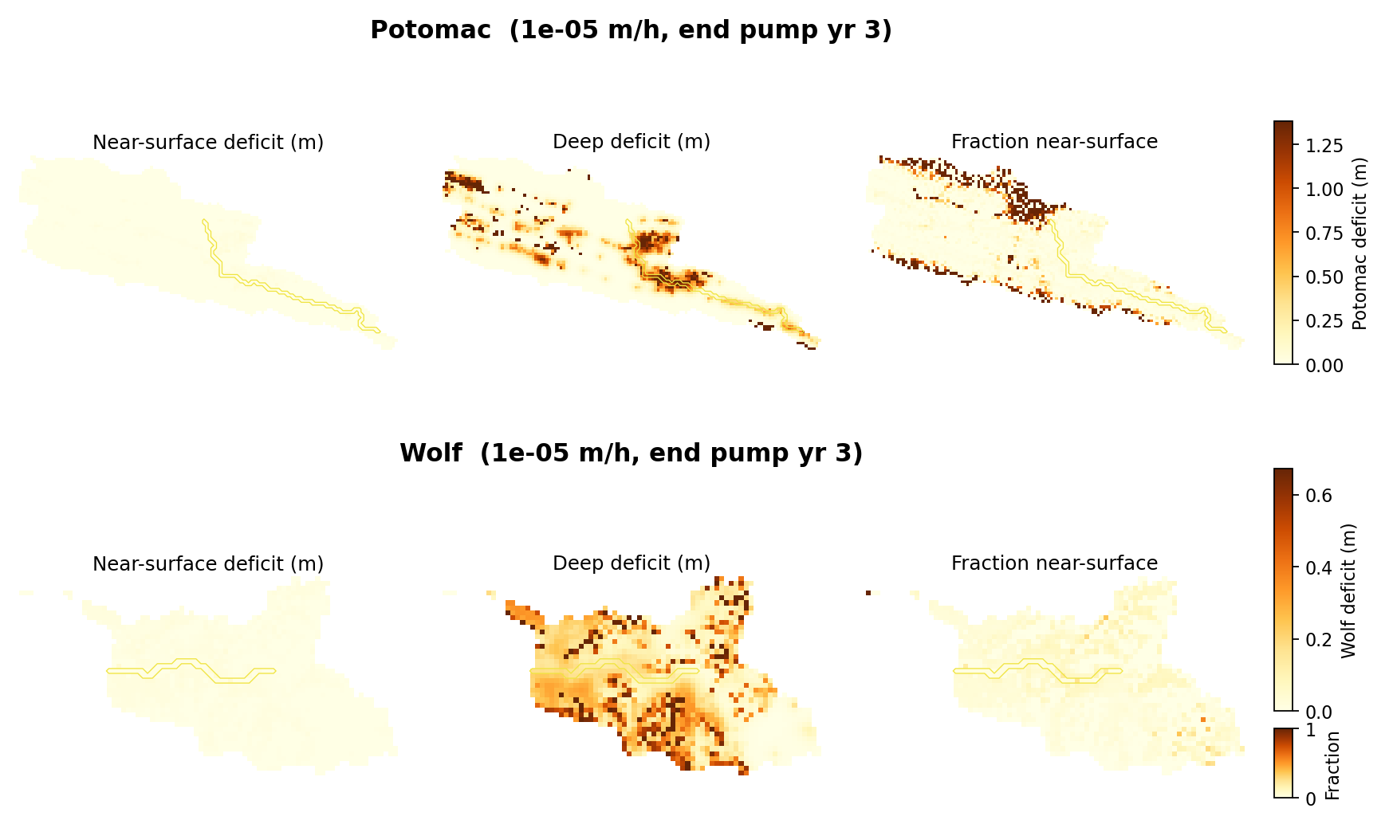
Pumping spatial end-yr3 (1e-5): deep dominates the map

Slide 18
End-of-pump % of deficit in deep
• Potomac: 80→91% (1e-7) … 100% (1e-4) by end of year 3
• Wolf: 71→86% (1e-7) … 99% (1e-4) by end of year 3
• At ≥1e-5, both domains are 97–100% deep by year 3
• Contrast drought temporary volume: ~80–100% near-surface
• Layer-2 extraction writes memory deep even in high water-availability cells

Slide 19
5. Mid-stress regen
Near-surface still pulses — but it is a thin skin beside the deep ratchet

Slide 20
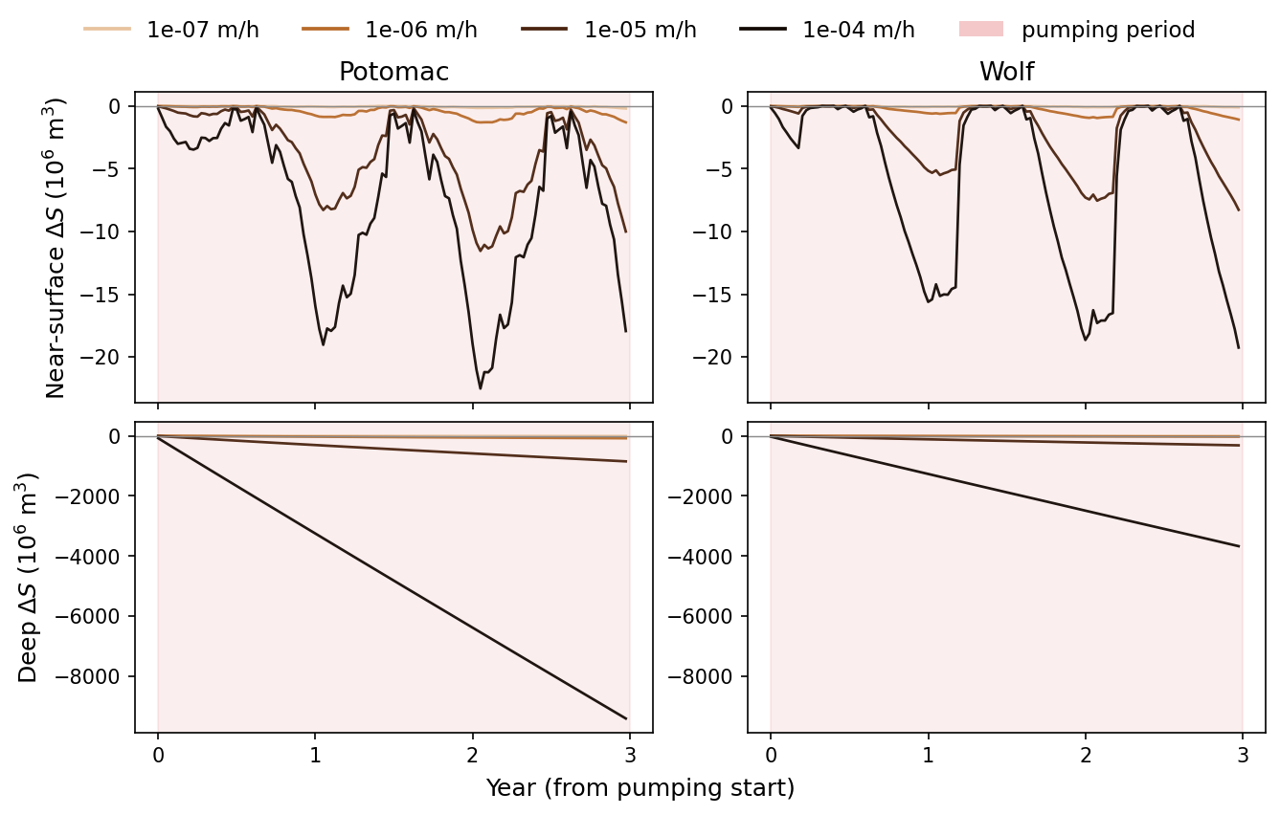
Mid-pump: near-surface regenerates, deep ratchets (by rate)

Slide 21
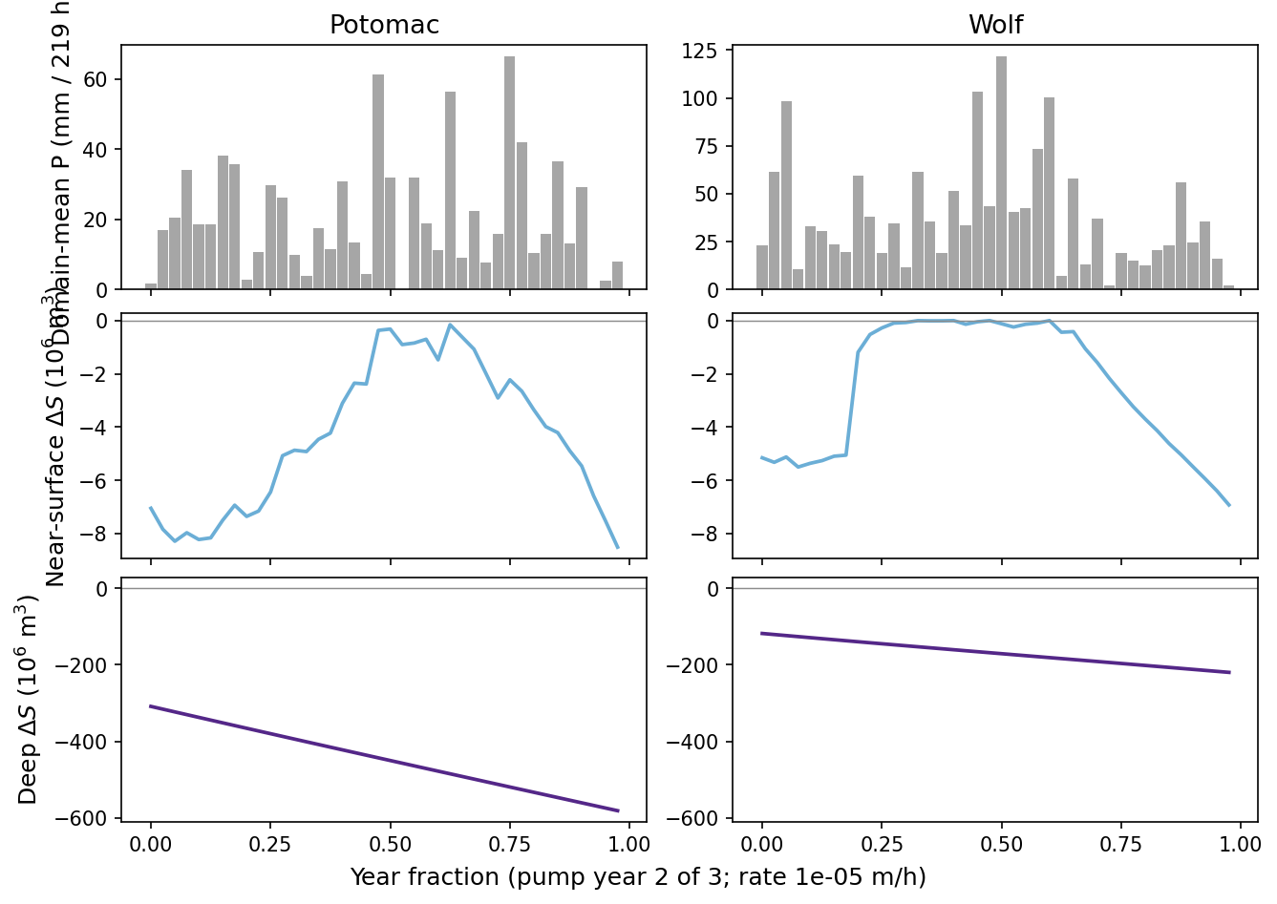
One pump year: NS tracks P; deep has no pulse response

Slide 22
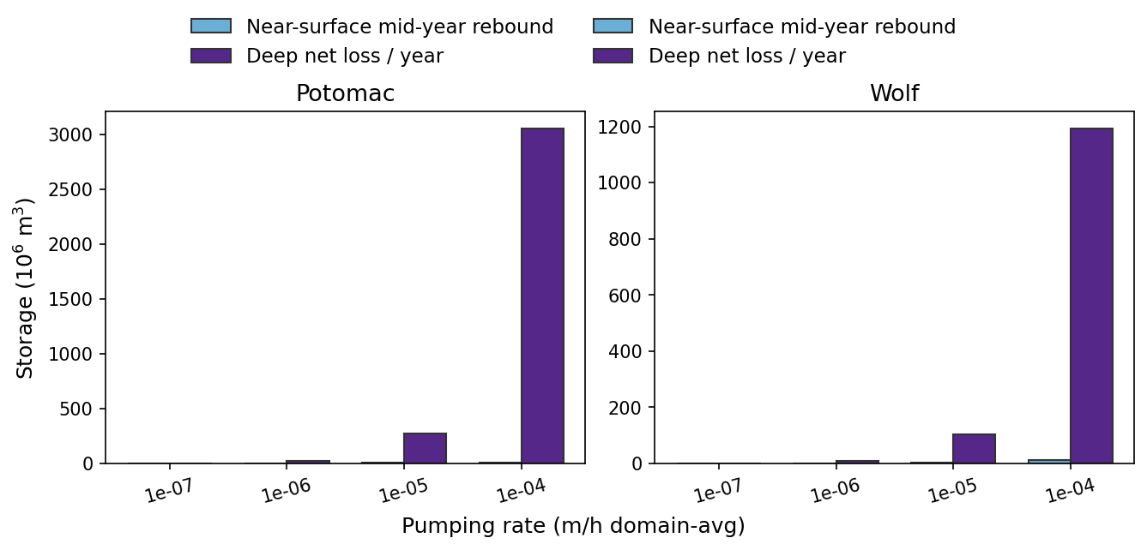
Fast proxy vs persist-like: NS rebound ≪ deep net loss / yr

Slide 23
Mid-pump wet-window ΔS (1e-5 m/h)
• Potomac: near-surface +0.4×10⁶ m³ vs deep −7.1×10⁶ m³ (ρ(P,ns)=0.62, ρ(P,deep)≈0)
• Wolf: near-surface +0.3×10⁶ m³ vs deep −2.7×10⁶ m³ (ρ(P,ns)=0.28, ρ(P,deep)≈0)
• Potomac mean NS mid-year rebound 5.5 vs deep net loss 276 ×10⁶ m³/yr
• Wolf mean NS mid-year rebound 4.2 vs deep net loss 103 ×10⁶ m³/yr
• Same qualitative split as drought — different volume balance under deep extraction

Slide 24
6. Streamflow
Outlet Q vs baseline — does deep pumping couple to flow?

Slide 25
Contrast with drought Q
• 50-yr drought: deep storage grew for decades while outlet Q stepped down then plateaued
• Here precip forcing stays average-year — any Q drop is capture / storage coupling
• Ask: does mean Q keep falling as ΔS builds (yr1→yr3), or stay flat?
• Caveat: outlet p10≈0 on baseline — classical baseflow ratios still undefined
See pumping_streamflow_impact_summary.md · persistent_storage_vs_streamflow_50yr.md

Slide 26
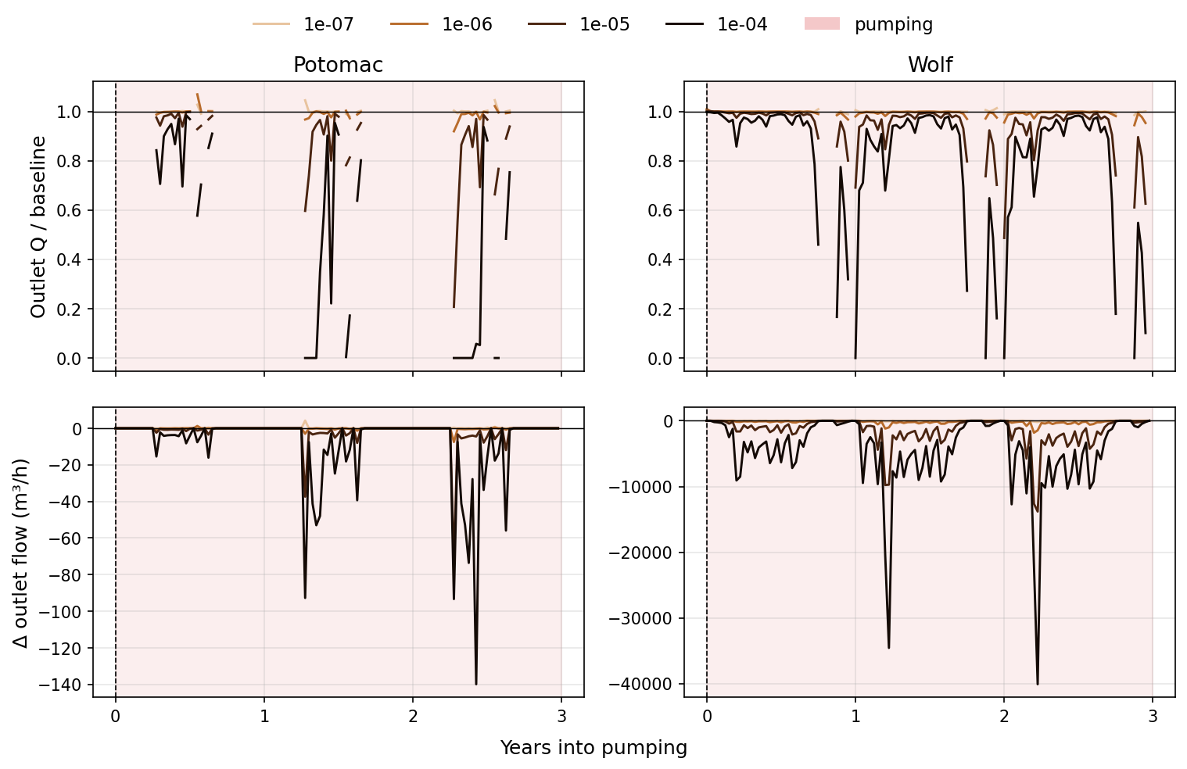
Outlet Q / baseline and ΔQ during pumping

Slide 27
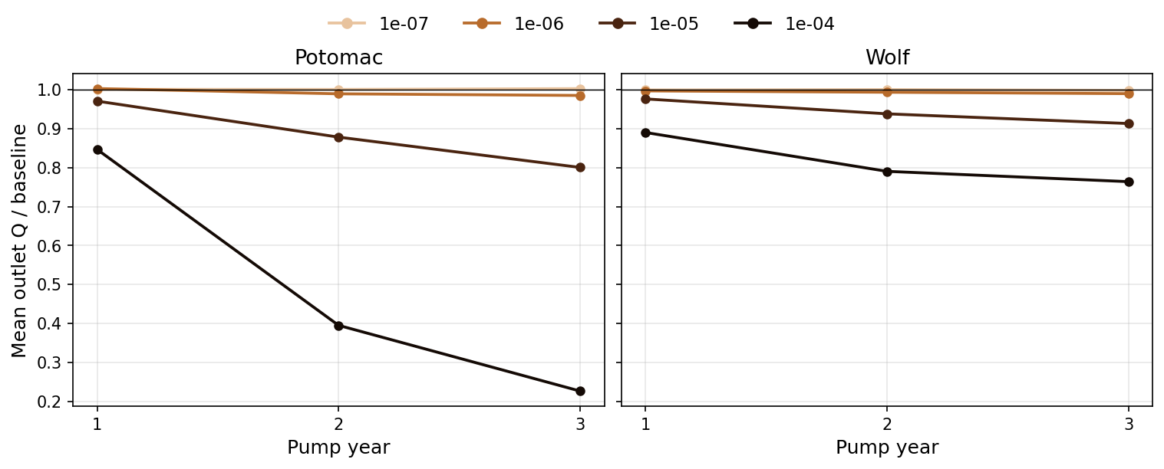
Mean Q ratio declines across pump years (not a mid-drought plateau)

Slide 28
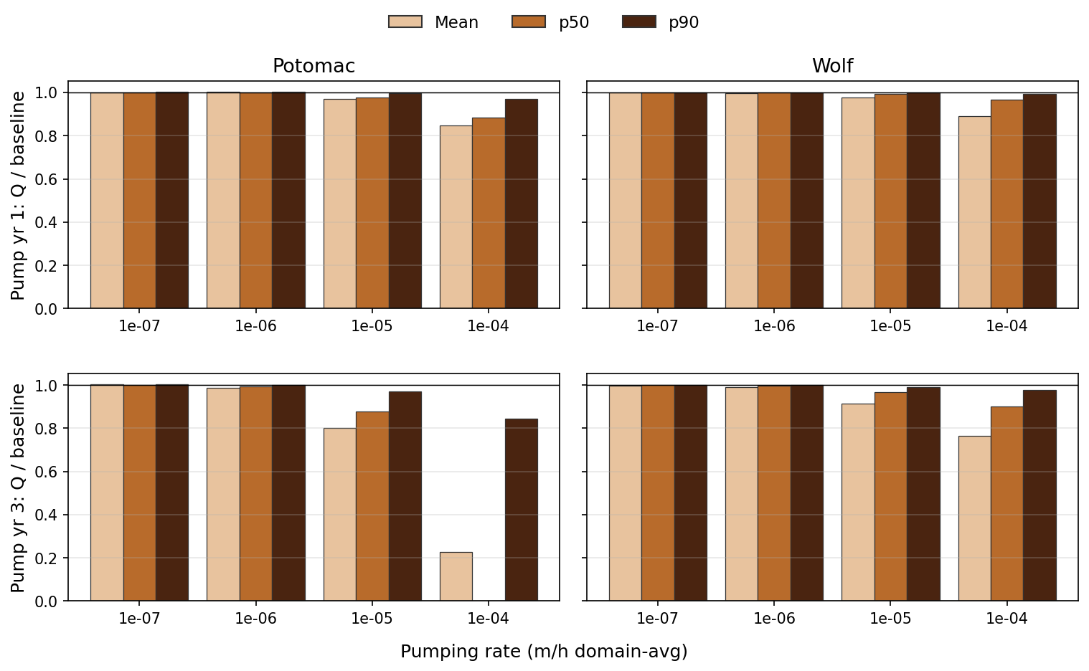
Year 1 vs year 3: mean / p50 / p90 Q ratios by rate

Slide 29
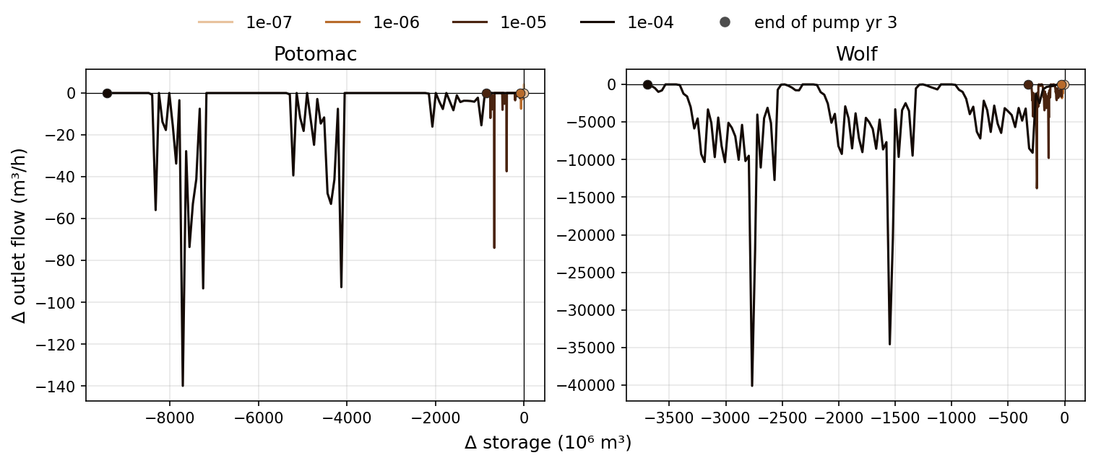
ΔQ vs ΔS: pulsed flow hits while storage ratchets down

Slide 30
Outlet Q / baseline (mean)
• Low rates (1e-7): Q ≈ baseline in both domains
• Potomac 1e-5: yr1=0.97 → yr3=0.80; 1e-4 collapses to yr3=0.23 (p50≈0)
• Wolf 1e-5: yr1=0.98 → yr3=0.91; 1e-4 → yr3=0.76
• Unlike mid-drought, mean Q keeps falling as deep ΔS grows — capture couples storage to flow
• Suppression is strongest on the body/high flows (p90 still near 1 at 1e-5); peaks are hit harder at 1e-4

Slide 31
7. Takeaways
What differs — and what to check with recovery

Slide 32
Preliminary conclusions
• Pumping storage losses sit deep (≈86–100% by yr3) — opposite of drought temporary losses
• Near-surface still regenerates on precip pulses; that pool is tiny vs the deep ratchet
• Unlike drought, outlet Q keeps declining as deep storage builds (esp. Potomac ≥1e-5)
• Shielding / Q–storage decoupling weakens when extraction is at layer 2
• Next: recovery years (and layer-4 tests) for true temporary/persistent and Q rebound
Scripts: pumping_streamflow_impact.py · pumping_shallow_deep_proxies.py · redo_pumping_recovery_analogues.py

