Slide 1
Drought recovery & pumping response figures
Potomac & Wolf · 1 / 3 / 10-year droughts (no 50-year) · August 2026

Slide 2
Drought recovery (1 / 3 / 10-year)

Slide 3
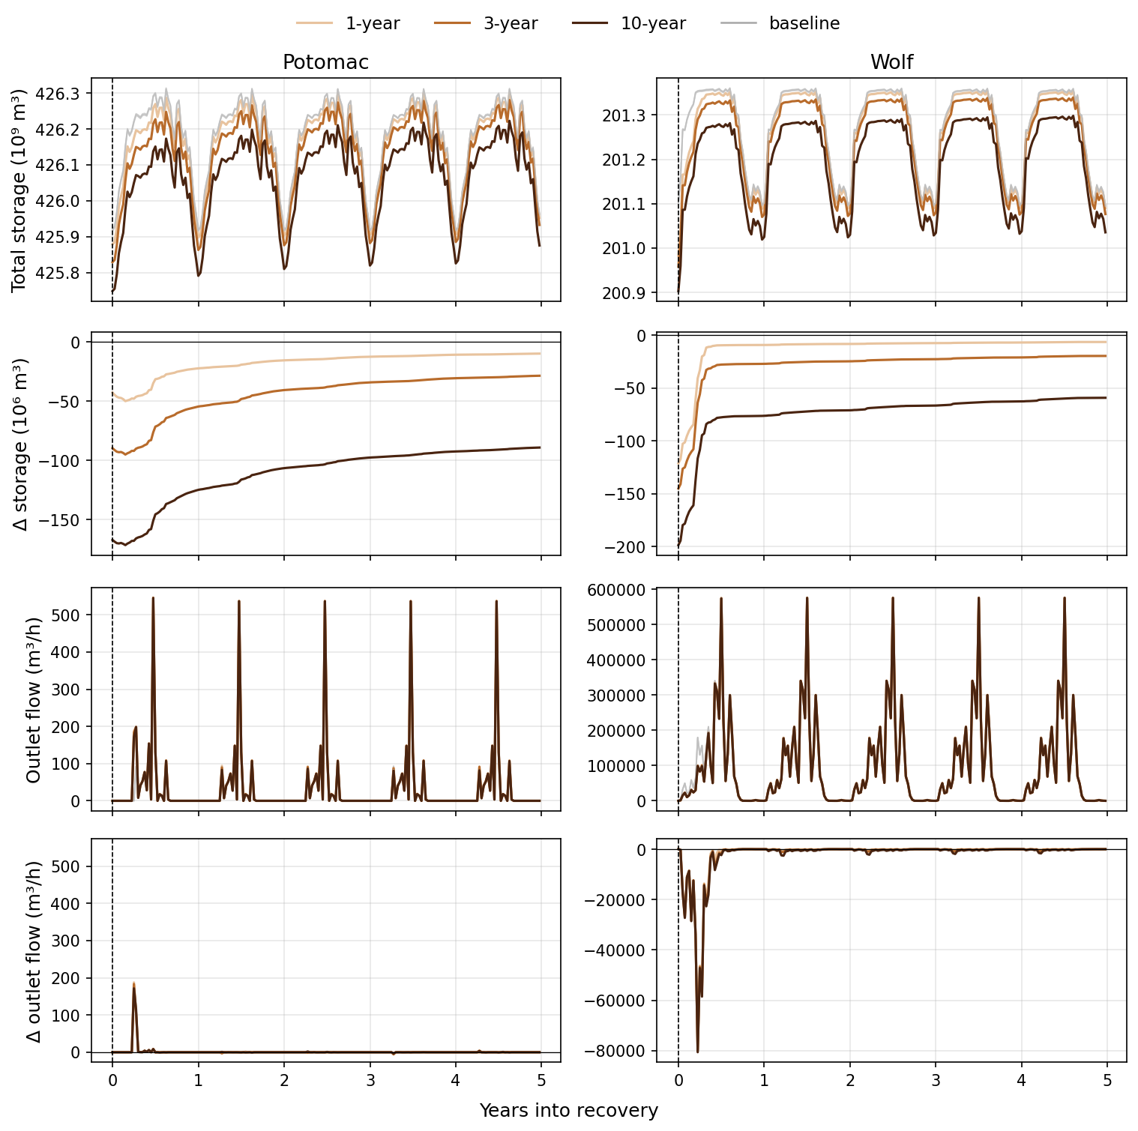
Recovery: storage & flow by drought length
1 / 3 / 10-year only. 5-year recovery after drought end.

Slide 4
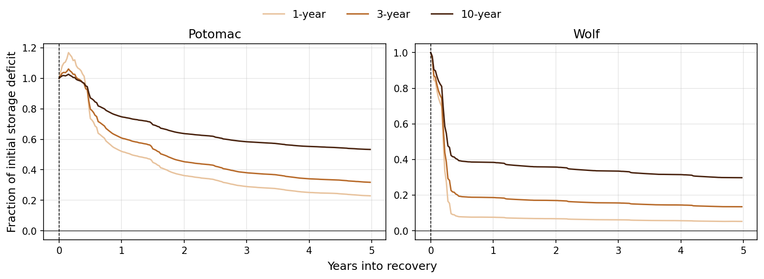
Fractional storage deficit during recovery
Fraction of initial (t=0) storage deficit remaining.

Slide 5
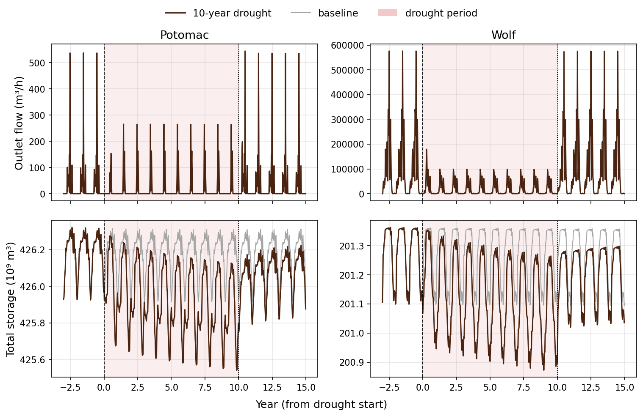
10-year drought course
Last 3 spinup years → drought → 5-year recovery.

Slide 6
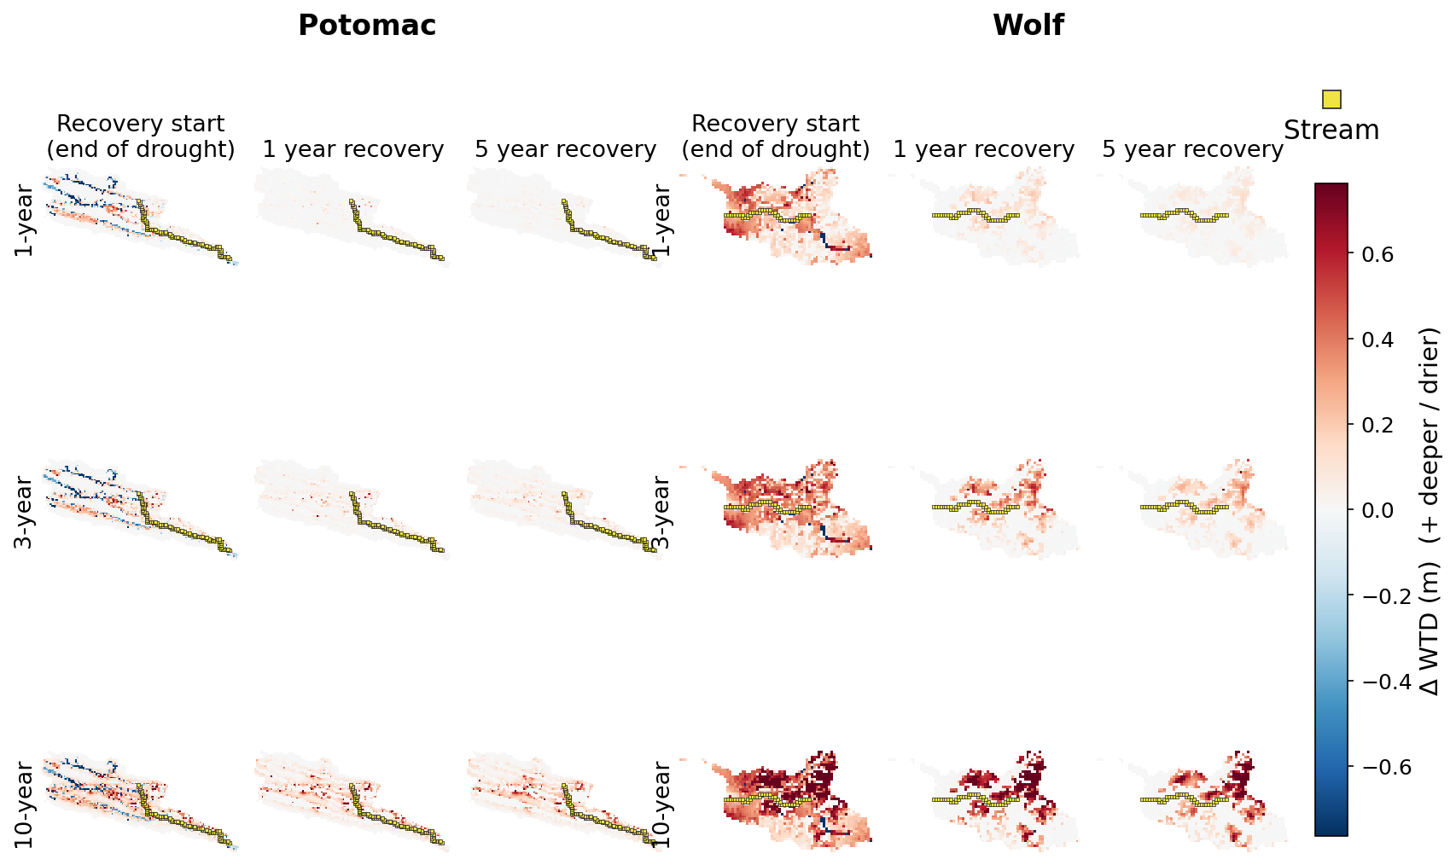
WTD anomaly maps (recovery)
ΔWTD at recovery start, +1 yr, +5 yr. Color scale excludes 50-year.

Slide 7
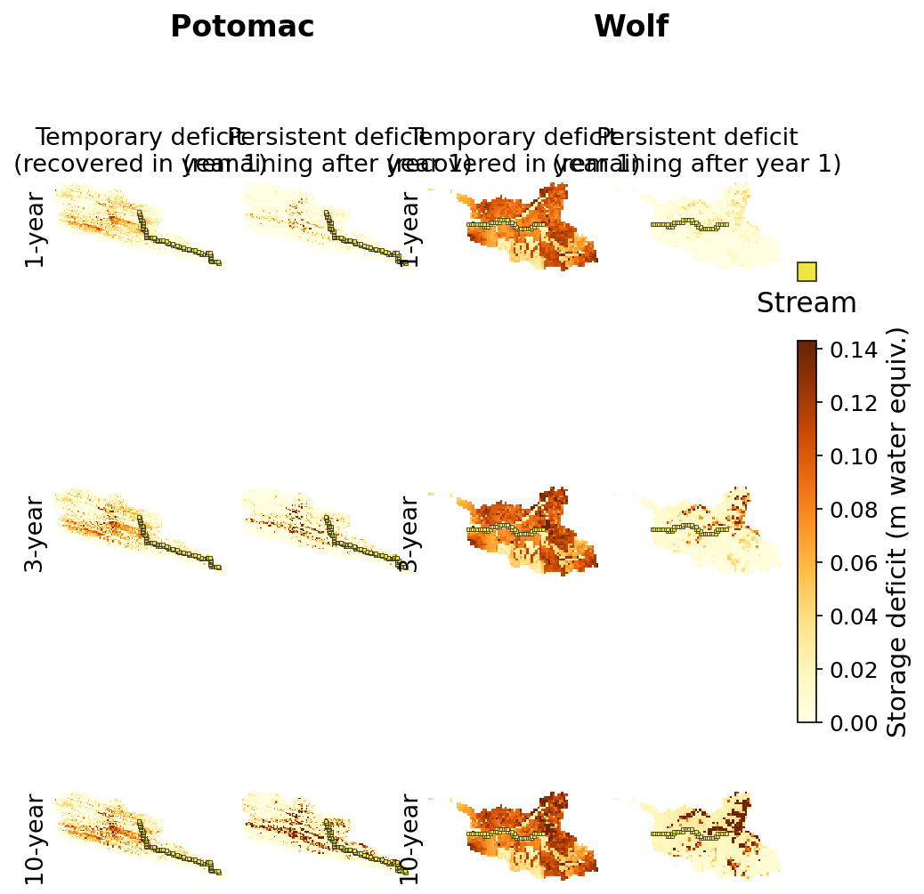
Temporary vs persistent storage deficits
Temporary = recovered in recovery year 1; persistent = remaining.

Slide 8
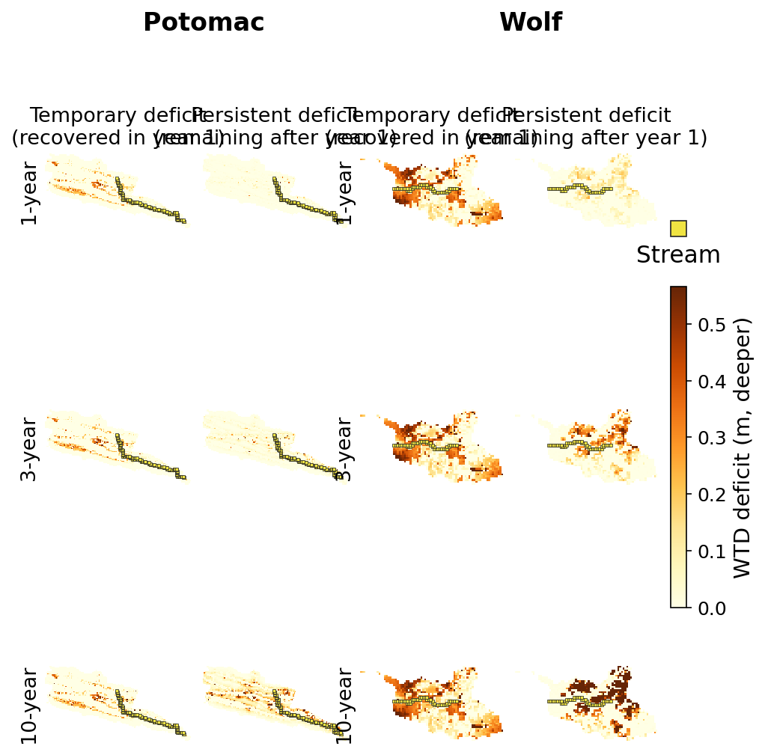
Temporary vs persistent WTD deficits
Same split for ΔWTD.

Slide 9
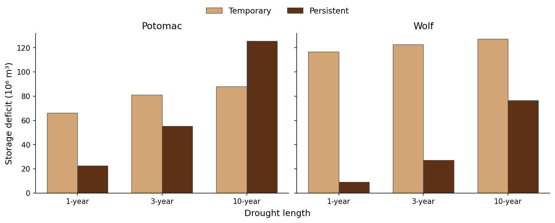
Domain-total temporary vs persistent
Map-based domain totals (10⁶ m³).

Slide 10
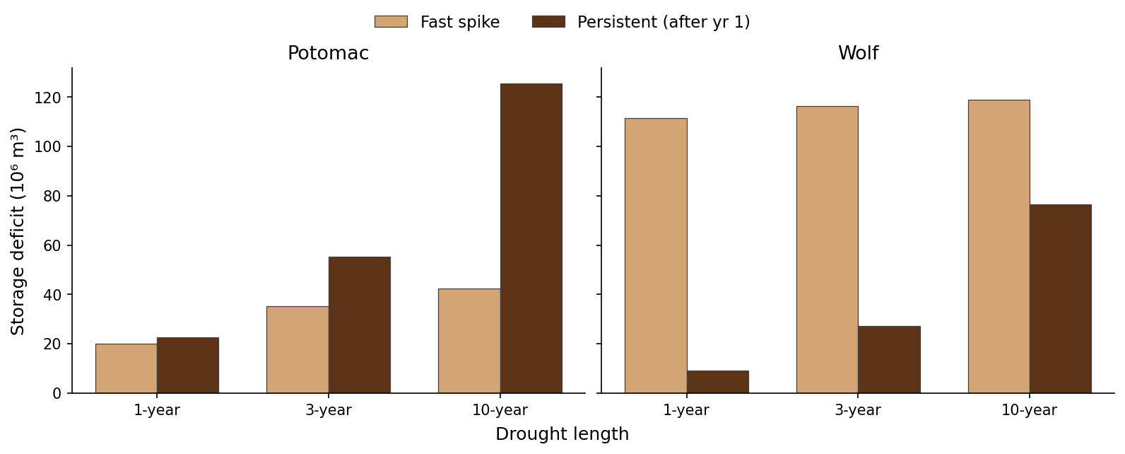
Fast spike vs persistent (corrected)
Slow branch projected to t=0 to isolate the fast spike.

Slide 11
Pumping analogues (3-year pumping tests)

Slide 12
Design note
Ensemble is 40 yr average spinup + 3 yr pumping at rates 1e-7 … 1e-4 m/h (domain-average). No post-pump recovery years, so figures compare rates during pumping and split early (yr1) vs buildup (yr2–3).

Slide 13
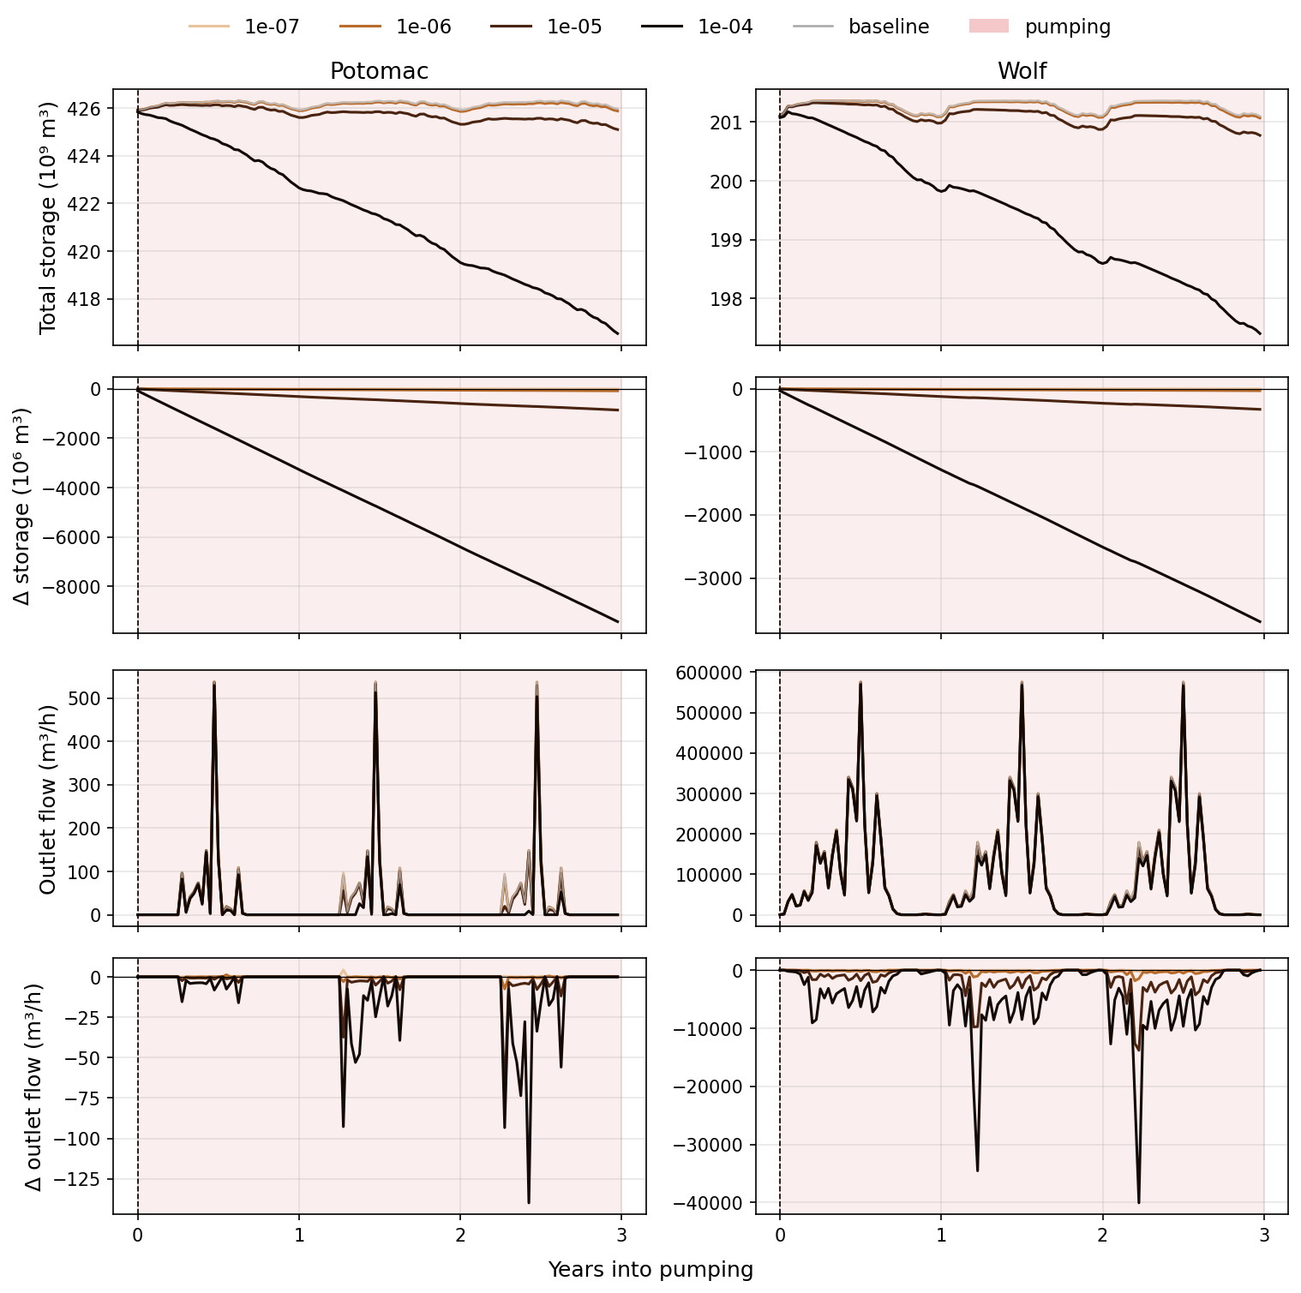
During pumping: storage & flow by rate
t=0 at pumping onset; shaded = pumping period.

Slide 14
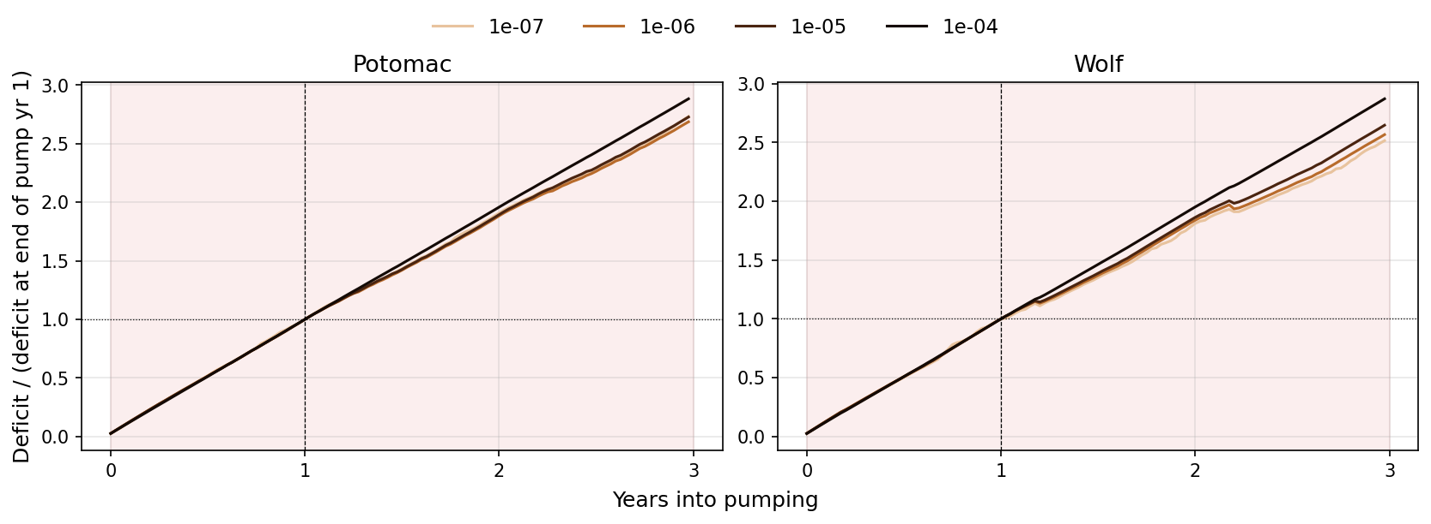
Fractional deficit growth during pumping
Deficit relative to end of pump year 1.

Slide 15
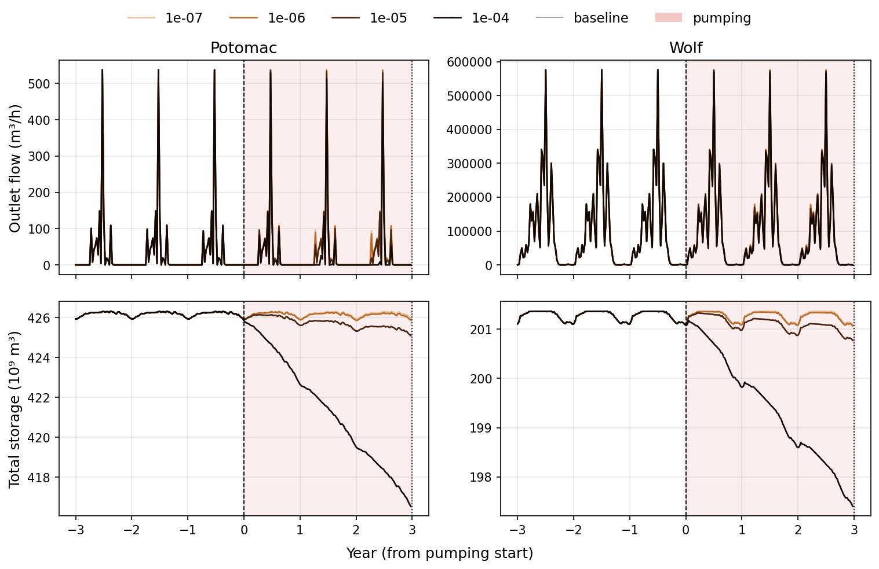
Pumping course (spinup → 3 yr pump)
Last 3 spinup years + 3 pumping years vs baseline.

Slide 16
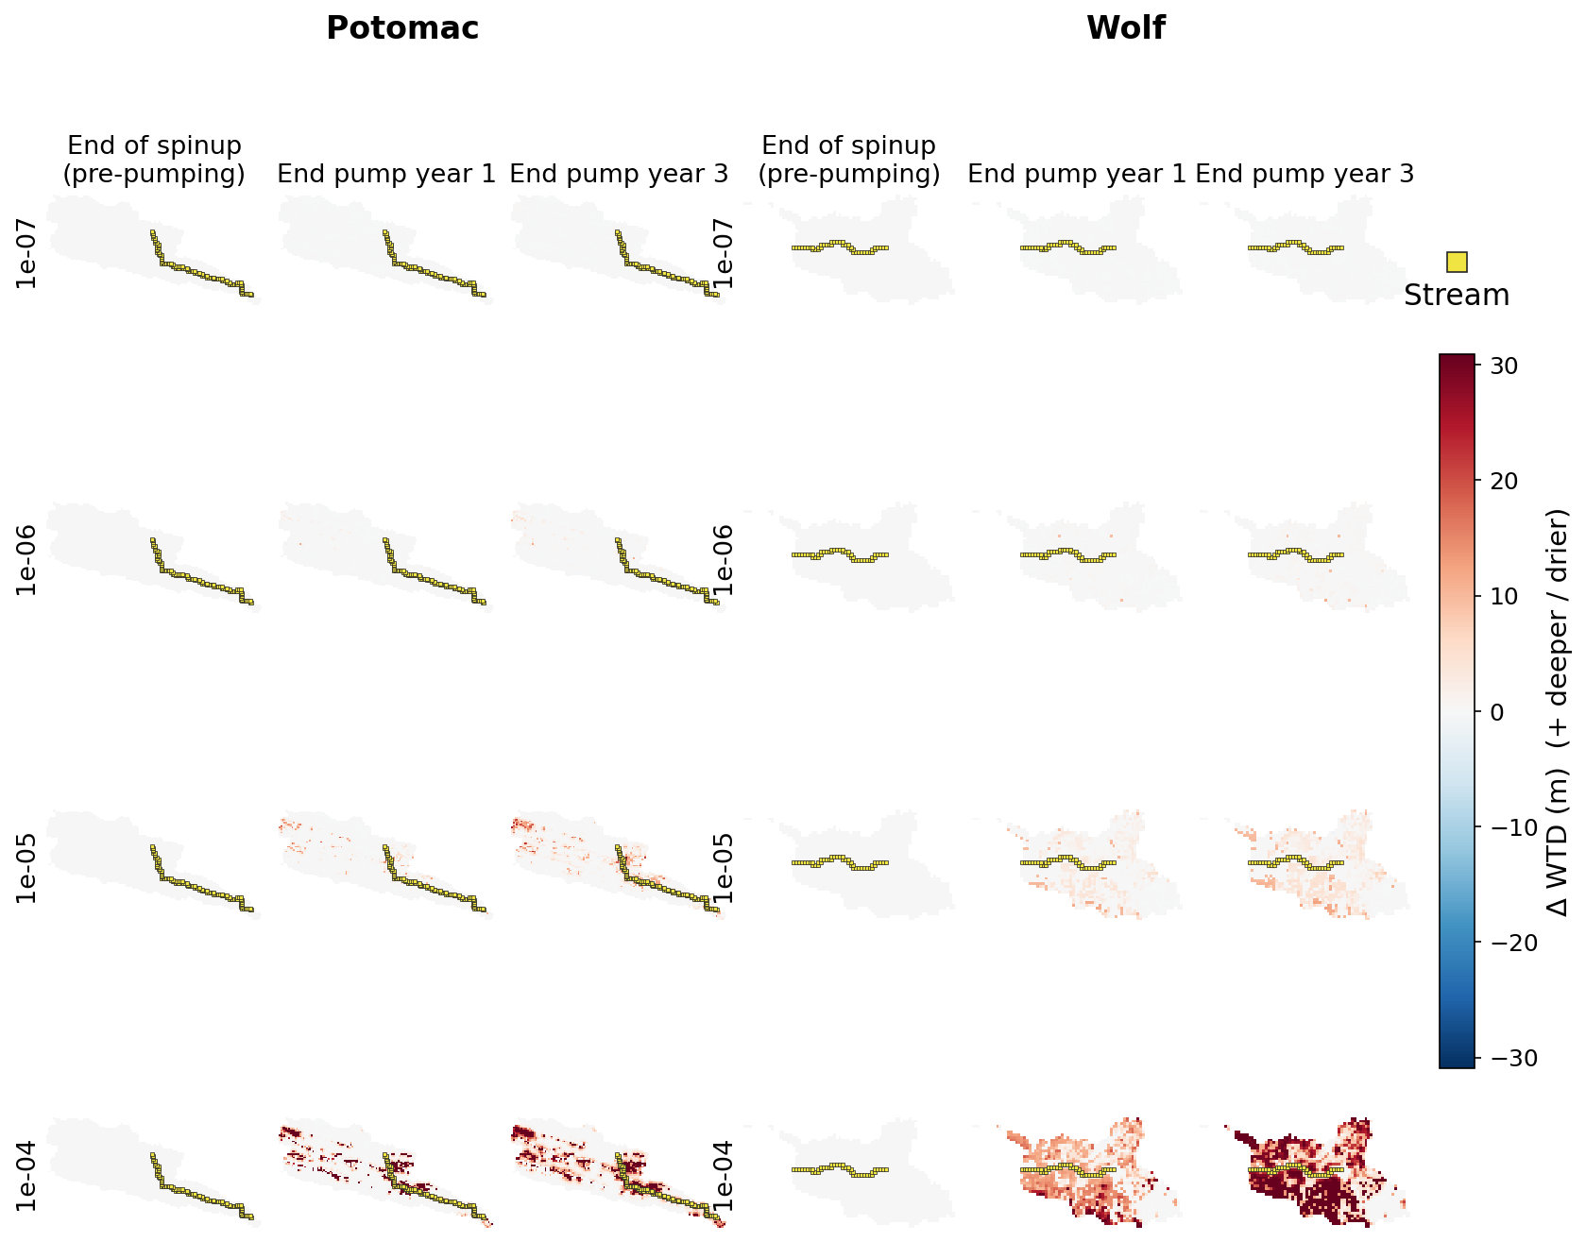
WTD anomaly maps (pumping)
End spinup / end pump yr1 / end pump yr3.

Slide 17
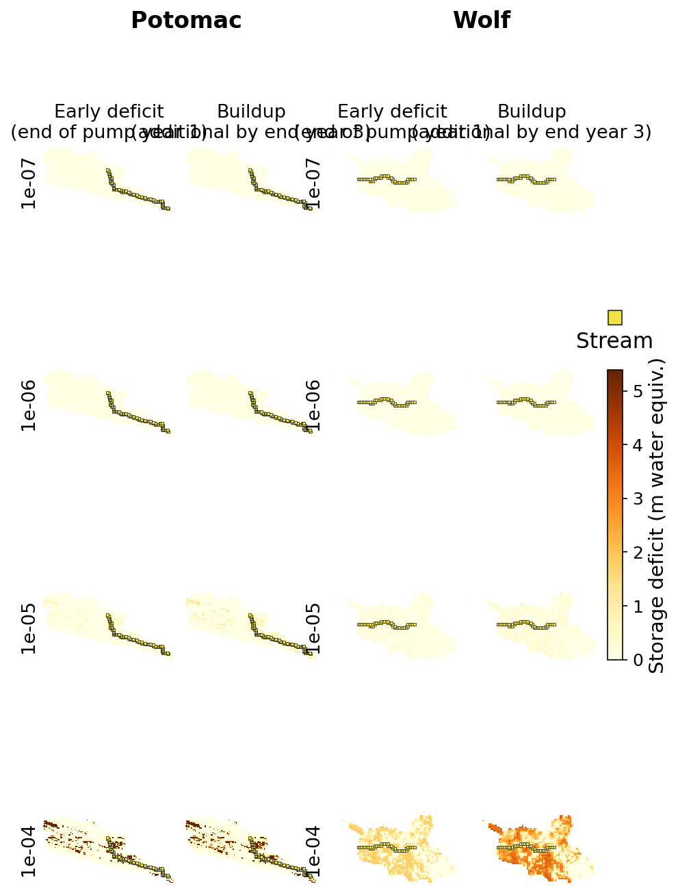
Early vs buildup storage deficits
Early = end yr1 deficit; buildup = additional by end yr3.

Slide 18
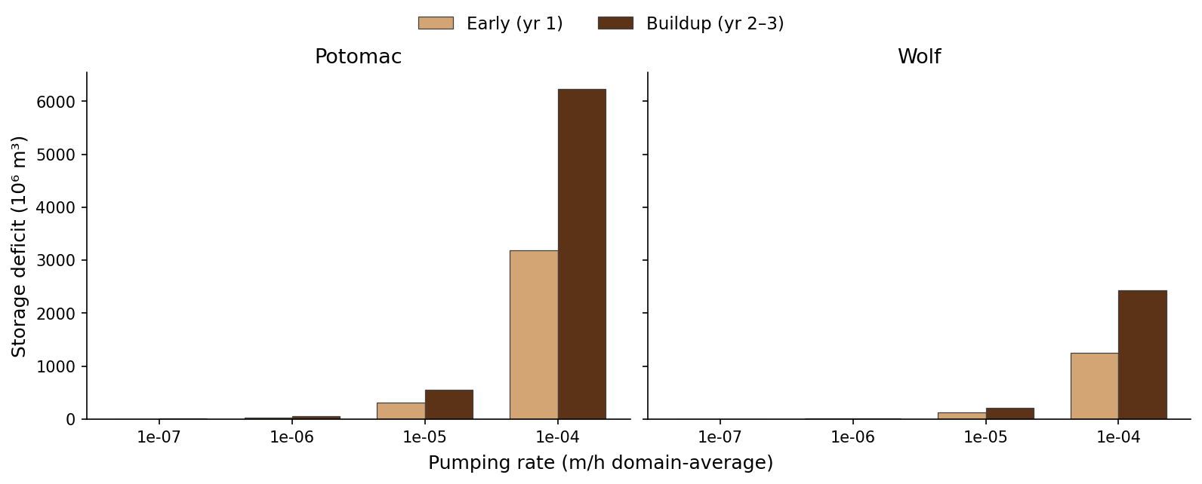
Domain-total early vs buildup
Map-based domain totals by pumping rate.

