Slide 1
Drought storage memory
Temporary vs persistent deficits · overland connectivity · local Budyko · near-surface shielding
Potomac & Wolf

Slide 2
1. Results
What temporary vs persistent looks like

Slide 3
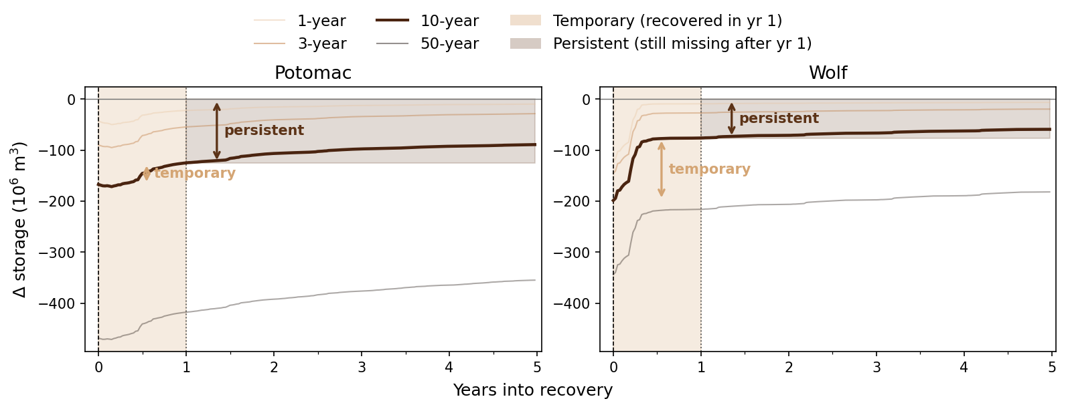
Definition: temporary vs persistent recovery

Slide 4
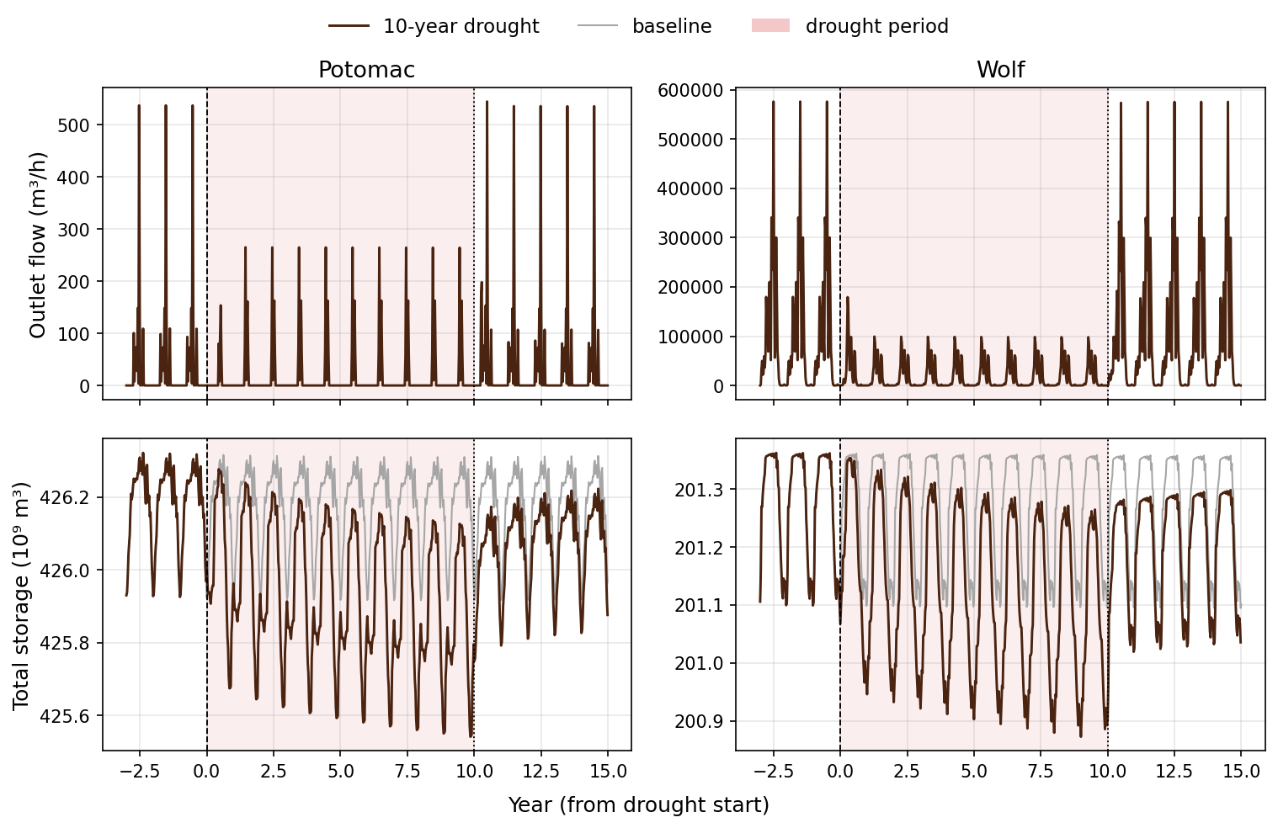
Drought course (10-year)

Slide 5
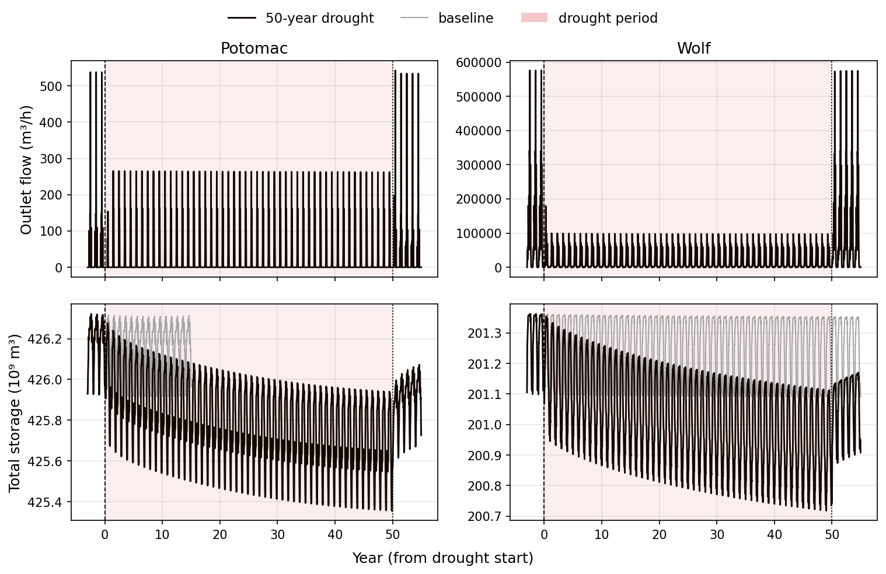
Drought course (50-year)

Slide 6
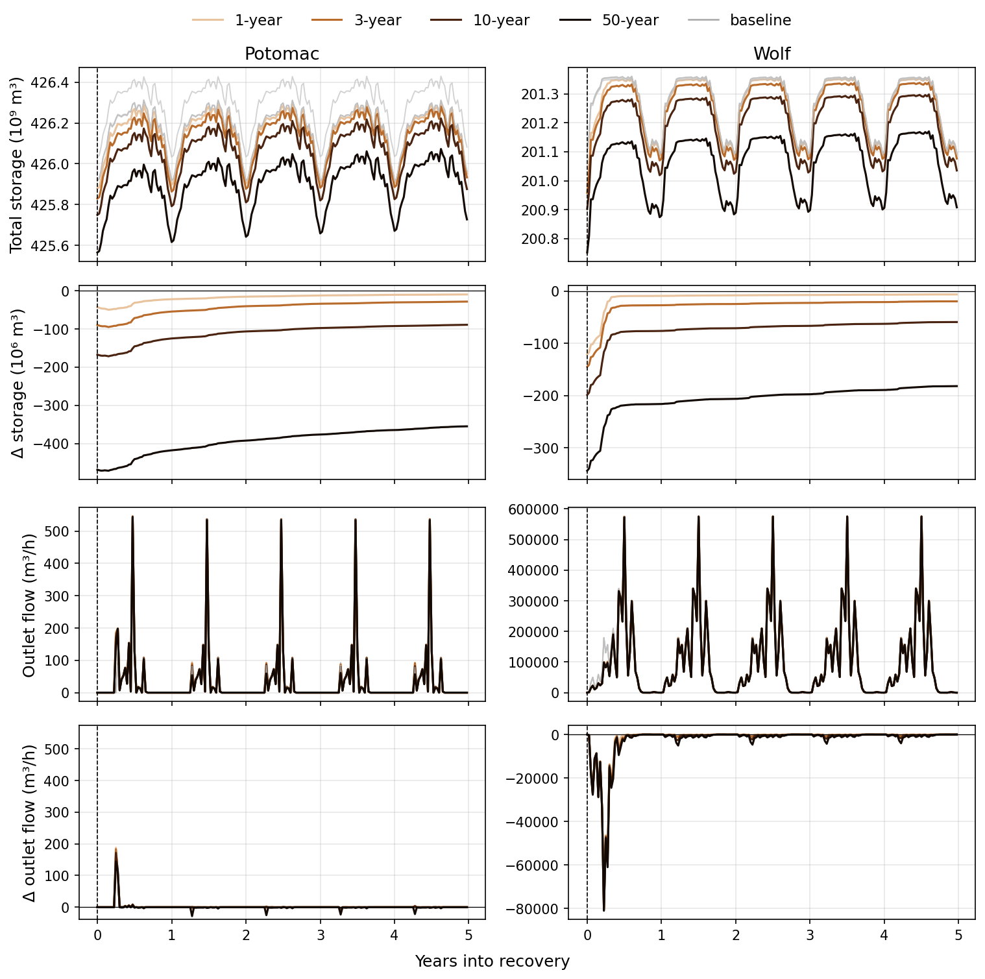
Recovery by drought length

Slide 7
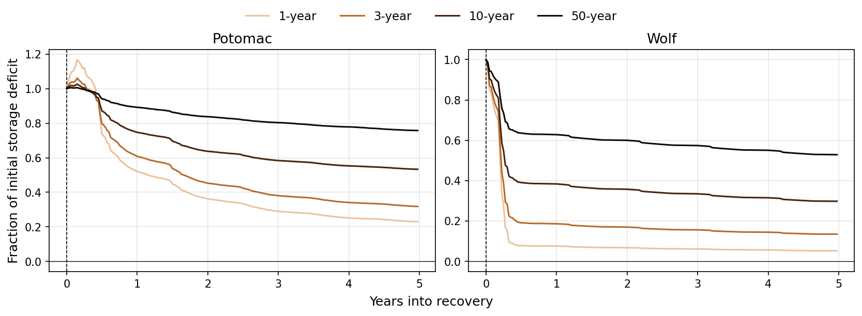
Fraction of storage deficit remaining

Slide 8
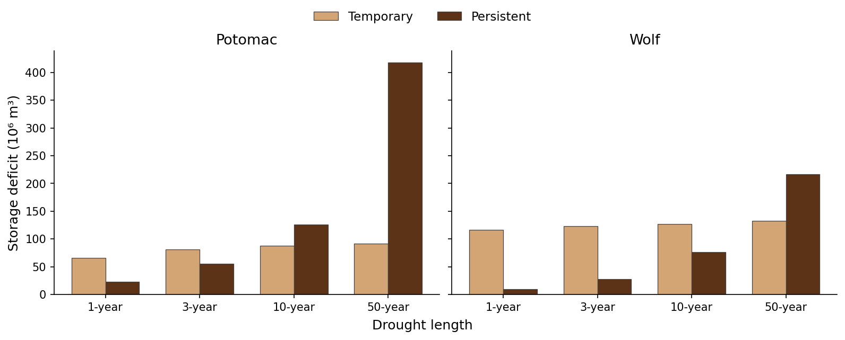
Temporary saturates; persistent grows

Slide 9
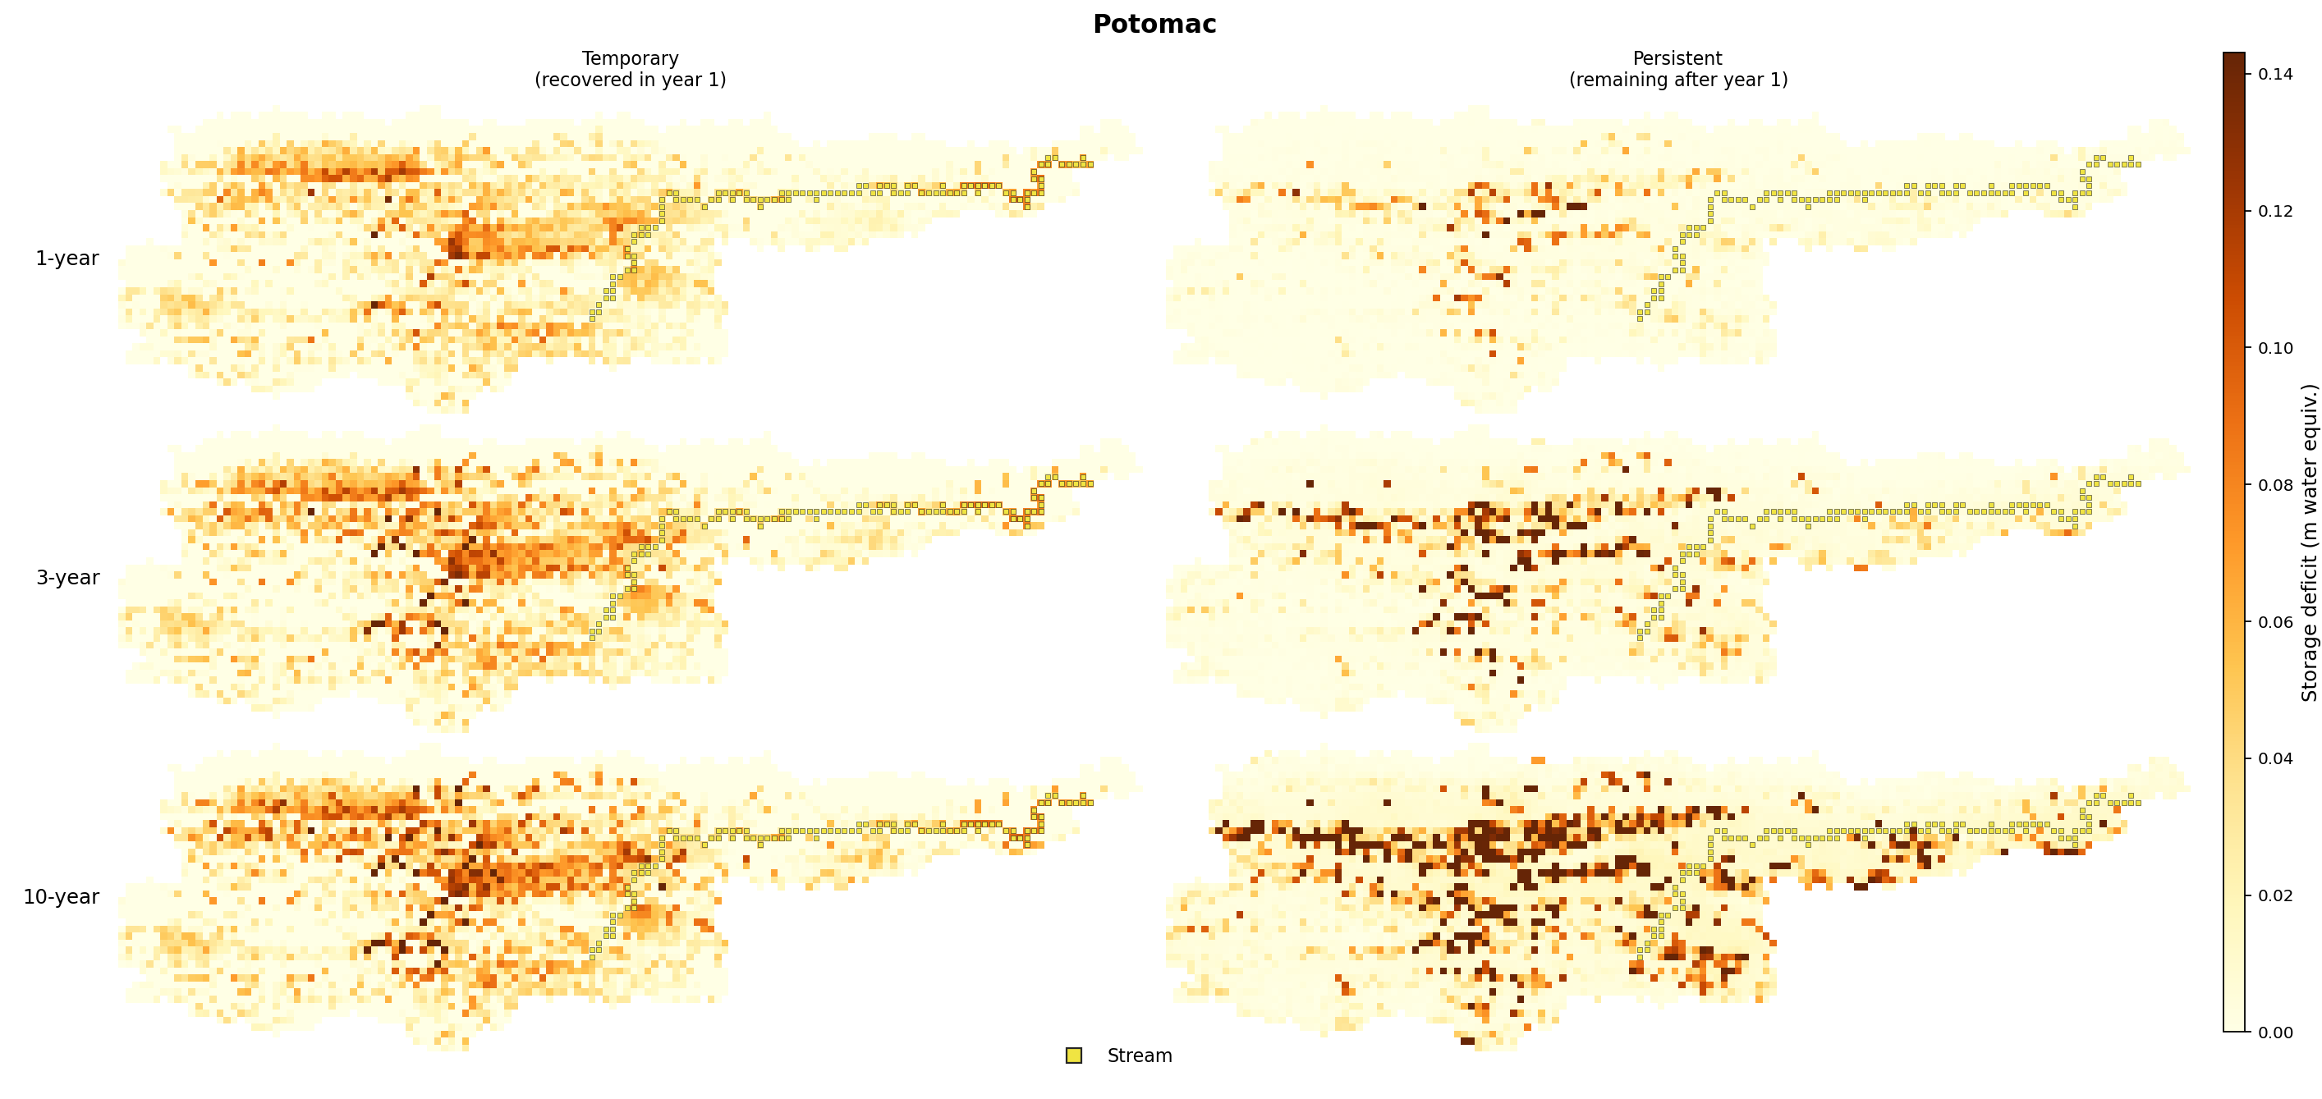
Temporary vs persistent storage — Potomac

Slide 10
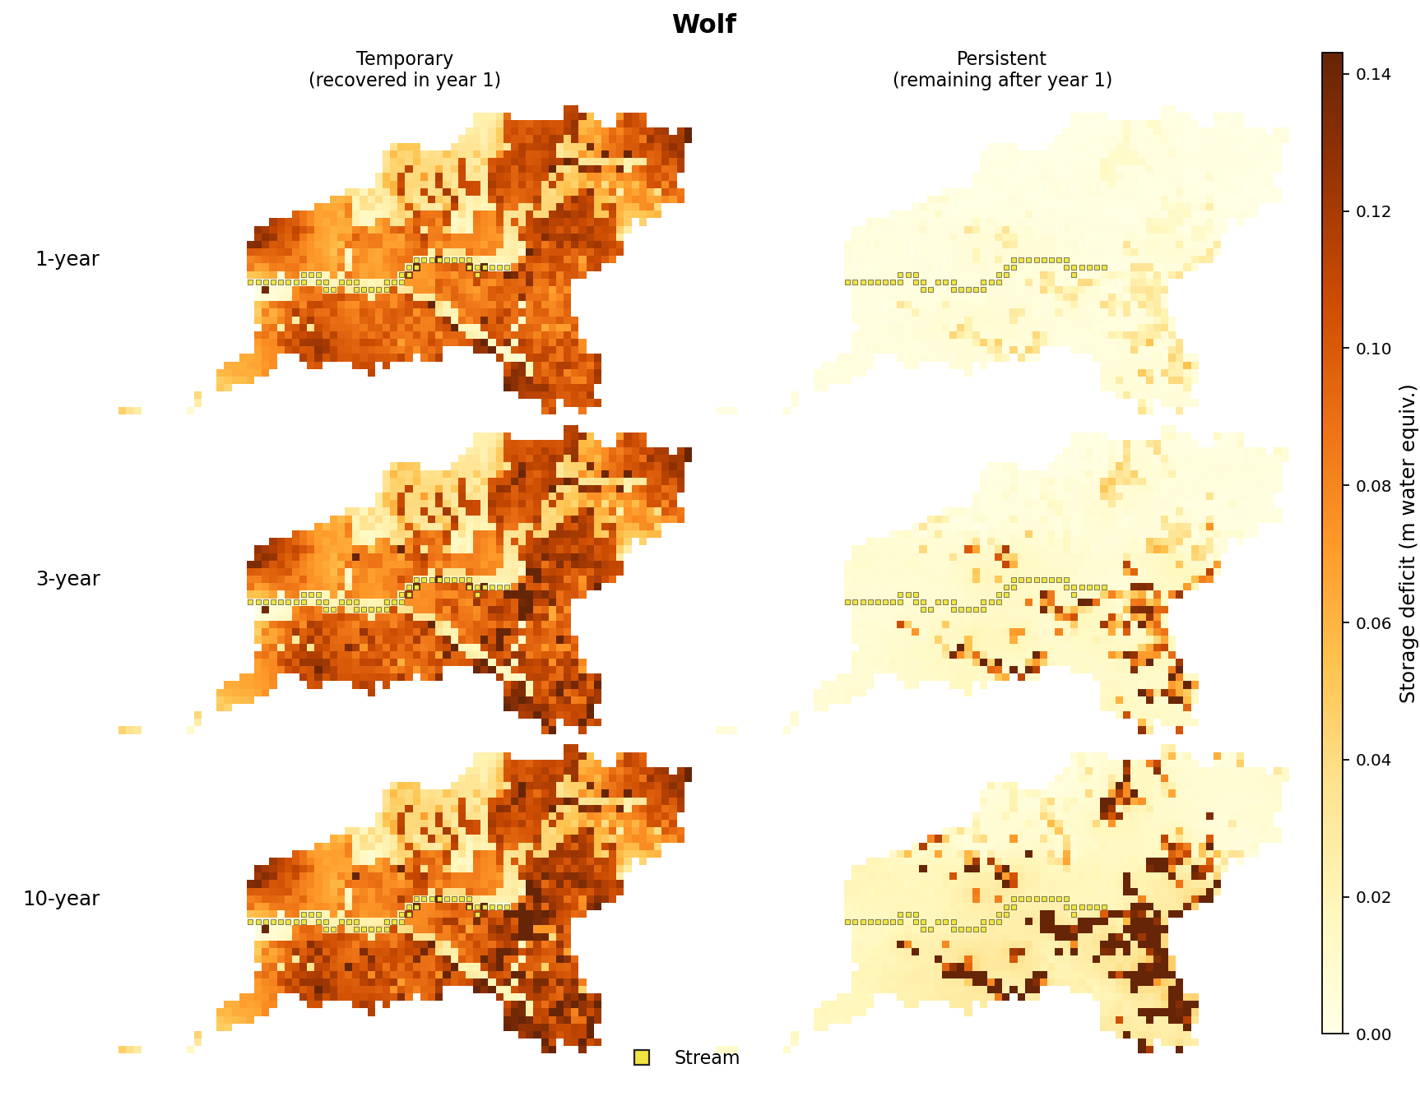
Temporary vs persistent storage — Wolf

Slide 11
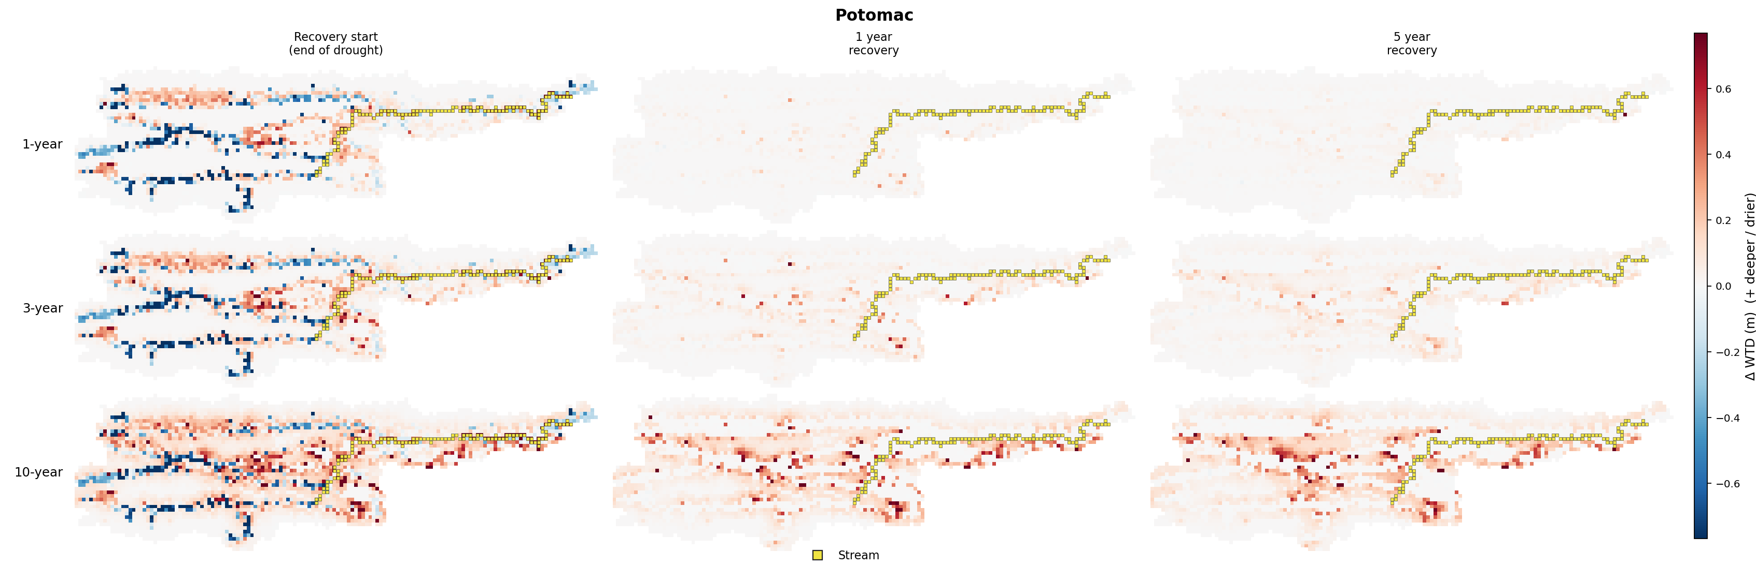
WTD anomaly through recovery — Potomac

Slide 12
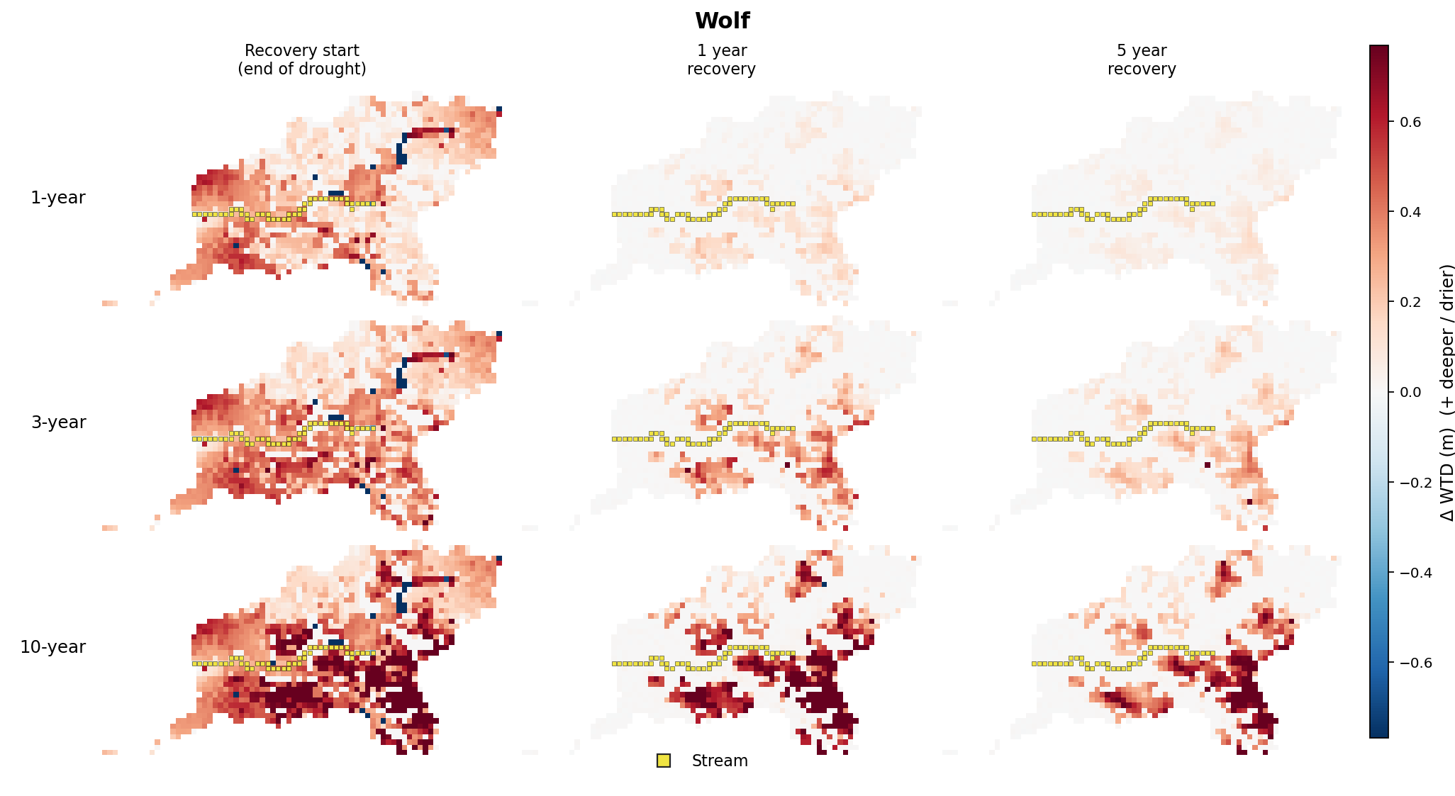
WTD anomaly through recovery — Wolf

Slide 13
2. Overland flow → deficit type
Low-overland cells hold the persistent mass; distance-to-stream is weaker

Slide 14
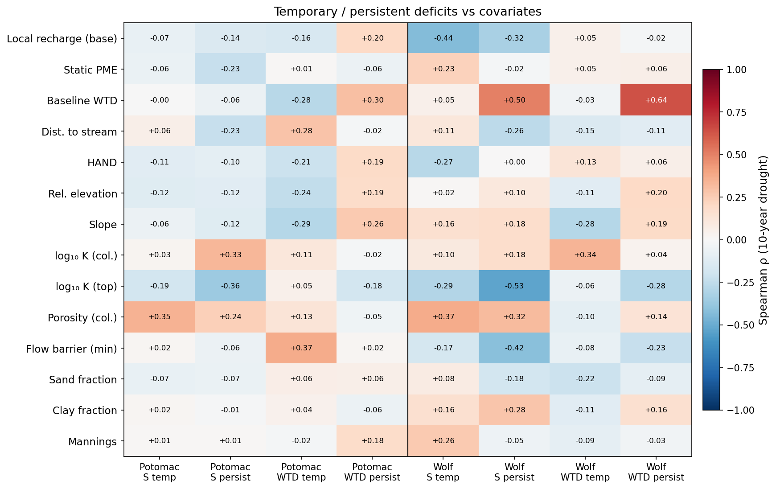
Temporary / persistent deficits vs covariates

Slide 15
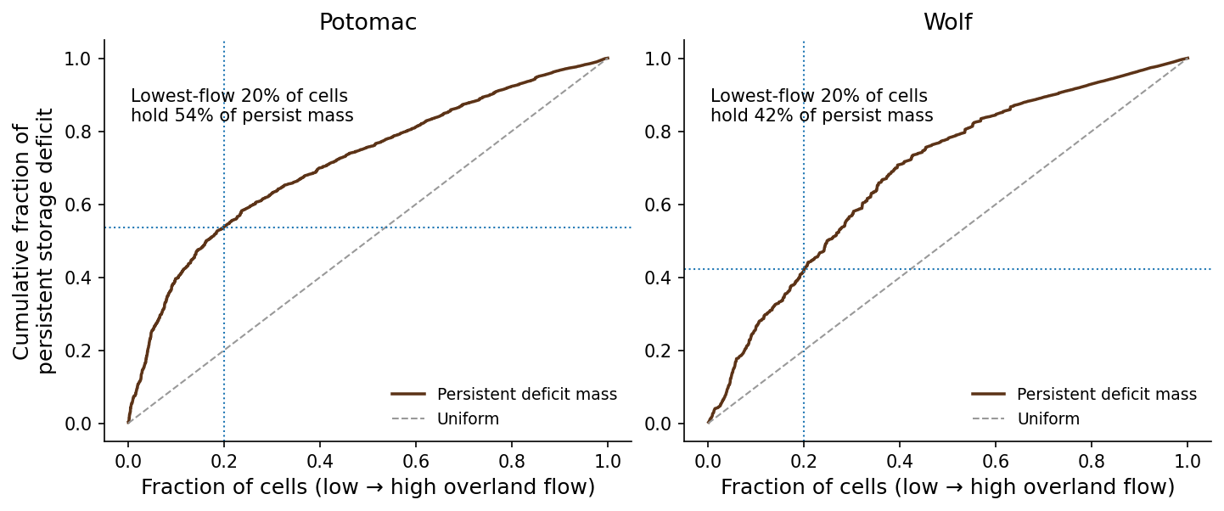
Persistent mass concentrates in low-overland cells

Slide 16
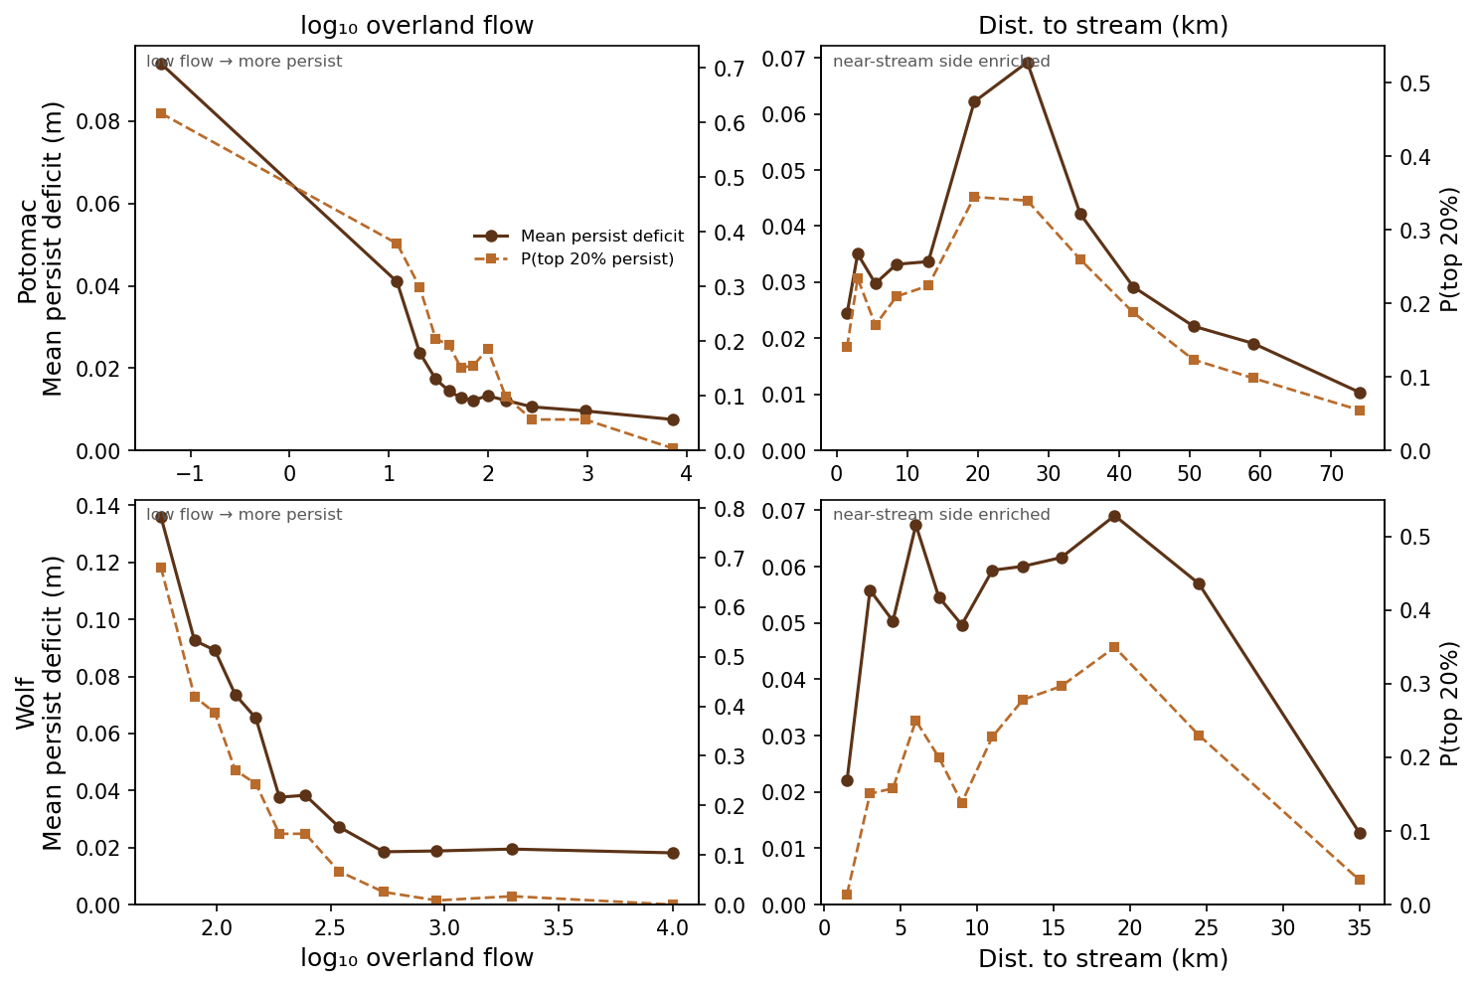
log overland flow vs distance to stream

Slide 17
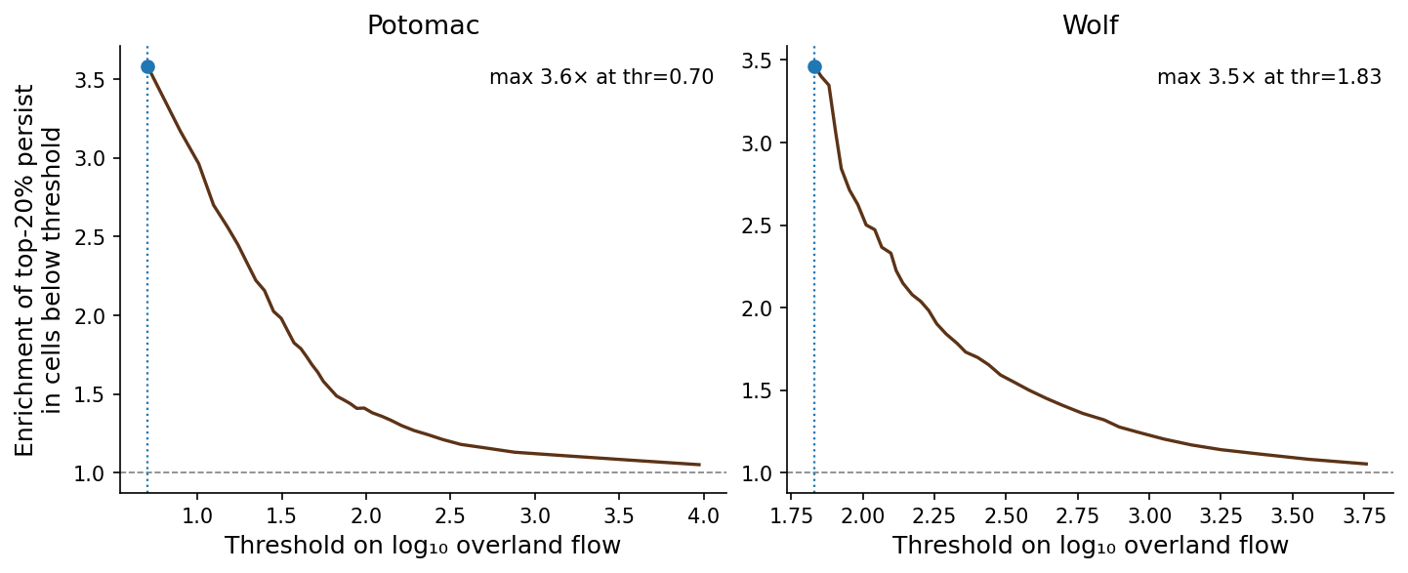
Enrichment of top-20% persist below flow thresholds

Slide 18
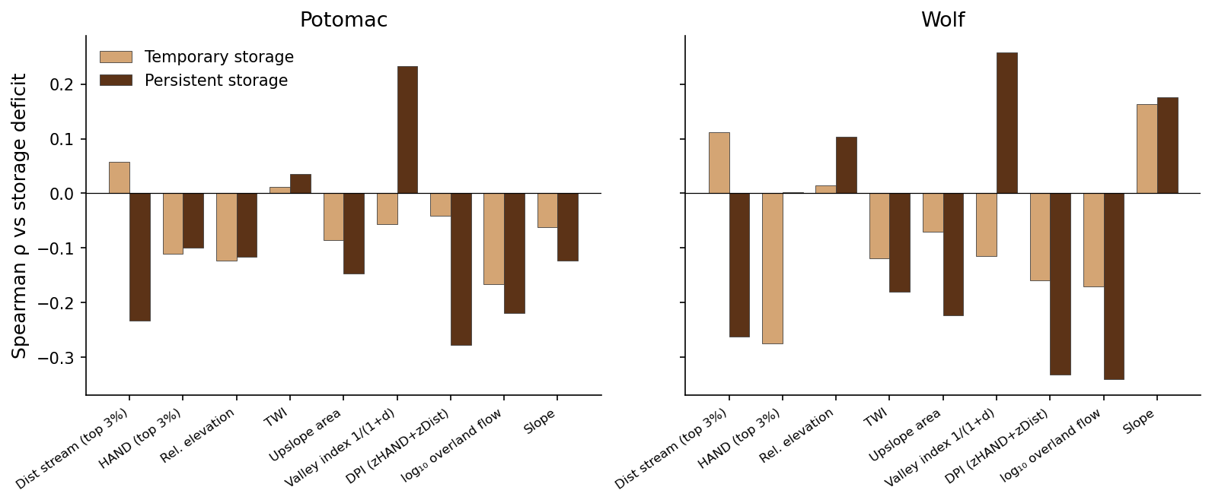
Drainage-position heuristics vs temp/persist

Slide 19
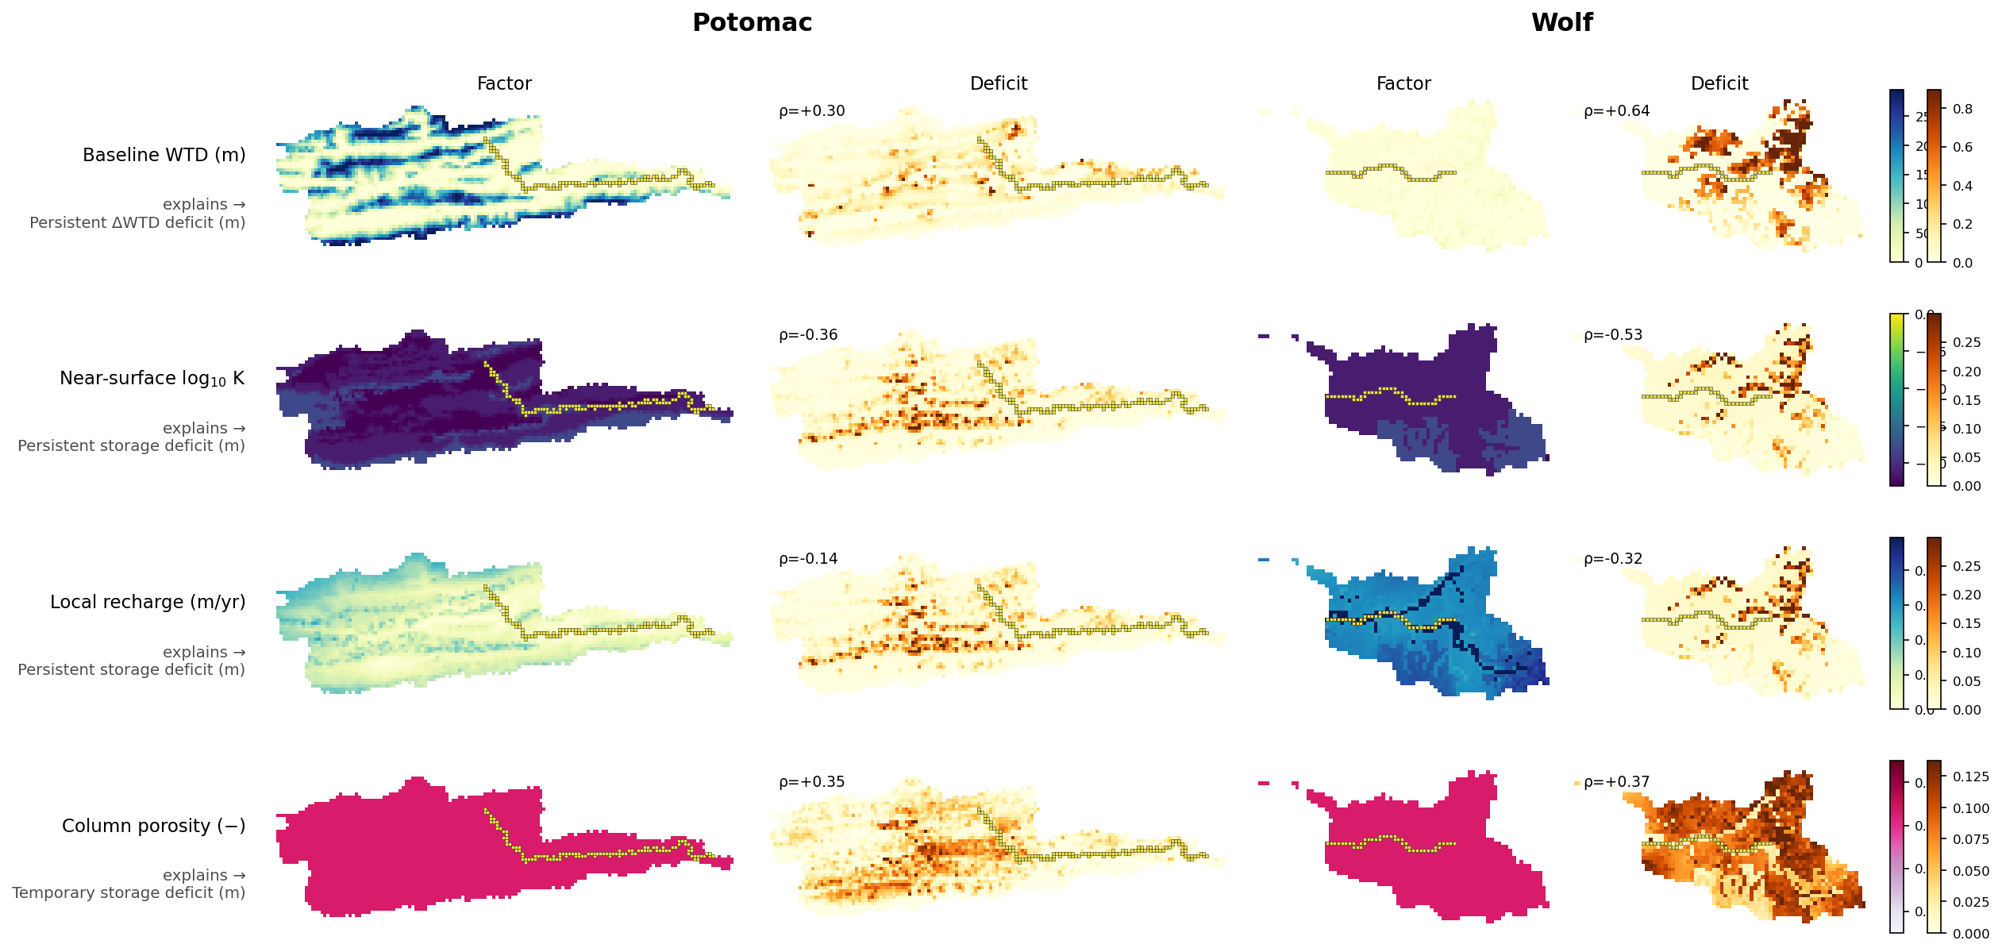
Best single-factor maps (WTD, K, recharge, porosity)

Slide 20
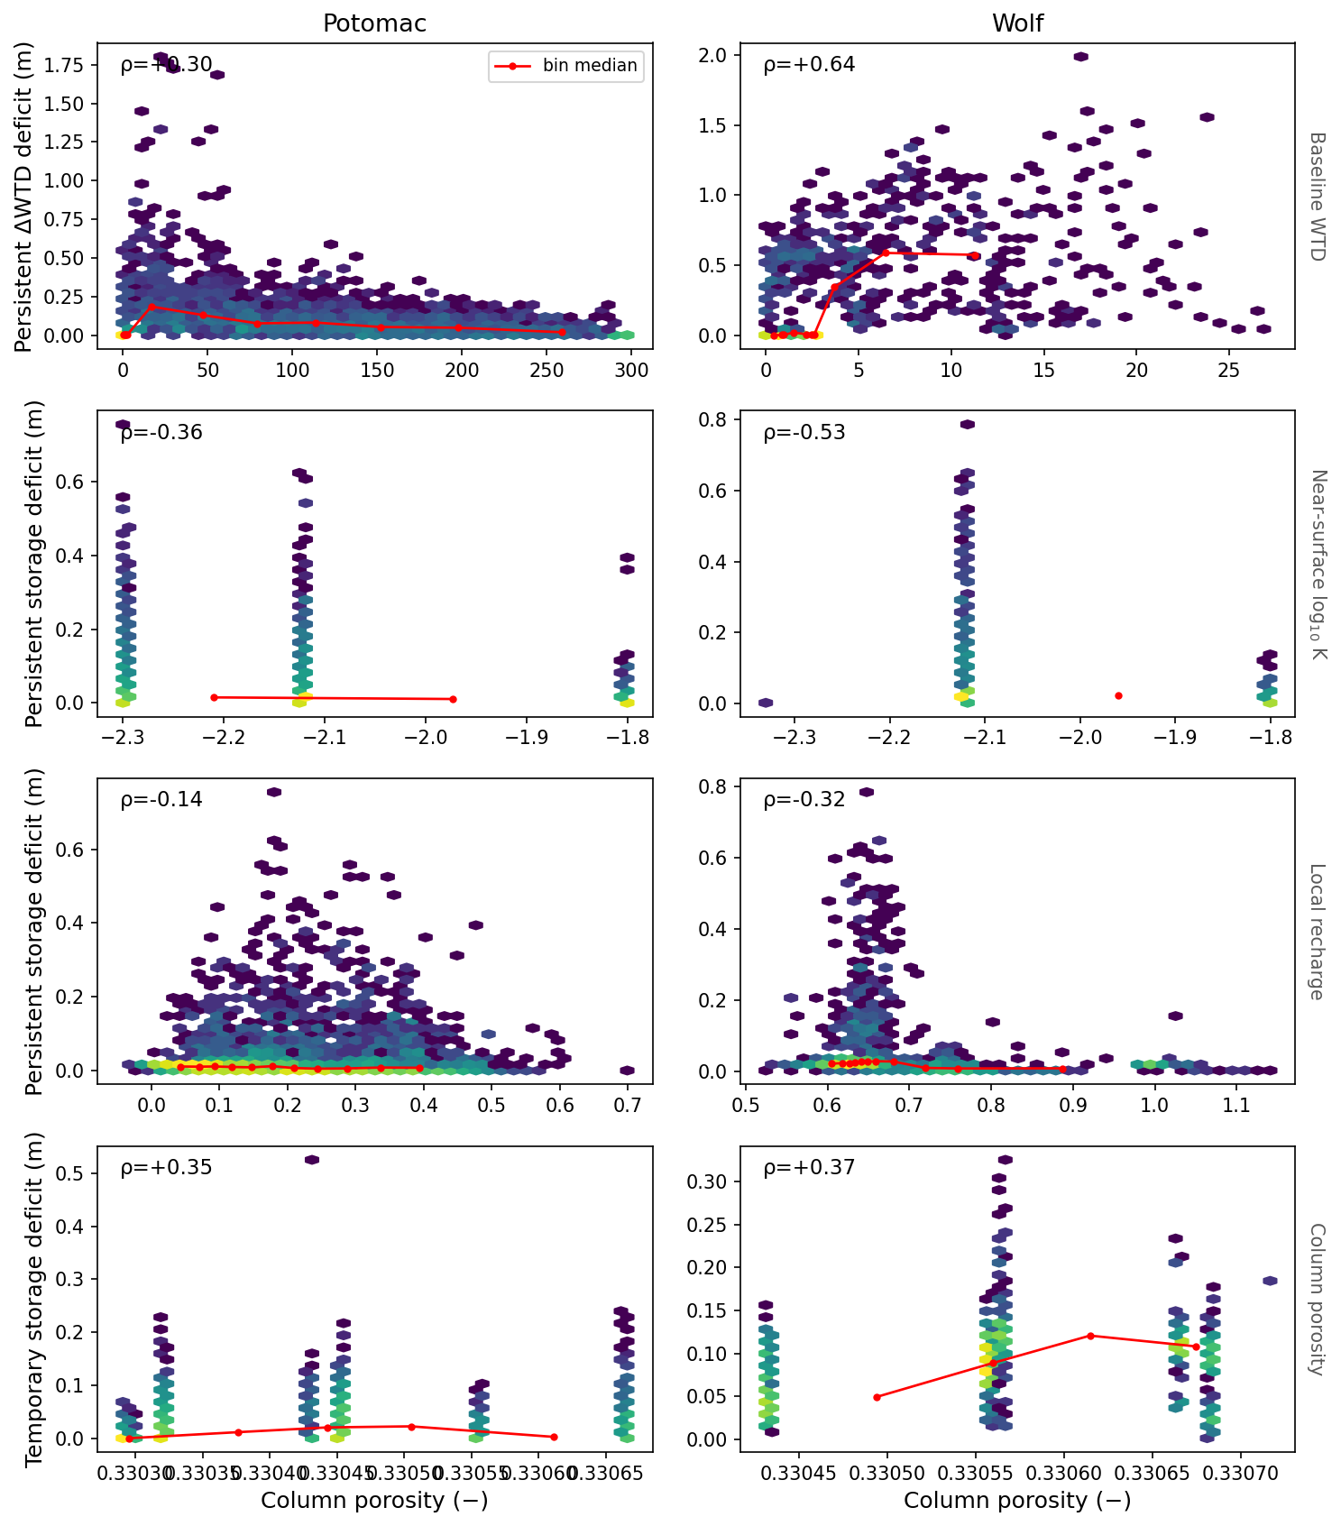
Best single-factor hexbins

Slide 21
3. Local Budyko framing
Domain climate sets the regime; within-basin ranking is overland / WTD, not φ

Slide 22
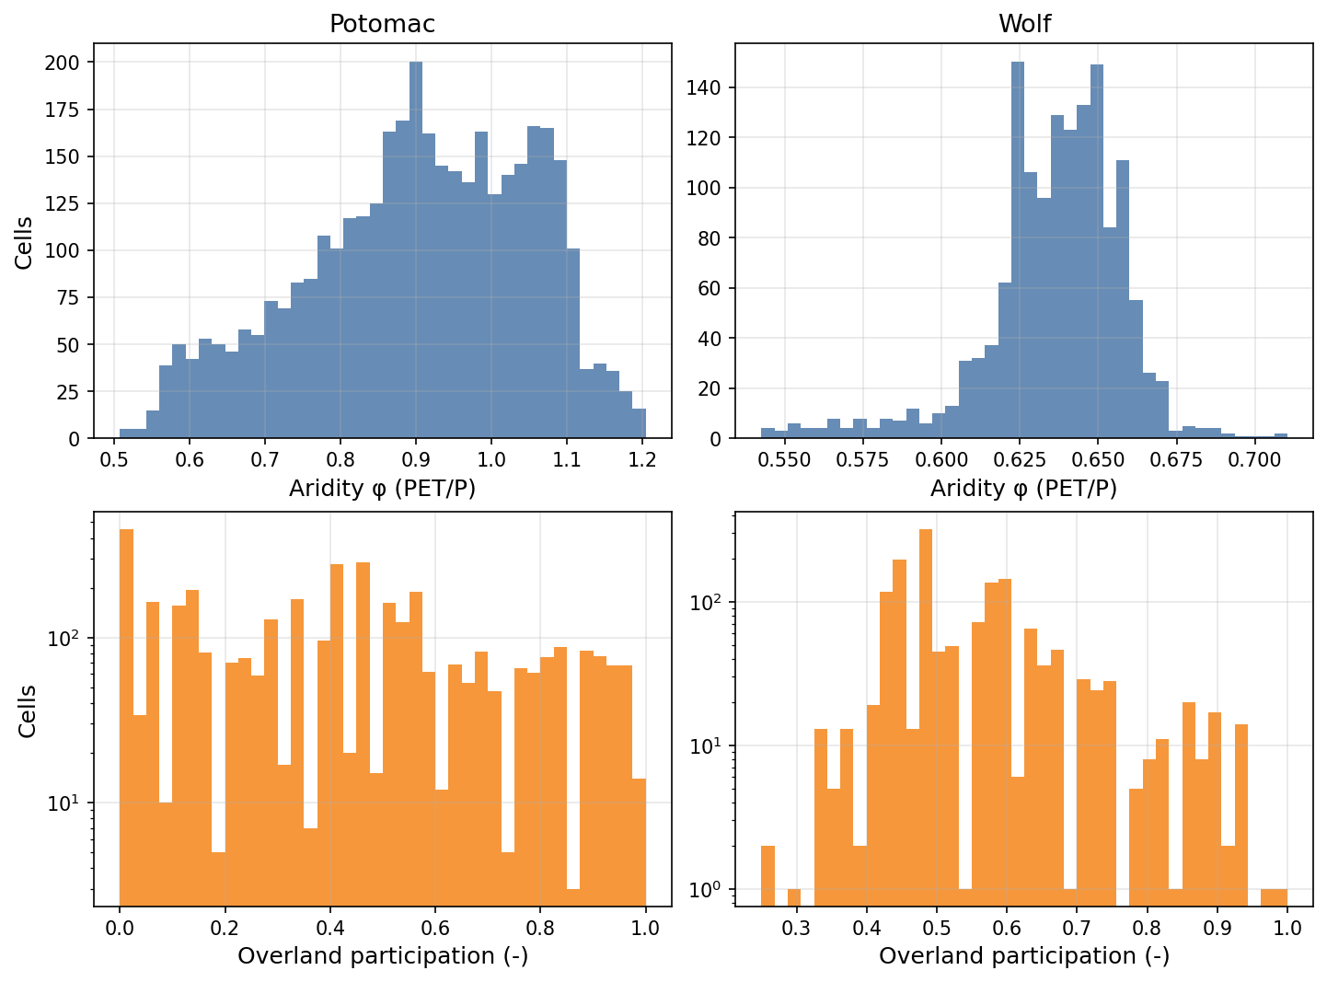
Aridity is flat; overland participation varies

Slide 23
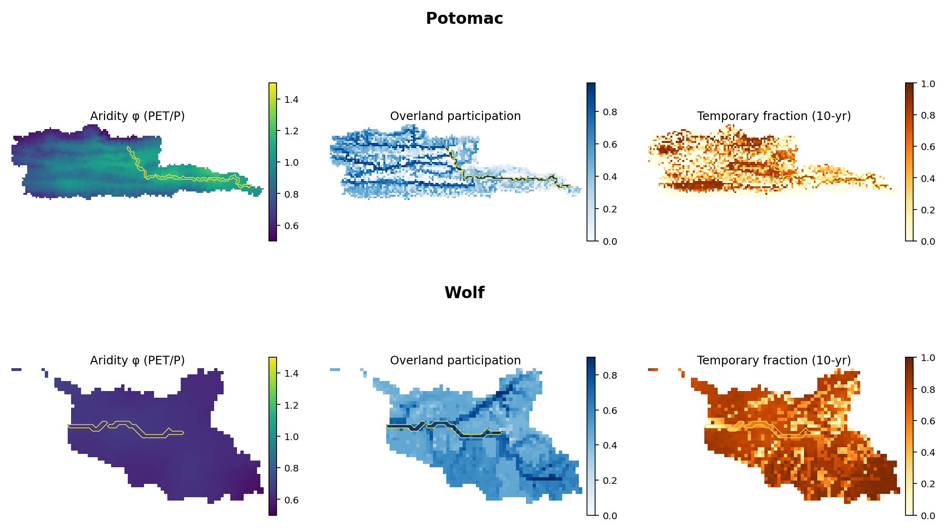
Maps: aridity, overland, temporary fraction

Slide 24
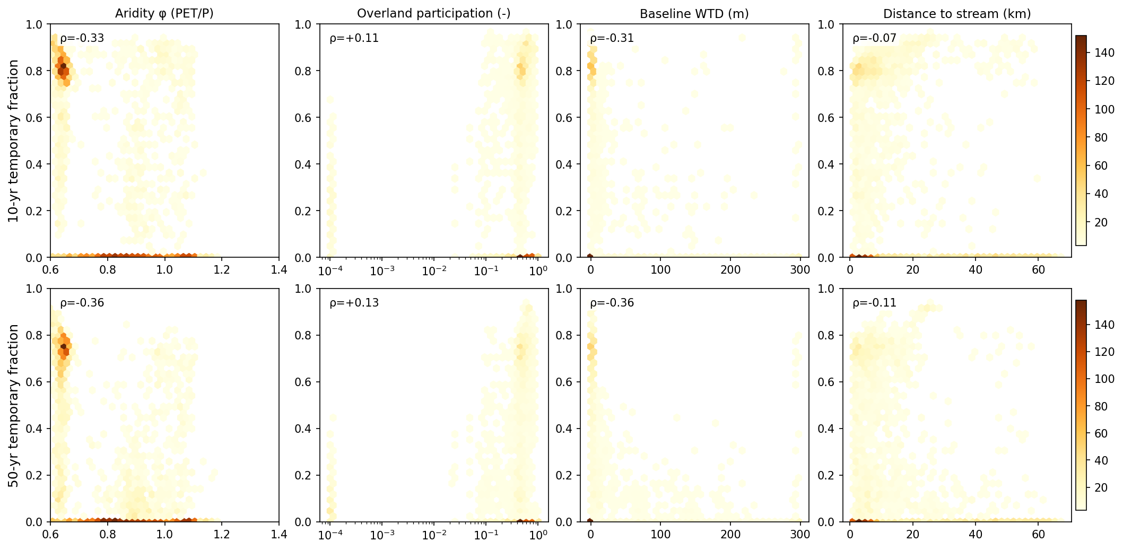
f_temp vs overland, WTD, and stream distance

Slide 25
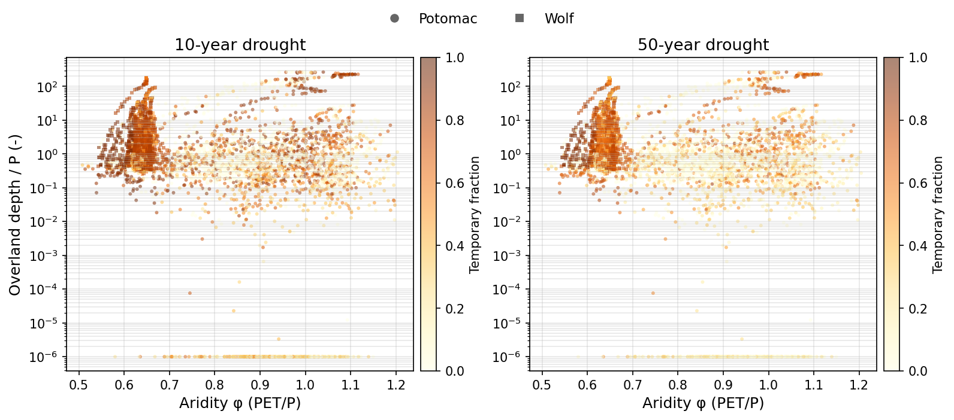
Local Budyko space colored by temporary fraction

Slide 26
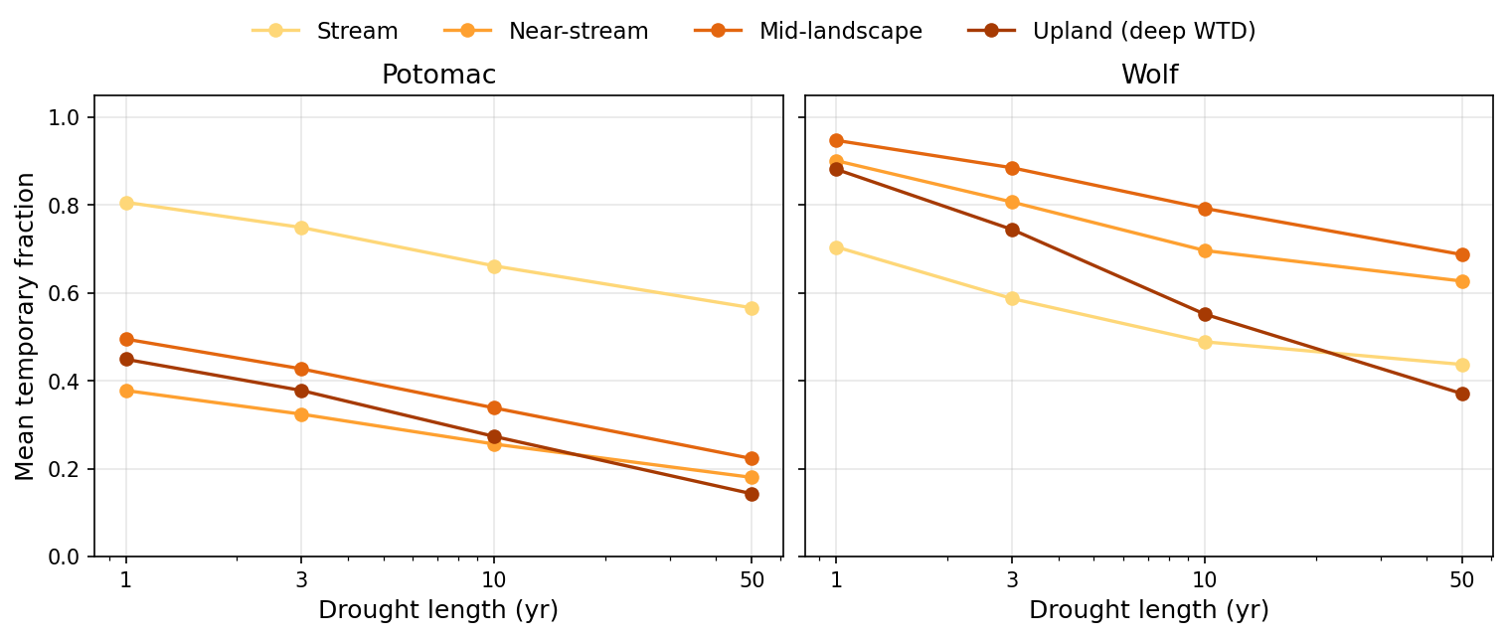
Temporary fraction by landscape stratum

Slide 27
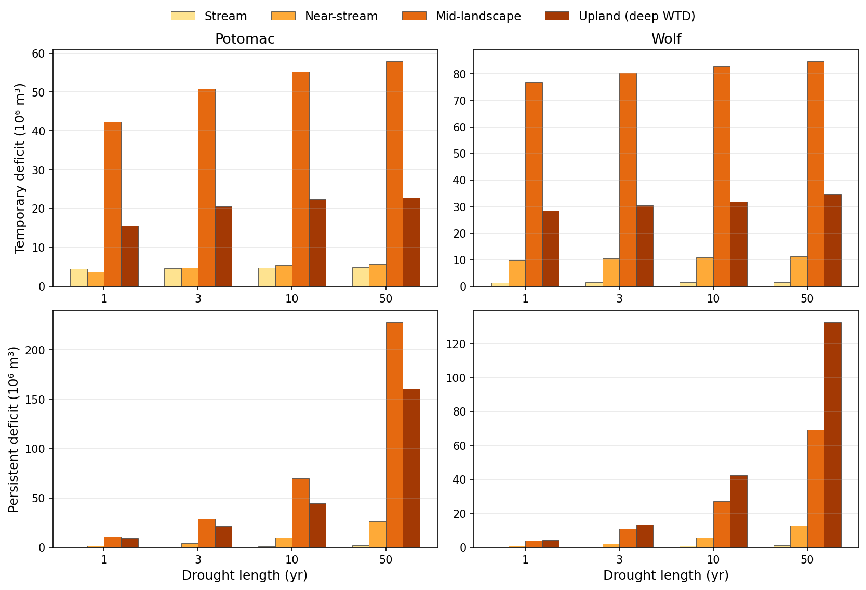
Temp / persist volume by stratum

Slide 28
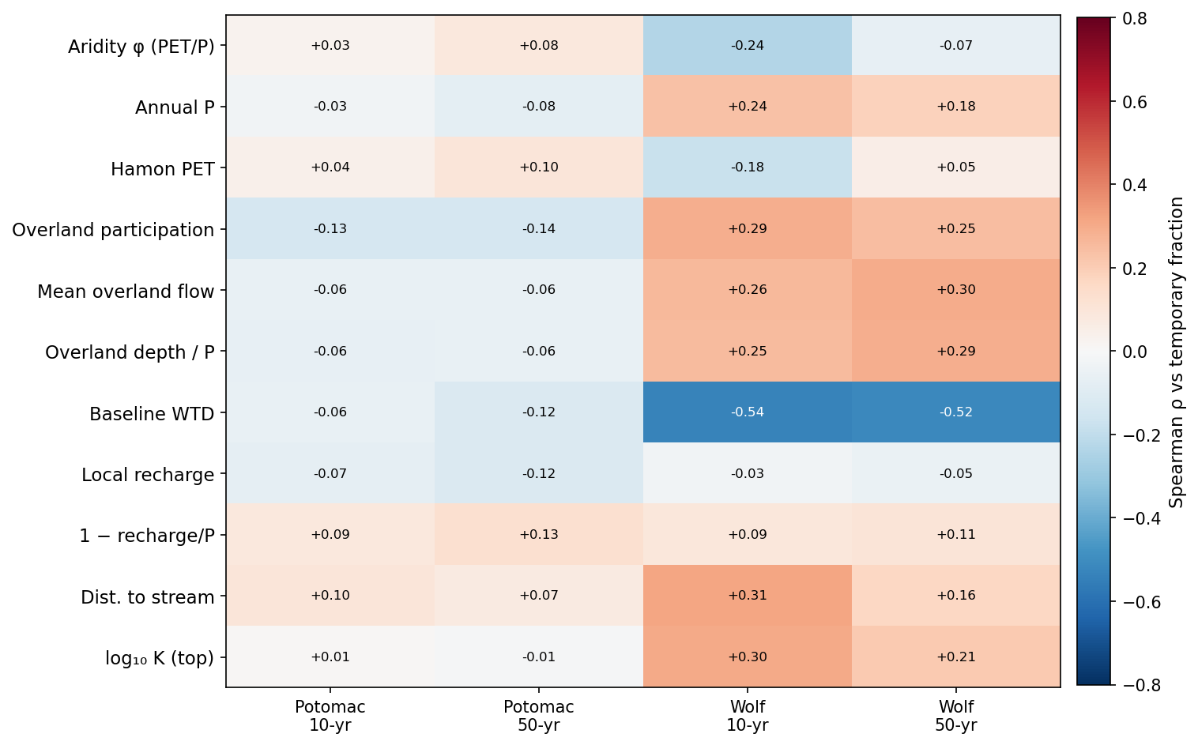
Within-domain Spearman (overland & WTD vs f_temp)

Slide 29
4. Mechanism: depth
Near-surface regenerates; deep losses persist

Slide 30
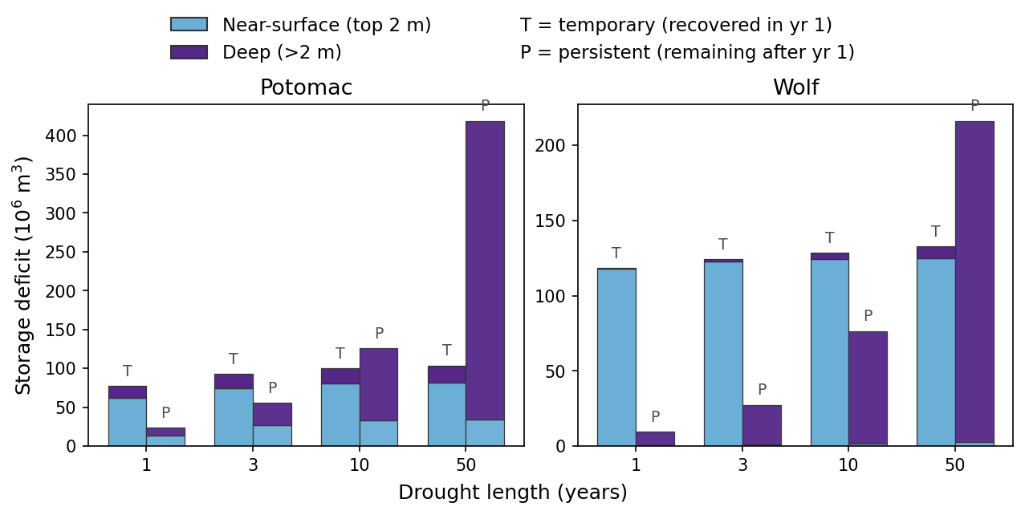
Temporary ≈ near-surface; persistent ≈ deep

Slide 31
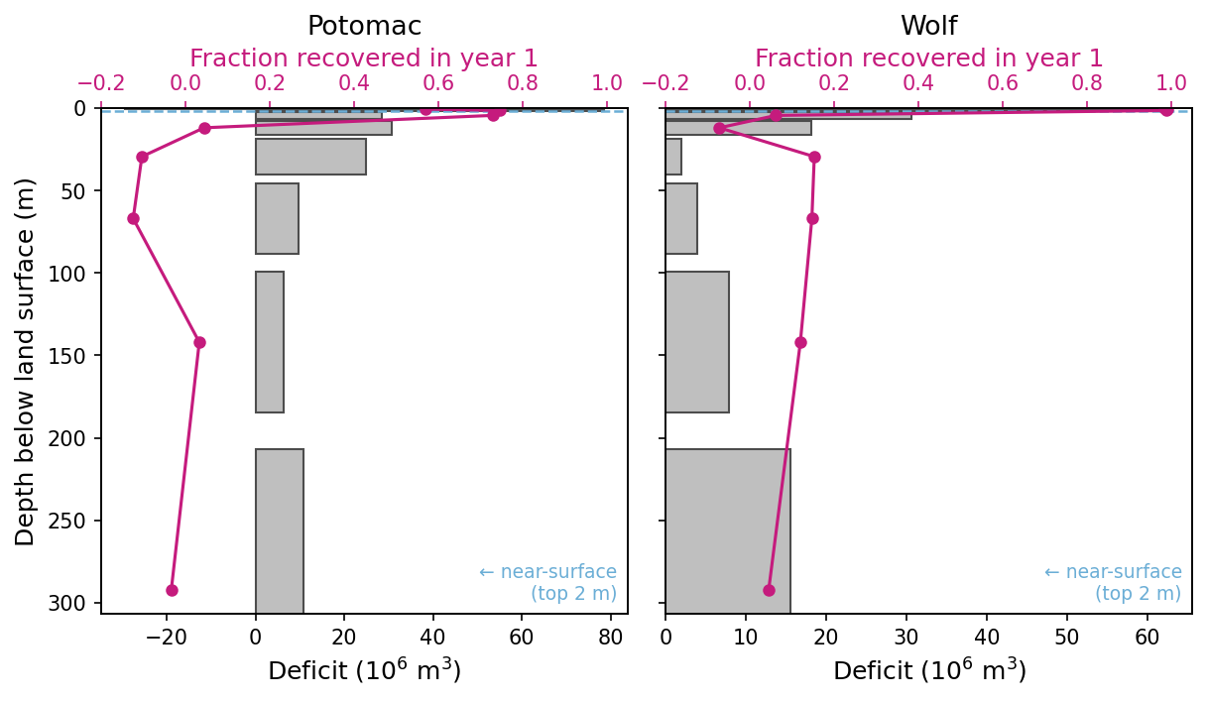
Recovery fraction by depth (10-year)

Slide 32
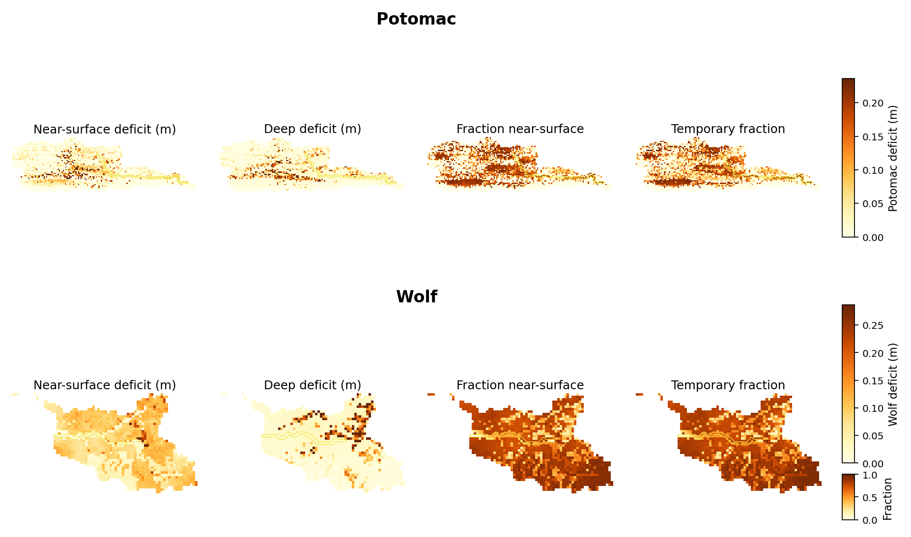
Spatial: near-surface fraction ≈ temporary fraction

Slide 33
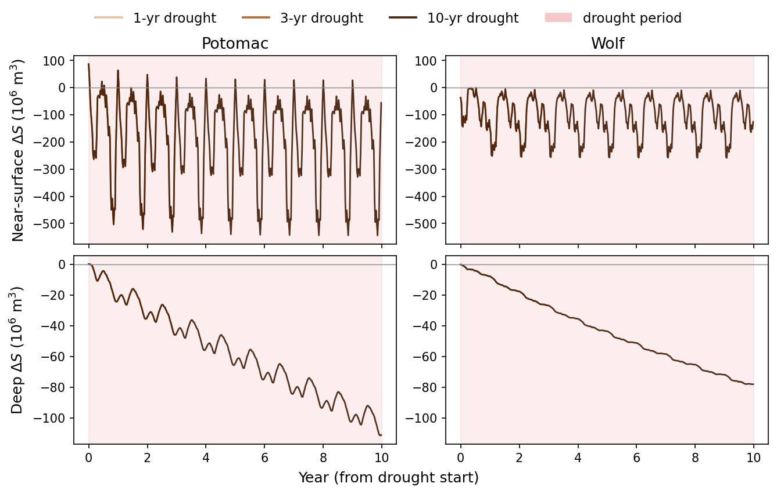
Mid-drought: near-surface regenerates, deep ratchets down

Slide 34
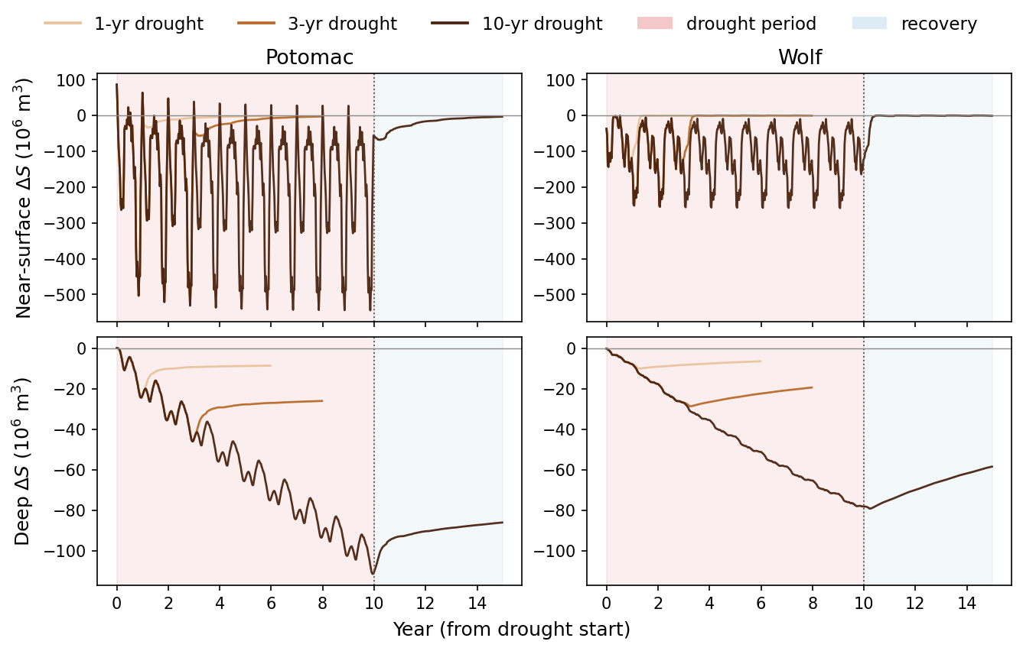
Same series through recovery (near-surface rebounds; deep lags)

Slide 35
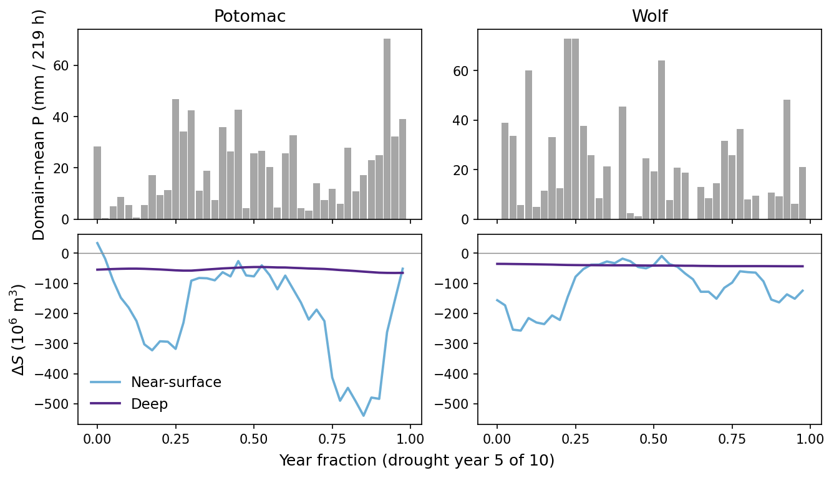
One drought year: storage tracks precip only near the surface

