Slide 1
Drought storage memory
Temporary deficits recover in a year; persistent deficits are deep, poorly connected, and grow with drought length
Potomac & Wolf · 1 / 3 / 10 / 50-year droughts

Slide 2
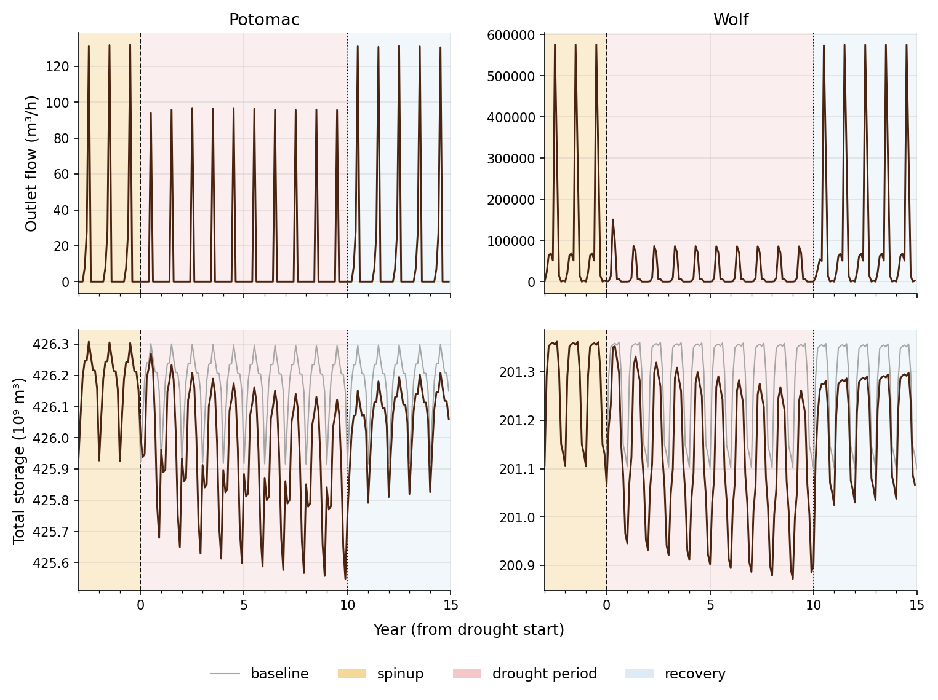
A 10-year drought draws storage down for the whole drought

Slide 3
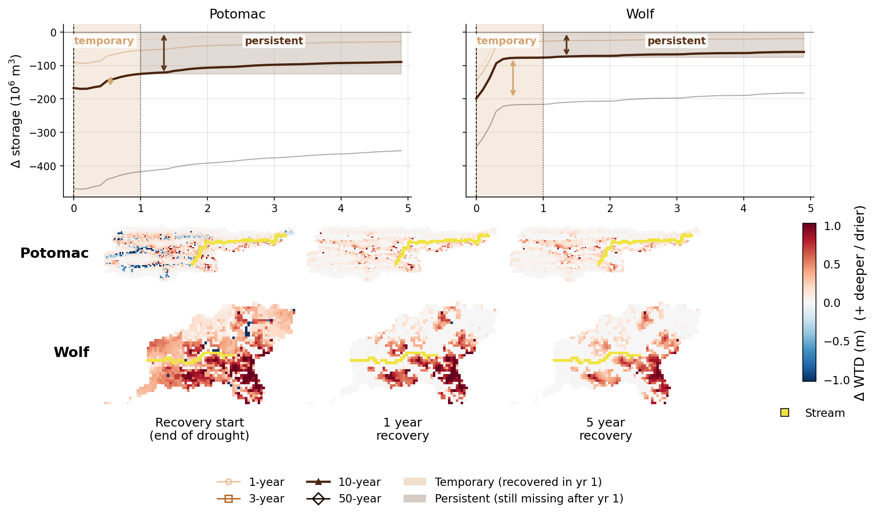
Recovery is two-phase; near-stream cells recover, uplands stay dry

Slide 4
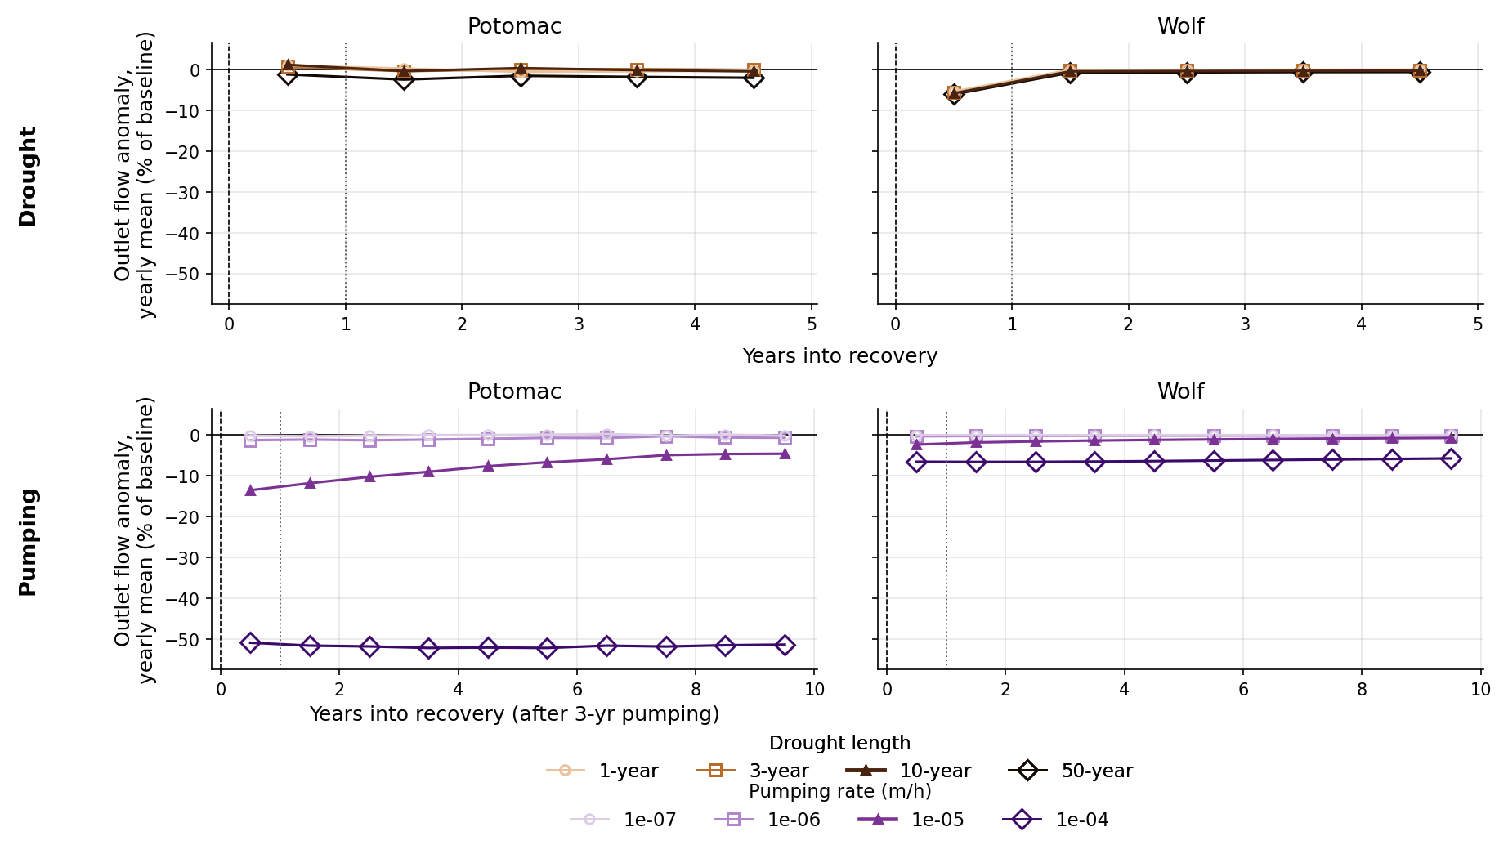
Streamflow returns within a year; pumping stays depressed after shutoff

Slide 5
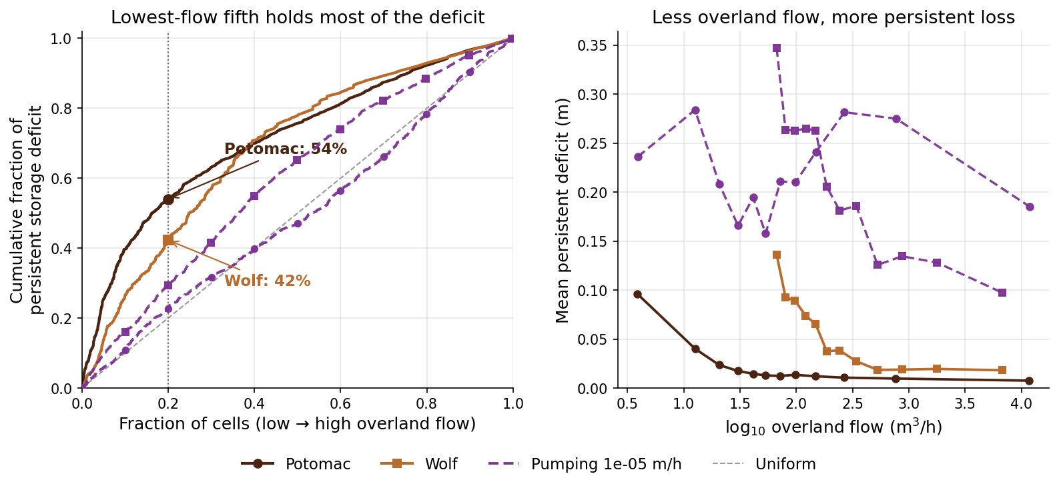
The persistent deficit sits where overland flow is low

Slide 6
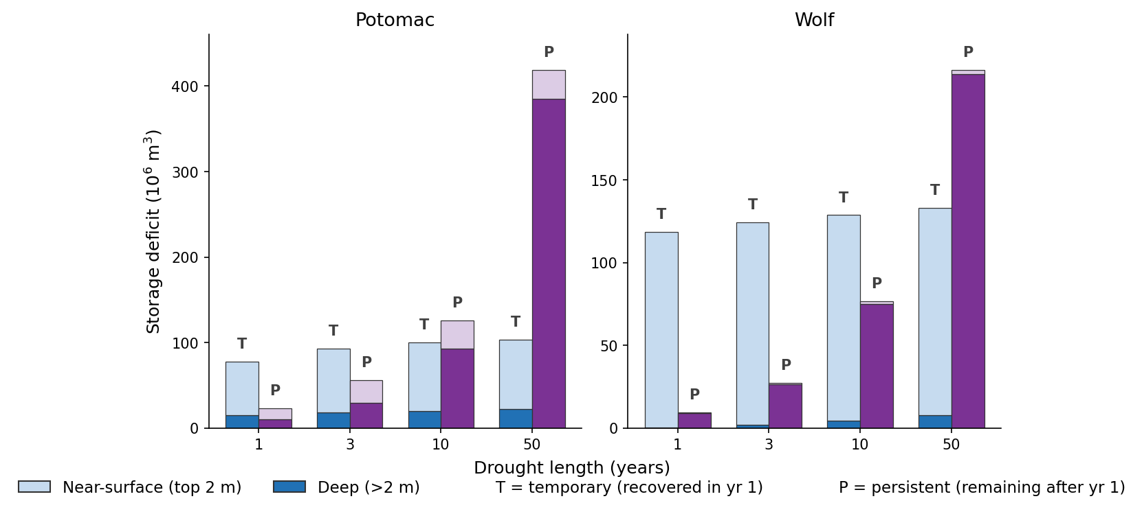
Temporary saturates, persistent grows — and persistent is deep

Slide 7
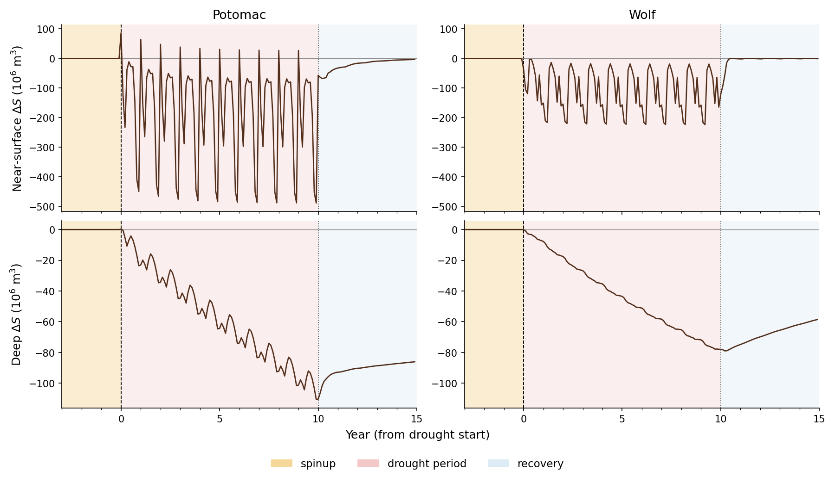
Near-surface regenerates through the drought; deep ratchets down and only partly refills

Slide 8
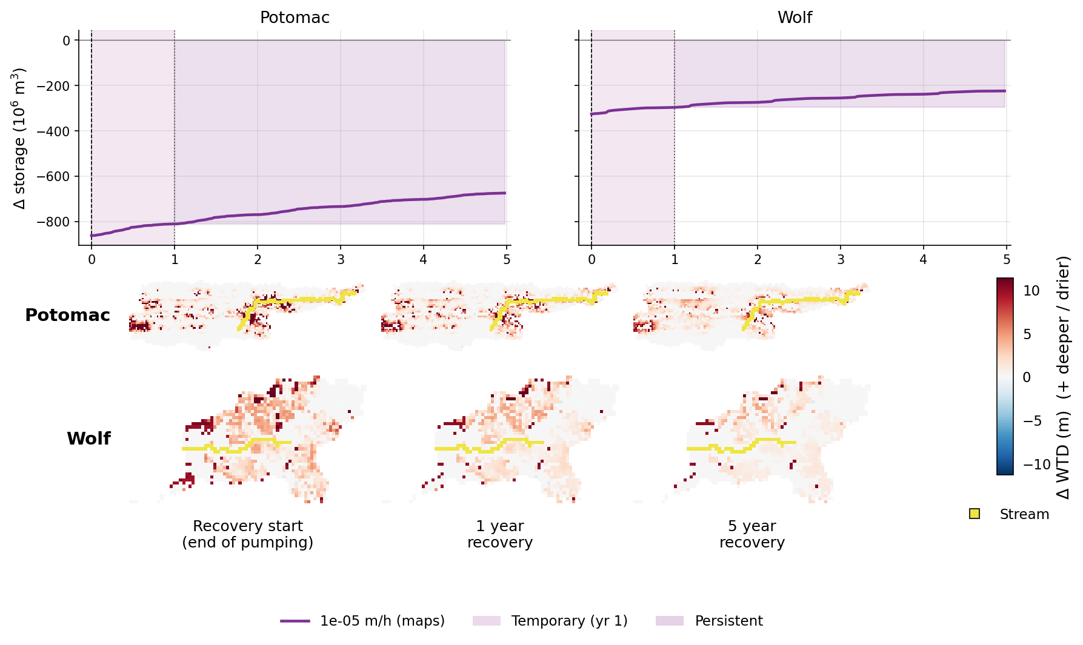
After pumping: little returns in year 1; near-stream cells recover first

