Slide 1
Pumping vs drought storage losses
Preliminary: depth partition & mid-stress regen proxies
(no pumping recovery years yet)
Potomac & Wolf · 3-year pumping tests · August 2026

Slide 2
1. Framing
Why drought temporary/persistent proxies should change under pumping

Slide 3
Ensemble contrast
Droughts
Pumping (3-year tests)
• Stress = duration (1 / 3 / 10 / 50 yr)
• Losses begin at the water table / near surface
• Recovery years define temporary vs persistent
• Temporary ≈ near-surface (top 2 m); persistent ≈ deep
• High-overland cells regenerate a near-surface skin
• Stress = rate (1e-7 … 1e-4 m/h domain-avg)
• Extraction at layer 2 (deep), including wet cells
• Ends while still pumping — no recovery on disk yet
• Proxies: early (yr1) vs buildup (yr2–3); NS rebound vs deep ratchet
• Expect deep memory even where drought would stay temporary

Slide 4
Proxies used here (until recovery exists)
• Near-surface vs deep deficit: split at 2 m (z≥6 vs z<6), same as drought shielding
• Mid-pump regen: near-surface ΔS pulses with average-year P; deep ΔS ratchets
• Fast / temp proxy: mean mid-year near-surface rebound (max − year-start)
• Persist-like proxy: mean deep net loss per pump year
• Drought-style onset spike ≈ 0 under pumping — deficit grows from ~0
See pumping_shallow_deep_proxies_summary.md

Slide 5
2. Drought reminder
Temporary ≈ near-surface regenerating skin; persistent ≈ deep

Slide 6
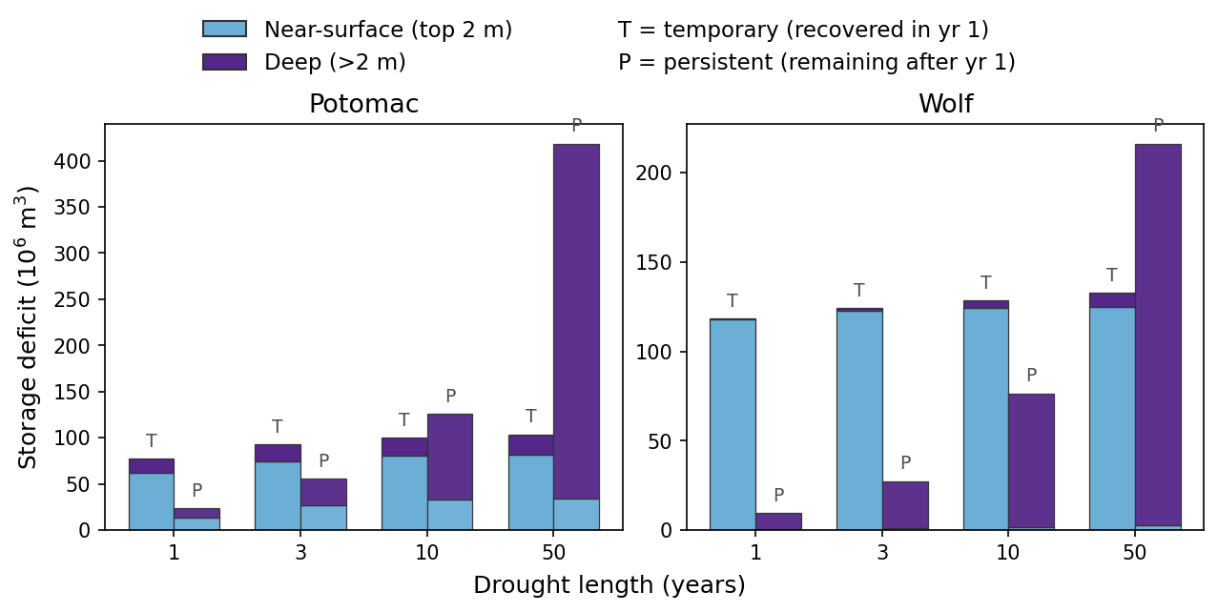
Drought: temporary ≈ near-surface; persistent ≈ deep

Slide 7
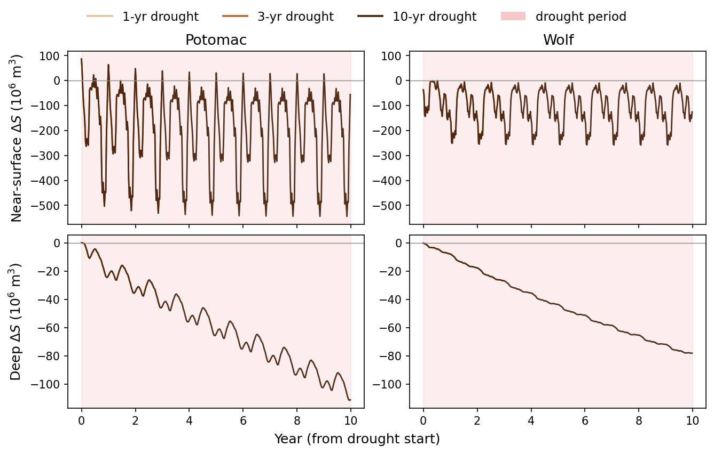
Drought: mid-stress near-surface regenerates, deep ratchets

Slide 8
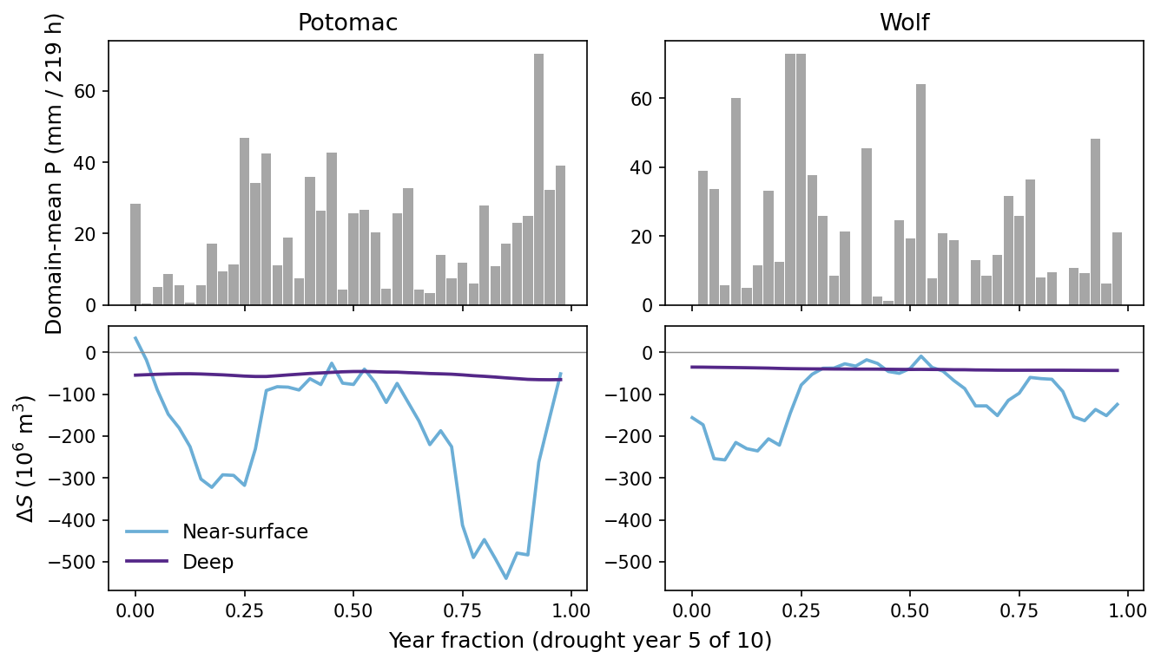
Drought year pulse: storage tracks precip only near the surface

Slide 9
3. Pumping response
Rates during 3-year pumping (early vs buildup)

Slide 10
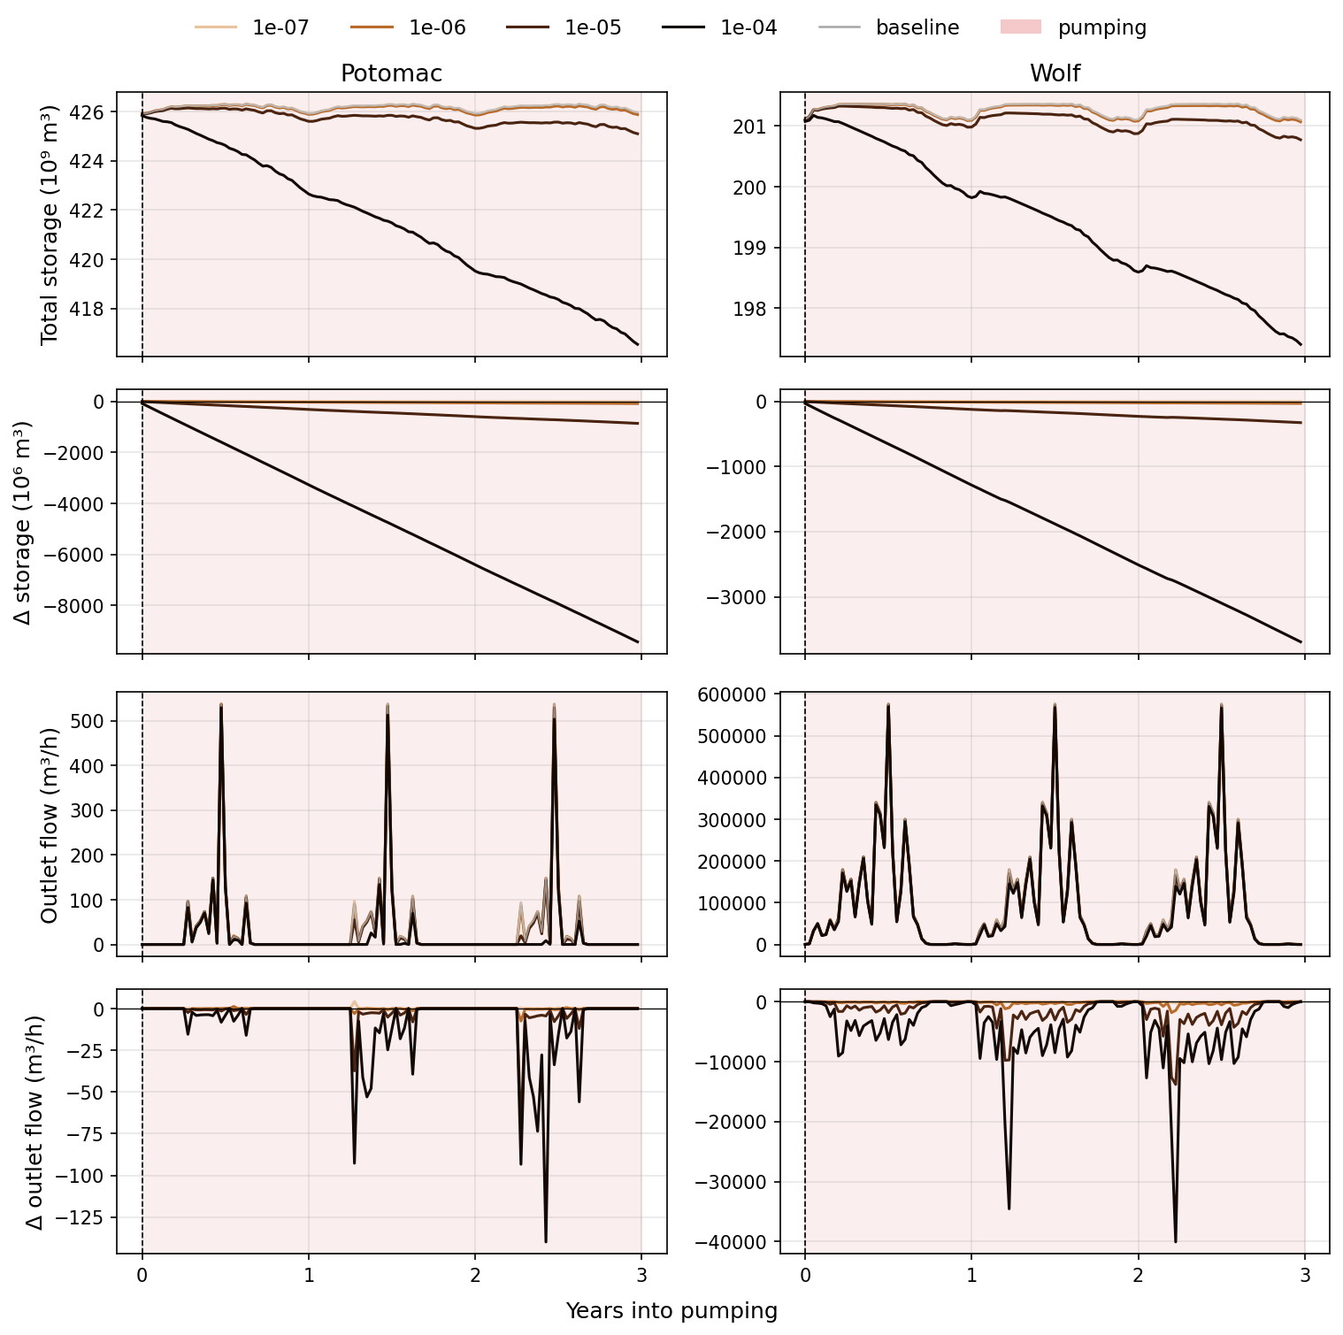
During pumping: storage & flow by rate

Slide 11
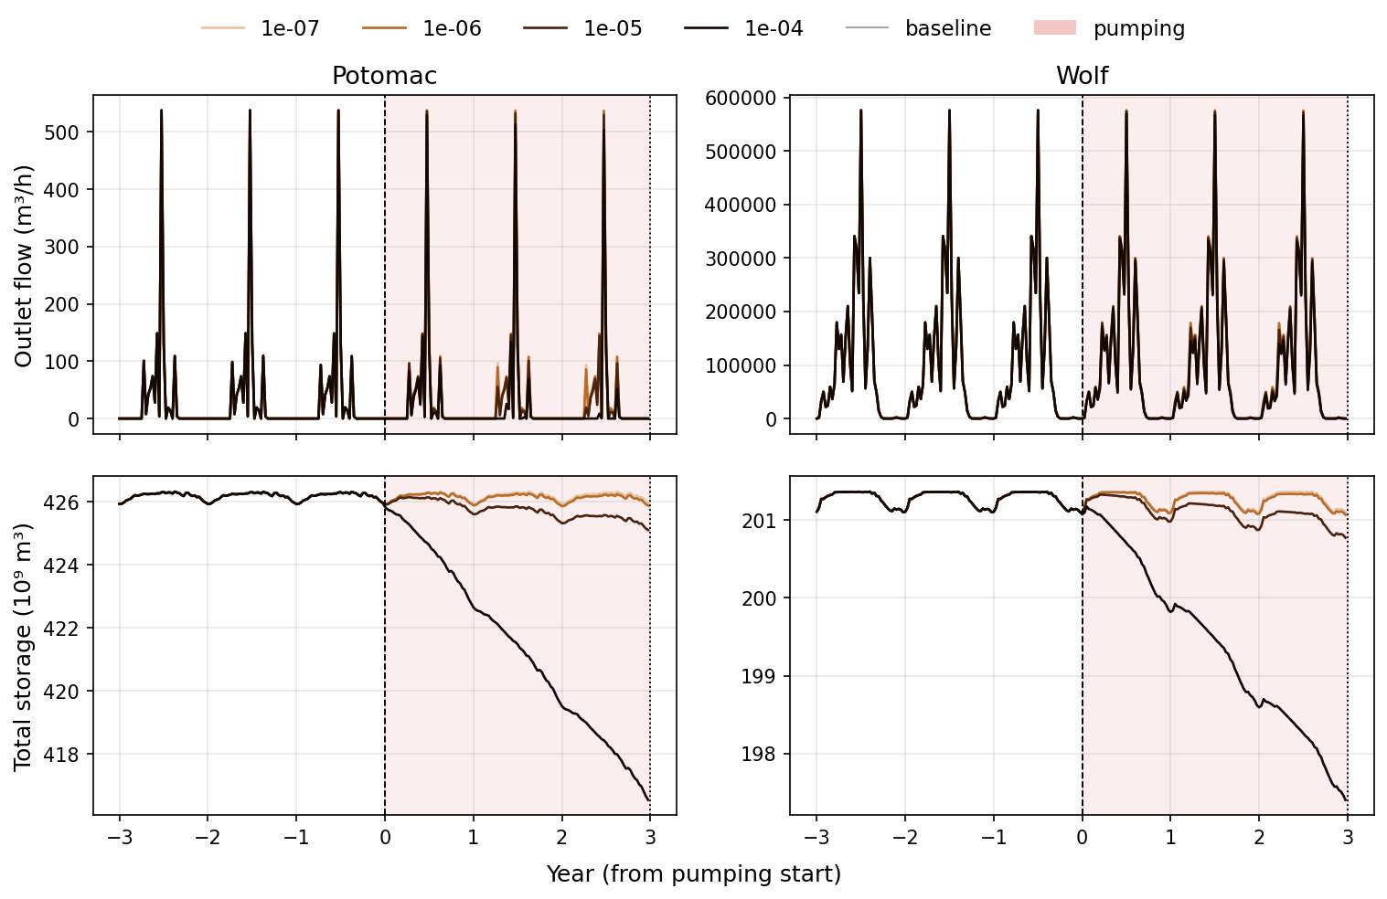
Pumping course (spinup → 3 yr pump)

Slide 12
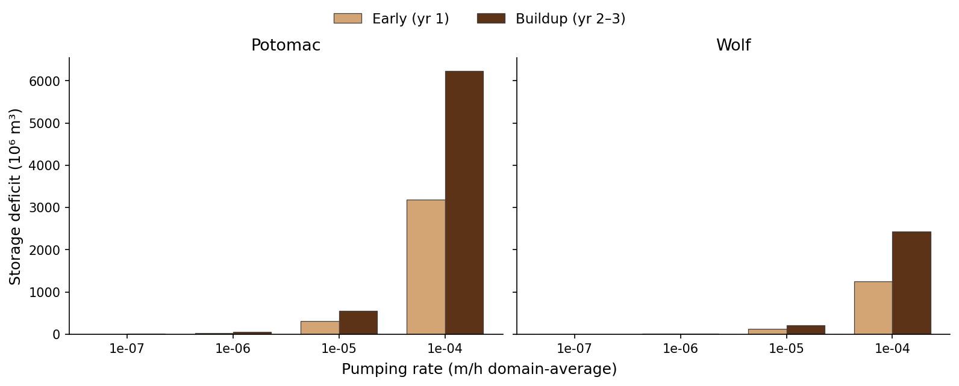
Early (yr1) vs buildup (yr2–3) storage deficits

Slide 13
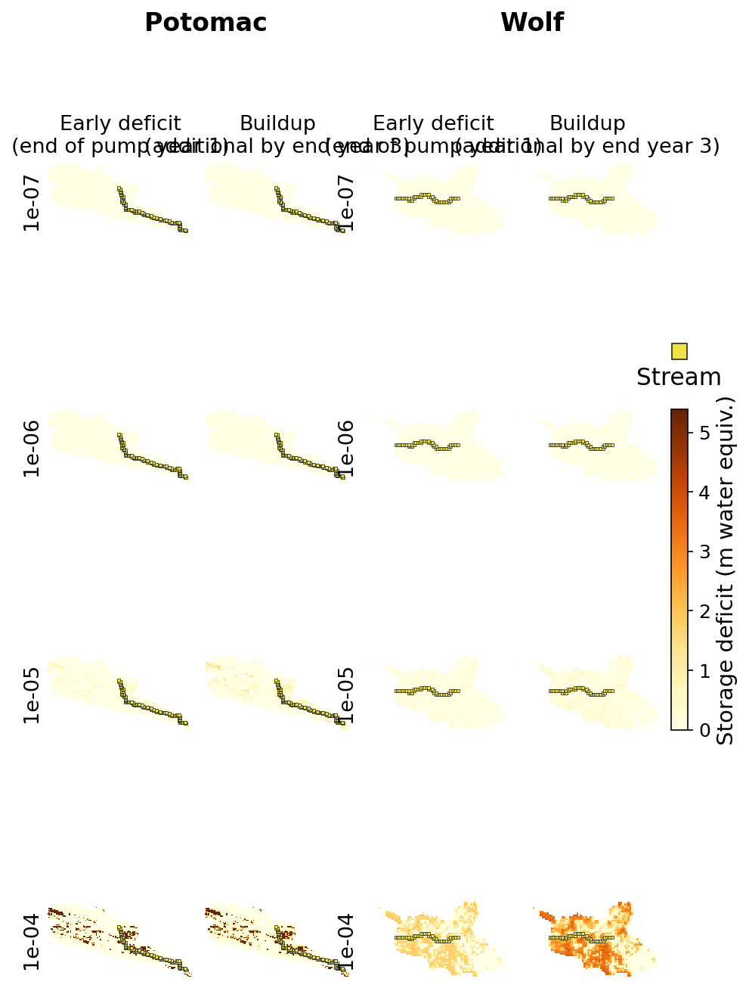
Early vs buildup storage deficit maps

Slide 14
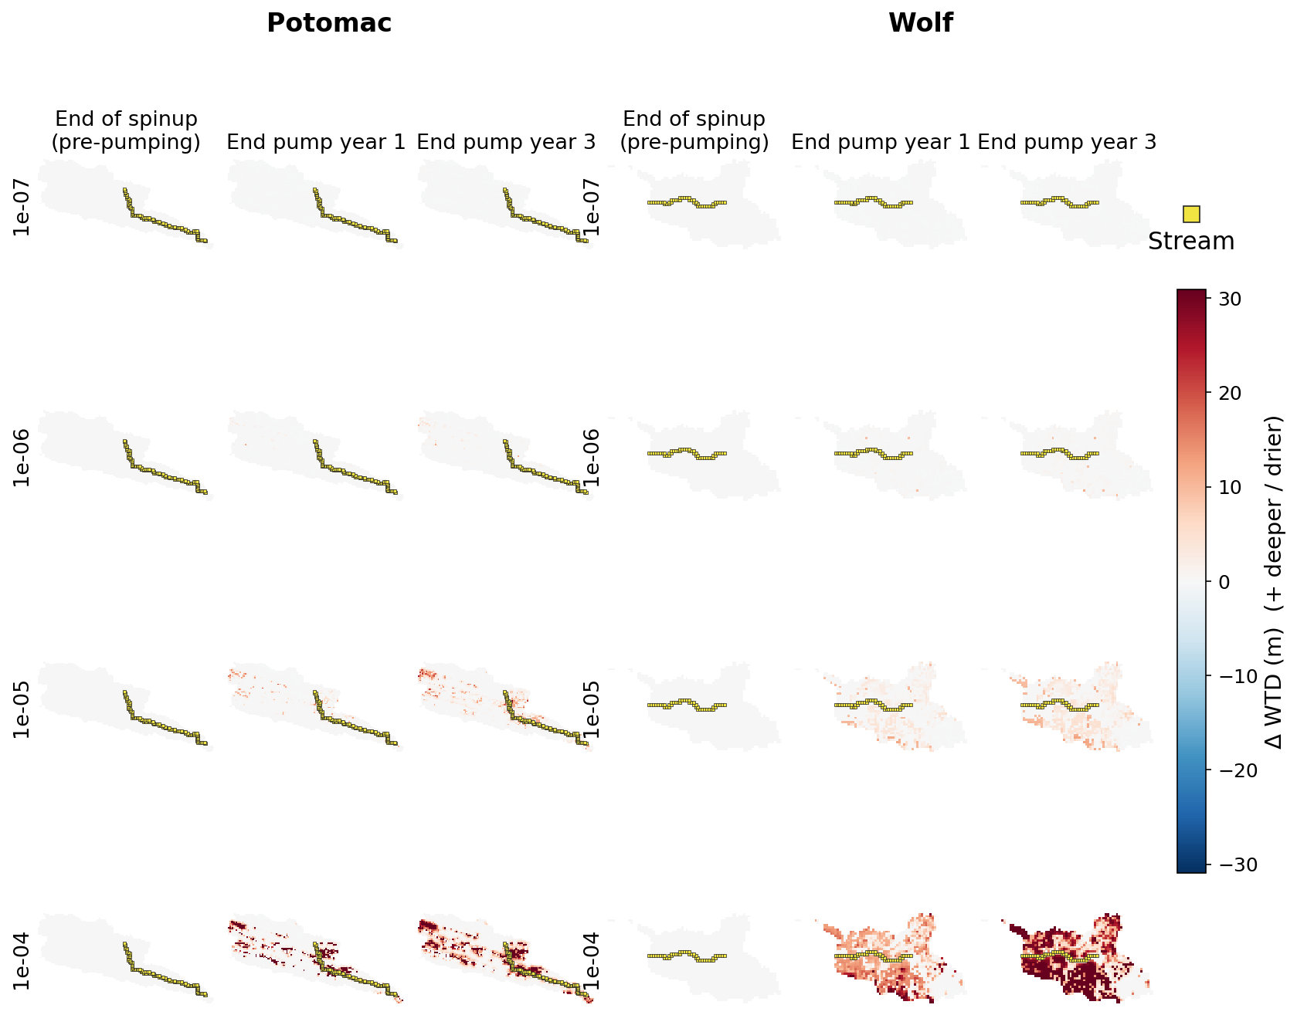
WTD anomaly maps through pumping

Slide 15
4. Depth contrast
Under pumping, end-of-stress deficit is almost all deep

Slide 16
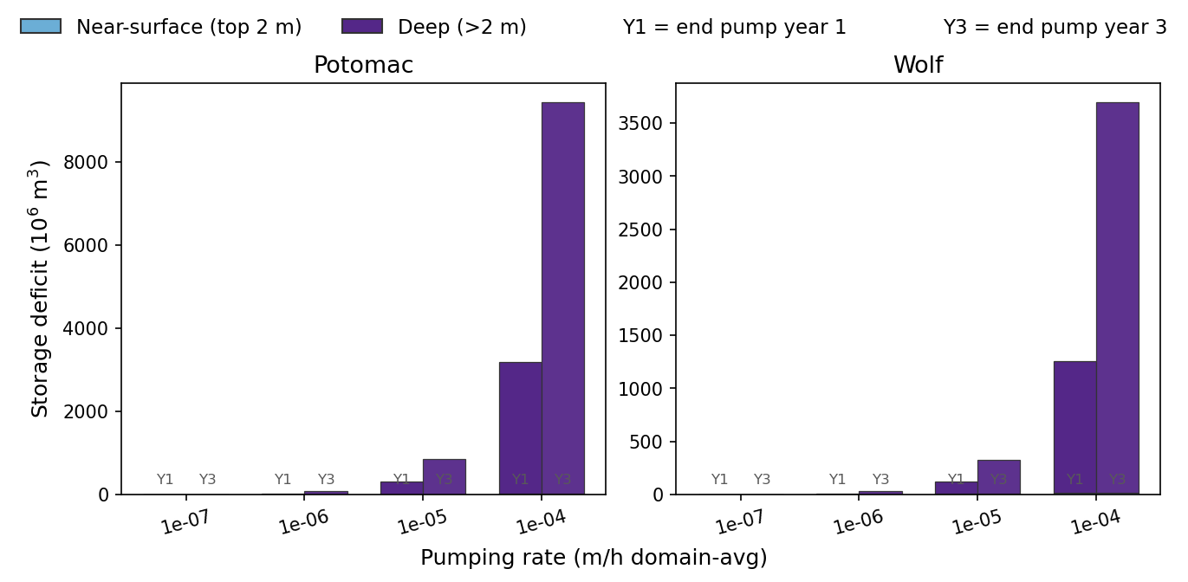
Pumping: end yr1 / yr3 deficit near-surface vs deep

Slide 17
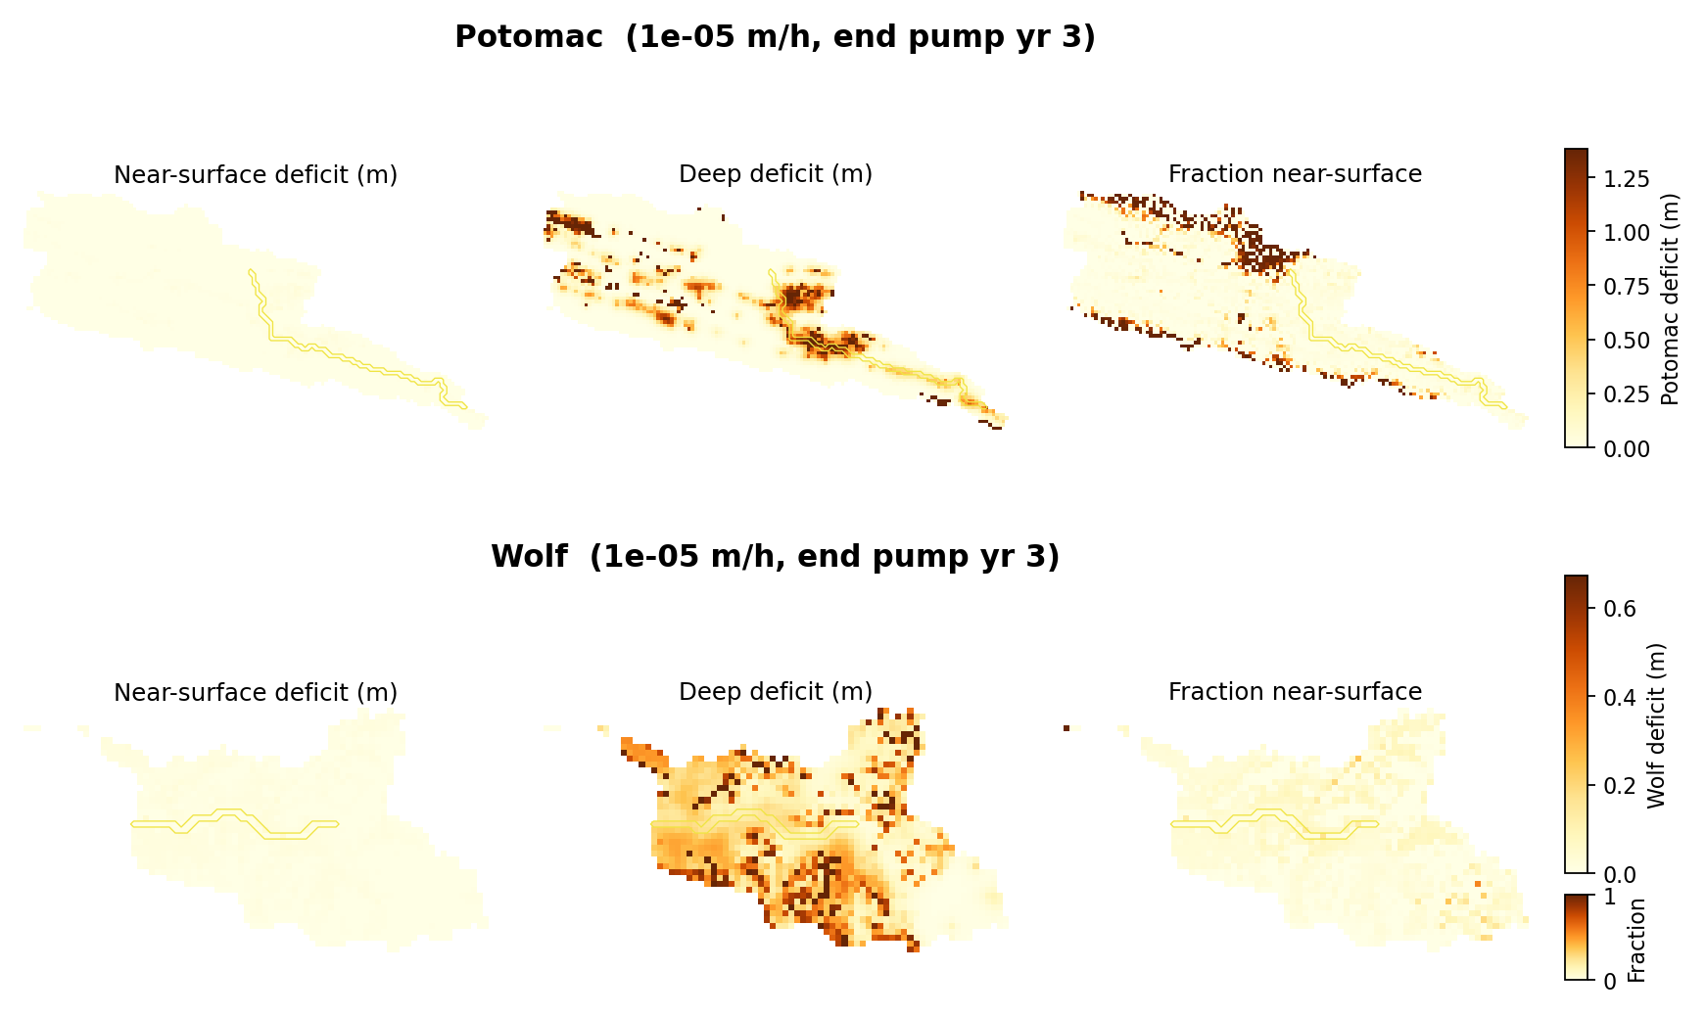
Pumping spatial end-yr3 (1e-5): deep dominates the map

Slide 18
End-of-pump % of deficit in deep
• Potomac: 80→91% (1e-7) … 100% (1e-4) by end of year 3
• Wolf: 71→86% (1e-7) … 99% (1e-4) by end of year 3
• At ≥1e-5, both domains are 97–100% deep by year 3
• Contrast drought temporary volume: ~80–100% near-surface
• Layer-2 extraction writes memory deep even in high water-availability cells

Slide 19
5. Mid-stress regen
Near-surface still pulses — but it is a thin skin beside the deep ratchet

Slide 20
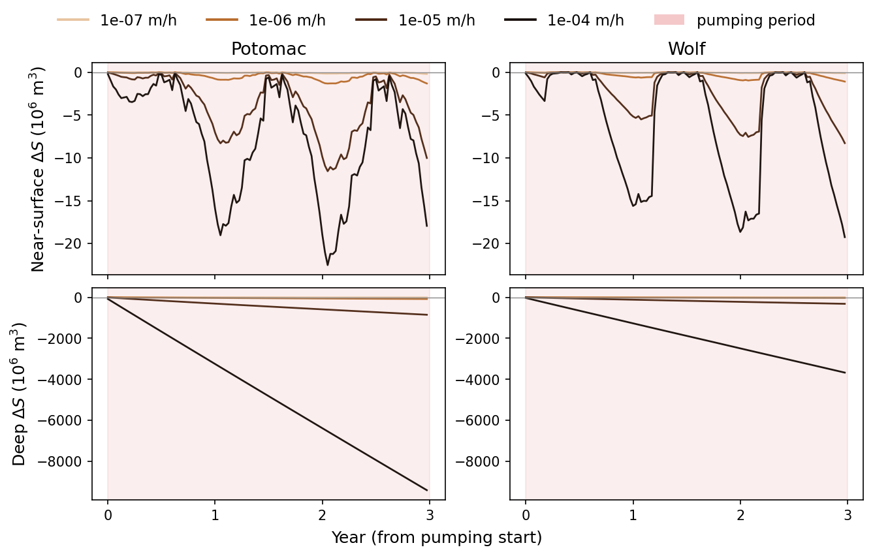
Mid-pump: near-surface regenerates, deep ratchets (by rate)

Slide 21
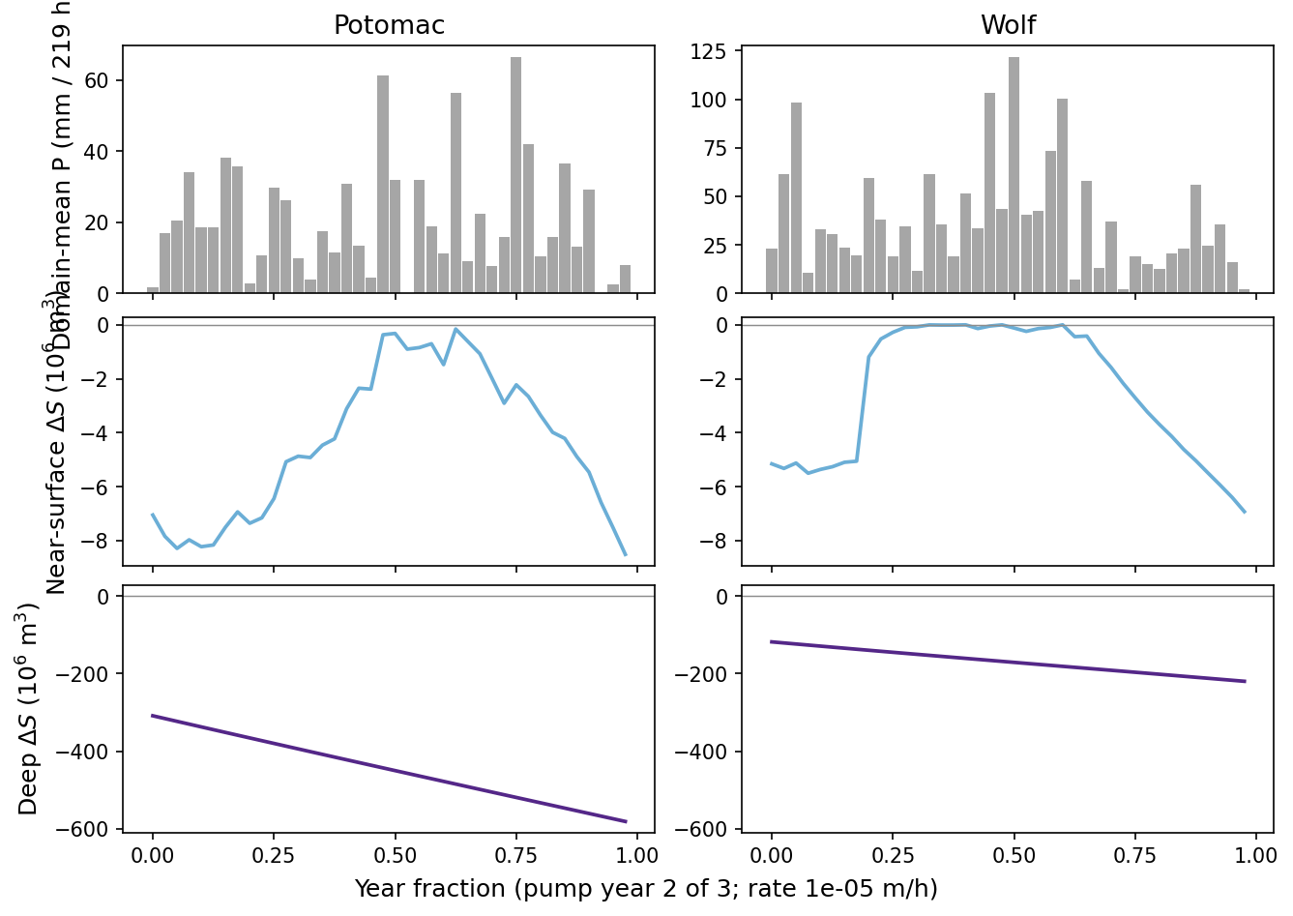
One pump year: NS tracks P; deep has no pulse response

Slide 22
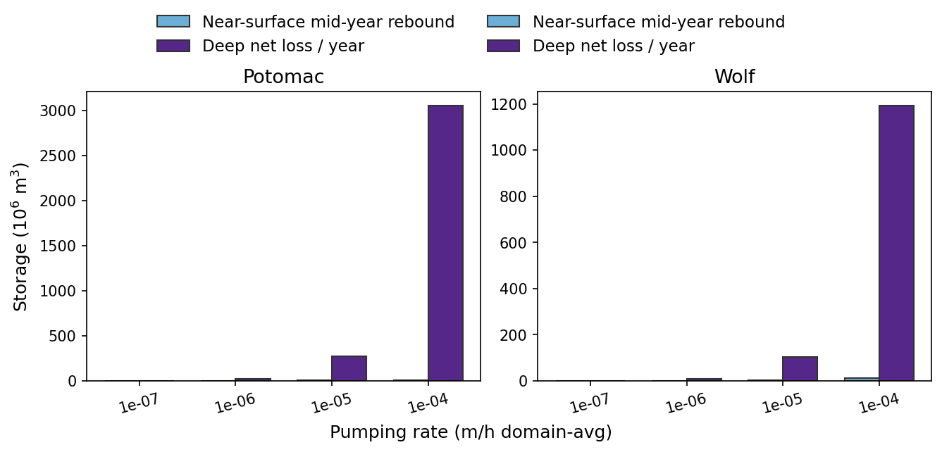
Fast proxy vs persist-like: NS rebound ≪ deep net loss / yr

Slide 23
Mid-pump wet-window ΔS (1e-5 m/h)
• Potomac: near-surface +0.4×10⁶ m³ vs deep −7.1×10⁶ m³ (ρ(P,ns)=0.62, ρ(P,deep)≈0)
• Wolf: near-surface +0.3×10⁶ m³ vs deep −2.7×10⁶ m³ (ρ(P,ns)=0.28, ρ(P,deep)≈0)
• Potomac mean NS mid-year rebound 5.5 vs deep net loss 276 ×10⁶ m³/yr
• Wolf mean NS mid-year rebound 4.2 vs deep net loss 103 ×10⁶ m³/yr
• Same qualitative split as drought — different volume balance under deep extraction

Slide 24
6. Streamflow
Outlet Q vs baseline — does deep pumping couple to flow?

Slide 25
Contrast with drought Q
• 50-yr drought: deep storage grew for decades while outlet Q stepped down then plateaued
• Here precip forcing stays average-year — any Q drop is capture / storage coupling
• Ask: does mean Q keep falling as ΔS builds (yr1→yr3), or stay flat?
• Caveat: outlet p10≈0 on baseline — classical baseflow ratios still undefined
See pumping_streamflow_impact_summary.md · persistent_storage_vs_streamflow_50yr.md

Slide 26
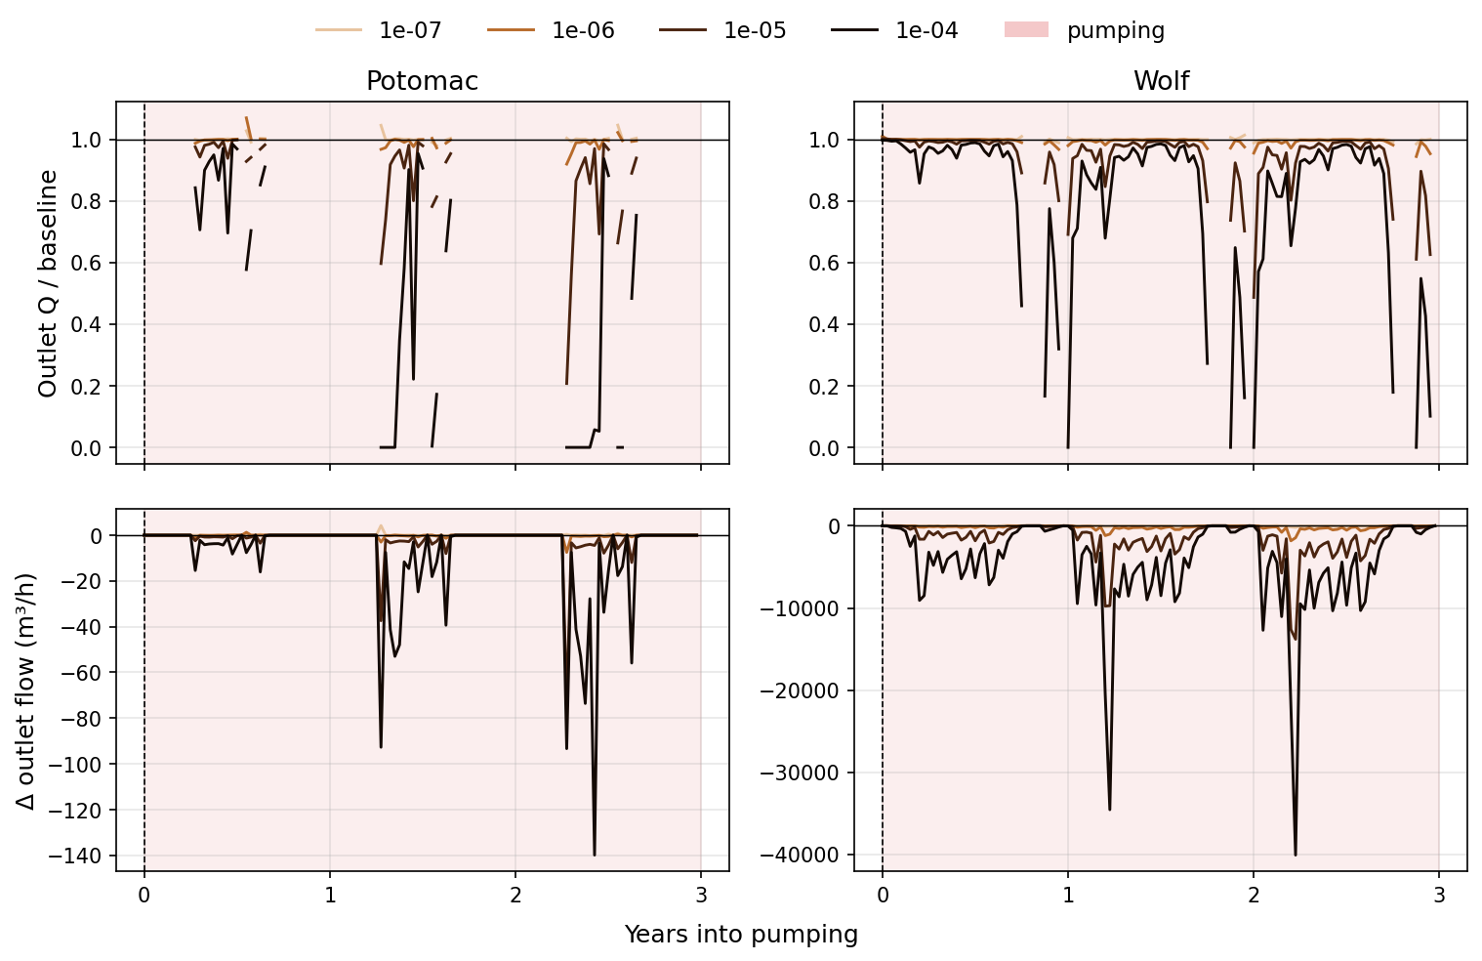
Outlet Q / baseline and ΔQ during pumping

Slide 27
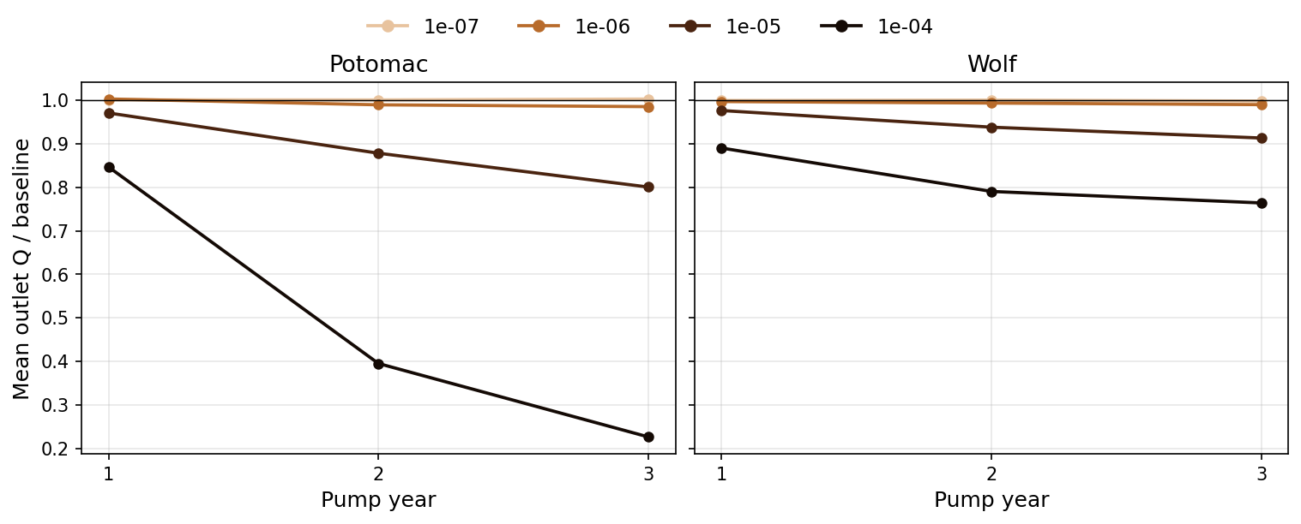
Mean Q ratio declines across pump years (not a mid-drought plateau)

Slide 28
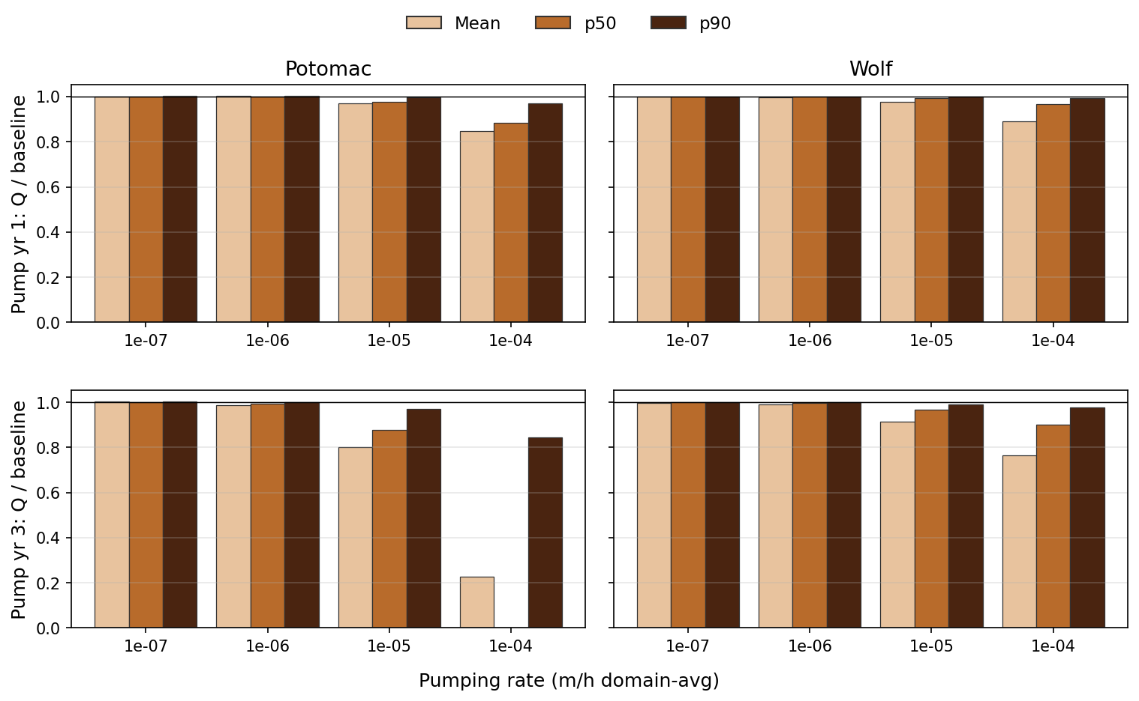
Year 1 vs year 3: mean / p50 / p90 Q ratios by rate

Slide 29
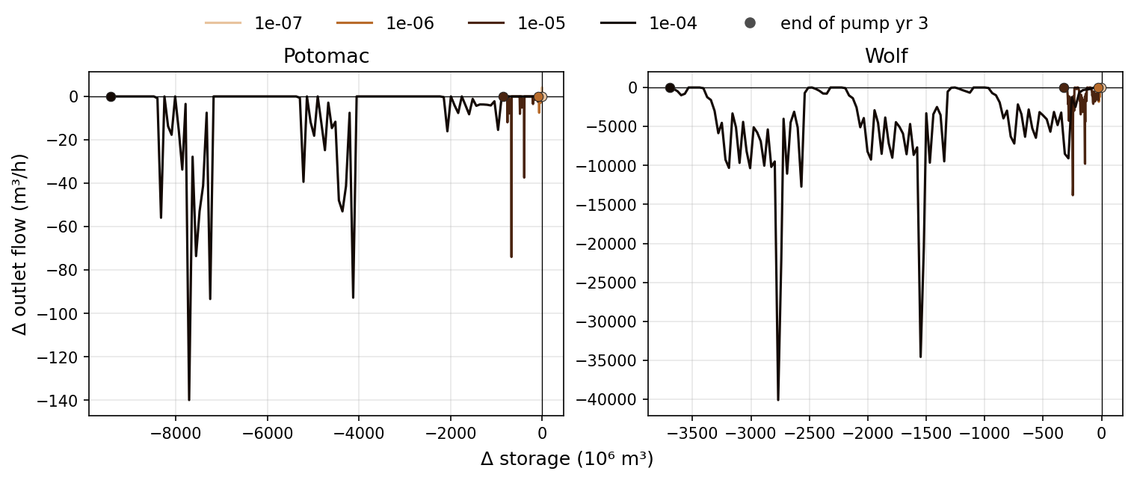
ΔQ vs ΔS: pulsed flow hits while storage ratchets down

Slide 30
Outlet Q / baseline (219 h mean, during pumping)
• Low rates (1e-7): Q ≈ baseline in both domains
• Potomac 1e-5: yr1=0.97 → yr3=0.80; 1e-4 collapses to yr3=0.23 (p50≈0)
• Wolf 1e-5: yr1=0.98 → yr3=0.91; 1e-4 → yr3=0.76
• Unlike mid-drought, mean Q keeps falling as deep ΔS grows — capture couples storage to flow
• 219 h ratios overweight dry windows; annualized (yearly volume) is milder — next slides

Slide 31
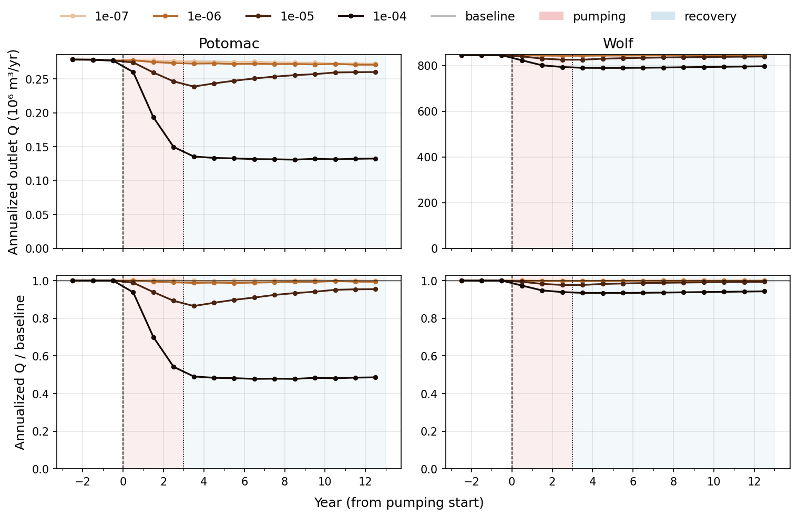
Annualized Q through pumping + 10-yr recovery

Slide 32
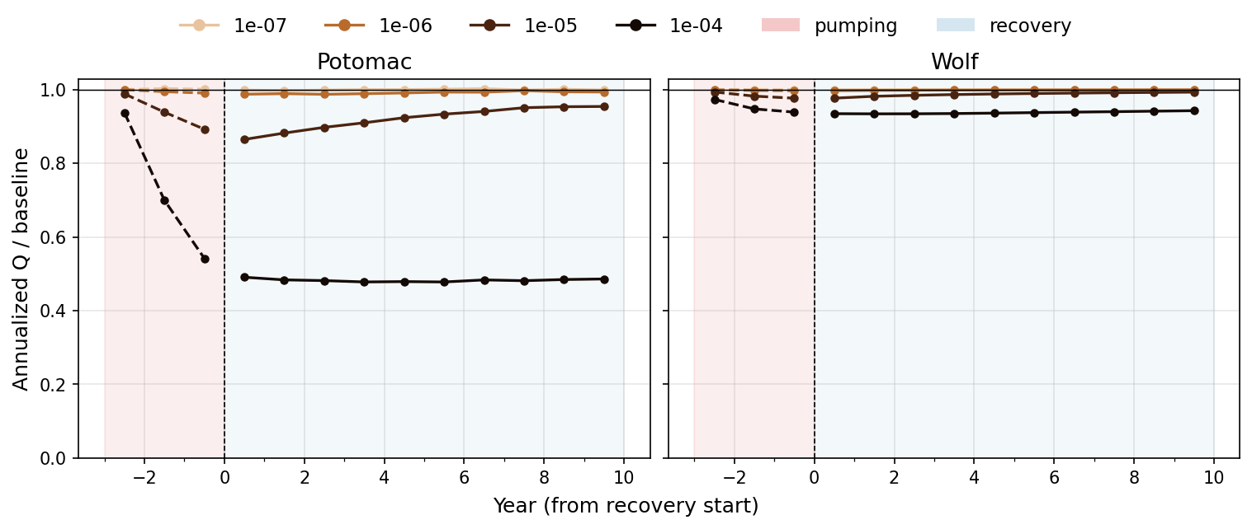
Annualized Q / baseline, origin at recovery start

Slide 33
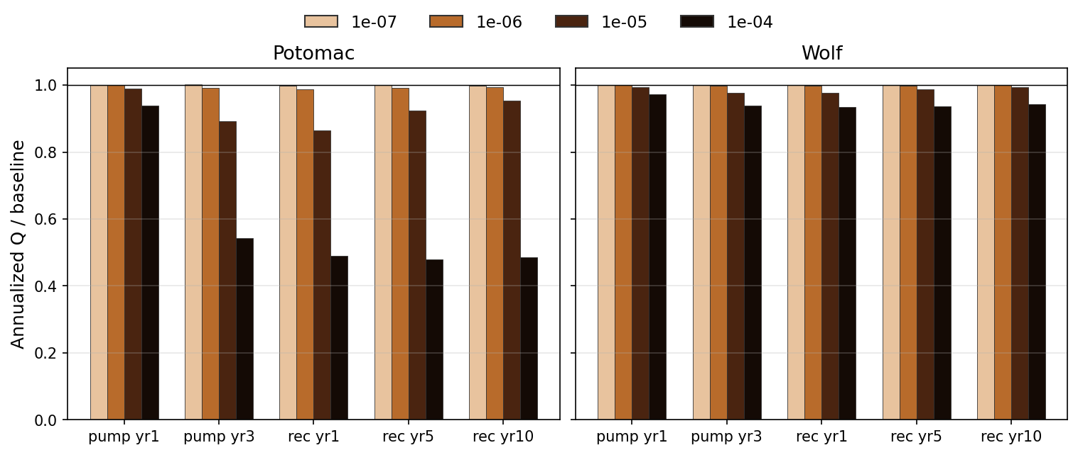
Annualized Q / baseline at pump and recovery milestones

Slide 34
Annualized Q / baseline (yearly volume)
• Potomac 1e-5: pump 0.99→0.89; rec yr1=0.86 then 0.92 / 0.95 at yr5 / yr10 — slow partial rebound
• Potomac 1e-4: pump yr3=0.54; rec yr1–yr10 stays ~0.49 — no Q recovery in 10 years
• Wolf 1e-5: 0.99→0.98 then back to 0.99 by yr10; 1e-4 residual ~0.94 through recovery
• Q nadir is rec yr1, not pump-end — capture keeps biting after wells shut off
• Wolf annualized Q is much more buffered than Potomac at the same domain-avg rate
See pumping_annualized_q_summary.md

Slide 35
7. No drought-style temporary pool
Same 3-year stress; temporary = recovered in recovery year 1

Slide 36
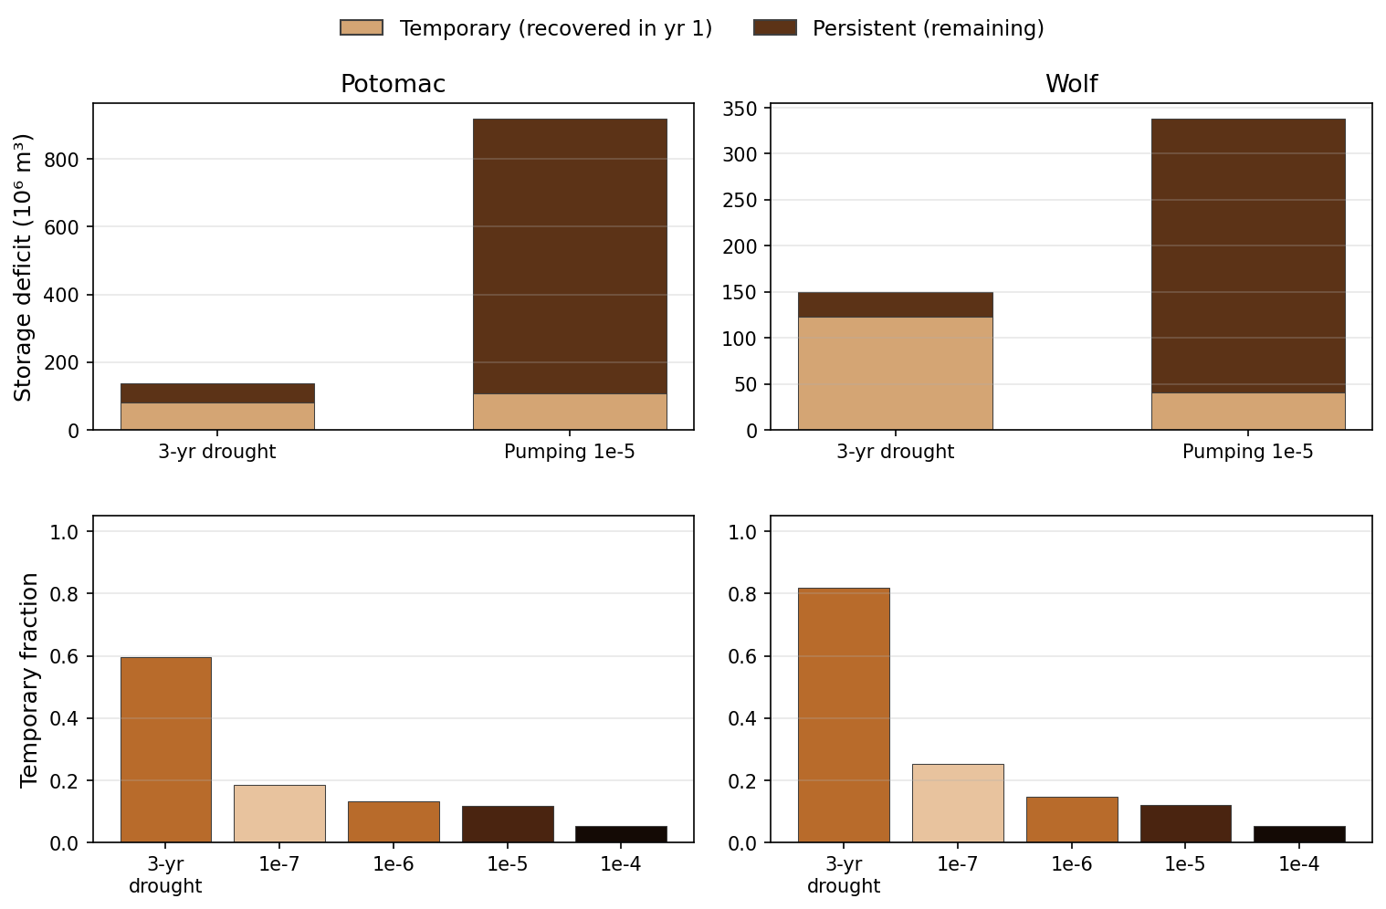
Temporary vs persistent volume, and temporary fraction

Slide 37
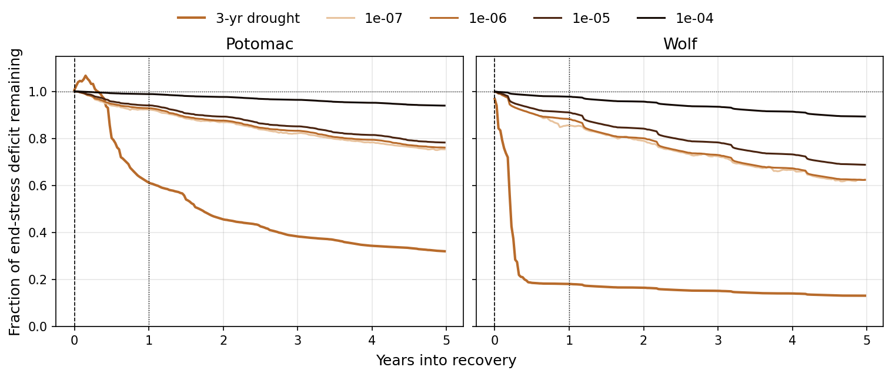
Fraction of end-stress deficit remaining in recovery

Slide 38
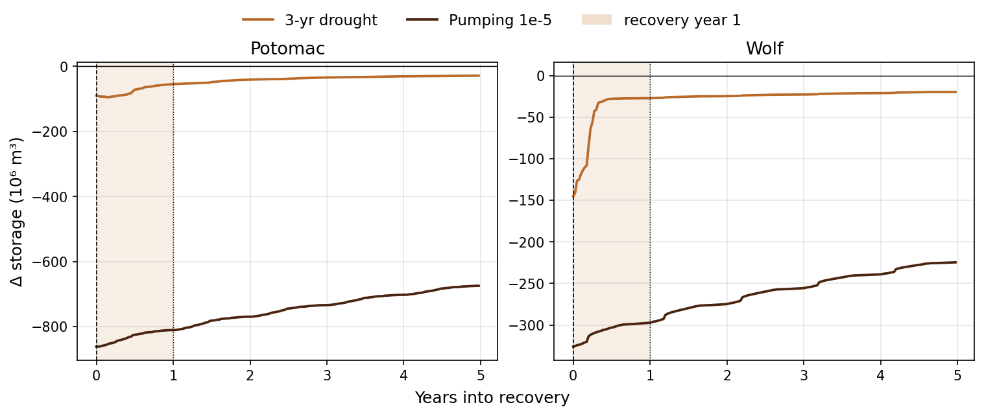
ΔS through recovery: drought rebounds in year 1; pumping does not

Slide 39
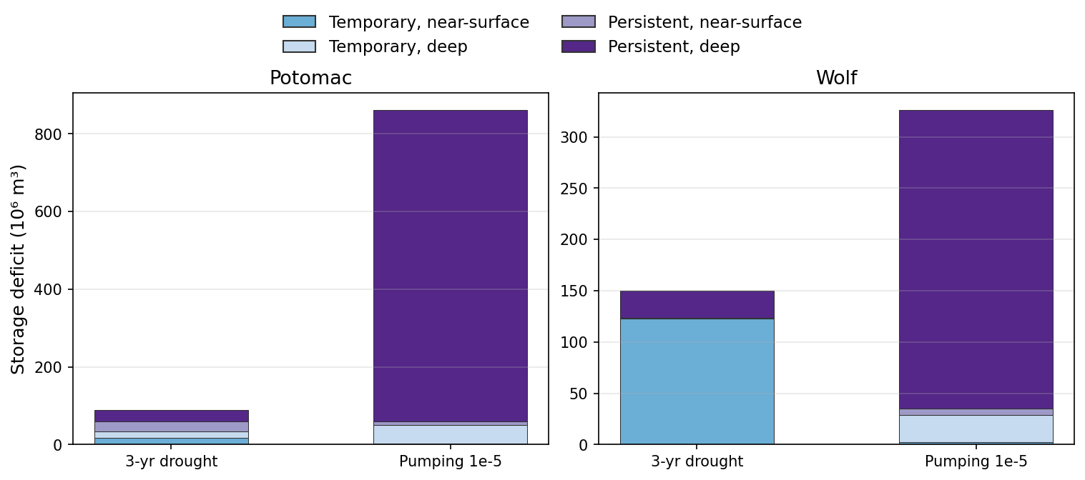
Where the deficit sits: drought near-surface temporary vs pumping deep persistent

Slide 40
Pumping deficits are not drought deficits
• Drought has a large year-1 temporary limb (Wolf f_temp=0.82; Potomac 0.59)
• Pumping 1e-5 f_temp=0.12 in both domains — little of the loss comes back in year 1
• Drought deficit drops in recovery yr1 then plateaus; pumping stays near the end-stress deficit
• Drought temporary mass is the top 2 m (esp. Wolf); pumping leftover is deep (layer-2 extraction)
• Higher rates make this worse: 1e-4 leaves f_temp≈0.05
See pumping_vs_drought_deficits_summary.md

Slide 41
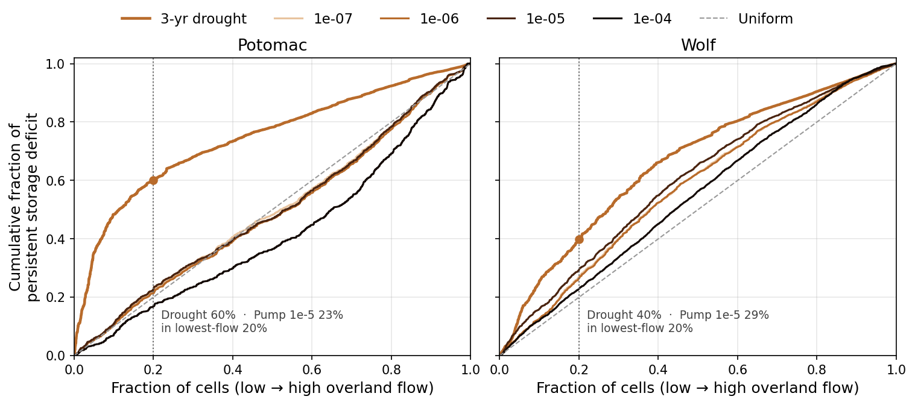
Persistent mass vs overland rank: drought concentrates, pumping does not

Slide 42
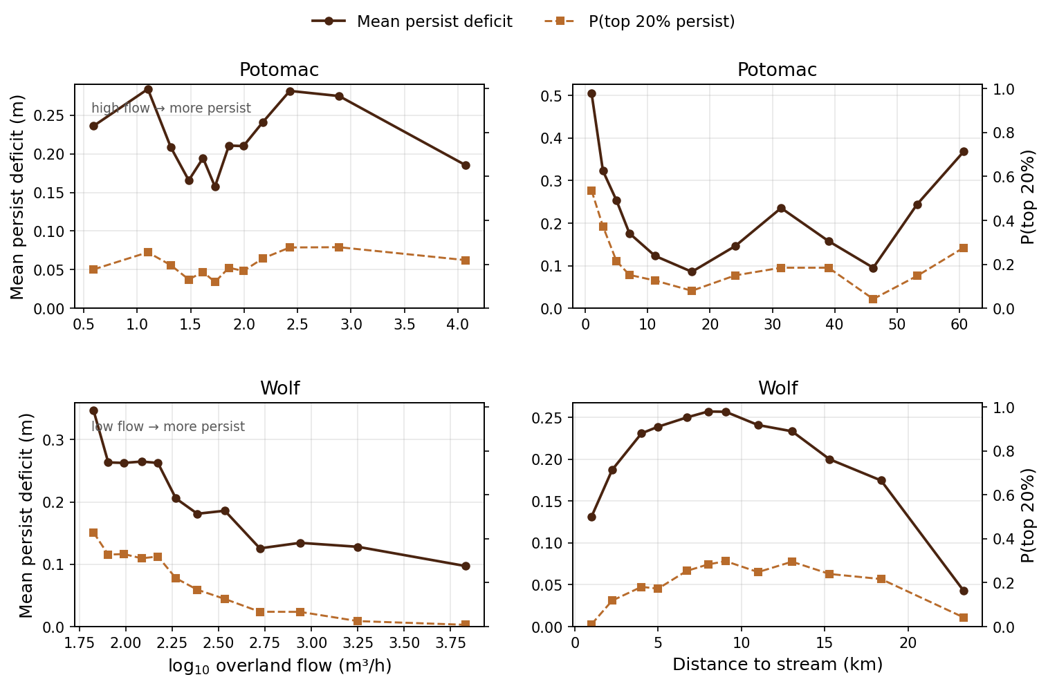
Pumping 1e-5: mean persist vs log overland and vs stream distance

Slide 43
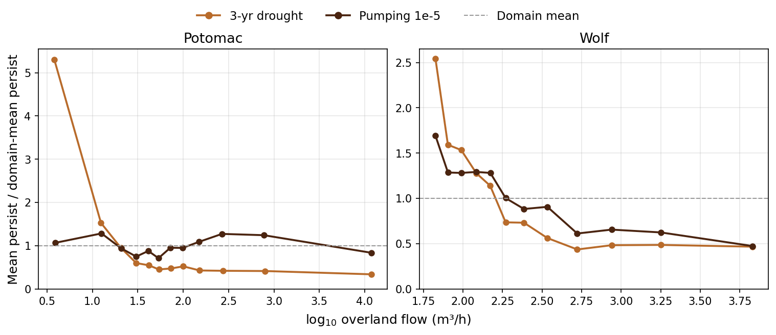
Mean persist vs log overland, scaled by domain mean

Slide 44
Overland no longer locates the persistent mass
• Drought: lowest-flow 20% of cells hold 60% (Potomac) / 40% (Wolf) of persist mass
• Pumping 1e-5: those same cells hold 23% / 29% — near uniform (20%)
• Potomac pumping persist even leans slightly toward higher-flow cells (ρ=+0.10)
• Wolf keeps a weak low-flow slope, but the mass is not stacked in dry uplands the way drought is
• Layer-2 extraction writes memory off the overland ranking that organizes drought persistence
See pumping_overland_persist_summary.md

Slide 45
8. Takeaways
What differs — storage type, depth, and Q

Slide 46
Preliminary conclusions
• Pumping has no drought-style temporary pool: year-1 recovery is a thin sliver
• Pumping persist is not the drought overland pattern: near-uniform in flow rank
• Losses sit deep (layer 2) even in cells that would pay drought with a near-surface skin
• Unlike drought, outlet Q declines as deep storage builds — capture couples S to Q
• After shutoff: Potomac 1e-5 slowly rebounds; 1e-4 Q stays ~half of baseline for 10 yr
• Wolf annualized Q is weakly affected; storage memory is still mostly persistent
Scripts: pumping_vs_drought_deficits.py · pumping_annualized_q.py · pumping_shallow_deep_proxies.py

