Slide 1
Brain-Computer Interfaces
Finn Westenfelder

Slide 2
Outline
Project Goals
P300 Overview
Speller Interface
OpenBCI Hardware and API
EEG Dataset
Keras Neural Network (CUDA)
User Interface
Transfer Learning and Data Collection
Challenges
Lessons Learned
Demo

Slide 3
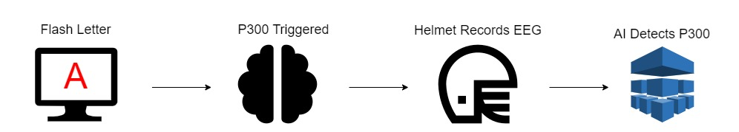
Project Goals
Learn about Electroencephalography (EEG)
Learn what BCI is and how (high level) a P300 BCI speller works
Implement basic neural networks and machine learning
Use hardware involved in a dry electrode EEG cap/helmet
Understand how to approach creating a basic P300 BCI speller

Slide 4
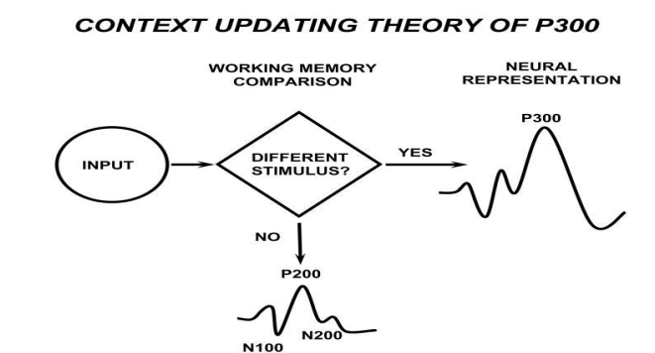
P300 Overview

Slide 5
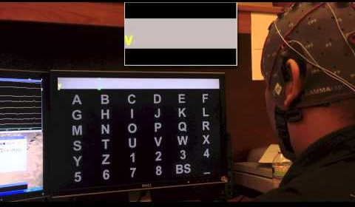
Speller Interface

Slide 6
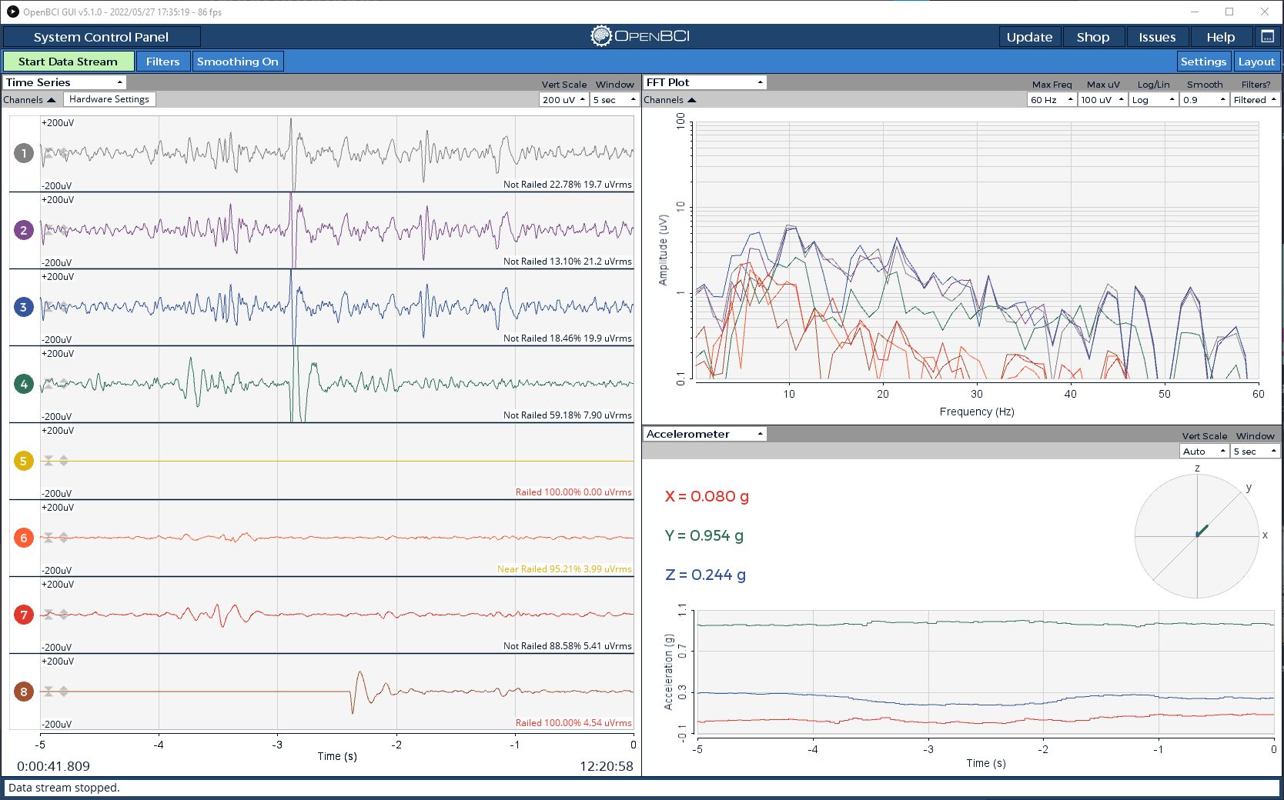
OpenBCI Hardware and API

Slide 7

8 Channels:
Fpz
C2
C3
C4
P2 P3
P4
O1
O2

Slide 8
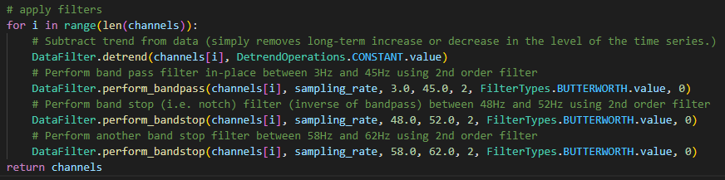
Signal Filtering

Slide 9
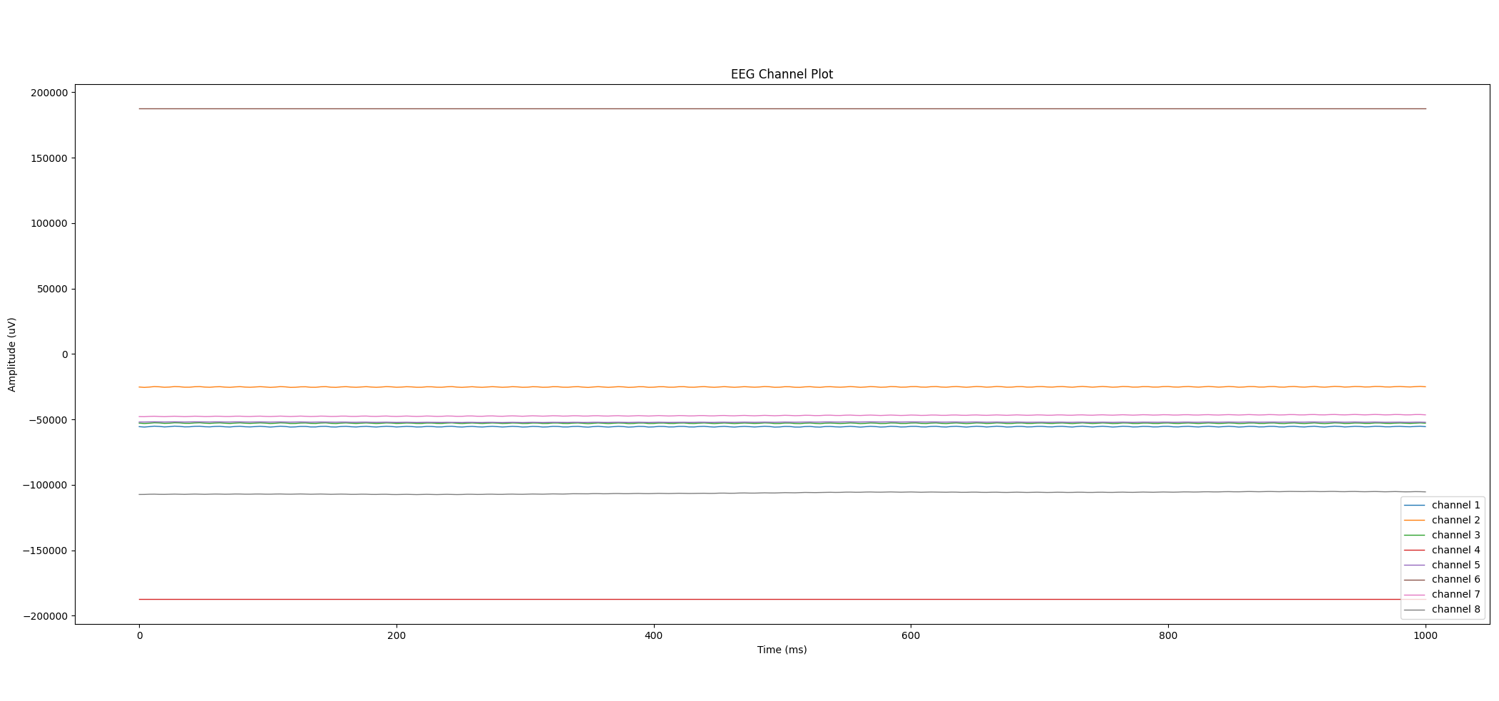

Slide 10
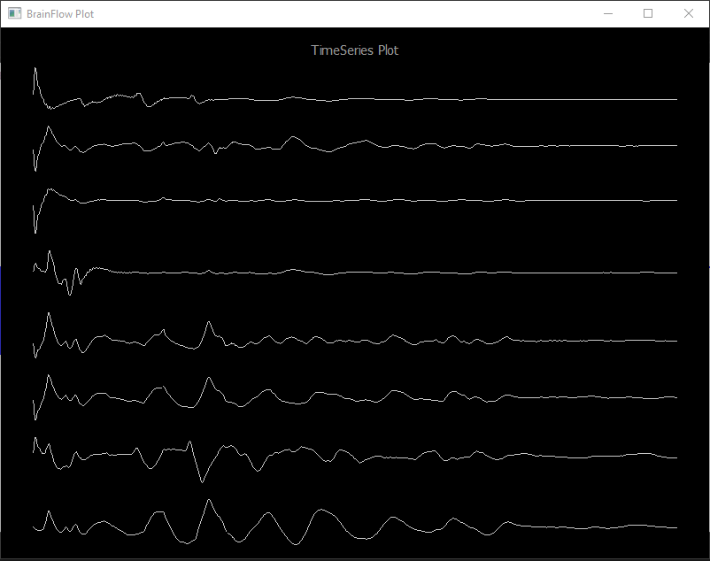

Slide 11
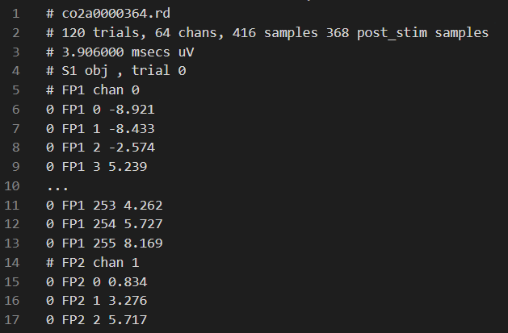
EEG Dataset
Data Shape:
3,725 Trials
8 Channels/Trial
256 Samples/Channel
Roughly 7.5 million datapoints

Slide 12
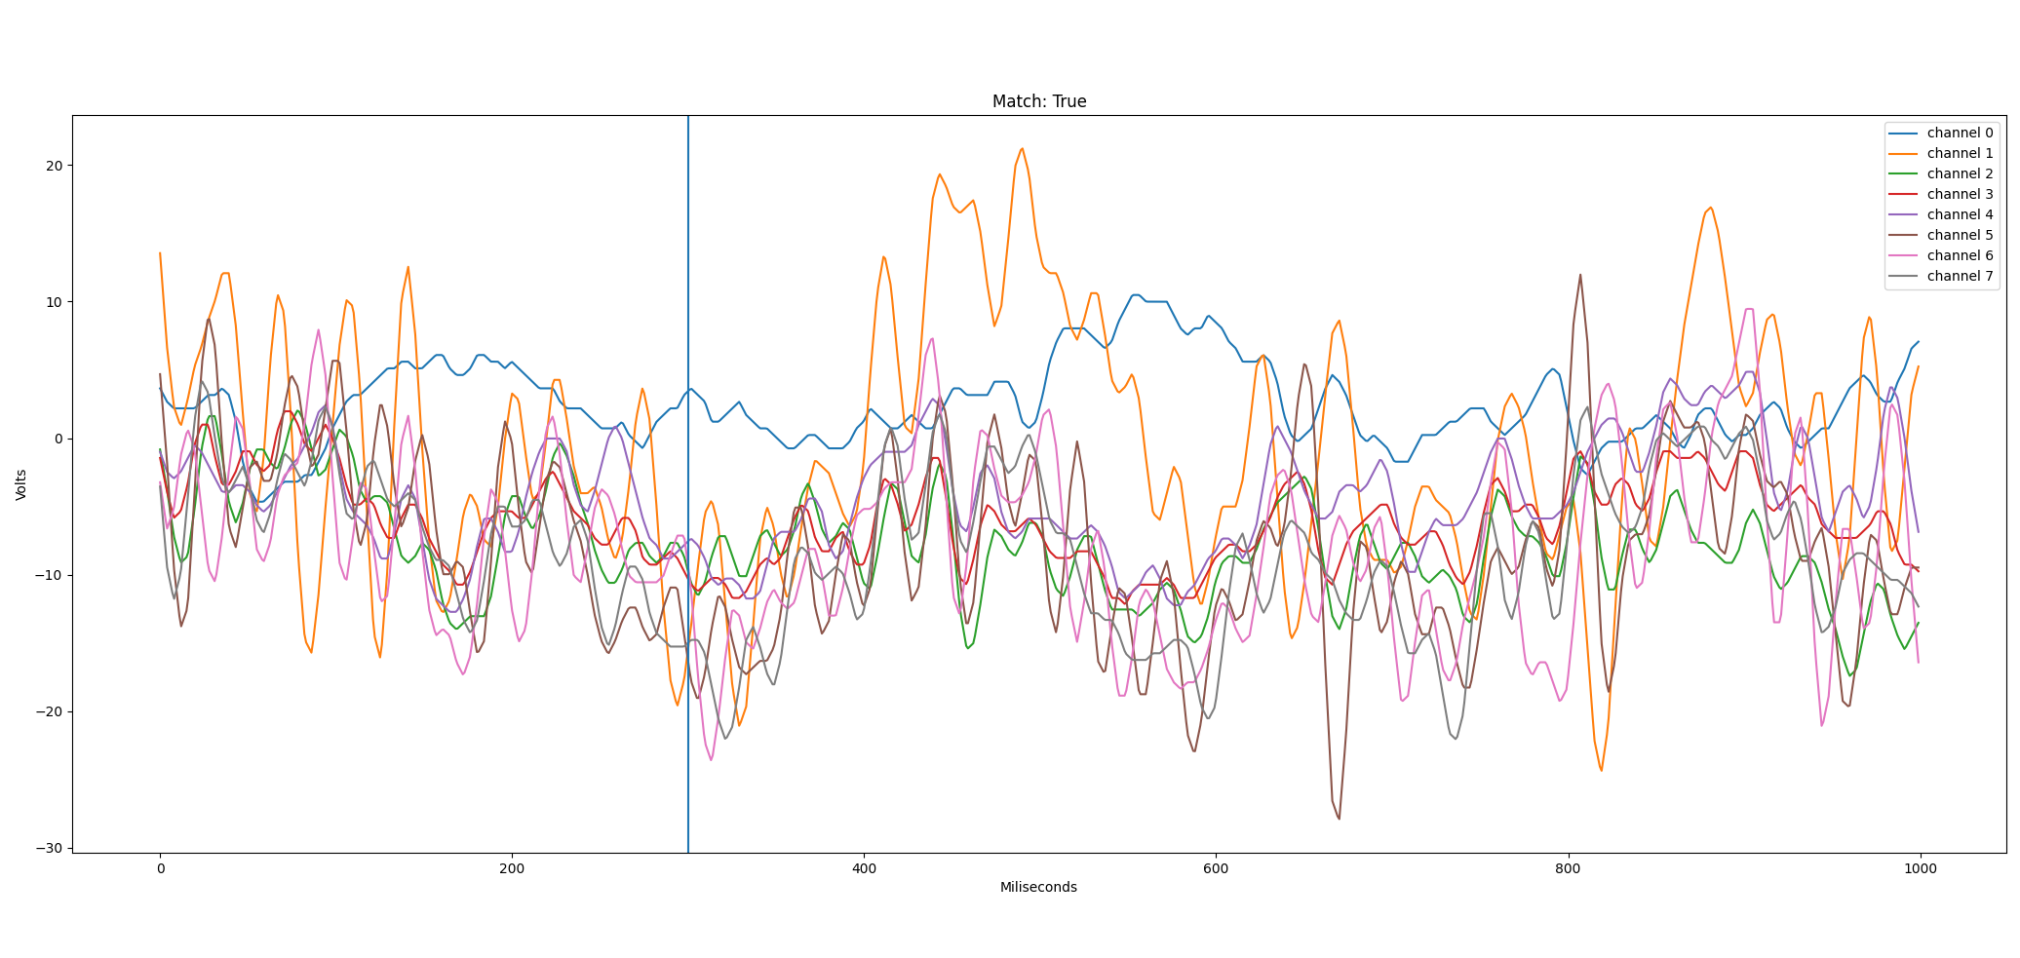

Slide 13
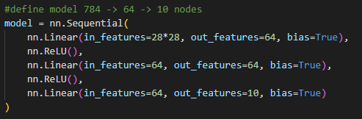
Feedforward Neural Network Practice

Slide 14
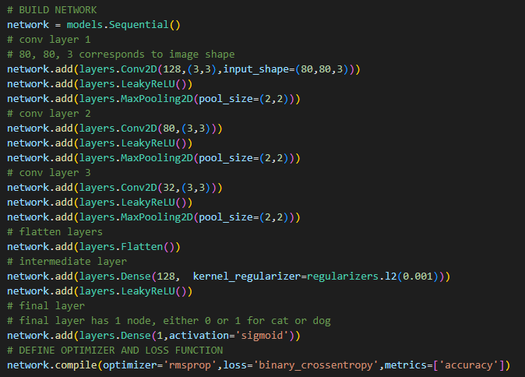
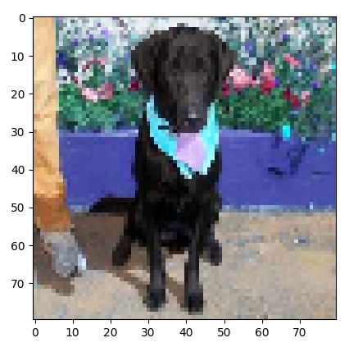
Convolutional Neural Network Practice

Slide 15
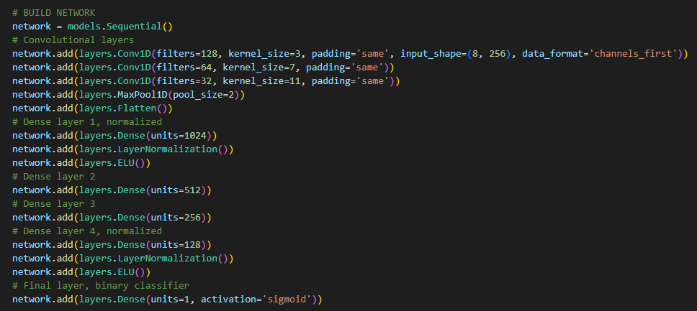
Keras Neural Network (CUDA)

Slide 16
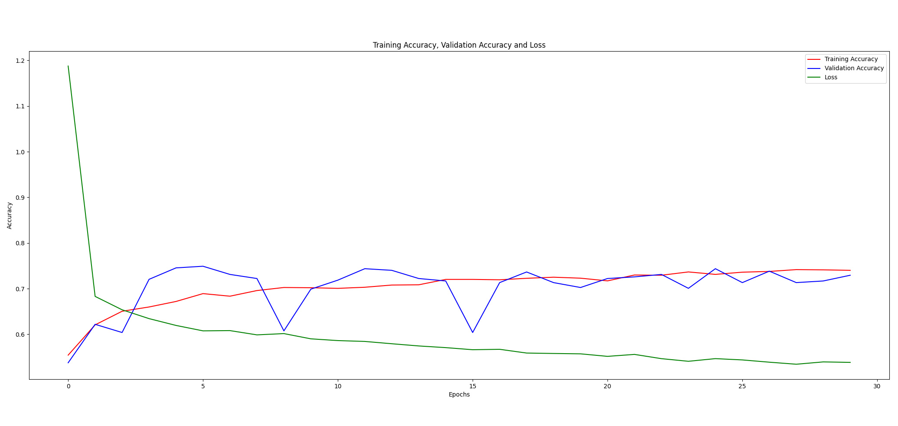

Slide 17

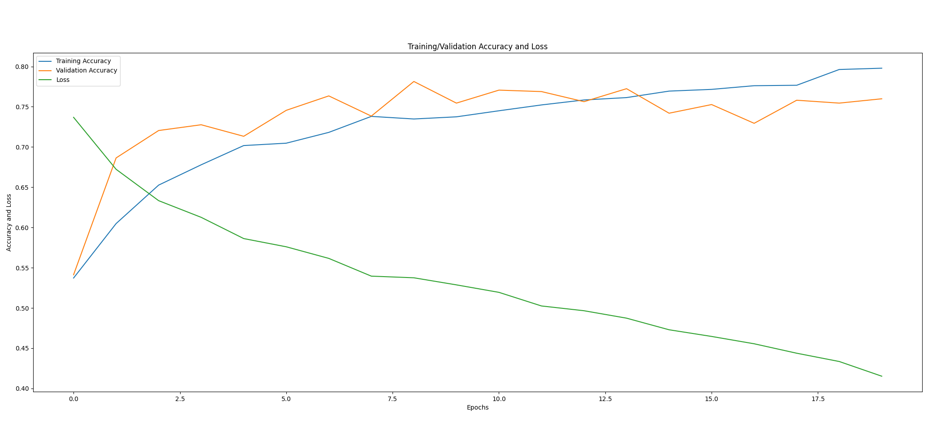

Slide 18
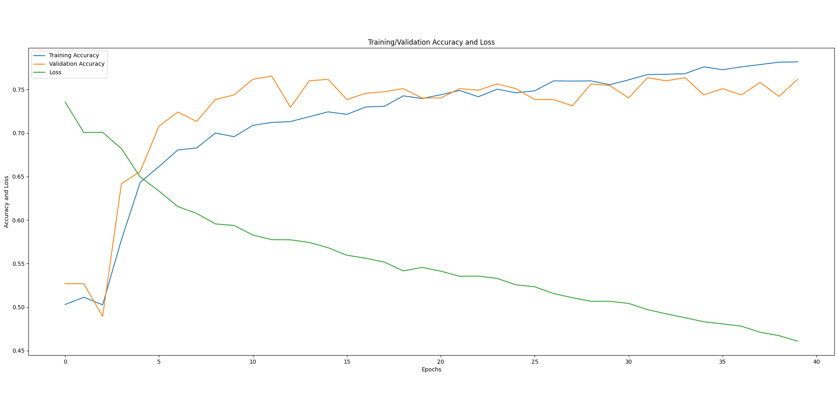

Slide 19
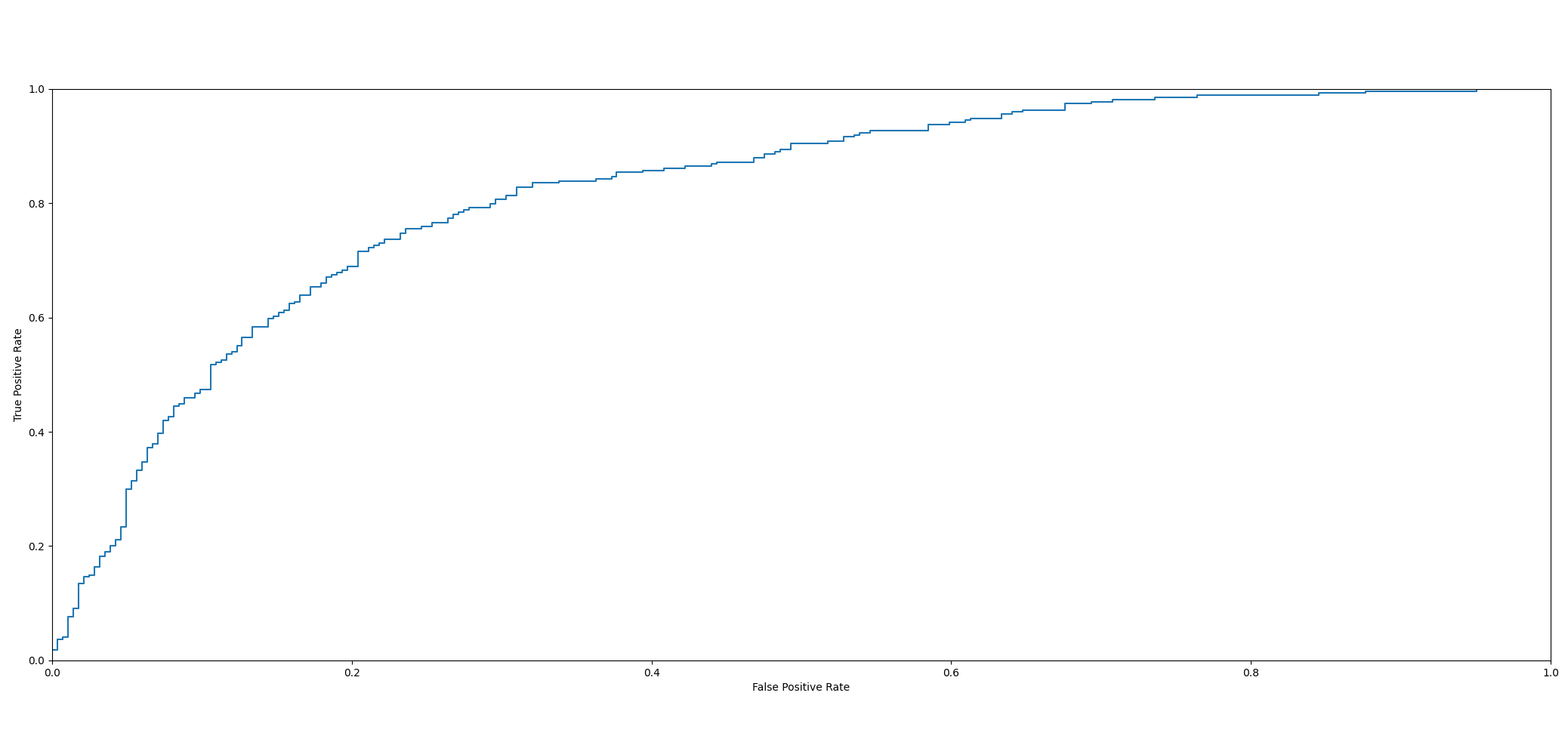

Slide 20
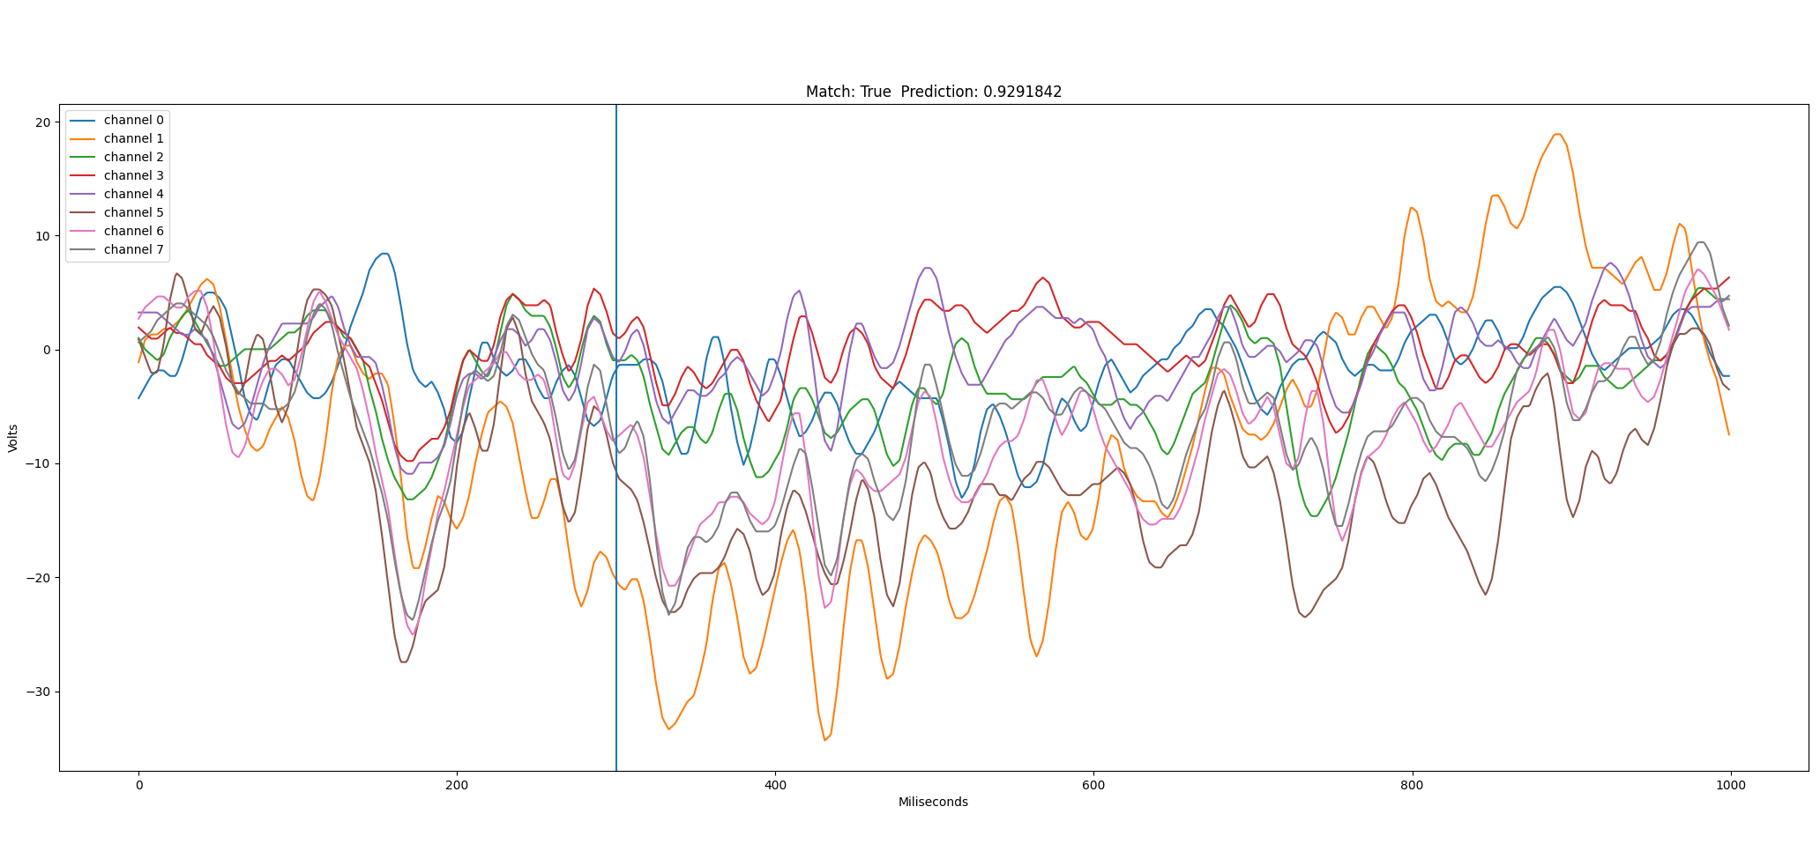

Slide 21
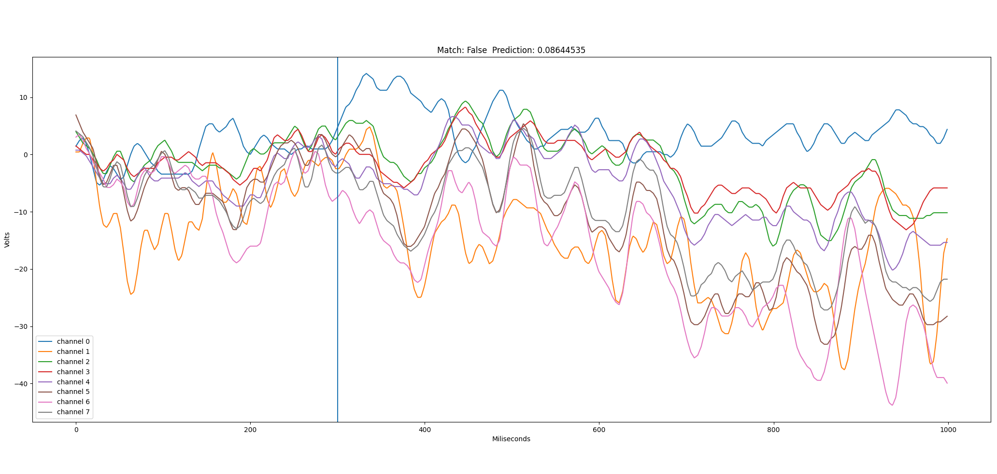

Slide 22
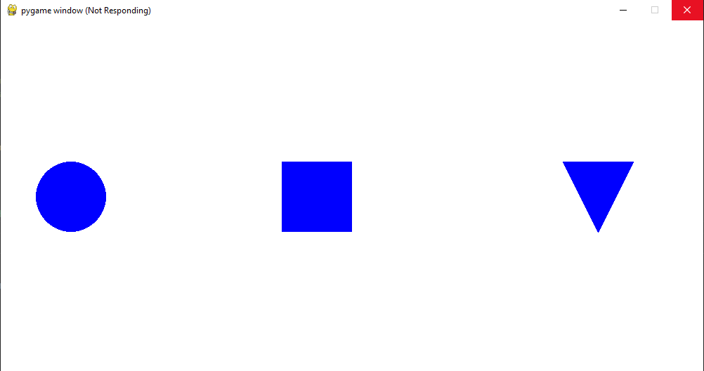
User Interface and Transfer Learning
Show GUI and explainmultiple flashes and multithreading
Also show hwo I checked if channels were railed

Slide 23
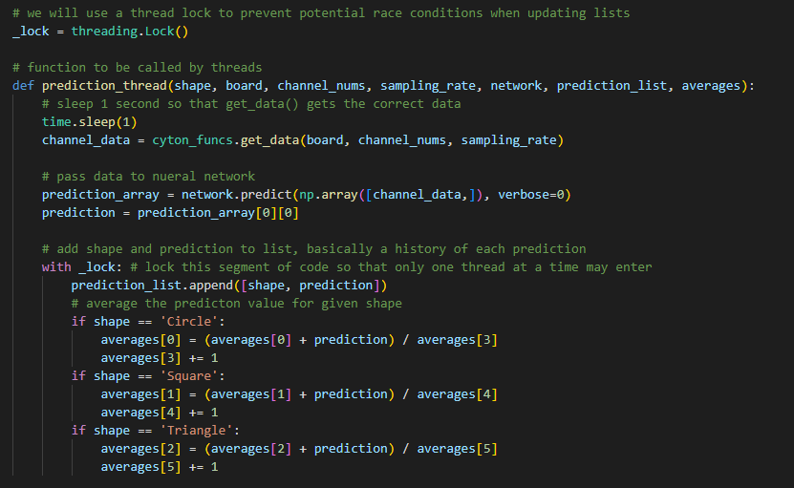
Multithreading

Slide 24
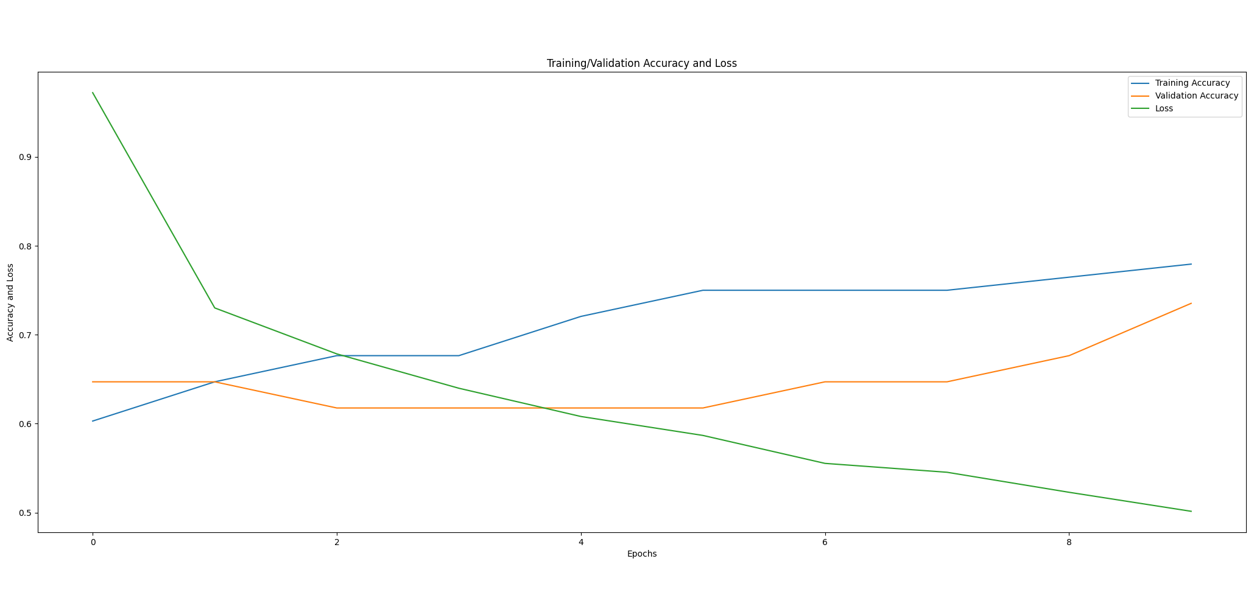

Slide 25
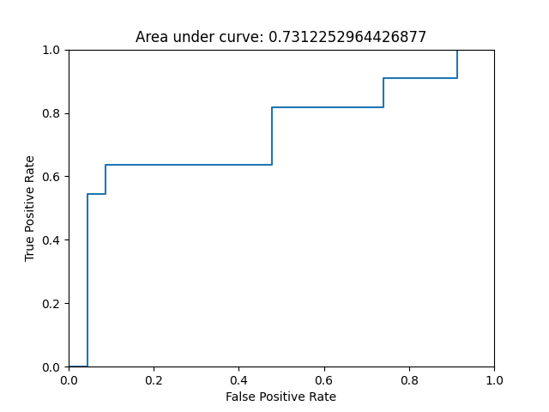

Slide 27
Challenges
Small initial training dataset
Signal filtering for live data
Neural network implementation
Time required for transfer learning data collection
Development on different OS (graphics libraries)
Safe data structures for multithreaded applications
Time offsets for data collection
Keras library limitations

Slide 28
Lessons Learned
Size of datasets required for AI
Importance of signal processing and data filtering
Strategies for managing large coding projects
Hardware and real-world limitations
Managing expectations for research

Slide 29
Demo

