Slide 1
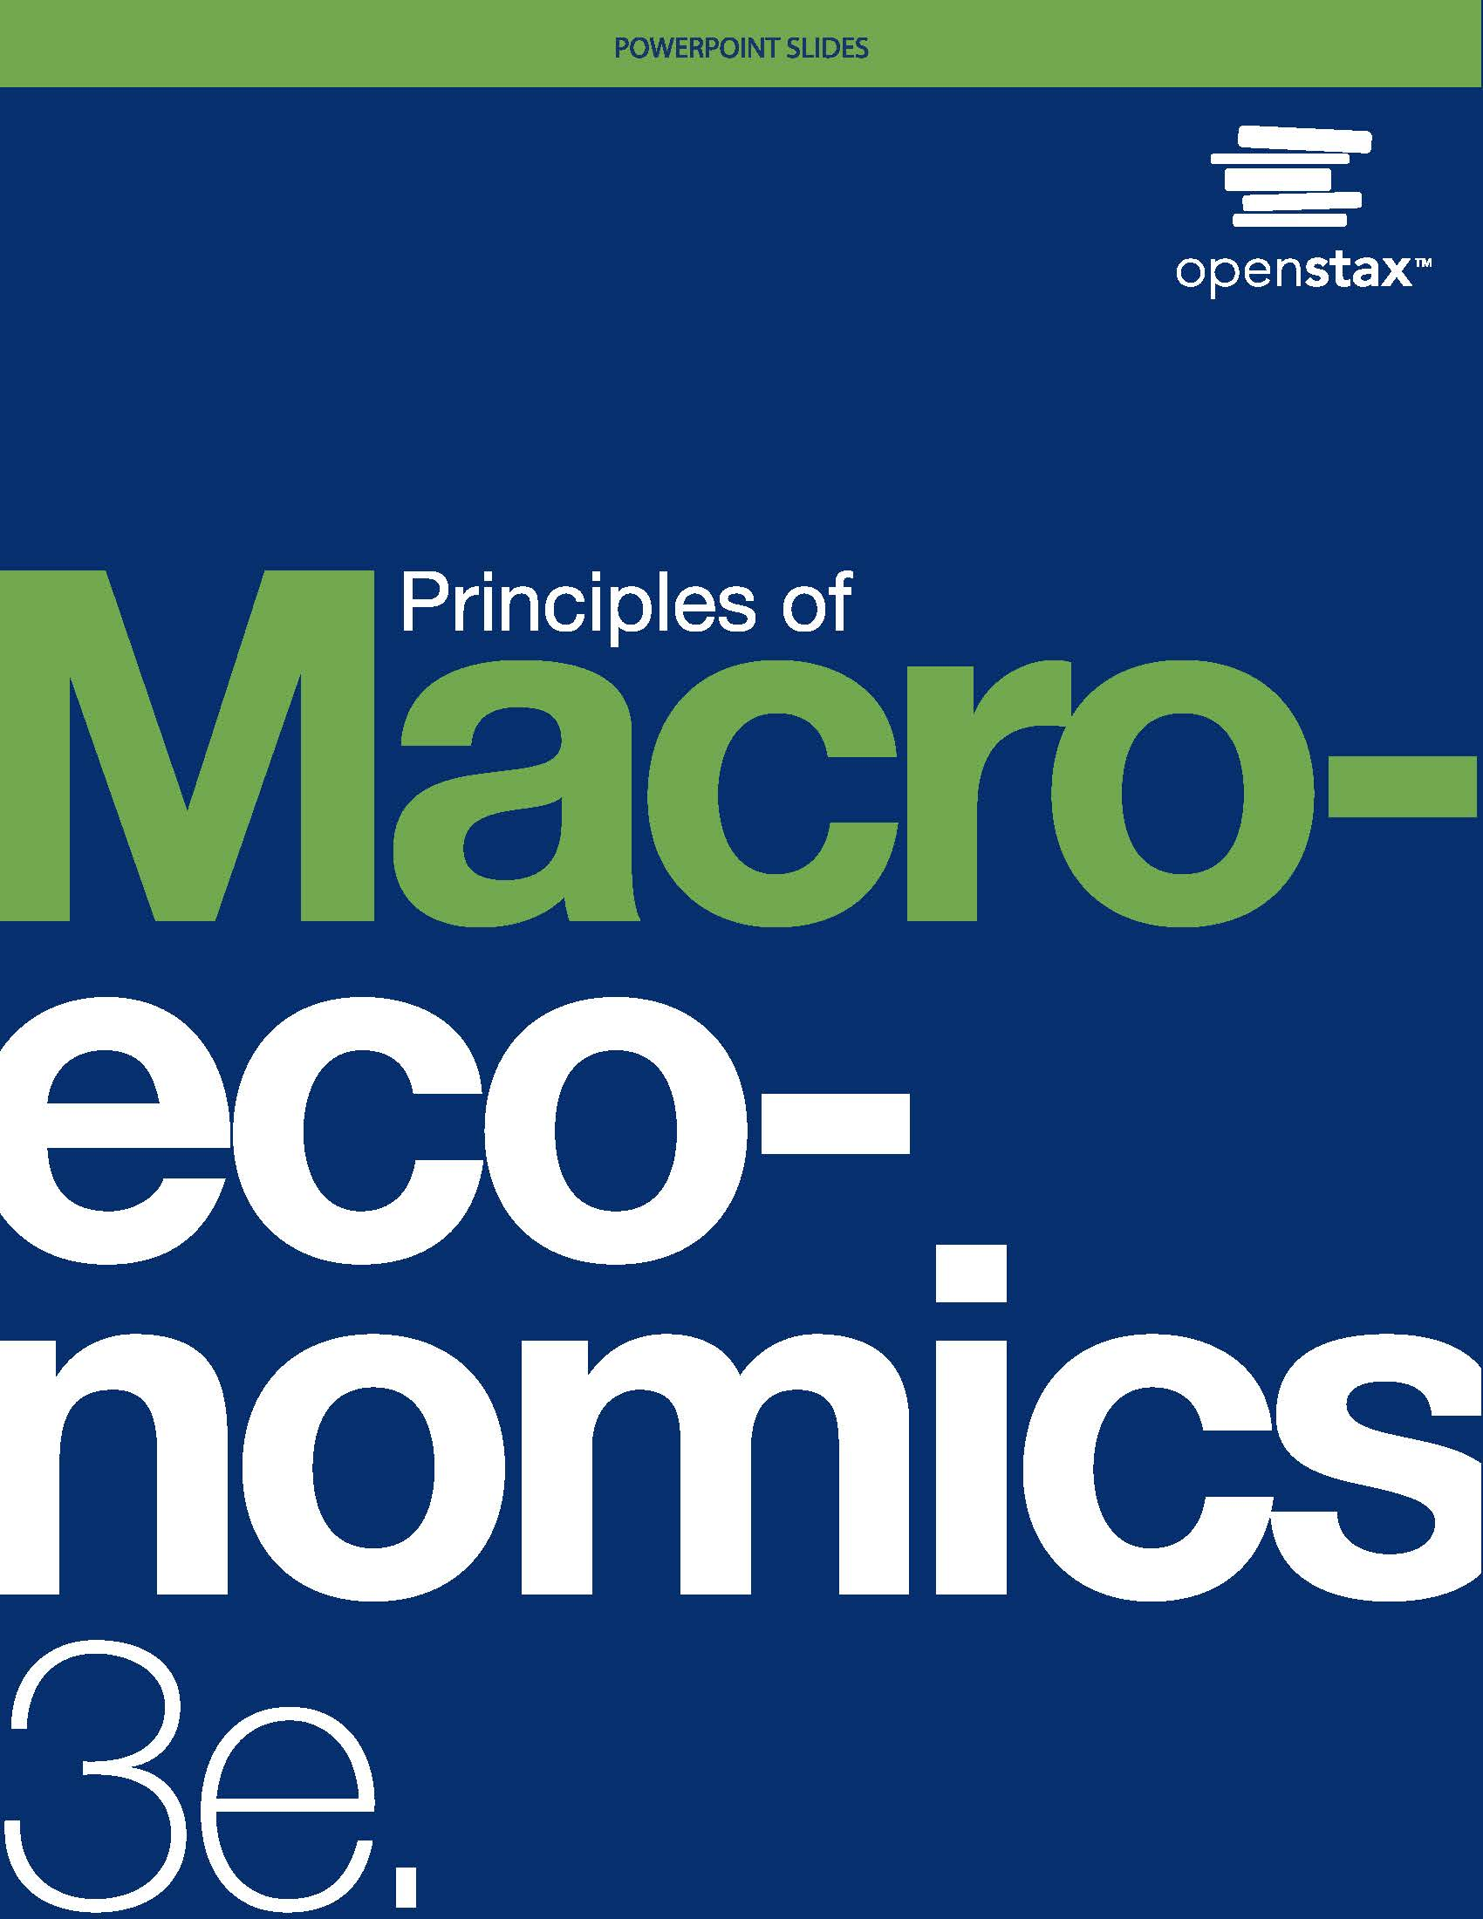
Principles of Macroeconomics 3e
Chapter 2 CHOICE IN A WORLD OF SCARCITY
PowerPoint Image Slideshow

Slide 2
Ch.2 OUTLINE
2.1: How Individuals Make Choices Based on Their Budget Constraint
2.2: The Production Possibilities Frontier and Social Choices
2.3: Confronting Objections to the Economic Approach

Slide 3

2.1 How Individuals Make Choices Based
on Their Budget Constraint
Budget constraint - all possible consumption combinations of goods that someone can afford, given the prices of goods, when all income is spent; “the boundary of the opportunity set”.
With a limited amount of income to spend on things, consumers must choose what they need and want. (What two “Fundamentals of Economics” are here?)
Given the price of the two goods and a budget amount, a budget constraint can be illustrated graphically. YAY!!!!!!

Slide 4
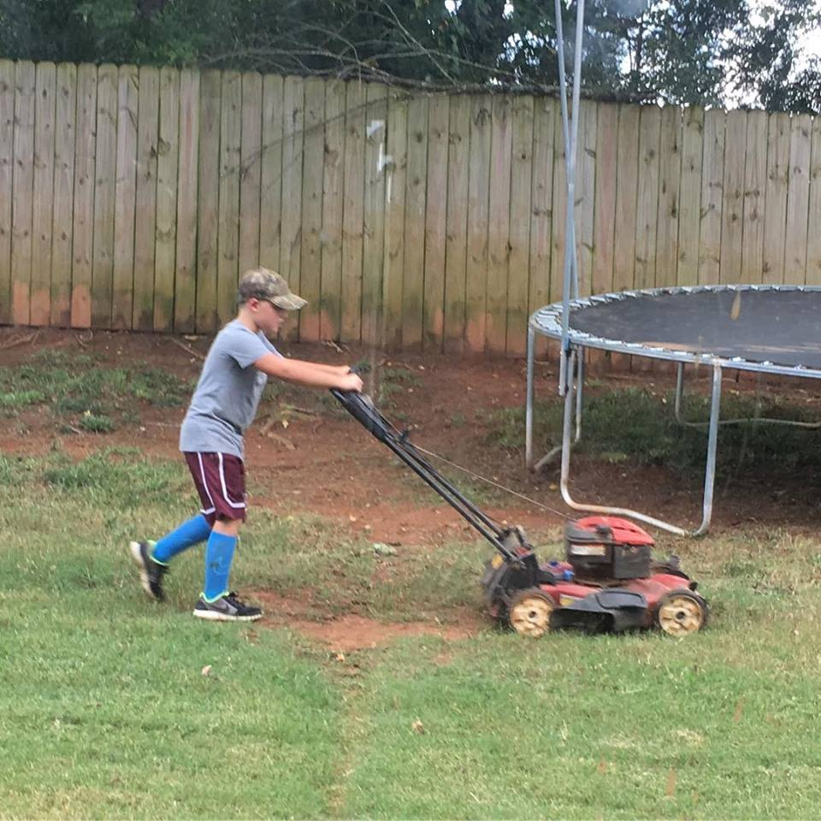
Will the Workin’ Man
Budget - $10 Burgers - $2 Bus Tickets - $0.50

Slide 5
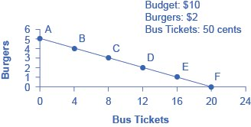
The Budget Constraint: Will’s Consumption Choice
Each point on the budget constraint represents a combination of burgers and bus tickets whose total cost adds up to Will’s budget of $10.
The opportunity set - every point on (or inside) the constraint which shows a combination of burgers and bus tickets that Will can afford.
What about a point outside the constraint?

Slide 6
The Concept of Opportunity Cost
Opportunity cost indicates what one must give up to obtain what he or she desires.
The cost of one item is the lost opportunity to do or consume something else.
The opportunity cost is the value of the next best alternative. (College vs. Work)
A fundamental principle of economics is that every choice has an opportunity cost.
For Will, what is the the opportunity cost of a burger?

Slide 7
Opportunity Cost Examples
Discussion Question: What are the opportunity costs of...
Buying vs. leasing a car
Investing in different ways (i.e., savings accounts, certificates of deposit, mutual funds, stocks, etc.)
Going out to eat vs. preparing food at home
Walking or taking public transportation

Slide 8

Consumer’s goal is to maximize utility!
Utility – satisfaction, usefulness or value one obtains from consuming goods and services.

Slide 9

Marginal Utility
Marginal analysis - examining the benefits and costs of choosing a little more or a little less of a good.

Slide 10
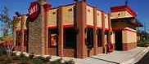
Diminishing Marginal Utility
Law of diminishing marginal utility - as a person receives more of a good, the additional (or marginal) utility from each additional unit of the good declines.

Slide 11
2.2 The Production Possibilities Frontier and Social Choices
Production possibilities frontier (PPF) - a diagram that shows the productively efficient combinations of two products that an economy can produce given the resources it has available.

Slide 12
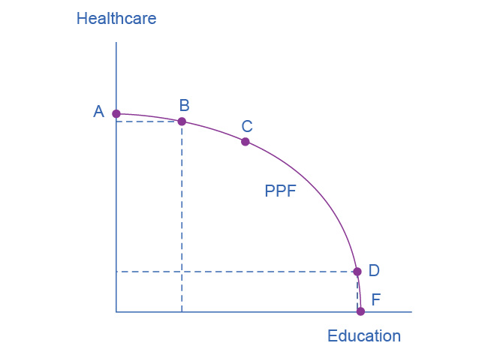
Healthcare vs. Education Production Possibilities Frontier
This production possibilities frontier shows a tradeoff between devoting social resources to healthcare and devoting them to education.
At A all resources go to healthcare and at B, most go to healthcare.
At D most resources go to education, and at F, all go to education.

Slide 13
Healthcare vs. Education Production Possibilities Frontier
A society could choose to produce any combination of healthcare and education on the production possibilities frontier.
It does not have enough resources to produce outside the PPF.
Because the PPF is downward sloping from left to right, the only way society can obtain more education is by giving up some healthcare.

Slide 14
The Shape of the PPF and the Law of Diminishing Returns
Law of diminishing returns - as additional increments of resources to producing a good or service are added, the marginal benefit from those additional increments will decline.
The law of diminishing marginal utility is a more specific case of the law of diminishing returns.

Slide 15
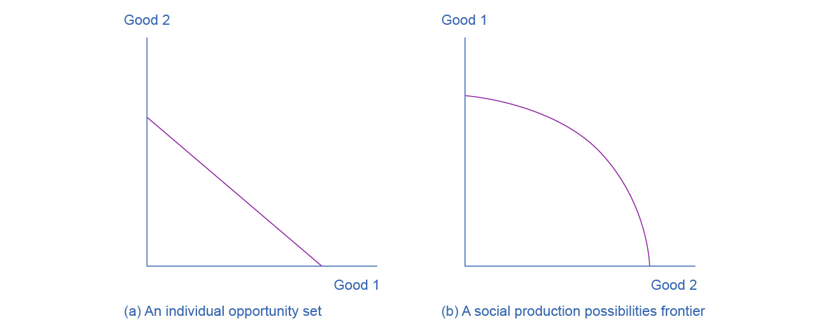
Similarities - Budget Constraint and PPF
Both the budget constraint and the social production possibilities frontier (PPF) show the constraints under which individual consumers and society as a whole operate.
Both diagrams show the tradeoff in choosing more of one good at the cost of less of the other.

Slide 16
Productive Efficiency and Allocative Efficiency
Productive efficiency - when it is impossible to produce more of one good (or service) without decreasing the quantity produced of another good (or service)
Any choice inside the PPF is productively inefficient because it is possible to produce more of one good, the other good, or some combination of both goods.
Allocative efficiency - when the mix of goods produced represents the mix that society most desires

Slide 17
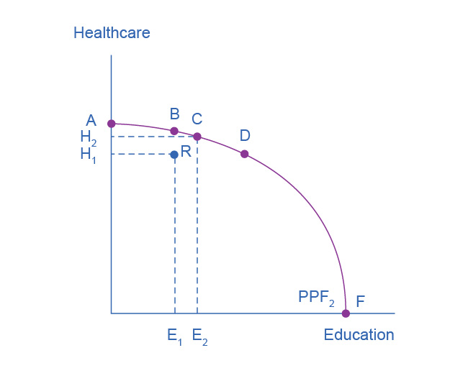
Healthcare vs. Education Production Possibilities Frontier, Continued
Productive efficiency -
All choices along a given PPF like B, C, and D display productive efficiency.
R does not, because it is inside the PPF curve, and thus not all resources are being used.

Slide 18
The PPF and Comparative Advantage
How much of a good a country decides to produce depends on how expensive it is to produce it versus buying it from a different country.
Countries tend to have different opportunity costs of producing a specific good, either because of different climates, geography, technology, or skills.
Comparative advantage - when a country can produce a good at a lower opportunity cost than another country.

Slide 19
2.3 Confronting Objections to the Economic Approach
Objections in understanding the economic approach to decision-making:
1) People, firms, and society do not act in a way that fits the economic way of thinking.
Economics begins with the premise that "individuals are pursuing their separate interest". (Attempting to maximize utility)
We may not use the vocabulary, but we use marginal analysis and budget constraints.

Slide 20
Confronting Objections to the Economic Approach
Objections in understanding the economic approach to decision-making:
2) People, firms, and society should not act this way.
Portrays people as self-interested, but economics is not a form of moral instruction.
Seeks to describe economic behavior as it actually exists.
Uses, positive statements, which describe the world as it is. These are factual.
Tries to avoid normative statements, which describe how the world should be. These statements are subjective questions of opinion.

Slide 21
Confronting Objections to the Economic Approach
3) It is not possible that broader social good can emerge from selfish individual actions.
Invisible hand - concept that individuals' self-interested behavior can lead to positive social outcomes
Identified in Adam Smith’s The Wealth of Nations.
Consumers will encourage businesses to offer goods and services that meet their needs.

