Slide 1

Principles of Macroeconomics 3e
Chapter 13 THE NEOCLASSICAL PERSPECTIVE
PowerPoint Image Slideshow

Slide 2
Ch.13 OUTLINE
13.1: The Building Blocks of Neoclassical Analysis
13.2: The Policy Implications of the Neoclassical Perspective
13.3: Balancing Keynesian and Neoclassical Models

Slide 3
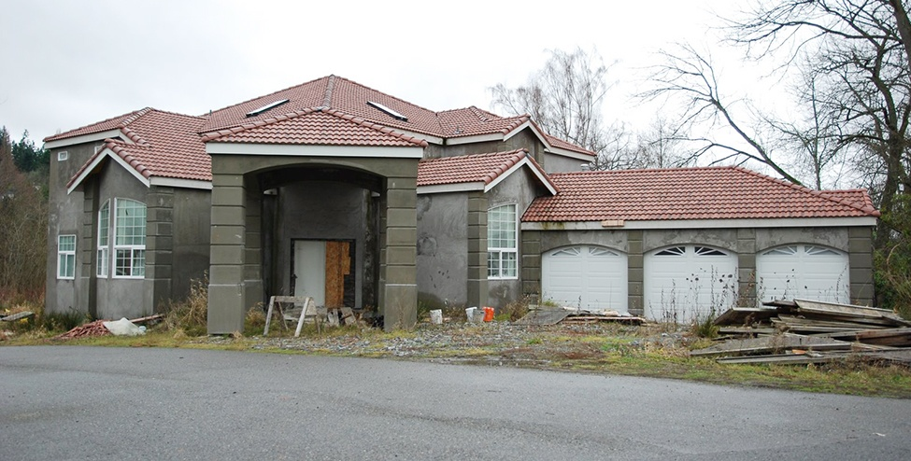
Impact of the Great Recession
We can see the impact of the Great Recession in many areas of the economy that impact our daily lives.
One of the most visible signs was in the housing market where many people were forced to abandon their homes and other buildings, including ones midway through construction. (Credit: modification of "House" by A McLin/Flickr Creative Commons, CC BY 2.0)

Slide 4
13.1 The Building Blocks of Neoclassical Analysis
Neoclassical perspective - the philosophy that, in the long run, the business cycle will fluctuate around the potential, or full-employment, level of output.
Two building blocks of neoclassical economics:
Potential GDP determines the economy's size.
Wages and prices will adjust in a flexible manner so that the economy will adjust back to its potential GDP level of output.

Slide 5
The Importance of Potential GDP in the Long Run
Over the long run, the level of potential GDP determines the size of real GDP.
“Potential GDP” is the level of output that an economy can achieve when all resources (land, labor, capital, and entrepreneurial ability) are fully employed.
While the unemployment rate in labor markets will never be zero, full employment in the labor market refers to zero cyclical unemployment.
Economists benchmark actual or real GDP against the potential GDP to determine how well the economy is performing.

Slide 6
Increasing and Investing in Physical and Human Capital
GDP growth can be explained by increases in investment in physical capital and human capital per person, as well as advances in technology.
Physical capital per person - the amount and kind of machinery and equipment available to help a person produce a good or service.
Increasing human capital involves increasing levels of knowledge, education, and skill sets per person through vocational or higher education.
Physical and human capital improvements with technological advances will increase overall productivity and, thus, GDP.

Slide 7
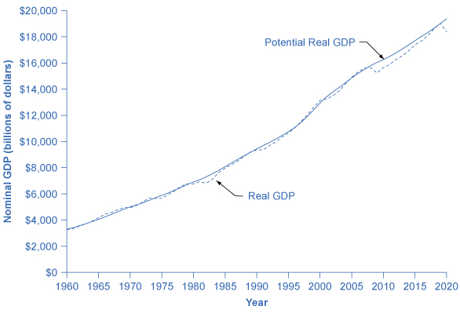
Potential and Actual GDP (in 2012 Dollars)
Actual GDP falls below potential GDP during and after recessions, like the recessions of 1980 and 1981–82, 1990–91, 2001, and 2008–2009 and continues below potential GDP through 2019, when it goes slightly above potential.
In other cases, actual GDP can be above potential GDP for a time, as in the late 1990s.

Slide 8
Potential vs Actual GDP
The potential GDP is estimated by the nonpartisan Congressional Budget Office.
Most economic recessions and upswings are times when the economy is 1–3% below or above potential GDP in a given year.

Slide 9
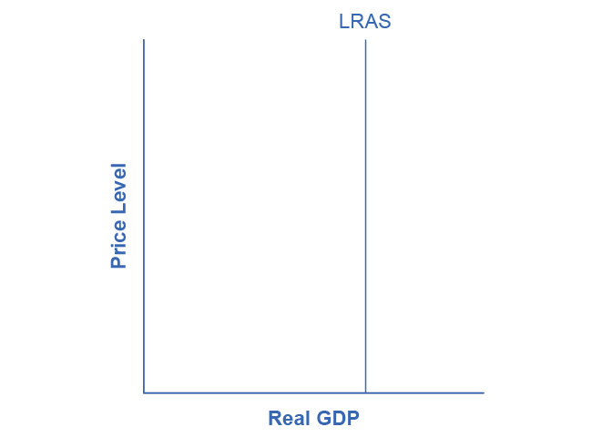
A Vertical Aggregate Supply Curve
In the neoclassical model, we draw the aggregate supply curve as a vertical line at the level of potential GDP.
If AS is vertical, then it determines the level of real output, no matter where we draw the aggregate demand curve.
Over time, the LRAS curve shifts to the right as productivity increases and potential GDP expands.

Slide 10
The Role of Flexible Prices
Economists base the neoclassical view of how the macroeconomy adjusts on the insight that even if wages and prices are “sticky” in the short run, they are still flexible over time.
An economy may produce above its level of potential GDP in the short run, due to a surge in aggregate demand.
However, the economy cannot sustain production above its potential GDP in the long run.
Over the long run, the surge in aggregate demand ends up as an increase in the price level, not as a rise in output.

Slide 11
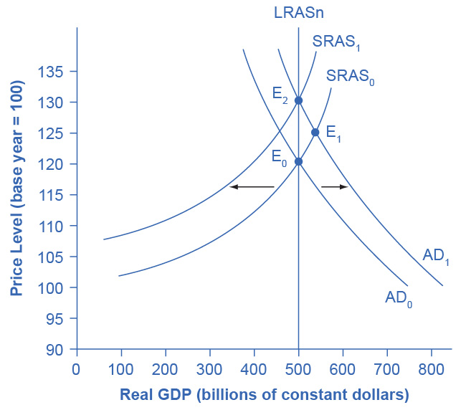
The Rebound to Potential GDP after AD Increases
The original equilibrium (E₀) happens at the intersection of the aggregate demand curve (AD₀) and the short-run aggregate supply curve (SRAS₀).
The output at E₀ is equal to potential GDP.
Aggregate demand shifts right from AD₀ to AD₁.
The new equilibrium is E₁, with a higher output level and price level.

Slide 12
The Rebound to Potential GDP after AD Increases, Continued
With unemployment rates unsustainably low, eager employers bid up wages.
This increases the price of a major input to production, thus shifting the short-run aggregate supply to the left, from SRAS₀ to SRAS₁.
The new equilibrium (E₂) is at the same original level of output, but at a higher price level.
Thus, the long-run aggregate supply curve (LRAS_{n}), which is vertical at the level of potential GDP, determines the level of real GDP in this economy in the long run.

Slide 13
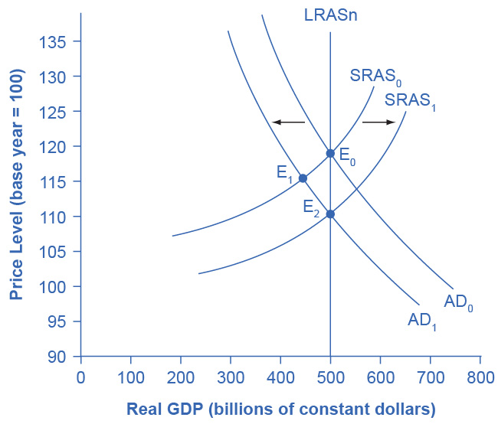
A Rebound Back to Potential GDP from a Shift to the Left in Aggregate Demand
The original equilibrium (E₀) happens at the intersection of the aggregate demand curve (AD₀) and the short-run aggregate supply curve (SRAS₀).
The output at E₀ is equal to potential GDP.
Aggregate demand shifts left, from AD₀ to AD₁.
The new equilibrium is at E₁, with a lower output level and downward pressure on the price level.

Slide 14
A Rebound Back to Potential GDP from a Shift to the Left in Aggregate Demand, Continued
With high unemployment rates, wages are held down.
Lower wages are an economy-wide decrease in the price of a key input, which shifts short-run aggregate supply to the right, from SRAS₀ to SRAS₁.
The new equilibrium (E₂) is at the same original level of output, but at a lower price level.

Slide 15
How Fast Is the Speed of Macroeconomic Adjustment?
Rational expectation - the theory that people form the most accurate possible expectations about the future that they can, using all information available to them
In an economy where most people have rational expectations, economic adjustments may happen very quickly.
Theorizes that everyone will recognize that the process is heading toward a change in the price level and then will act on that expectation quickly, without a drawn-out zigzag of output and employment.

Slide 16
How Fast Is the Speed of Macroeconomic Adjustment?, Continued
An alternate assumption is that people and firms act with adaptive expectations.
Adaptive expectations - the theory that people look at past experience and gradually adapt their beliefs and behavior as circumstances change.
Are not perfect synthesizers of information and accurate predictors of the future.
If most people and businesses have some form of adaptive expectations, then the adjustment from the short run to the long run will be traced out in incremental steps that occur over time.

Slide 17
13.2 The Policy Implications of the Neoclassical Perspective
Expected inflation - a future rate of inflation that consumers and firms build into current decision making.
In the Keynesian perspective, the focus is that the government should adjust AD so that the economy produces at its potential GDP.
Not so low that cyclical unemployment results and not so high that inflation results.
In the neoclassical perspective, aggregate supply will determine output at potential GDP.
The natural rate of unemployment determines unemployment.
Shifts in aggregate demand are the primary determinant of changes in the price level.

Slide 18
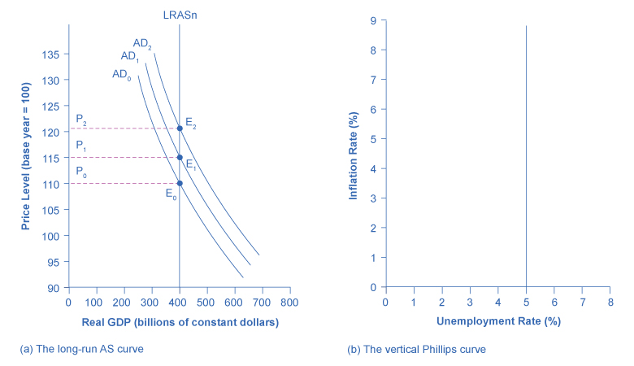
From a Long-Run AS Curve to a Long-Run Phillips Curve
For graph (a), with a vertical LRAS curve, shifts in aggregate demand do not alter the level of output but do lead to changes in the price level.
Because output is unchanged between the equilibria E₀, E₁, and E₂, all unemployment in this economy will be due to the natural rate of unemployment.
For graph (b), if the natural rate of unemployment is 5%, then the Phillips curve will be vertical. That is, regardless of changes in the price level, the unemployment rate remains at 5%.

Slide 19
Fighting Unemployment or Inflation?
When the economy is producing at potential GDP, cyclical unemployment will be zero.
For neoclassical economists:
The view of unemployment tends to focus on how the government can adjust public policy to reduce the natural rate of unemployment.
Do not tend to see aggregate demand as a useful tool for reducing unemployment.
Since a vertical aggregate supply curve determines economic output, then aggregate demand has no long-run effect on unemployment.
Believe that aggregate demand should be allowed to expand only to match the gradual shifts of aggregate supply to the right - keeping the price level much the same and inflationary pressures low.

Slide 20
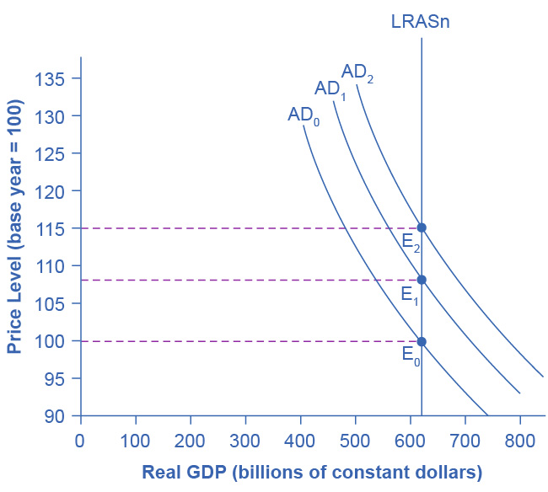
How Aggregate Demand Determines the Price Level in the Long Run
As aggregate demand shifts to the right, from AD₀ to AD₁ to AD₂, real GDP in this economy and the level of unemployment do not change.
However, there is inflationary pressure for a higher price level as the equilibrium changes from E₀ to E₁ to E₂.
If aggregate demand rises rapidly in the neoclassical model, in the long run it leads only to inflationary pressures.

Slide 21
Fighting Recession or Encouraging Long-Term Growth?
Neoclassical economists believe that the economy will rebound out of a recession or eventually contract during an expansion.
Because prices and wage rates are flexible and will adjust either upward or downward to restore the economy to its potential GDP.
The key policy question for neoclassicals is how to promote growth of potential GDP.
Economic growth depends on the growth rate of long-term productivity.
Government policy should focus on promoting long-run productivity growth through:
investments in human capital, physical capital, and technology.
operating together in a market-oriented environment that rewards innovation.

Slide 22
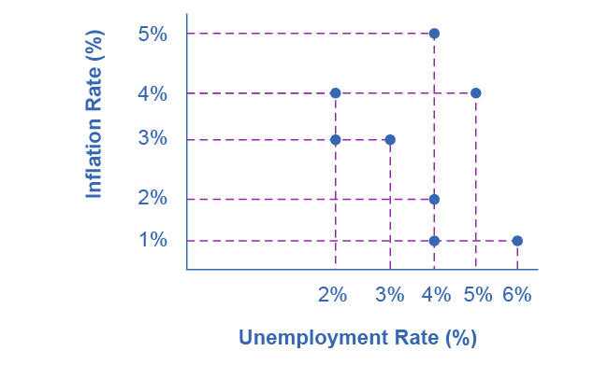
Example: Tracking Inflation and Unemployment Rates
This graph shows inflation and unemployment rates recorded every 5 years between 1970 and 2000.
Discussion Question: What patterns do you see in the data? Do you see the Phillips curve(s) in the data?
If we trace the downward sloping trend of data points, we can see a short-run Phillips curve that exhibits the inverse trade off between higher unemployment and lower inflation rates.
If we trace the vertical line of data points, we could see a long-run Phillips curve at the 4% natural rate of unemployment.

Slide 23
13.3 Balancing Keynesian and Neoclassical Models
Many mainstream economists believe both the Keynesian and neoclassical perspectives.
At short time scales (and sometimes deep and long-lasting recessions), the Keynesian model can be a good approximation.
At very long time scales, the neoclassical framework can make more sense.

