Slide 1
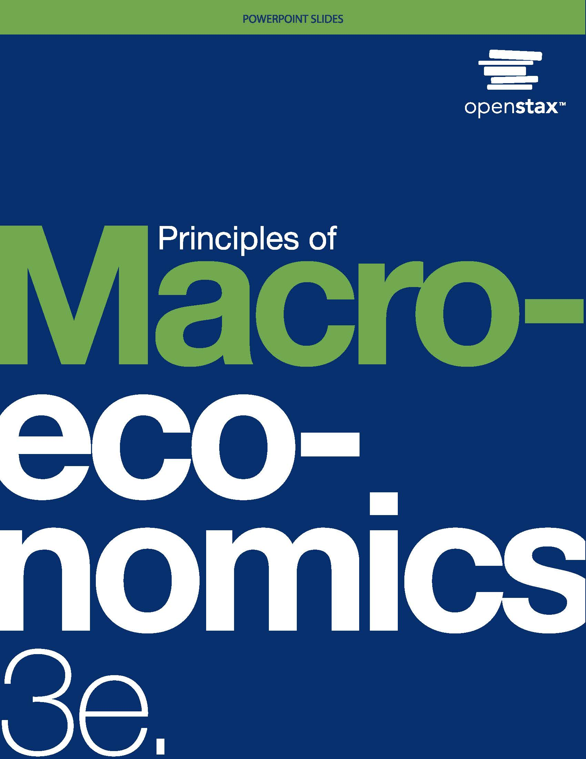
Principles of Macroeconomics 3e
Chapter 17 GOVERNMENT BUDGETS AND FISCAL POLICY
PowerPoint Image Slideshow

Slide 2
Ch.17 OUTLINE
17.1: Government Spending
17.2: Taxation
17.3: Federal Deficits and the National Debt
17.4: Using Fiscal Policy to Fight Recession, Unemployment, and Inflation
17.5: Automatic Stabilizers
17.6: Practical Problems with Discretionary Fiscal Policy
17.7: The Question of a Balanced Budget

Slide 3

Shut Downs and Parks
Yellowstone National Park is one of the many national parks forced to close operations during the government shutdown in 2013 and 2018–2019.
(Credit: modification of “Close up of sign” by David Fulmer/Flickr Creative Commons, CC BY 2.0)

Slide 4
17.1 Government Spending
Budget deficit - when the federal government spends more money than it receives in taxes in a given year.
Budget surplus - when the government receives more money in taxes than it spends in a year.
Balanced budget - when government spending and taxes are equal.
Major federal spending categories:
national defense
Social Security
health programs
interest payments

Slide 5
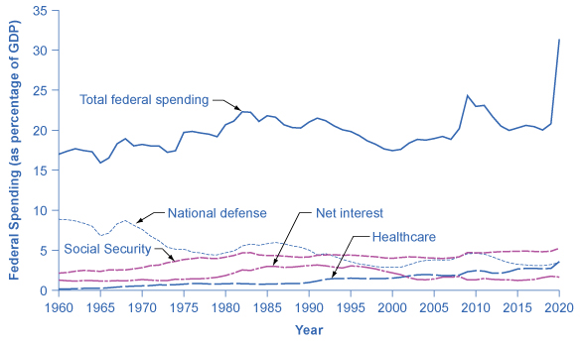
Federal Spending, 1960–2020
Since 1960, total federal spending has ranged from about 18% to 22% of GDP. It climbed above that level in 2009, quickly dropped back down to that level by 2013, and again climbed above that level in 2020.
The share that the government has spent on national defense has generally declined, while the share it has spent on Social Security and on healthcare expenses (mainly Medicare and Medicaid) has increased. (Source: Economic Report of the President, 2021, Table B47, https://www.govinfo.gov/app/collection/erp/2021)

Slide 6
Deficit vs Debt
The deficit is not the debt.
The government deficit (or surplus) refers to what happens with the federal government budget each year.
The government debt is accumulated over time and is the sum of all past deficits and surpluses.

Slide 7
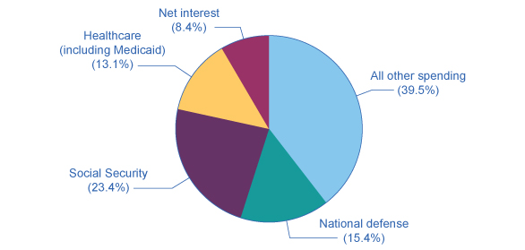
Slices of Federal Spending, 2019
About 60% of government spending goes to four major areas: national defense, Social Security, healthcare, and interest payments on past borrowing.
This leaves about 40% of federal spending for all other functions of the U.S. government.
(Source: https://www.whitehouse.gov/omb/budget/Historicals/)

Slide 8
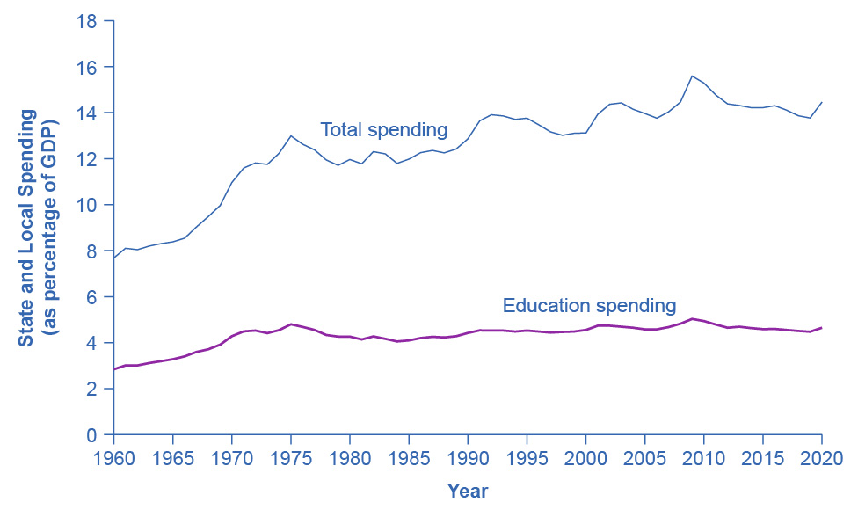
State and Local Spending, 1960–2020
Spending by state and local government increased from about 10% of GDP in the early 1960s to 14–16% by the mid-1970s.
It has remained at roughly that level since.
The single biggest spending item is education, including both K–12 spending and support for public colleges and universities, which has been about 4–5% of GDP in recent decades.
(Source: Bureau of Economic Analysis, https://apps.bea.gov/iTable/index_nipa.cfm.)

Slide 9
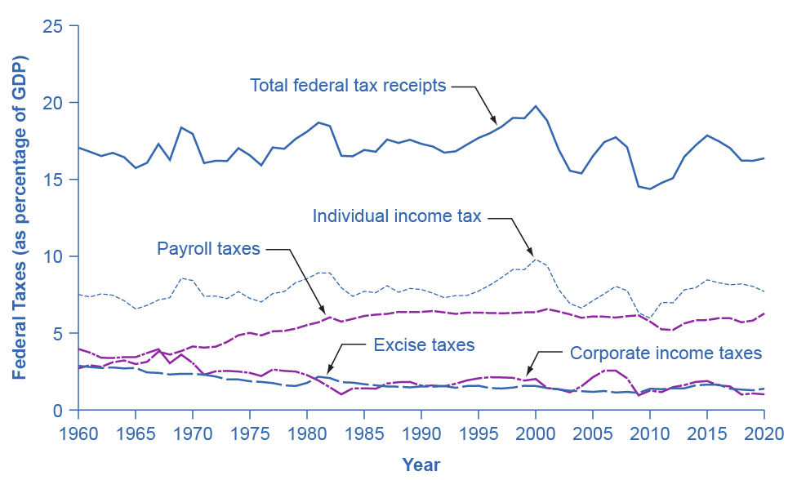
17.2 Taxation
Federal tax revenues have been about 17–20% of GDP during most periods in recent decades.
The primary sources of federal taxes are individual income taxes and the payroll taxes that finance Social Security and Medicare.
Corporate income taxes and social insurance taxes provide smaller shares of revenue. (Source: Economic Report of the President, 2021. Table B-47, https://www.govinfo.gov/app/collection/erp/2021)

Slide 10
Taxes Collected by the Federal Government
Individual income tax - a tax based on the income, of all forms, received by individuals.
Payroll tax - a tax based on the pay received from employers.
These taxes provide funds for Social Security and Medicare.
Progressive tax - a tax that collects a greater share of income from those with high incomes than from those with lower incomes.
What the U.S. income tax is.

Slide 11
Taxes Collected by the Federal Government, Continued
Marginal tax rate - the tax rate an individual would pay on one additional dollar of income; the tax percentage on the last dollar earned. Currently ranges from 10% to 35%.
Example: Using the table below, if a person earns $35,000, their marginal tax rate is 15%.
Income bracket | Tax rate
$0–$9,075 | 10%
$9,075–$36,900 | 15%
$36,900+ | 25%

Slide 12
Taxes Collected by the Federal Government, Continued
Proportional tax - a tax that is a flat percentage of income earned, regardless of level of income.
Regressive tax - a tax in which people with higher incomes pay a smaller share of their income in tax.
Corporate income tax - a tax imposed on corporate profits.
Excise tax - a tax on a specific good, like on gasoline, tobacco, and alcohol.
Estate and gift tax - a tax on people who pass assets to the next generation - either after death or during life in the form of gifts.

Slide 13
State and Local Taxes
The revenue sources for state and local governments are:
sales taxes,
property taxes,
revenue passed along from the federal government,
personal and corporate income taxes,
a variety of fees and charges.

Slide 14
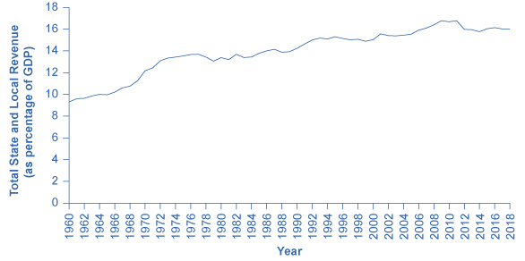
State and Local Tax Revenue as a Share of GDP, 1960–2020
State and local tax revenues have increased to match the rise in state and local spending.
(Source: Economic Report of the President, 2020. Table B-50, https://www.govinfo.gov/app/collection/erp/2021)

Slide 15
17.3 Federal Deficits and the National Debt
Annual budget deficit (or surplus) - the difference between the tax revenue collected and spending over a fiscal year.
Fiscal year starts October 1 and ends September 30 of the next year.
The budget deficit refers to how much the government has borrowed in one particular year.
National debt - the total accumulated amount the government has borrowed, over time, and not yet paid back.
The dollar value of all the outstanding Treasury bonds on which the federal government owes money.

Slide 16
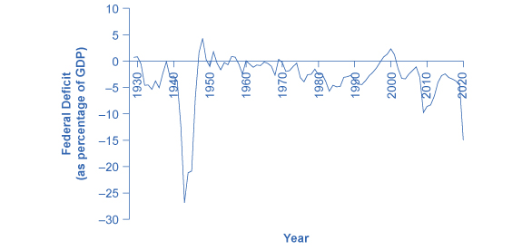
Pattern of Federal Budget Deficits and Surpluses, 1929–2020
The federal government has run budget deficits for decades.
The budget was briefly in surplus in the late 1990s, before heading into deficit again in the first decade of the 2000s—and especially deep deficits in the 2007–2009 and 2020 recessions.
(Source: Federal Reserve Bank of St. Louis (FRED). http://research.stlouisfed.org/fred2/series/FYFSGDA188S)

Slide 17
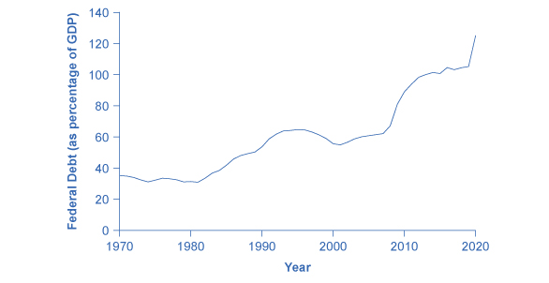
Federal Debt as a Percentage of GDP, 1942–2014
Federal debt is the sum of annual budget deficits and surpluses.
Annual deficits do not always mean that the debt/GDP ratio is rising.
During the 1960s and 1970s, the government often ran small deficits, but since the debt was growing more slowly than the economy, the debt/GDP ratio was declining over this time.
In the 2008–2009 recession, the debt/GDP ratio rose sharply, before leveling off through the later 2010s. In 2020, it rose sharply again. (Source: https://fred.stlouisfed.org/series/GFDEGDQ188S))

Slide 18
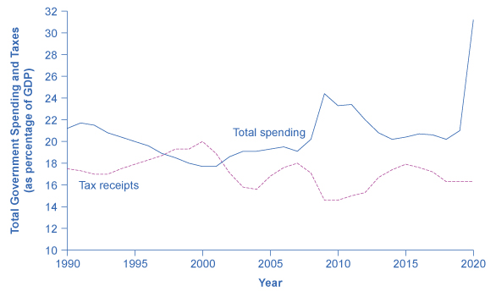
Total Government Spending and Taxes as a Share of GDP, 1990–2014
When government spending exceeds taxes, the gap is the budget deficit.
When taxes exceed spending, the gap is a budget surplus.
The recessionary period starting in late 2007 saw higher spending and lower taxes, combining to create a large deficit in 2009.
The same thing happened in a more extreme way in 2020. (Source: Economic Report of the President, Tables B-46, https://www.govinfo.gov/app/collection/erp/2021)

Slide 19
17.4 Using Fiscal Policy to Fight Recession, Unemployment, and Inflation
Fiscal policy is the use of government spending and tax policy to influence the path of the economy over time.
Expansionary fiscal policy - fiscal policy that increases the level of aggregate demand, either through increases in government spending or cuts in taxes.
Contractionary fiscal policy - fiscal policy that decreases the level of aggregate demand, either through cuts in government spending or increases in taxes.

Slide 20
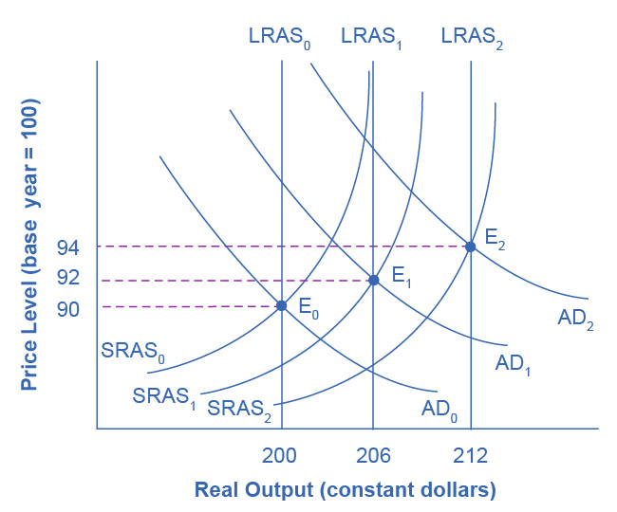
A Healthy, Growing Economy
In this well-functioning economy, each year aggregate supply and aggregate demand shift to the right so that the economy proceeds from equilibrium E₀ to E₁ to E₂.
Each year, the economy produces at potential GDP with only a small inflationary increase in the price level.
However, if aggregate demand does not smoothly shift to the right and match increases in aggregate supply, growth with deflation can develop.

Slide 21
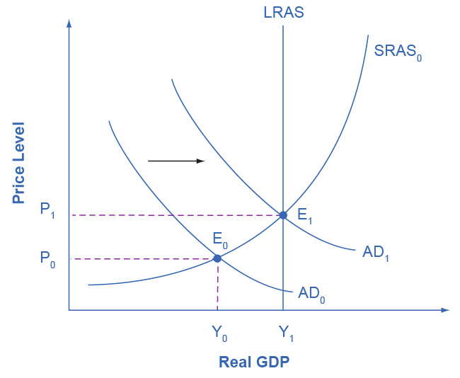
Expansionary Fiscal Policy, Illustrated
The original equilibrium (E₀) represents a recession, occurring at a quantity of output (Y₀) below potential GDP.
However, a shift of aggregate demand from AD₀ to AD₁, enacted through an expansionary fiscal policy, can move the economy to a new equilibrium output of E₁ at the level of potential GDP which the LRAS curve shows.
Since the economy was originally producing below potential GDP, any inflationary increase in the price level from P₀ to P₁ that results should be relatively small.

Slide 22
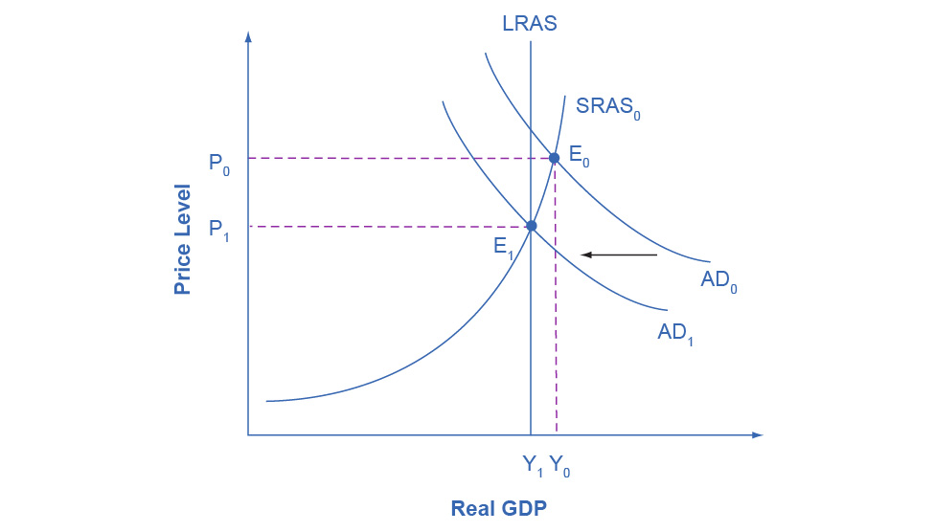
Contractionary Fiscal Policy, Illustrated
The economy starts at the equilibrium quantity of output Y₀, which is above potential GDP.
The extremely high level of aggregate demand will generate inflationary increases in the price level.
A contractionary fiscal policy can shift aggregate demand down from AD₀ to AD₁, leading to a new equilibrium output E₁, which occurs at potential GDP, where AD₁ intersects the LRAS curve.

Slide 23
17.5 Automatic Stabilizers
Discretionary fiscal policy - the government passes a new law that explicitly changes overall tax or spending levels with the intent of influencing the level of overall economic activity.
The 2009 stimulus package is an example.
Automatic stabilizers - tax and spending rules that have the effect of slowing down the rate of decrease in aggregate demand when the economy slows down and restraining aggregate demand when the economy speeds up, without any additional change in legislation.
Examples are unemployment insurance and food stamps.

Slide 24
The Standardized Employment Deficit or Surplus
Standardized employment budget - the budget deficit or surplus in any given year adjusted for what it would have been if the economy were producing at potential GDP.
If people who look for work were finding jobs and businesses were making normal profits.
Eliminates the impact of the automatic stabilizers.

Slide 25
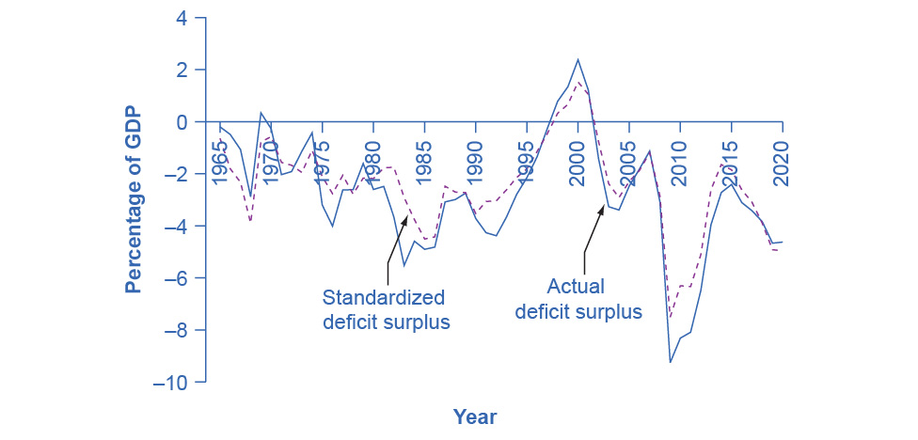
Comparison of Actual Budget Deficits with the Standardized Employment Deficit
When the economy is in recession, the standardized employment budget deficit is less than the actual budget deficit because the economy is below potential GDP, and the automatic stabilizers are reducing taxes and increasing spending.

Slide 26
Comparison of Actual Budget Deficits with the Standardized Employment Deficit, Cont.
When the economy is performing extremely well, the standardized employment deficit (or surplus) is higher than the actual budget deficit (or surplus) because the economy is producing about potential GDP, so the automatic stabilizers are increasing taxes and reducing the need for government spending. (Sources: Actual and Cyclically Adjusted Budget Surpluses/Deficits, https://www.cbo.gov/data/budget-economic-data#8)

Slide 27
17.6 Practical Problems with Discretionary Fiscal Policy
Fiscal policy and monetary policy are interconnected.
Crowding out - where government borrowing and spending results in higher interest rates, which reduces business investment and household consumption.

Slide 28
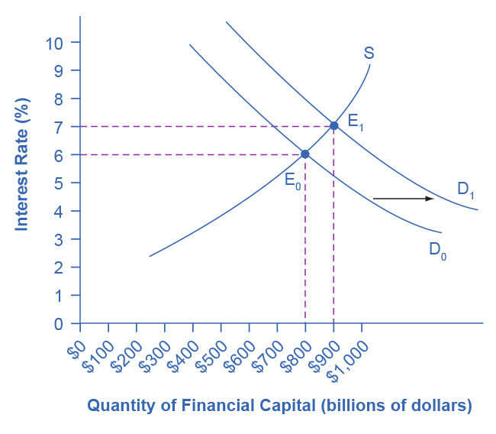
Fiscal Policy and Interest Rates Example
When a government borrows money in the financial capital market, it causes a shift in the demand for financial capital from D₀ to D₁.
As the equilibrium moves from E₀ to E₁, the equilibrium interest rate rises from 6% to 7%.
In this way, an expansionary fiscal policy intended to shift aggregate demand to the right can also lead to a higher interest rate, which has the effect of shifting aggregate demand back to the left.

Slide 29
Long and Variable Time Lags
It can take time to enact fiscal policy.
Recognition lag - the time it takes to determine that a recession has occurred.
Legislative lag - the time it takes to get a fiscal policy bill passed.
Implementation lag - the time it takes for the funds relating to fiscal policy to be dispersed to the appropriate agencies to implement the programs.

Slide 30
17.7 The Question of a Balanced Budget
Discussion Question: What are the arguments for and against requiring the U.S. federal budget to be balanced?
In the short term, economists would expect the budget deficits and surpluses to fluctuate up and down with the economy and the automatic stabilizers.
Recessions -> larger deficits or smaller surpluses.
Economic booms -> smaller deficits or larger surpluses.
In the long-term, running large budget deficits, through long-term investments in human capital and physical infrastructure could build the country's long-term productivity.
This could not be done with a required balanced budget.

