Slide 1

Principles of Macroeconomics 3e
Chapter 18 THE IMPACTS OF GOVERNMENT BORROWING
PowerPoint Image Slideshow

Slide 2
Ch.18 OUTLINE
18.1: How Government Borrowing Affects Investment and the Trade Balance
18.2: Fiscal Policy and the Trade Balance
18.3: How Government Borrowing Affects Private Saving
18.4: Fiscal Policy, Investment, and Economic Growth

Slide 3
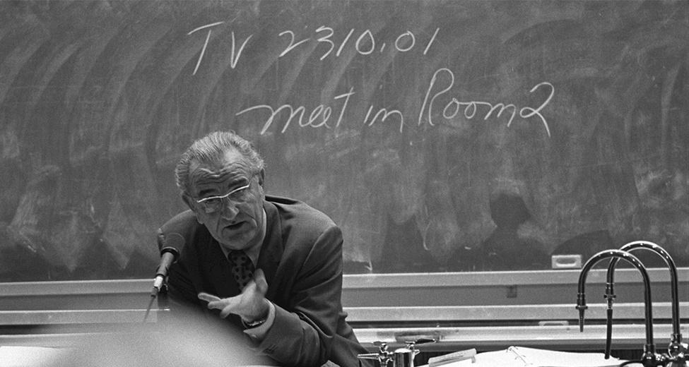
President Lyndon B. Johnson
President Lyndon Johnson played a pivotal role in financing higher education.
(Credit: modification of "Lyndon Johnson in 1970” by LBJ Museum & Library, Public Domain)

Slide 4
18.1 How Government Borrowing Affects Investment and the Trade Balance
When governments are borrowers in financial markets, there are 3 possible sources for the funds from a macroeconomic point of view:
households might save more;
private firms might borrow less;
more foreign financial investors from outside the country.
Recall that the national saving and investment identity always holds:
Quantity supplied of financial capital = Quantity demanded of financial capital
S + (M – X) = I + (G – T)
S = saving by individuals and firms
( M – X) = imports (M) - exports (E) = trade deficit (or surplus)
I = private sector investment
G = government spending
T = taxes collected

Slide 5
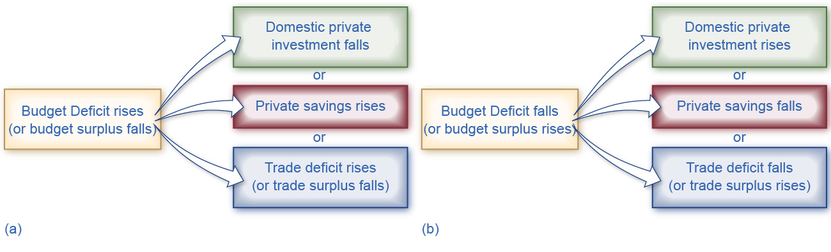
Effects of Change in Budget Surplus or Deficit on Investment, Savings, and The Trade Balance
Chart (a) shows the potential results when the budget deficit rises (or budget surplus falls).
Chart (b) shows the potential results when the budget deficit falls (or budget surplus rises).

Slide 6
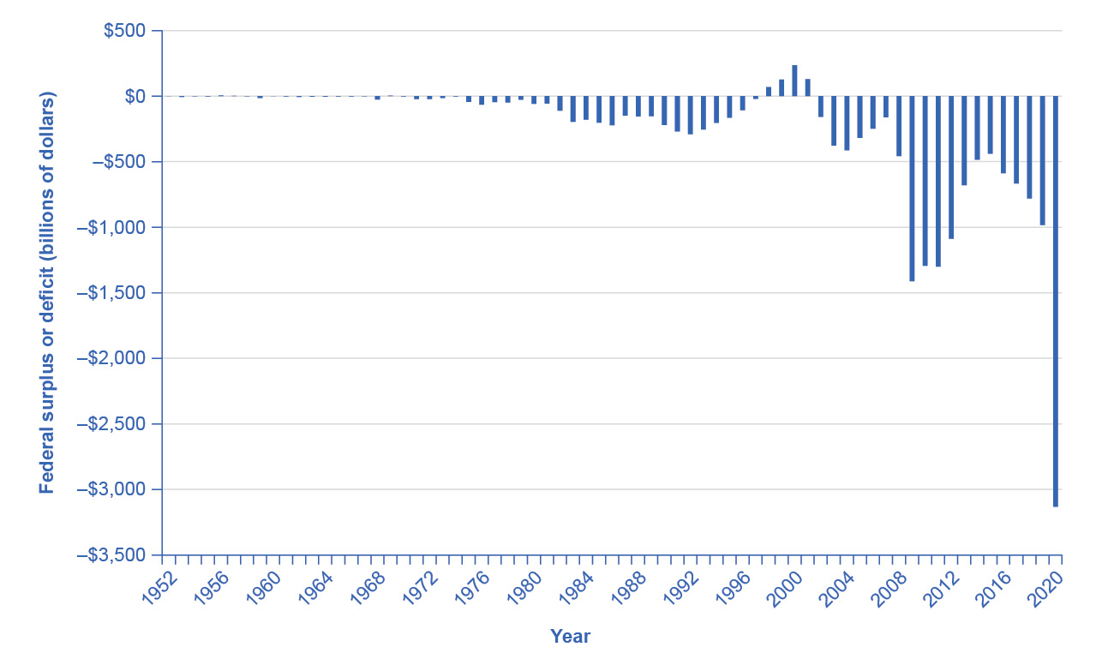
United States On-Budget, Surplus, and Deficit, 1952–2020 ($ billions)
The United States has run a budget deficit for over 30 years, with the exception of 1999 and 2000.
Military expenditures, entitlement programs, and the decrease in tax revenue coupled with increased safety net support during the Great Recession are major contributors to the dramatic increases in the deficit after 2008. (Source: Office of Management and Budget, https://fred.stlouisfed.org/series/FYFSGDA188S)

Slide 7
18.2 Fiscal Policy and the Trade Balance
Government budget balances can affect the trade balance.
Remember that a net inflow of foreign financial investment always accompanies a trade deficit, while a net outflow of financial investment always accompanies a trade surplus.
There is no expectation that the budget deficit and trade deficit will move in lockstep, because of the other parts of the national saving and investment identity (investment and private savings will often change as well).
Twin deficits - deficits that occur when a country is running both a trade and a budget deficit.

Slide 8
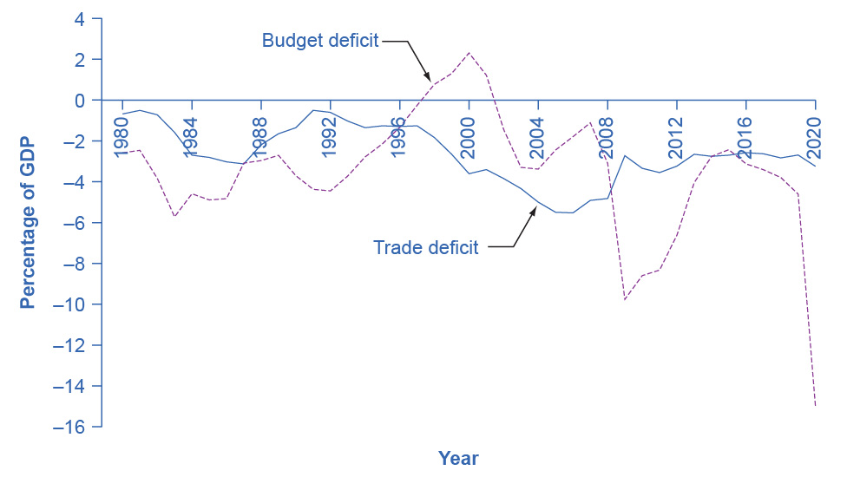
U.S. Budget Deficits and Trade Deficits
In the 1980s, the budget deficit and the trade deficit declined at the same time.
However, since then, the deficits have stopped being twins.
The trade deficit grew smaller in the early 1990s as the budget deficit increased, and then the trade deficit grew larger in the late 1990s as the budget deficit turned into a surplus.
In the first half of the 2000s, both budget and trade deficits increased.
In 2009, the trade deficit declined as the budget deficit increased.
Through the 2010s, the trade deficit remained relatively stable as the budget deficit declined.
While the budget deficit increased in 2020, there has been hardly any change in the trade deficit.

Slide 9
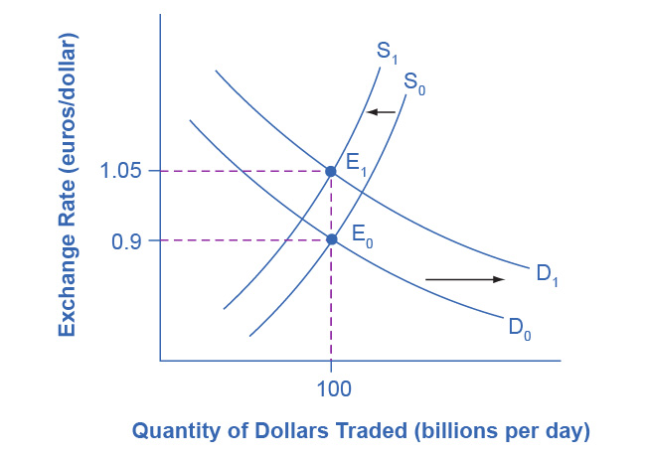
Budget Deficits and Exchange Rates
Imagine that the U.S. government increases its borrowing and the funds come from European financial investors.
To purchase U.S. government bonds, those European investors will need to demand more U.S. dollars on foreign exchange markets, causing the demand for U.S. dollars to shift to the right from D₀ to D₁.

Slide 10
Budget Deficits and Exchange Rates, Continued
European financial investors as a group will also be less likely to supply U.S. dollars to the foreign exchange markets, causing the supply of U.S. dollars to shift from S₀ to S₁.
The equilibrium exchange rate strengthens from 0.9 euro/dollar at E₀ to 1.05 euros/dollar at E₁.

Slide 11
Budget Deficits, Exchange Rates, and Trade Deficits
Exchange rates can also help to explain why budget deficits are linked to trade deficits.
A budget deficit can result in an inflow of foreign financial capital, a stronger exchange rate, and a trade deficit.
The U.S. budget deficit rises and foreign financial investment provides the source of funds for that budget deficit.
This causes a stronger exchange rate.
Makes it more difficult for exporters to sell their goods abroad while making imports cheaper, so a trade deficit (or a reduced trade surplus) results.

Slide 12
From Budget Deficits to International Economic Crisis
A series of large budget deficits can become a cause for concern among international investors.
This could lead to an outflow of international financial capital, which can cause a deep recession by:
depreciating the exchange rate,
thus reducing banks’ ability to repay international loans
and reducing aggregate demand.

Slide 13
18.3 How Government Borrowing Affects Private Saving
A change in government budgets may impact private saving.
Ricardian equivalence - the theory that rational private households might shift their saving to offset government saving or borrowing.
If true, then any change in budget deficits or budget surpluses would be completely offset by a corresponding change in private saving.
Changes in government borrowing would have no effect at all on either physical capital investment or trade balances.
In reality, the private sector only sometimes and partially adjusts its savings behavior to offset government budget deficits and surpluses.

Slide 14
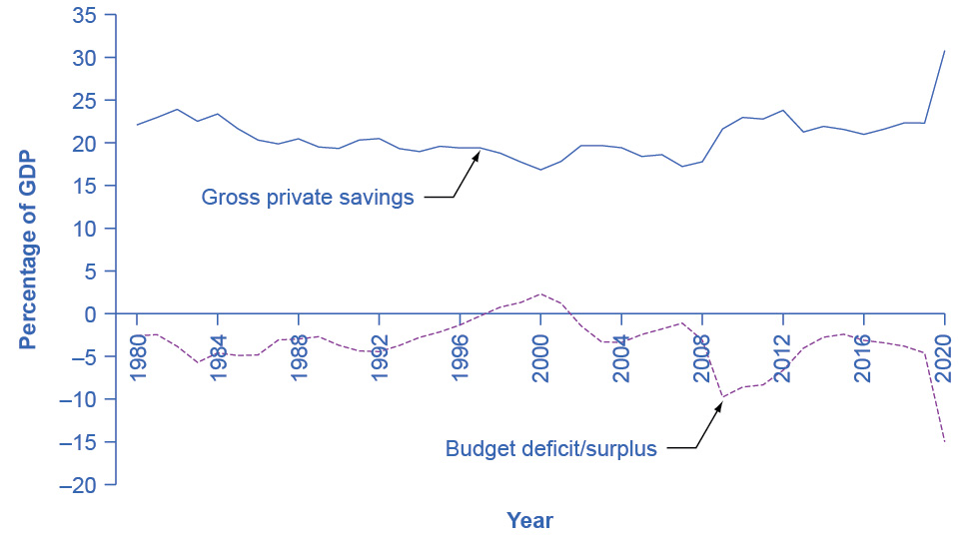
U.S. Budget Deficits and Private Savings
The theory of Ricardian equivalence suggests that additional private saving will offset any increase in government borrowing, while reduced private saving will offset any decrease in government borrowing.
Sometimes this theory holds true, and sometimes it does not.
(Source: Bureau of Economic Analysis and Federal Reserve Economic Data)

Slide 15
18.4 Fiscal Policy, Investment, and Economic Growth
The underpinnings of economic growth are investments in physical capital, human capital, and technology.
Set in an economic environment where firms and individuals can react to the incentives provided by well-functioning markets and flexible prices.
Government borrowing can reduce the financial capital available for private firms to invest in physical capital.
However, government spending can also encourage certain elements of long-term growth.
Examples: spending on roads or water systems, on education, or on research and development that creates new technology.

Slide 16
Crowding Out Physical Capital Investment
A larger budget deficit will increase demand for financial capital.
If private saving and the trade balance remain the same, then less financial capital will be available for private investment in physical capital.
When government borrowing soaks up available financial capital and leaves less for private investment in physical capital, economists call the result crowding out.

Slide 17
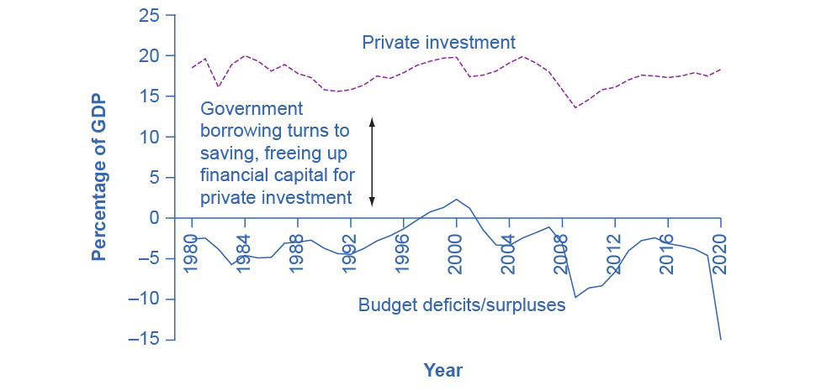
U.S. Budget Deficits/Surpluses and Private Investment
The connection between private savings and flows of international capital plays a role in budget deficits and surpluses.
Consequently, government borrowing and private investment sometimes rise and fall together.
For example, the 1990s show a pattern in which reduced government borrowing helped to reduce crowding out so that more funds were available for private investment.

Slide 18
The Interest Rate Connection
A survey of economic studies on the connection between government borrowing and interest rates in the U.S. economy suggests that an increase of 1% in the budget deficit will lead to a rise in interest rates of between 0.5 and 1.0%.
A higher interest rate tends to discourage firms from making physical capital investments.

Slide 19
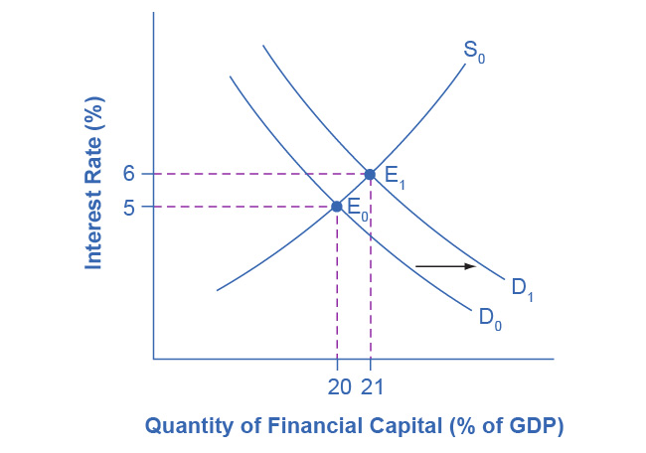
Budget Deficits and Interest Rates
In the financial market, an increase in government borrowing can shift the demand curve for financial capital to the right from D₀ to D₁.
As the equilibrium interest rate shifts from E₀ to E₁, the interest rate rises.
The higher interest rate is one economic mechanism by which government borrowing can crowd out private investment.

Slide 20
Public Investment in Physical Capital
Public investment in physical capital can increase the economy's output and productivity.
Types of public physical capital:
Transportation
Community and regional development
Natural resources and the environment
Education, training, employment, and social services
It is hard to quantify how much government investment in physical capital will benefit the economy, because government responds to political and economic incentives.

Slide 21
Public Investment in Physical Capital, Continued
If government decides to finance an investment in public physical capital with higher taxes or lower government spending in other areas, it may not be directly crowding out private investment.
Indirectly however, higher household taxes could cut down on the level of private savings available.
If a government decides to finance an investment in public physical capital by borrowing, it may be at the cost of crowding out investment in private physical capital.

Slide 22
Public Investment in Human Capital
In most countries, the government plays a large role in society's investment in human capital through the education system.
A highly educated and skilled workforce contributes to a higher rate of economic growth.
However in the U.S. in recent decades, increased financial resources at the K–12 level have not brought greater measurable gains in student performance.
Some education experts question whether the problems may be due to structure, not just to the resources spent.

Slide 23
Public Investment in Human Capital, Continued
Other government programs seek to increase human capital either before or after the K–12 education system.
Head Start program - a program for early childhood education directed at families with limited educational and financial resources.
Government also offers support for universities and colleges.
For the U.S. economy, and for other high-income countries, the primary focus at this time is more on how to get a bigger return from existing spending on education and how to improve the performance of the average high school graduate, rather than dramatic increases in education spending.

Slide 24
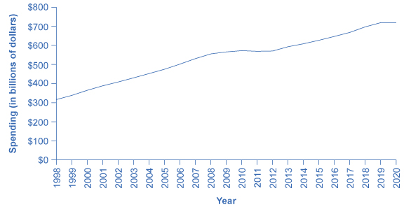
Total Spending for Elementary, Secondary, and Vocational Education (1998–2020) in the United States
The graph shows that government spending on education was continually increasing up until 2006 where it leveled off until 2008 where it increased dramatically.
Since 2010, spending has steadily decreased. (Source: Office of Management and Budget)

Slide 25
How Fiscal Policy Can Improve Technology
Research and development (R&D) efforts are the lifeblood of new technology.
About one-fifth of U.S. R&D spending goes to defense and space-oriented research.
Defense-oriented R&D spending sometimes produces consumer-oriented spinoffs, but is less likely to benefit the civilian economy than direct civilian R&D spending.
Fiscal policy can encourage R&D using either direct spending or tax policy.
Spend more on the R&D in government laboratories.
Expanding federal R&D grants to universities and colleges, nonprofit organizations, and the private sector.
Tax incentives which allow firms to reduce their tax bill as they increase spending on R&D.

