Slide 1

FINANCE & FINANCIAL TECHNOLOGY (FINTECH)
Cryptocurrency Market Structure
Microstructure, Derivatives, Stablecoins, and Limits of Algorithmic Forensics
A comprehensive analysis of digital asset market architecture: consensus mechanisms, peer-to-peer protocols, mining economics, wallet cryptography, order book liquidity, derivatives dominance, the migration of illicit flows to stablecoins, and empirical findings from Jalal & Westland on the base-rate fallacy in anti-money laundering automated governance.
J. Christopher Westland
Fulbright-García Robles U.S. Scholar (Science and Technology)
hosted by Universidad Anáhuac Mayab | Mérida, México
Professor, Information & Decision Sciences | University of Illinois Chicago
Editor-in-Chief: Electronic Commerce Research (Springer)
Faculty Profile: business.uic.edu/profiles/westland-james-christopher
EMPIRICAL RESEARCH
Based on empirical research by:
Fabiha Jalal & J. Christopher Westland
"The Limits of Blockchain Forensics: Deconstructing the Mythologies of Automated Governance"
© J. Christopher Westland. All rights reserved.

Slide 2
COURSE OVERVIEW
Lecture Structure and Thematic Roadmap
1. Protocol & Mining Architecture
• The Blockchain: Distributed Ledger Technology (DLT) & immutability.
• Block Addition: Mempool, Merkle trees, mining, and validation.
• P2P Network & Consensus: Gossip protocol, longest-chain rule, BIPs & forks.
• Mining Economics: Geography, hashrate, halving & altcoin mortality (~7,000+).
• Price-Volume Series: OHLCV candlestick reading and investor decisions.
• Wallets & Fiat Rails: Cryptographic custody, On/Off-ramps, and banks.
2. Microstructure & Markets
• The Order Book: Bids, asks, market depth (DOM), and CEX/DEX matching.
• Bid-Ask Spread: Quantitative liquidity measurement and Amihud ratio.
• Derivatives Hegemony: 2/3 of volume in perpetual swaps, futures, and options.
• Stablecoin Ecosystem: USDT, USDC, reserves, corporate governance & supply.
• The Trading Hub: Why active pairs trade against stablecoins, not fiat.
• CEX vs DEX Execution: Off-chain order books vs. on-chain AMMs (x·y=k).
3. Forensics & Empirical Paper
• Illicit Flow Migration: From volatile Bitcoin to high-liquidity stablecoins.
• RQ1 (Trees vs GNNs): Simple tabular trees match or beat complex graph models.
• RQ2 (The Price Null): Illicit flows fail to predict prices or market volatility.
• RQ3 (Base-Rate Fallacy): 40k-116k false alarms per catch: triage vs alarms.
• RQ4 (DEX Wash Trading): Behavioral screening pipeline & the Wash-Discount metric.
• Label Staleness Crisis: 2-year half-life of illicit public address labels.
© J. Christopher Westland. All rights reserved. | hosted by Universidad Anáhuac Mayab | Cryptocurrency Market Structure | Slide 02/24

Slide 3
DIGITAL ASSET FOUNDATIONS
What is Blockchain? Distributed Ledger Architecture
Definition & Core Operating Principles
• Distributed Ledger Technology (DLT): A decentralized database synchronized and replicated across a peer-to-peer (P2P) network without a central clearing authority.
• Cryptographic Immutability: Each block embeds the hash of the preceding block. Retroactively altering past records requires recalculating all downstream proof-of-work/stake across the entire network.
• Decentralized & 'Trustless': No reliance on financial intermediaries or central custodians. Ledger state validity is established purely through algorithmic consensus.
• Pseudonymous Transparency: All transaction records, account balances, and historical transfers are permanently visible on public block explorers, tied to cryptographic addresses.
Essential Technological Pillars
1. Asymmetric Cryptography: Paired public keys (identity/account) and private keys (digital authorization and transaction signing via ECDSA).
2. One-Way Hash Functions: Deterministic hashing algorithms (SHA-256 in Bitcoin, Keccak-256 in Ethereum) compressing data into fixed, collision-resistant digests.
3. Consensus Mechanisms: Distributed state agreement protocols (Proof of Work in Bitcoin, Proof of Stake in Ethereum) preventing double-spending without central authority.
4. P2P Node Protocol: A global mesh of full nodes independently verifying every transaction and enforcing protocol rules autonomously.
© J. Christopher Westland. All rights reserved. | hosted by Universidad Anáhuac Mayab | Cryptocurrency Market Structure | Slide 03/24

Slide 4
PROTOCOL MECHANICS
How is a Block Added to the Blockchain? Step-by-Step Lifecycle
1. Transaction Signing
User constructs transaction and cryptographically signs it with their private key, broadcasting it to peer nodes.
2. Mempool Aggregation
Unconfirmed transactions enter the memory pool (mempool), prioritized by miners based on transaction fee density.
3. Block Packaging & Merkle Tree
Miners/validators batch transactions and compute the cryptographic Merkle Root stored in the block header.
4. Consensus Execution
PoW solves cryptographic difficulty puzzles (Nonce); PoS selects validators proportional to economic stake.
5. Cryptographic Block Chaining
The block header embeds the previous block's hash (H_{t-1}), mathematically linking it to the historical chain.
6. Global Propagation & Finality
The new block is broadcast across P2P nodes. Each node validates all signatures and appends it to its local ledger.
© J. Christopher Westland. All rights reserved. | hosted by Universidad Anáhuac Mayab | Cryptocurrency Market Structure | Slide 04/24

Slide 5
NETWORK TOPOLOGY & CONSENSUS
The P2P Network, Node Gossip & How Miners Update the Ledger
P2P Network Dynamics & Agreement Rules
• Mesh Gossip Protocol: Nodes discover peer IP addresses and broadcast transactions and blocks epidemically. Every node forwards valid data to ~8-12 peers, ensuring global propagation in seconds without central routers.
• Nakamoto Consensus & Longest Chain Rule: Miners make agreements mathematically: nodes always accept and build upon the chain with the **greatest cumulative Proof-of-Work difficulty** ('heaviest chain').
• Ephemeral Fork Resolution: If two miners find blocks simultaneously at the same height, nodes track both branches. The tie is broken autonomously as soon as the next block is found on one branch, orphaning the shorter side.
• Full Nodes vs. Miners (Sovereignty): Miners propose blocks, but **non-mining full nodes enforce the rules**. If a mining pool with 60% hashrate creates an invalid block (e.g., spending unowned coins), every full node instantly rejects it.
How the Network Agrees on Upgrades
1. Improvement Proposals (BIPs & EIPs): Formalized open-source architectural specifications (e.g., BIP-141 SegWit, BIP-340 Taproot, EIP-1559 burn) debated through peer review and developer rough consensus.
2. Miner Signaling Windows (BIP-9): Miners vote on upgrade readiness by setting designated version bits in mined block headers. Reaching a threshold (e.g., 90% over 2,016 blocks) locks in activation.
3. Soft Forks (Backward-Compatible): Tighten protocol rules. Old nodes still see blocks as valid (e.g., SegWit). Does not split the network.
4. Hard Forks (Backward-Incompatible): Loosen rules; requires 100% of nodes to upgrade. If consensus fails, the chain permanently splits into two rival networks (e.g., Bitcoin vs Bitcoin Cash in 2017; Ethereum vs Ethereum Classic in 2016).
© J. Christopher Westland. All rights reserved. | hosted by Universidad Anáhuac Mayab | Cryptocurrency Market Structure | Slide 05/24

Slide 6
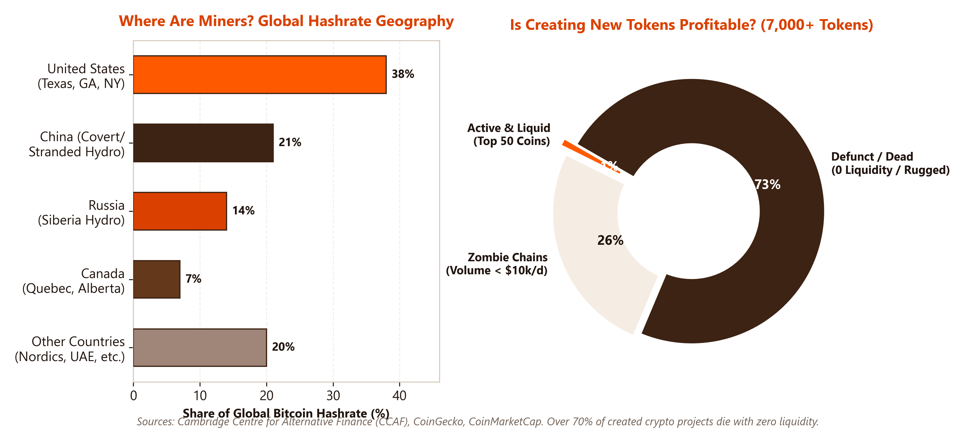
INDUSTRIAL REALITY & ALTCOIN VIABILITY
Who & Where Miners Are: Viability & The Profitability of Altcoins
The Industrial & Economic Reality
• Who Miners Are: Transitioned from home hobbyists to multi-billion-dollar NASDAQ-listed conglomerates (Marathon, Riot, CleanSpark) and giant pools (Foundry USA, AntPool) aggregating thousands of ASICs.
• Where Miners Are: Concentrated in energy-advantaged regions: **United States (~38%**, driven by Texas ERCOT grid & flared gas), China (~21% covert hydro), Russia (~14% cheap Siberian hydro), and Canada.
• Is Mining Still Viable?: Brutal margin compression. The April 2024 Halving cut block subsidy from 6.25 to 3.125 BTC. With network hashrate >700 EH/s, survival requires **electricity < $0.045/kWh** and latest-gen ASICs (<17.5 J/TH). Less efficient operators face bankruptcy.
• Is Creating Altcoins Profitable? (~7,000+): Over 7,000 to tens of thousands of tokens created. **>70-80% die with zero volume or liquidity** ('dead coins', rug pulls). Only top 50 hold lasting value.
• Who Profits from New Coins?: Early insiders, founders with pre-mines, and launchpad creators who sell into initial retail hype. For 99% of creators and buyers, token creation yields zero net profit due to insurmountable network effects (Metcalfe's Law).
© J. Christopher Westland. All rights reserved. | hosted by Universidad Anáhuac Mayab | Cryptocurrency Market Structure | Slide 06/24

Slide 7
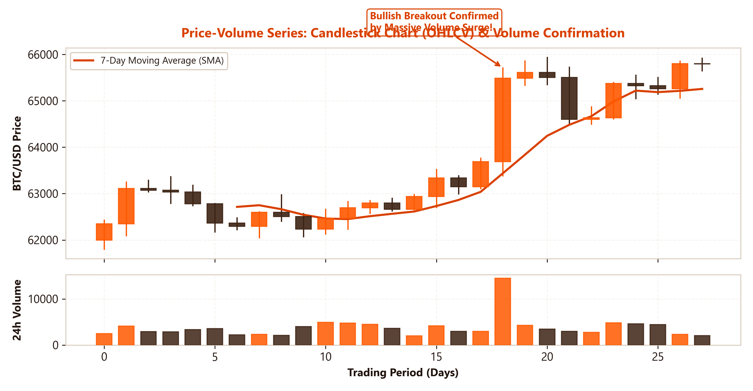
TECHNICAL ANALYSIS & DECISION MAKING
Price-Volume Series: The Core of Investor Decision Making
Interpreting Market Behavior
• Candlestick Charts (OHLCV): Synthesizes intraday price action through Open, High, Low, and Close, reflecting the continuous tug-of-war between buyers and sellers.
• Volume Validation: 'Price is what you pay; volume is the institutional conviction behind the move.' Price advances backed by rising volume confirm genuine accumulation.
• Divergence Analysis: New price highs accompanied by diminishing volume signal buyer exhaustion and warn of impending trend reversals.
• Breakout Confirmation: Breaking key technical resistance without volume is typically a 'fakeout'; high-volume surges confirm structural trend shifts.
• Essential Limitations: Exchange-reported volume can be contaminated by internal wash trading and omits large institutional Over-The-Counter (OTC) settlements.
© J. Christopher Westland. All rights reserved. | hosted by Universidad Anáhuac Mayab | Cryptocurrency Market Structure | Slide 07/24

Slide 8
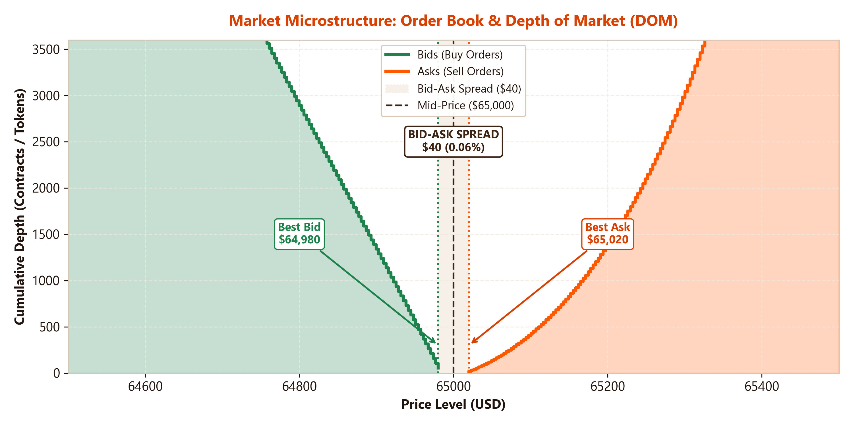
MARKET MICROSTRUCTURE
The Order Book & Depth of Market (DOM)
Central Limit Order Book (CLOB) Mechanics
• Buy Side (Bids): Limit buy orders ranked in descending price order. The highest price willing to buy is the 'Best Bid'.
• Sell Side (Asks / Offers): Limit sell orders ranked in ascending price order. The lowest price willing to sell is the 'Best Ask'.
• Depth of Market (DOM): Cumulative liquidity available across price ticks. Deeper books absorb substantial order flow without sharp price displacement.
• Makers vs. Takers: Market Makers provide passive liquidity via limit orders (earning fee rebates); Takers consume resting liquidity via aggressive market orders.
• Execution Slippage: Occurs when a market order exceeds resting liquidity at the top of the book, forcing fills across successively worse price levels.
© J. Christopher Westland. All rights reserved. | hosted by Universidad Anáhuac Mayab | Cryptocurrency Market Structure | Slide 08/24

Slide 9
MARKET MICROSTRUCTURE
The Bid-Ask Spread & Quantitative Liquidity Measurement
Anatomy of the Bid-Ask Spread
• Absolute Spread: Difference between the lowest ask and highest bid:
Spread = P_{ask} - P_{bid}
• Relative Percentage Spread: Normalized by the mid-price:
Spread % = [(P_{ask} - P_{bid}) / P_{mid}] × 100
• Instantaneous Friction Cost: The immediate toll paid by any market participant executing an aggressive market order ('crossing the spread').
• Market Maker Compensation: Compensates liquidity providers for three core risks: inventory holding risk, adverse selection from informed traders, and processing costs.
Quantitative Liquidity Estimators
• Amihud (2002) Illiquidity Ratio: Quantifies price impact per monetary volume unit transacted:
ILLIQ_t = |r_t| / Volume_t
(Higher ratios indicate fragile, illiquid trading environments).
• Corwin-Schultz (2012) Spread Estimator: Estimates effective bid-ask spreads from daily high-low price ratios (evaluated in the Jalal & Westland study).
• Order Flow Imbalance (OFI): Net imbalance between bid and ask side order flow; exhibits strong short-horizon predictive power for high-frequency price changes.
© J. Christopher Westland. All rights reserved. | hosted by Universidad Anáhuac Mayab | Cryptocurrency Market Structure | Slide 09/24

Slide 10
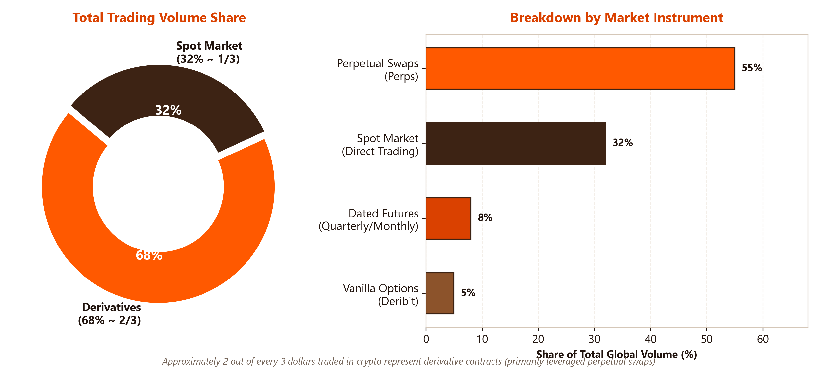
GLOBAL TRADING STRUCTURE
The Hegemony of Derivatives: ~2/3 of Global Crypto Trading Volume
Why Do Derivatives Dominate?
1. Capital Efficiency & Leverage: Traders are not required to post 100% notional capital; leveraged positions (5x, 20x, 50x) can be opened with fractional initial margins.
2. Frictionless Short Selling: Enables portfolio hedging and downside speculation synthetically without the need to locate and borrow the underlying physical crypto asset.
3. Absence of On-Chain Friction: Derivatives trading on CEXs eliminates blockchain network gas fees and confirmation latency for each transaction.
4. Central Venue for Price Discovery: Empirical literature shows price discovery originates in perpetual futures markets before transmitting to spot exchanges.
© J. Christopher Westland. All rights reserved. | hosted by Universidad Anáhuac Mayab | Cryptocurrency Market Structure | Slide 10/24

Slide 11
ADVANCED FINANCIAL INSTRUMENTS
Anatomy of Crypto Derivatives: Perpetuals, Options, and Cascades
Perpetual Swaps (Perps)
• No Expiration Date: Invented by BitMEX; contracts can be rolled and held indefinitely.
• 8-Hour Funding Rate: Periodic cash flows anchoring the perpetual price to the underlying spot. If Perp > Spot, longs pay shorts; if Perp < Spot, shorts pay longs.
• Margining Models: USDT-margined (linear contracts) vs. Coin-margined (inverse contracts).
Dated Futures & Options
• Dated Futures: Monthly/quarterly delivery contracts (CME, Binance). Feature term structure basis (Contango or Backwardation).
• European Vanilla Options: Deribit dominance in BTC/ETH options; used to trade implied volatility (IV).
• DVOL Volatility Index: Calculates expected 30-day forward-looking annualized volatility.
Cascading Liquidations
• Maintenance Margin: If equity breaches maintenance requirements, liquidation engines force-close positions at market.
• Auto-Deleveraging (ADL): Massive forced sell orders deplete resting bids, driving prices down and triggering cascading secondary liquidations.
• Exchange Insurance Funds: Capital buffers collateralized by liquidation penalties to prevent socialized bankruptcy losses.
© J. Christopher Westland. All rights reserved. | hosted by Universidad Anáhuac Mayab | Cryptocurrency Market Structure | Slide 11/24

Slide 12
THE BACKBONE OF GLOBAL LIQUIDITY
Stablecoins: Typology, Peg Mechanisms, and Systemic Importance
1. Fiat-Backed (Off-Chain Reserves)
• 1:1 Reserve Model: For every digital dollar minted, the issuer holds $1 USD in bank deposits or short-duration US Treasury Bills.
• Prominent Examples: Tether (USDT), USD Coin (Circle USDC), FDUSD, PayPal USD (PYUSD).
• Core Vulnerabilities: Counterparty banking risk, regulatory seizure, and reserve opacity.
2. Over-Collateralized (On-Chain)
• Excess Collateralization: Minted by locking volatile crypto assets (ETH, WBTC) into smart contracts at 130%-150% collateral ratios.
• Prominent Examples: USDS / DAI (Sky / MakerDAO), LUSD (Liquity).
• Stability Mechanism: Decentralized governance via MKR/SKY tokens and autonomous on-chain liquidations.
3. Synthetic & Algorithmic
• Delta-Neutral (Ethena USDe): Backs the dollar peg by pairing spot stETH collateral with short perpetual futures, capturing basis yields.
• The Terra/UST Collapse: Historical lesson: unbacked algorithmic expansion designs collapse into systemic 'death spirals'.
• Systemic Role: Stablecoins function as the 'Internet Dollar', acting as the universal unit of account and trading settlement asset.
© J. Christopher Westland. All rights reserved. | hosted by Universidad Anáhuac Mayab | Cryptocurrency Market Structure | Slide 12/24

Slide 13
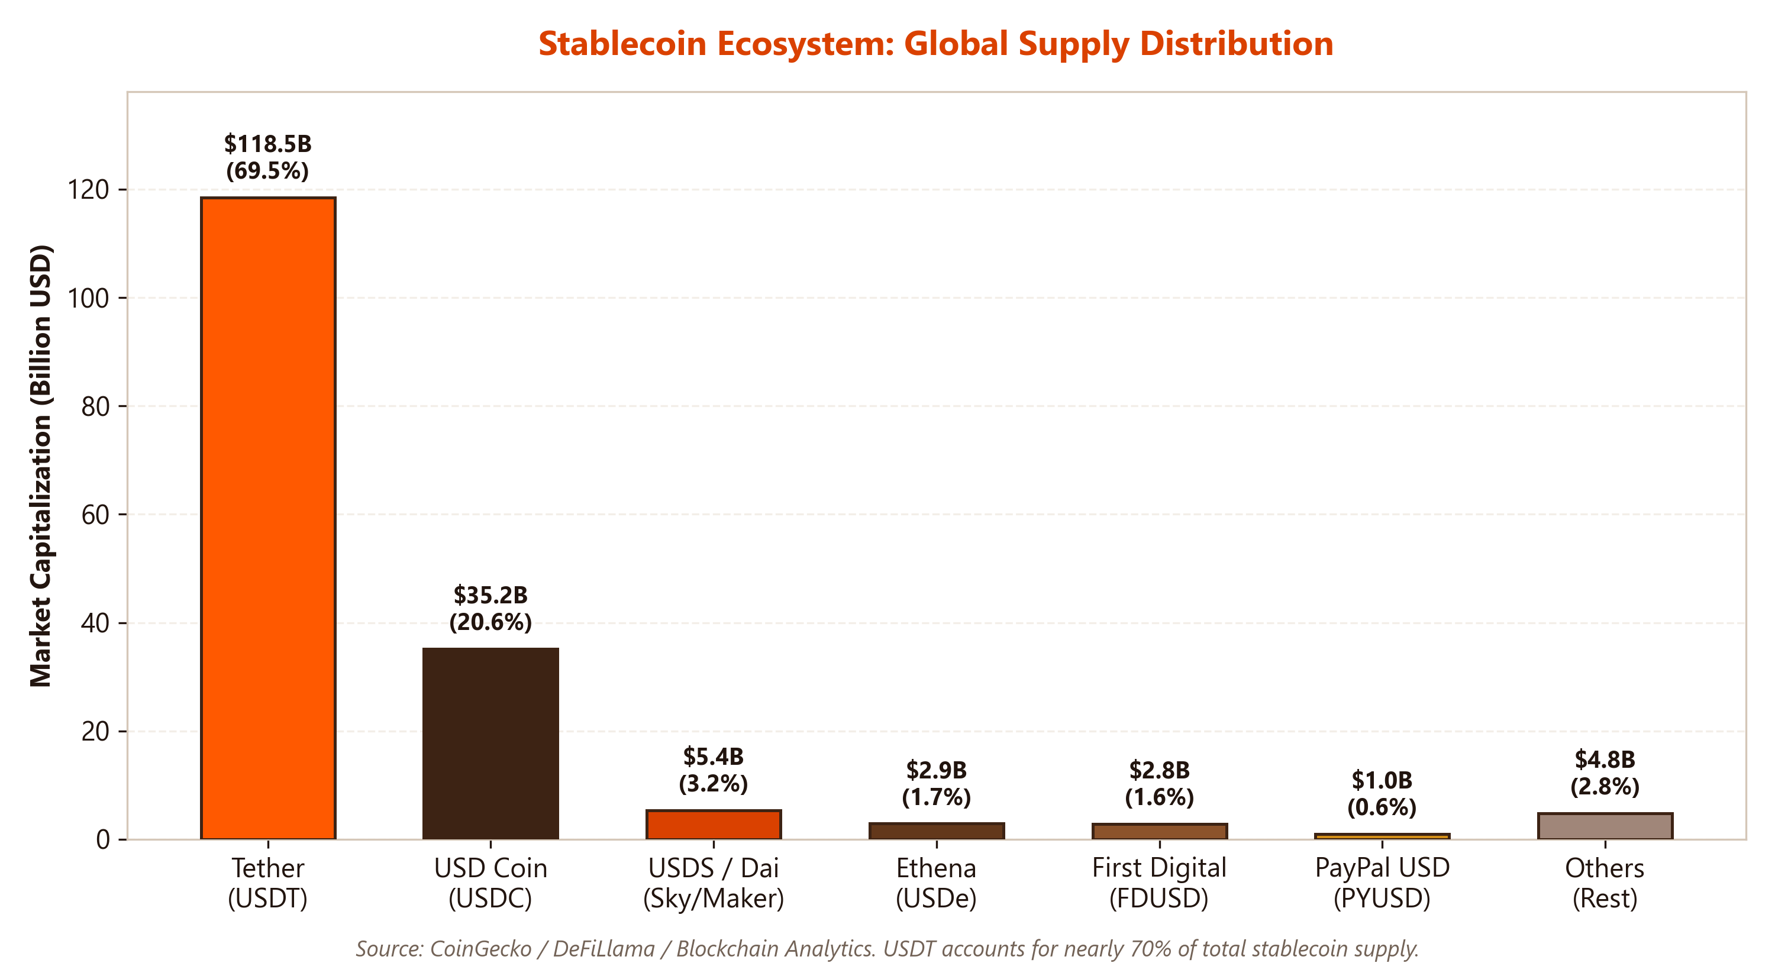
MARKET DISTRIBUTION & CORPORATE GOVERNANCE
Histogram of Top Stablecoins & Who Owns and Runs Them
Who Owns and Manages the Stablecoins?
• Tether (USDT - ~$118.5B): Operated by Tether Holdings Ltd. (subsidiary of iFinex Inc., parent of Bitfinex). Led by Paolo Ardoino (CEO) & Giancarlo Devasini (CFO). Backed by >$80B in US T-Bills and corporate reserves.
• USD Coin (USDC - ~$35.2B): Issued by Circle Internet Financial (CEO: Jeremy Allaire). US regulated financial institution and EU MiCA-compliant entity; reserves held at BNY Mellon and audited monthly by Deloitte.
• USDS / DAI (~$5.4B): Sky Protocol (formerly MakerDAO, founded by Rune Christensen). Governed via decentralized on-chain voting by MKR/SKY token holders.
• First Digital USD (FDUSD - ~$2.8B): Issued by FD121 Limited (Hong Kong Trust, filial of First Digital Labs). Adopted heavily by Binance post-BUSD phaseout.
© J. Christopher Westland. All rights reserved. | hosted by Universidad Anáhuac Mayab | Cryptocurrency Market Structure | Slide 13/24

Slide 14
IDENTITY & CRYPTOGRAPHY
What are Crypto Wallets? Keys, Custody Models, and Addresses
The Cryptographic Triad of a Wallet
• Wallets Store Keys, Not Coins: Tokens reside immutably on the public blockchain; the wallet merely stores the cryptographic keys required to sign and authorize transfers.
• 1. Private Key: A 256-bit random integer kept strictly secret. It serves as the sovereign digital signature authorizing the spending of funds.
• 2. Public Key: Mathematically derived from the private key via Elliptic Curve Cryptography (secp256k1). Computationally irreversible.
• 3. Public Address: One-way cryptographic hash of the public key (SHA-256 + RIPEMD-160 in BTC, Keccak-256 in ETH: '0x...'). Functions as the public bank account number.
• BIP-39 Mnemonic Seed Phrase: A standardized 12 or 24-word sequence that deterministically regenerates all hierarchical keys (HD Wallets).
Custody Models & Security Profiles
• Hot Wallets (Online): Software wallets connected to the internet (MetaMask, Phantom, Trust Wallet). Fast and convenient for daily trading, but vulnerable to malicious drainers and phishing.
• Cold Wallets (Air-Gapped): Isolated physical hardware devices (Ledger, Trezor). Private keys never touch an internet-connected operating system; transactions are signed internally.
• Custodial vs. Non-Custodial: 'Not your keys, not your coins.' On centralized exchanges (Binance, Coinbase), users forfeit technical custody to omnibus exchange balance sheets.
© J. Christopher Westland. All rights reserved. | hosted by Universidad Anáhuac Mayab | Cryptocurrency Market Structure | Slide 14/24

Slide 15
EXECUTION MECHANICS
How Trades and Transfers Happen Between Wallets
Direct On-Chain Wallet Transfers
1. Payload Construction: Sending wallet specifies the destination address, transfer amount, nonce, and the maximum gas fee offered.
2. Digital Signature Generation: The transaction hash is signed using ECDSA and the sender's private key, proving mathematical ownership without revealing the key.
3. P2P Mempool Broadcasting: The signed payload is propagated to peer nodes, verified for sufficient funds and correct nonce, and queued in the mempool.
4. Block Inclusion & Finality: A validator batches the transfer into an approved block; upon inclusion, account balances update irreversibly on the global ledger.
Trading Execution: CEX vs. DEX
• CEX Off-Chain Execution: On Binance or Coinbase, trades DO NOT touch the blockchain. Orders match in centralized in-memory databases in microseconds with zero gas. Only deposits and withdrawals hit the ledger.
• DEX On-Chain Swaps (AMM): On Uniswap or Raydium, trades execute against on-chain Liquidity Pools governed by constant product formulas (x · y = k). Every trade is a smart contract transaction.
• MEV (Maximal Extractable Value): On DEXs, front-running bots monitor unconfirmed mempool transactions to execute lucrative 'sandwich attacks' via transaction reordering.
© J. Christopher Westland. All rights reserved. | hosted by Universidad Anáhuac Mayab | Cryptocurrency Market Structure | Slide 15/24

Slide 16
TRADFI-CRYPTO BRIDGE
Fiat On/Off-Ramps & The Central Stablecoin Trading Hub
THE STRUCTURAL FLOW OF CAPITAL: THE STABLECOIN SETTLEMENT HUB
[FIAT BANK (USD / EUR)] ─── On-Ramp (ACH/SEPA/Wire with KYC) ───► [REGULATED EXCHANGE (CEX)]
▼
[IMMEDIATE CONVERSION TO STABLECOINS (USDT / USDC)] ◄─── THE LIQUID CORE OF THE MARKET
▼
[ACTIVE TRADING ECOSYSTEM (BTC, ETH, Altcoins, Perpetual Futures, Options, DeFi Yield)]
▼
[CONVERSION BACK TO STABLECOINS] ─── Off-Ramp ───► [FIAT BANK ACCOUNT REDEMPTION]
Fiat On-Ramp and Off-Ramp Gateways
• The Regulated Chokepoint: Fiat conversion gateways represent the primary point of strict banking supervision, mandatory KYC, and Suspicious Activity Reporting (SAR).
• Traditional Banking Friction: Commercial banks operate on rigid clearing house schedules and frequently restrict direct wires to cryptocurrency entities.
Why Do Traders Use Stablecoins, Not Fiat?
• Universal Quote Asset: >85% of active trading pairs on global CEXs quote against USDT or USDC (e.g., BTC/USDT), not fiat USD or EUR.
• 24/7/365 Continuous Liquidity: Allows institutional desks to rebalance capital and execute cross-exchange arbitrage on weekends without banking delays.
• Global Dollarized Liquidity: Enables international traders to access synthetic US Dollar purchasing power while circumventing restrictive local capital controls.
© J. Christopher Westland. All rights reserved. | hosted by Universidad Anáhuac Mayab | Cryptocurrency Market Structure | Slide 16/24

Slide 17
FINANCIAL CRIME DYNAMICS
The Migration of Money Laundering: From Cryptocurrencies to Stablecoins
The Structural Shift in Illicit Flows
• Bitcoin's Displaced Dominance: Prior to 2020, Bitcoin was the primary vehicle for illicit crypto transactions. By 2023–2026, over 60–70% of total illicit volume migrated to **Stablecoins (predominantly USDT on TRON - TRC20)**.
• Organized Syndicate Adoption: UNODC and blockchain forensic reports demonstrate that large-scale transnational laundering (narcotics, cyber-fraud, sanctions evasion) operates primarily in stablecoins.
• Specialized Shadow Infrastructure: Proliferation of unregulated Over-The-Counter (OTC) broker desks and digital guarantor markets settling billions in illicit proceeds strictly via USDT.
4 Core Economic Drivers for Laundering
1. Elimination of Volatility Risk: Laundering requires multi-hop layering. With BTC or ETH, a 15% intraday market crash erodes criminal proceeds. Stablecoins guarantee $1M remains $1M throughout the wash cycle.
2. Hyper-Liquidity Camouflage: USDT trades over $50B daily. Large illicit flows easily blend into massive commercial volume without distorting spreads or triggering immediate liquidity flags.
3. Sub-Cent Fees & Instant Settlement: Transferring $1,000,000 on networks like TRON costs less than $2 USD and clears within 3 seconds.
4. Parity with Cash Dollars: Seamless conversion into physical cash across informal Hawala networks and black-market money changers without interacting with the US banking grid.
© J. Christopher Westland. All rights reserved. | hosted by Universidad Anáhuac Mayab | Cryptocurrency Market Structure | Slide 17/24

Slide 18
EMPIRICAL RESEARCH FOCUS
Paper: The Limits of Blockchain Forensics (Jalal & Westland)
Deconstructing the Mythologies of Automated Governance in Blockchain
• Global Reality: UNODC estimates global money laundering at $800B to $2 Trillion (2–5% of world GDP). Crypto illicit flows represent ~$24.2B (<1% of crypto volume). Yet regulators and the multi-billion-dollar blockchain intelligence industry mandate automated scrutiny far exceeding traditional finance.
• The 'Complexity Trap': Commercial vendors market high-complexity Graph Neural Networks (GNNs) promising automated 'kill-switches' and market alpha. This empirical paper rigorously benchmarks these claims across three central mythologies.
RQ1: Structural vs. Behavioral
Do complex GNNs provide marginal utility over simple behavioral trees in detecting illicit wallets?
RQ2: Market Alpha Prediction
Do on-chain illicit flows predict next-day price, volatility, or liquidity, or is perceived alpha a data artifact?
RQ3: Standalone Alarms & Rarity
Can detectors operate as automated standalone kill-switches given extreme attacker rarity and base rates?
RQ4: DEX Wash-Trading Screening
Can wash trading on decentralized exchanges be effectively screened using behavioral microstructural metrics?
© J. Christopher Westland. All rights reserved. | hosted by Universidad Anáhuac Mayab | Cryptocurrency Market Structure | Slide 18/24

Slide 19
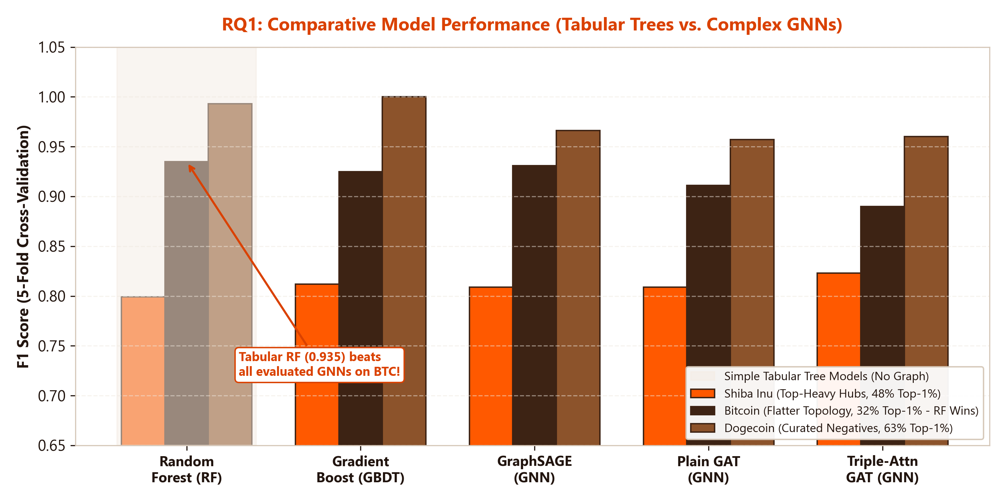
JALAL & WESTLAND — RQ1
Technical Mythology: Graph Neural Networks vs. Tabular Trees
Deconstructing the Technical Mythology
• The Industry Myth: Vendors claim blockchain's relational graph topology necessitates high-complexity GNNs (GCN, GraphSAGE, GATv2) to identify illicit wallets.
• Degree-Matched Protocol: Pairing each illicit wallet with a normal wallet of identical degree prevents false classification victories achieved simply by flagging high-volume nodes.
• On Bitcoin (Flatter Graph, 32% Hubs): Simple Random Forest wins outright at F1 = 0.935, beating GraphSAGE (0.931) and GAT (0.911). Structural features alone achieve 0.893 vs 0.844 behavioral.
• On Shiba & Doge (Top-Heavy Hubs): Exchange hubs (top 1% hold 48–63% of links) mask topological proximity; behavioral features (wallet age, recency, bursts) dominate completely.
• Key Takeaway: GNNs show no consistent operational advantage; institutions pay a heavy 'complexity premium' for zero marginal utility.
© J. Christopher Westland. All rights reserved. | hosted by Universidad Anáhuac Mayab | Cryptocurrency Market Structure | Slide 19/24

Slide 20
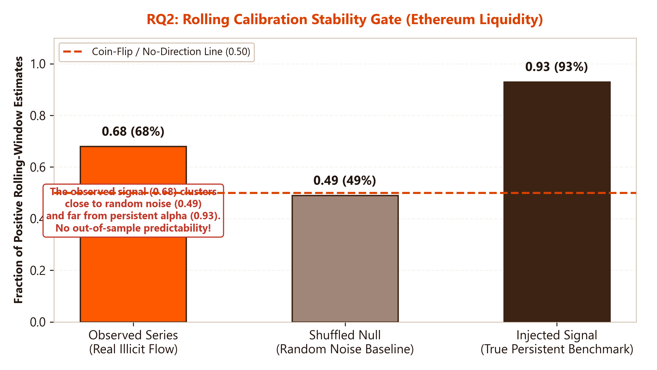
JALAL & WESTLAND — RQ2
Informational Mythology: The Predictive Null ('The Price Null')
The Illusion of 'Alpha' & Forensic Traps
• The Industry Myth: Vendors assert on-chain illicit flows provide leading indicators for asset returns, realized volatility, or liquidity shocks.
• Battery of 30 Statistical Tests: Granger Causality (lags 1–10), HAR-RV-X volatility forecasting, Toda–Yamamoto, and Temporal Fusion Transformers reveal a **robust out-of-sample null**.
• Trap 1: Look-Ahead Leak: Smearing connection lifetime activity backwards produced a fake 7% volatility forecasting gain in Dogecoin (0.934 MSFE). Rebuilt causally in real time, it collapsed to 1.044!
• Trap 2: Price-Feed Quoting Artifacts: Apparent predictive signals appearing on one exchange feed vanished on others, exposed as exchange-specific quoting noise.
• Rolling Calibration Failure: Under rolling windows, the observed liquidity relationship (0.68) clusters near the uninformative null (0.49), far from persistent alpha (0.93).
© J. Christopher Westland. All rights reserved. | hosted by Universidad Anáhuac Mayab | Cryptocurrency Market Structure | Slide 20/24

Slide 21
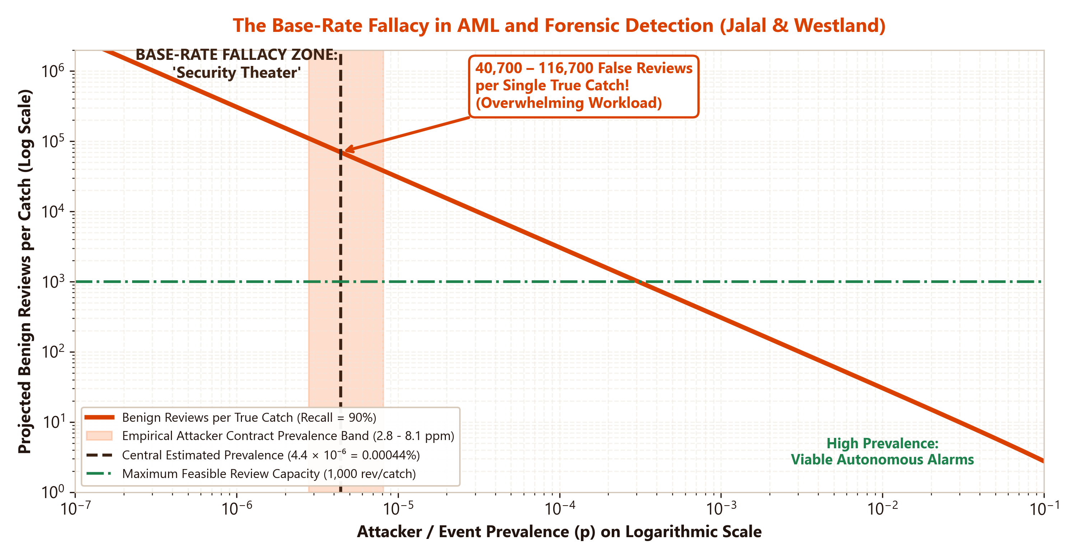
JALAL & WESTLAND — RQ3
Operational Mythology: The Base-Rate Fallacy & Review Overload
Mathematical Reality (Axelsson, 2000)
• Extreme Attacker Rarity (p): Only ~150 confirmed exploit contracts exist across 37.5M smart contract deployments (p ≈ 4.4 × 10⁻⁶ = 4.4 per million).
• Reviews-per-Catch Equation: Reviews / Catch = [(1 - p) / p] · [FPR_{at recall} / recall]
• Overwhelming Operational Burden: To achieve 90% recall with the XGBoost detector (AUC 0.876), **institutions face 40,700 to 116,700 benign reviews per single true catch**.
• 'Kill-Switches' are Infeasible: Automated autonomous blocking would paralyze tens of thousands of legitimate transactions, halting commercial operations.
• Value as a Triage Tool: The detector IS highly valuable for ranking human review: inspecting the top 1% riskiest contracts provides a **13.3x lift** over base rate.
© J. Christopher Westland. All rights reserved. | hosted by Universidad Anáhuac Mayab | Cryptocurrency Market Structure | Slide 21/24

Slide 22
JALAL & WESTLAND — RQ4
DEX Manipulation: Wash Trading Detection & The 'Wash-Discount'
Behavioral Screening Funnel in DEX Pools
• The Decentralized Challenge: In permissionless DEX environments lacking KYC, traders can generate synthetic volume across self-controlled addresses at zero spread cost.
1. Activity Threshold (K ≥ 4): Minimum weekly swap count executed by the trader address.
2. Directional Balance (≥ 0.60): Symmetric buy/sell volume balance: min(buys, sells) / max(buys, sells) ≥ 0.60.
3. Pool Volume Share (≥ 30%): Address swap count accounts for ≥ 30% of total weekly pool transactions.
4. Inventory Neutrality (< 0.10): Net-to-gross flow ratio below 10% in both tokens (recycling inventory without taking economic risk).
The 'Wash-Discount' Metric (WD_i)
• Beneish M-Score Analog: Inspired by forensic accounting metrics designed to detect earnings manipulation.
• Mathematical Formulation: WD_i = 1 - (Volume_{organic} / Volume_{reported}) = Σ_{a ∈ C_i} V_{a,i} / V_{i,reported}
• Practical Utility for Aggregators: Allows platforms like CoinMarketCap and CoinGecko to restate reported pool volumes to true underlying economic liquidity.
• Methodological Caution: Flagged candidate activity requires contextual validation to separate manipulation from legitimate market-making or arbitrage.
© J. Christopher Westland. All rights reserved. | hosted by Universidad Anáhuac Mayab | Cryptocurrency Market Structure | Slide 22/24

Slide 23
JALAL & WESTLAND — IMPLICATIONS
The Label Staleness Crisis & Regulatory Policy Guidance
The Rapid Half-Life of Public Labels
• ~2-Year Activity Half-Life in Ethereum: Across 3,279 examined illicit addresses, active usage decays by 50% in two years. **Only 12.9% of flagged addresses remained active into 2024**.
• Complete Inactivity in Dogecoin (0%): The scam cluster neighborhood in Dogecoin became completely dormant by 2022 (~0% active into 2024).
• OFAC vs. Phishing Longevity: State-sanctioned OFAC entities maintain higher longevity (26.5%) than short-lived phishing wallets (13.9%, z = 3.17).
• The 'Burner Wallet' Reality: Perpetrators abandon intermediate deposit addresses immediately following campaigns. Relying on static blacklists offers false security.
Actionable Recommendations for Stakeholders
1. For Regulators & FATF: Abandon mandates for automated transaction blocking under 'Travel Rule' frameworks. Mandate that evaluations report base rates, expected review workloads, and deploy AI strictly as triage shortlists.
2. For Crypto Exchanges & DEXs: Implement behavioral gating funnels and the Wash-Discount ($WD_i$) metric to de-anonymize synthetic volume rather than relying on stale blacklists.
3. For Blockchain Analytics Vendors: Stop marketing unverified GNN blackbox complexity. Demonstrate performance against simple baselines under strictly point-in-time features.
© J. Christopher Westland. All rights reserved. | hosted by Universidad Anáhuac Mayab | Cryptocurrency Market Structure | Slide 23/24

Slide 24
LECTURE CONCLUSION
Key Takeaways & Classroom Discussion Questions
Conceptual Synthesis of the Course
• Protocol & Consensus Core: The blockchain is governed by decentralized P2P gossip and Nakamoto consensus (longest chain rule); full nodes retain ultimate rule-enforcement sovereignty over miners.
• Microstructure Over Gross Volume: Real economic liquidity resides in order book depth (DOM), tight bid-ask spreads, and low Amihud price impact, not exchange-reported volume.
• Hegemony of Derivatives: 2 out of 3 dollars traded operate in perpetual swaps and futures, making derivatives the primary venue for price discovery.
• Stablecoins as the Systemic Hub: USDT and USDC represent the true quote currency of the crypto universe and have consequently absorbed the majority of illicit money laundering flows.
• Jalal & Westland Research Takeaway: Automated algorithmic governance ('kill-switches') is mathematically precluded by the base-rate fallacy (40k–116k false reviews per catch). AI must serve as a **human triage accelerator**, not an autonomous control.
Questions for Classroom Debate
1. Industrial Mining Viability: Given post-halving subsidy cuts and soaring network difficulty, will mining consolidate exclusively into state-backed or utility-owned mega-datacenters, threatening Bitcoin's censorship resistance?
2. The Altcoin Creation Dilemma: If 99% of new cryptocurrencies fail economically, should token creation be subject to securities registration, or does permissionless issuance drive essential financial innovation?
3. Regulation vs. Mathematical Reality: How should regulatory bodies (FATF, FinCEN) restructure anti-money laundering compliance mandates so virtual asset providers are not forced into performative 'security theater'?
© J. Christopher Westland. All rights reserved. | hosted by Universidad Anáhuac Mayab | Cryptocurrency Market Structure | Slide 24/24

